Slide 1
OSCE April 2019
TKOH

Slide 2
Question 1
7 months old baby girl, normal birth history
On bottle feeding
Brought in by mother, complains of 3 weeks of coughing, rhinorrhea without fever
Recent 3 days mother noticed that the baby had SOB , exacerbated by feeding
Appetite decreased from 6 oz to 4 oz per feed, similar time to consume a bottle as before.
Birth weight 2.9 kg, now Body weight 6.5kg

Slide 3
P/E:
Temp 37.3, HR 107, RR 30 , Sao2 100%
Pink
Hydration and peripheral perfusion good
No use of accessory muscle, no intercostal insucking
Chest clear, bilaterally equal, no added sound

Slide 5
Q1. What is the CXR finding?
Q2. What are the differential diagnosis?

Slide 6
Q3. How many types of child abuse are there?
Q4. What are the risk factors for child abuse? Name 4.
Q5. What are the salient history that would suggest element of child abuse?
Q6. Name 4 physical signs highly suggestive of NAI

Slide 7
Q7. What are the common radiological features of fracture in NAI? (Name 4)
Q8. The mother now refuses admission and wants to go home with the child. What is the best course of action?

Slide 8
Question 2
6 years old autistic boy
Referred from GP: torticollis for 5 days
Doubtful history of neck sprain by head turning.
PE: GC satisfactory, T: 36.9C,
Neck: torticollis to right side,
decreased range of movement
Cervical spine mild tenderness, no stepping
4 Limbs spontaneous movement, normal power and reflex

Slide 9
Q1. Name 4 life-threatening causes of acquired torticollis in children (2 marks)
1

Slide 10
Cervical Spine X ray

Slide 11
Q2. Describe 2 abnormal X ray findings.(2 marks)

Slide 12
Q3. Give 2 Differential diagnosis (1 mark)
Notes:
Pseudosubluxation 40% under age 7
Measure Swischuk's line =
spinolaminar line drawn from spinolaminar point on C1 to C3
spinolaminar point on C2 should be within 1.5 mm of spinolaminar line

Slide 13
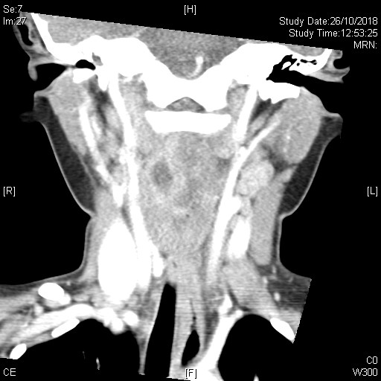
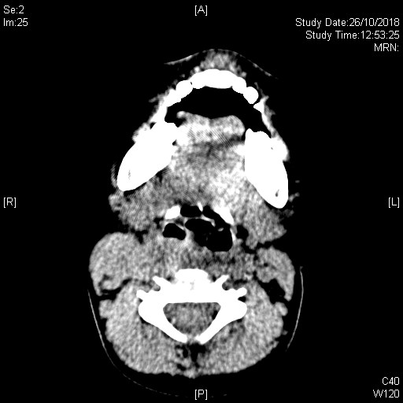
CT Cervical Spine with Contrast

Slide 14
Q4. Describe 4 significant CT findings? (2 marks)

Slide 15
Q5. What is the Diagnosis? (1 mark)

Slide 16
Q6. How to manage if the boy seems anxious and leaning forward with head in sniffing position ? (2 marks)

Slide 17
Question 3
2 years old boy, unremarkable past health, presented with on and off abdominal pain and decreased feeding x 1/7
Vomited undigested food x 1.
No diarrhea
No blood in stool noted
PE:
Lethragic, crying
Temp 36.2
HR 150, RR 20
Abdomen soft, non tender; ?mass felt
No hernia

Slide 18
Q1. Name 3 differential diagnosis

Slide 19
Describe the AXR. What is the diagnosis?

Slide 20
2. What are other possible signs on AXR?
She was admitted for Paediatric surgical unit. A bedside USG was done to confirm the diagnosis.
3. What are the possible signs in USG?
Notes:
https://www.hawaii.edu/medicine/pediatrics/pemxray/v7c18.html

Slide 21
4. What is the definitive treatment for stable patients?
5. If the patient also presented with generalized rash, what is the associated condition?

Slide 22
Question 4
A 53 year-old gentleman attended emergency department for palpitation, chest discomfort and dizziness while jogging in a park tonight.
PE:
- BP 118/101, P 190, SpO2 100% RA
- Afebrile
- GCS 15/15
- Unremarkable physical exam
An ECG was recorded:

Slide 23
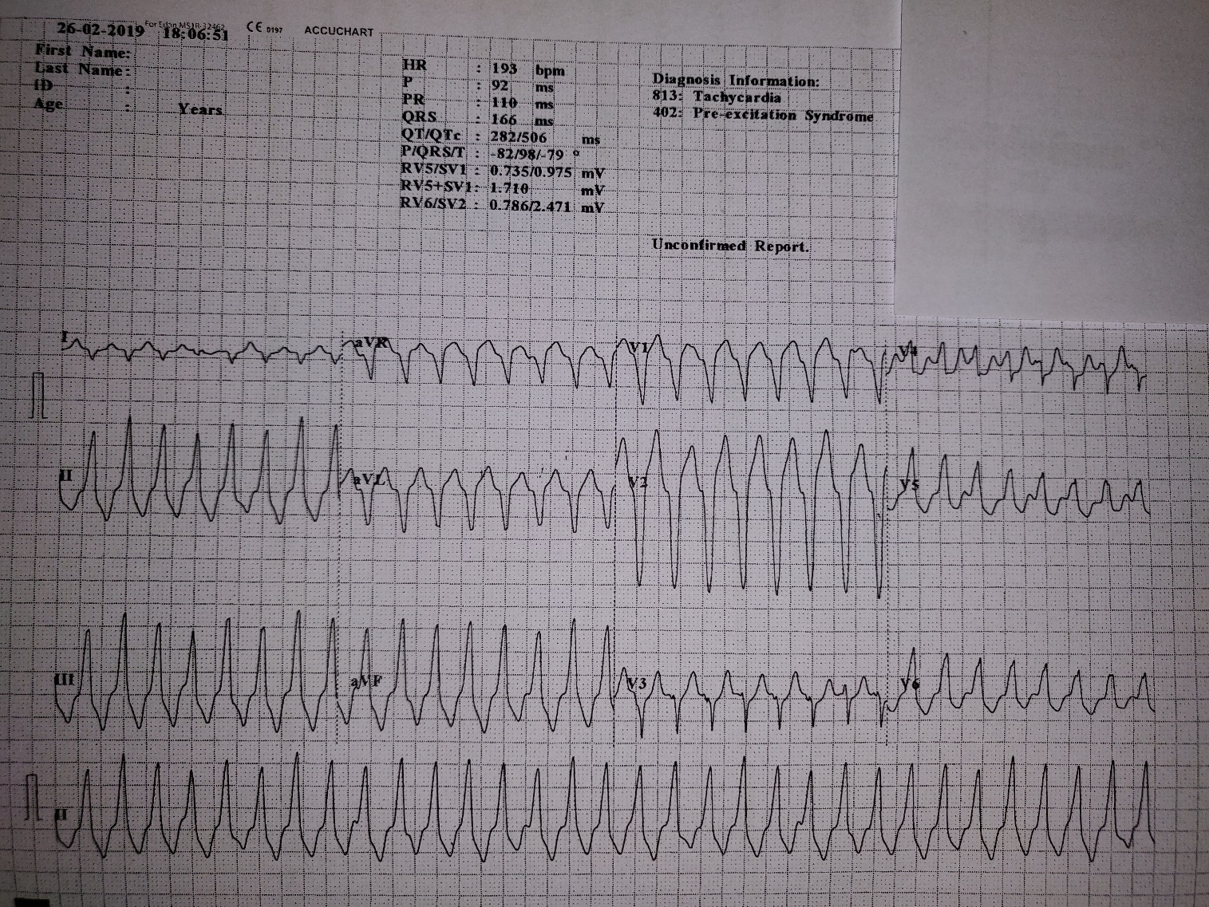

Slide 24
Is this rhythm supraventricular or ventricular in origin? Give 2 supportive features according to the ECG.

Slide 25
What is the diagnosis? List 2 specific diagnostic features on the ECG.
List 2 differential diagnoses

Slide 26
What is the initial treatment?
Despite the initial treatment, the patient becomes very drowsy and BP drops to 67/55 mmHg. The rhythm on cardiac monitor is the same. What is your immediate treatment? Please state the dosage as well.

Slide 27
Finally the patient is stabilized and transferred to CCU for further observation. What is the definitive management for his condition? (1)
Radiofrequency ablation

Slide 28
Question 5
A 55-year-old lady with history of asthma and being treated for URI symptoms for 1 week, presents with chest tightness, shortness of breath and a brief syncopal episode which has made her son call the ambulance. Her vital signs are as follows:
PE:
BP 75/40 P 95, SpO2 85% RA
Temperature 35 °C
GCS E4V5M6, breathless when talking

Slide 29
1. List 2 immediate actions you would do in the resuscitation room.

Slide 30
2. ECG is done as follows:

Slide 31
3. List 2 ECG abnormalities.

Slide 32
4. Chest auscultation is clear. Name 1 BEDSIDE test you can do to aid your diagnosis. Name 2 abnormalities you would expect to see in this test.

Slide 33
Contrast CT thorax is done after hemodynamic stability is restored:

Slide 35
5. I) What is the overall diagnosis of this lady?
6. What is the initial treatment of choice?

Slide 36
7. Name 3 risk factors for this condition.

Slide 37
Question 6
A 76-year-old woman presented with sudden onset of chest pain radiating to the back, with dizziness and vomiting.
On arrival, she is disoriented, sweating, and in pain. Her blood pressure is 71/47 mmHg, pulse 75/min, SaO2 97% on 100% O2.
After initial resuscitation, physical examination revealed a soft abdomen with epigastric tenderness, and PR yielded brownish stool.
She had a history of pAF with left atrial appendage occlusion (LAAO) done 2 months ago.

Slide 38
1. Please comment on the ECG and CXR.

Slide 40
2. What is your working diagnosis?

Slide 41
3. What specific bedside investigation would you do next? What would you look for?

Slide 42
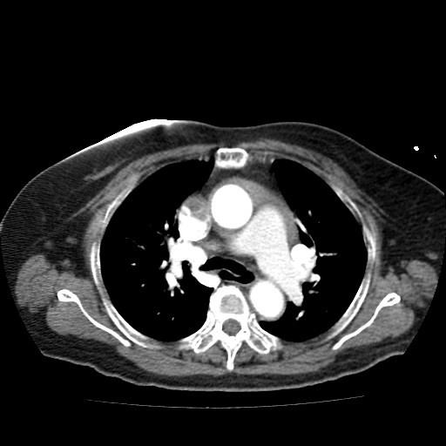
An urgent CT aortogram was ordered. Please comment on the images.

Slide 43
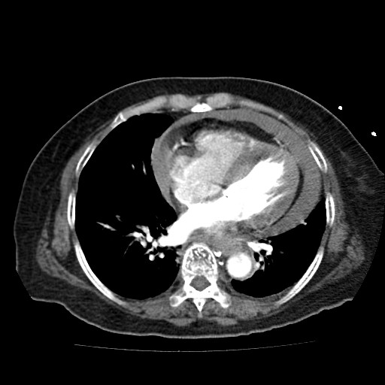

Slide 44
4. What is your final diagnosis? What is the immediate bedside treatment and how would you perform it?

Slide 45
5. After the emergency procedure was performed, the patient’s BP rose to 90/50 mmHg. The chest and back pain also subsided. What will you do now?

