Slide 1
2019 May Joint Clinical Meeting OSCE
Dr TT Chan and Dr YT Pe
A&E Department
Queen Mary Hospital

Slide 2
Case 1
M/73, PMH IHD, anemia, anxiety, arrhythmia not on pacemaker
C/O chest discomfort x 1/7
Non-exertional
Increase on lying flat
Mild palpitation
PE vitals stable, chest clear, HSN no murmur, LL edema –
ECG was ordered

Slide 4
Case 1
Q1. What is the ECG sign?

Slide 5
Case 1
Q1. What is the ECG sign?
Brugada sign

Slide 6
Case 1
Q2. What are the types of above ECG sign?

Slide 7
Case 1
Q2. What are the types of above ECG sign?
Type 1: Cove-shaped ST elevation in right precordial leads with J wave or ST elevation of ≥ 2mm (mV) at its peak followed by a negative T wave with little or no isoelectric interval in more than one right precordial leads V1-V3.
Type 2: The ST segments also have a high take-off but the J amplitude of ≥ 2mV gives rise to a gradually descending ST elevation remaining ≥ 1mV above the baseline followed by a positive or biphasic T wave that results in a saddle back configuration.
Type 3: Right precordial ST elevation of <1mm of saddle-back type or coved type.

Slide 9
Case 1
Q3. How do we diagnose the above-named syndrome and what are the implications?

Slide 10
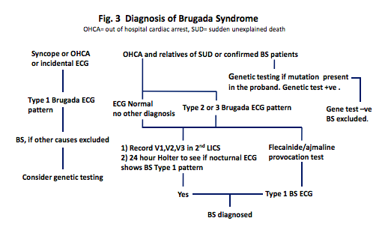
Case 1
Q3. How do we diagnose above-named syndrome and what are the implications?

Slide 11
Case 1
Affected individuals - risk stratification
MRI: to exclude arrhythmogenic right ventricular cardiomyopathy or myocarditis.
ICD: survived cardiac arrest or have a history of syncope and documented ventricular arrhythmia
+/- Electrophysiology Study (EPS)
+/- Quinidine / Isoprenaline
Asymptomatic individuals - controversial

Slide 12
Aftermath of case 1
Admitted to Internal Medicine ward
Serial Troponin T normal
Consulted Cardiac
In view of negative EPS and Hx of ? Brugada syndrome
Offered elective coronary workup
Discharged in 1 day

Slide 13
Case 2
51/M, good past health
C/O retrosternal chest discomfort for 1.5 hours radiating to jaw and back, sweating and SOB +
PE vitals stable, chest clear, HSN no murmur, LL edema –
2 ECGs were ordered

Slide 14
Case 2: 1st ECG

Slide 15
Case 2: 2nd ECG

Slide 16
Case 2
Q1. What are the abnormalities and dynamic changes?

Slide 17
Case 2
Q1. What are the abnormalities and dynamic changes?
Hyperacute T
? Ongoing ST depression V4-6

Slide 18
Case 2
Q2. What is the ECG sign called?

Slide 19
Case 2
Q2. What is the ECG sign called?
De Winter’s (T) wave
In view of the peaked T wave and ST depression over precordial leads

Slide 20
Case 2
Q3. What does this ECG configuration signify?

Slide 21
Case 2
Q3. What does this ECG configuration signify?
Occlusion of the proximal left anterior descending coronary artery (LAD)
2% of 1890 patients who underwent primary PCI of the LAD artery
? STEMI equivalent

Slide 22
Aftermath of case 2
CCU consulted
Primary PCI done, pLAD thrombotic occlusion
Echo: LV hypokinesia
Discharged to rehabilitative hospital in 4 days
1 year DAPT

Slide 23
Case 3
67/M, PMH PVC, glaucoma
C/O stung by insect over left index finger when washing a sort of mushroom
PE: mild swelling over distal phalanx of left index finger
No systemic symptom

Slide 24
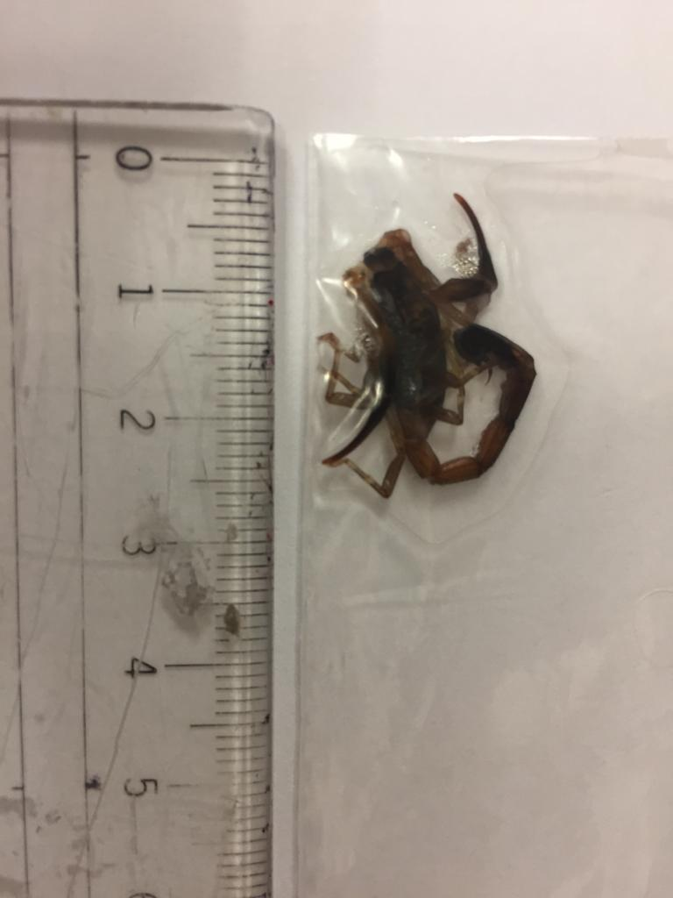
Case 3 – Q1. What is this?

Slide 25
Case 3 – Q1. What is this? - Scorpion

Slide 26
Case 3 – Q2. What sort of plant can it be?

Slide 27
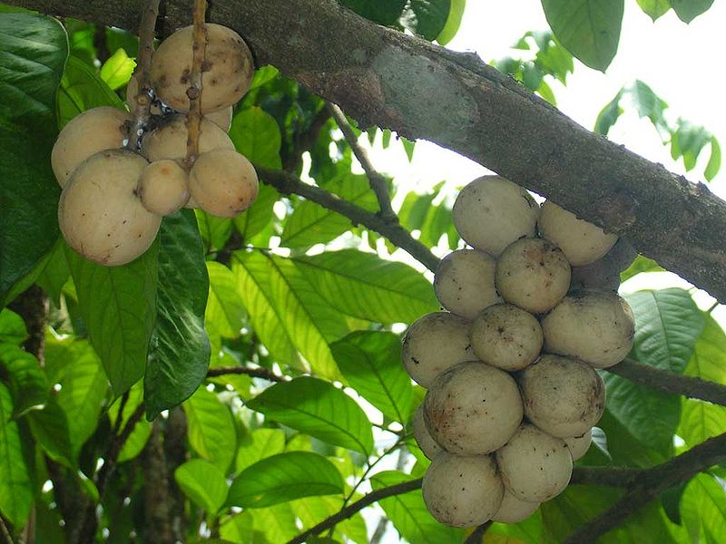
Case 3 – Q2. What sort of plant can it be?
蘆菇 / 蘭撒
Lansium domesticum
Plant kingdom
Report of scorpions in such plant since 2007 in Hong Kong

Slide 28
Case 3 – Q3. How do we manage the patient?

Slide 30
Case 3 – Q3. How do we manage the patient?
Scorpion sting in relation to Lansium
Cold compress
Gently wash the affected area with soap and water
Leave the wound intact
Do not scratch
Anti-tetanus toxoid
+/- antibiotics

Slide 31
Case 4
64/F, good past health
C/O burning sensation over throat and stomach after ingestion of some leaves

Slide 32
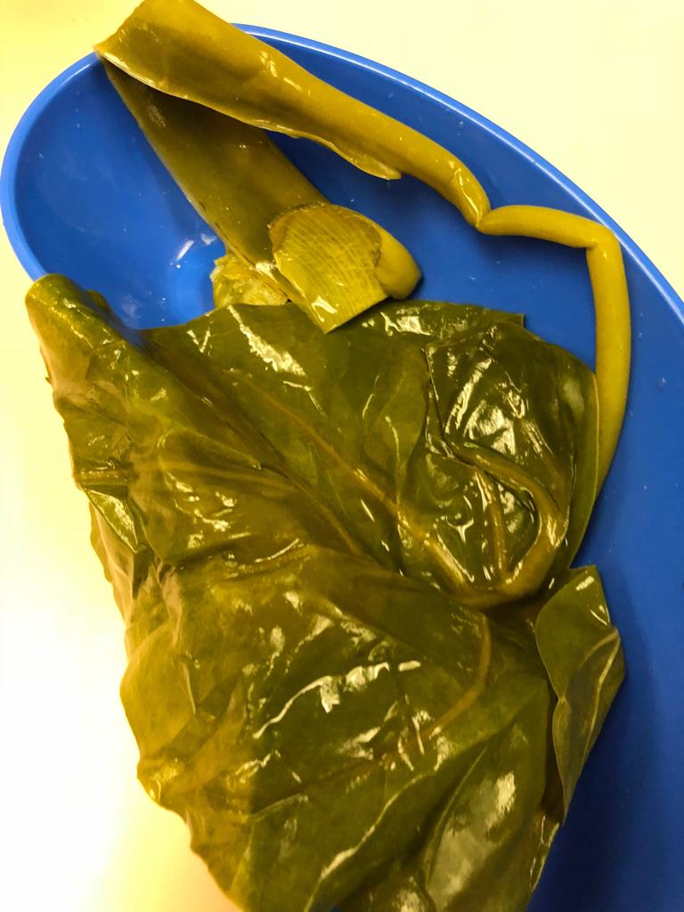
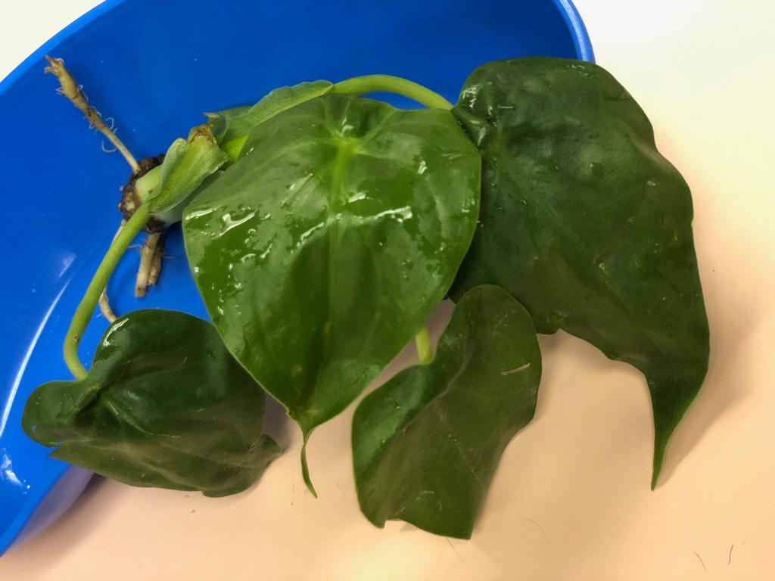
Case 4 – Q1. What is this plant?

Slide 33
Case 4 – Q1. What is this plant? - Alocasia

Slide 34
Case 4
Q2. What is the cause of the burning sensation?

Slide 35
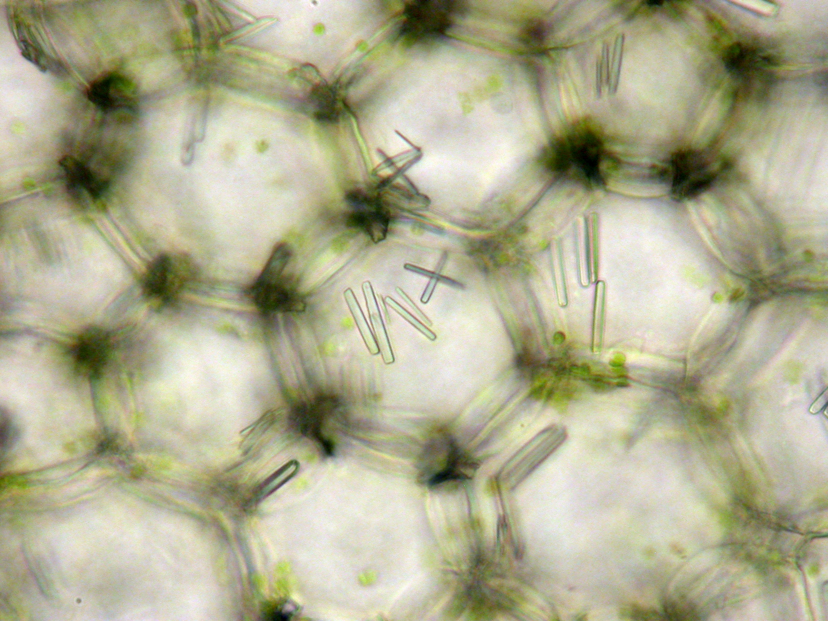
Case 4
Q2. What is the cause of the burning sensation?
Raphides of calcium oxalate

Slide 36
Case 4
Q3. How do we manage such cases?

Slide 37
Case 4
Q3. How do we manage such cases?
Conservative treatment is the primary approach
Systemic analgesics
Drinking 120–240 mL of ice water
Milk
Precipitate soluble oxalate by combining it with calcium.
No specific antidote
(continue in next page)

Slide 38
Case 4
Look for upper airway obstruction due to irritation and edema of the larynx
+/- antihistamine and steroid were provided in order to reduce the edema of the larynx
Retrospective study only
? Amyltriptline for A. macrorrhiza
X Inducing vomiting and gastric lavage
Large amounts of calcium oxalate can be dissolved in the stomach to form oxalic acid, binding calcium in the blood -> hypocalcemia +/- renal and hepatic impairment
Monitor for hypocalcemia e.g. muscle cramps, weak irregular pulse, hypotension, cardiac arrhythmias and blood calcium level
Tx with calcium chloride / gluconate and fluids.

Slide 39
Case 5
20/M, PMH croup
C/O right foot ? inversion injury during handball game
PE: vitals stable, pain and deformity + over right ankle, loss of ROM
No other injury noted
XR right tibia, fibula, ankle and foot requested

Slide 40
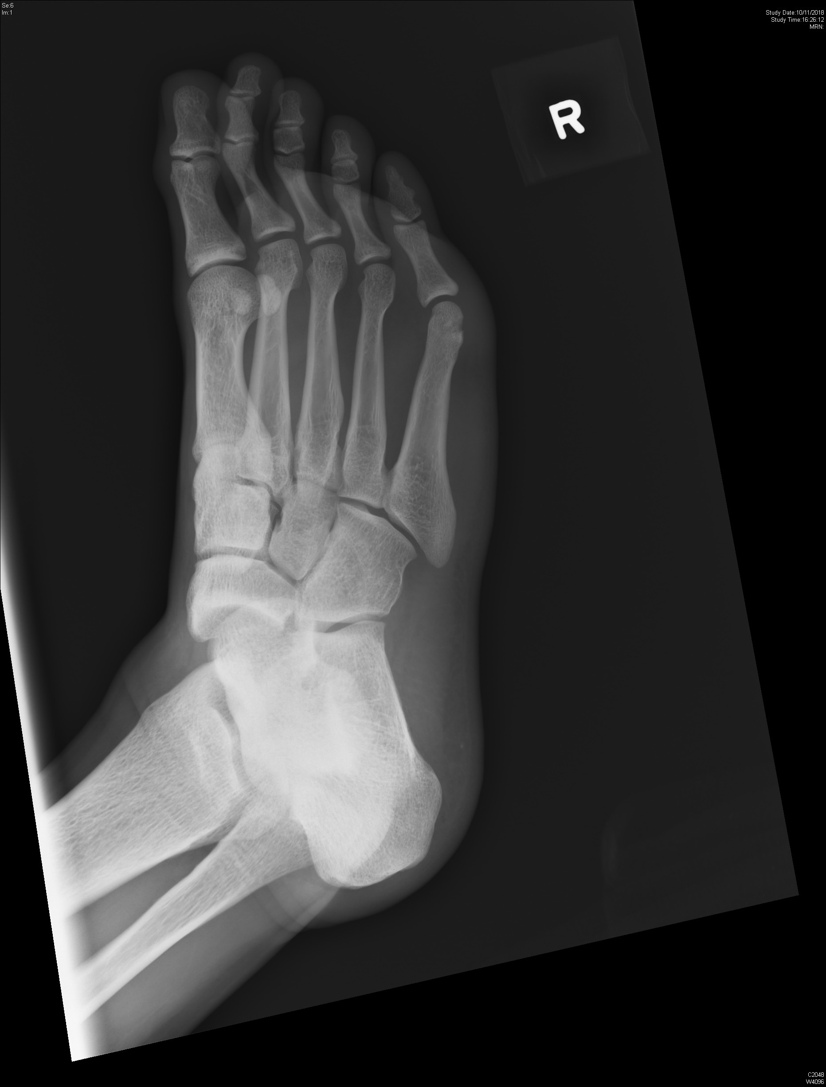
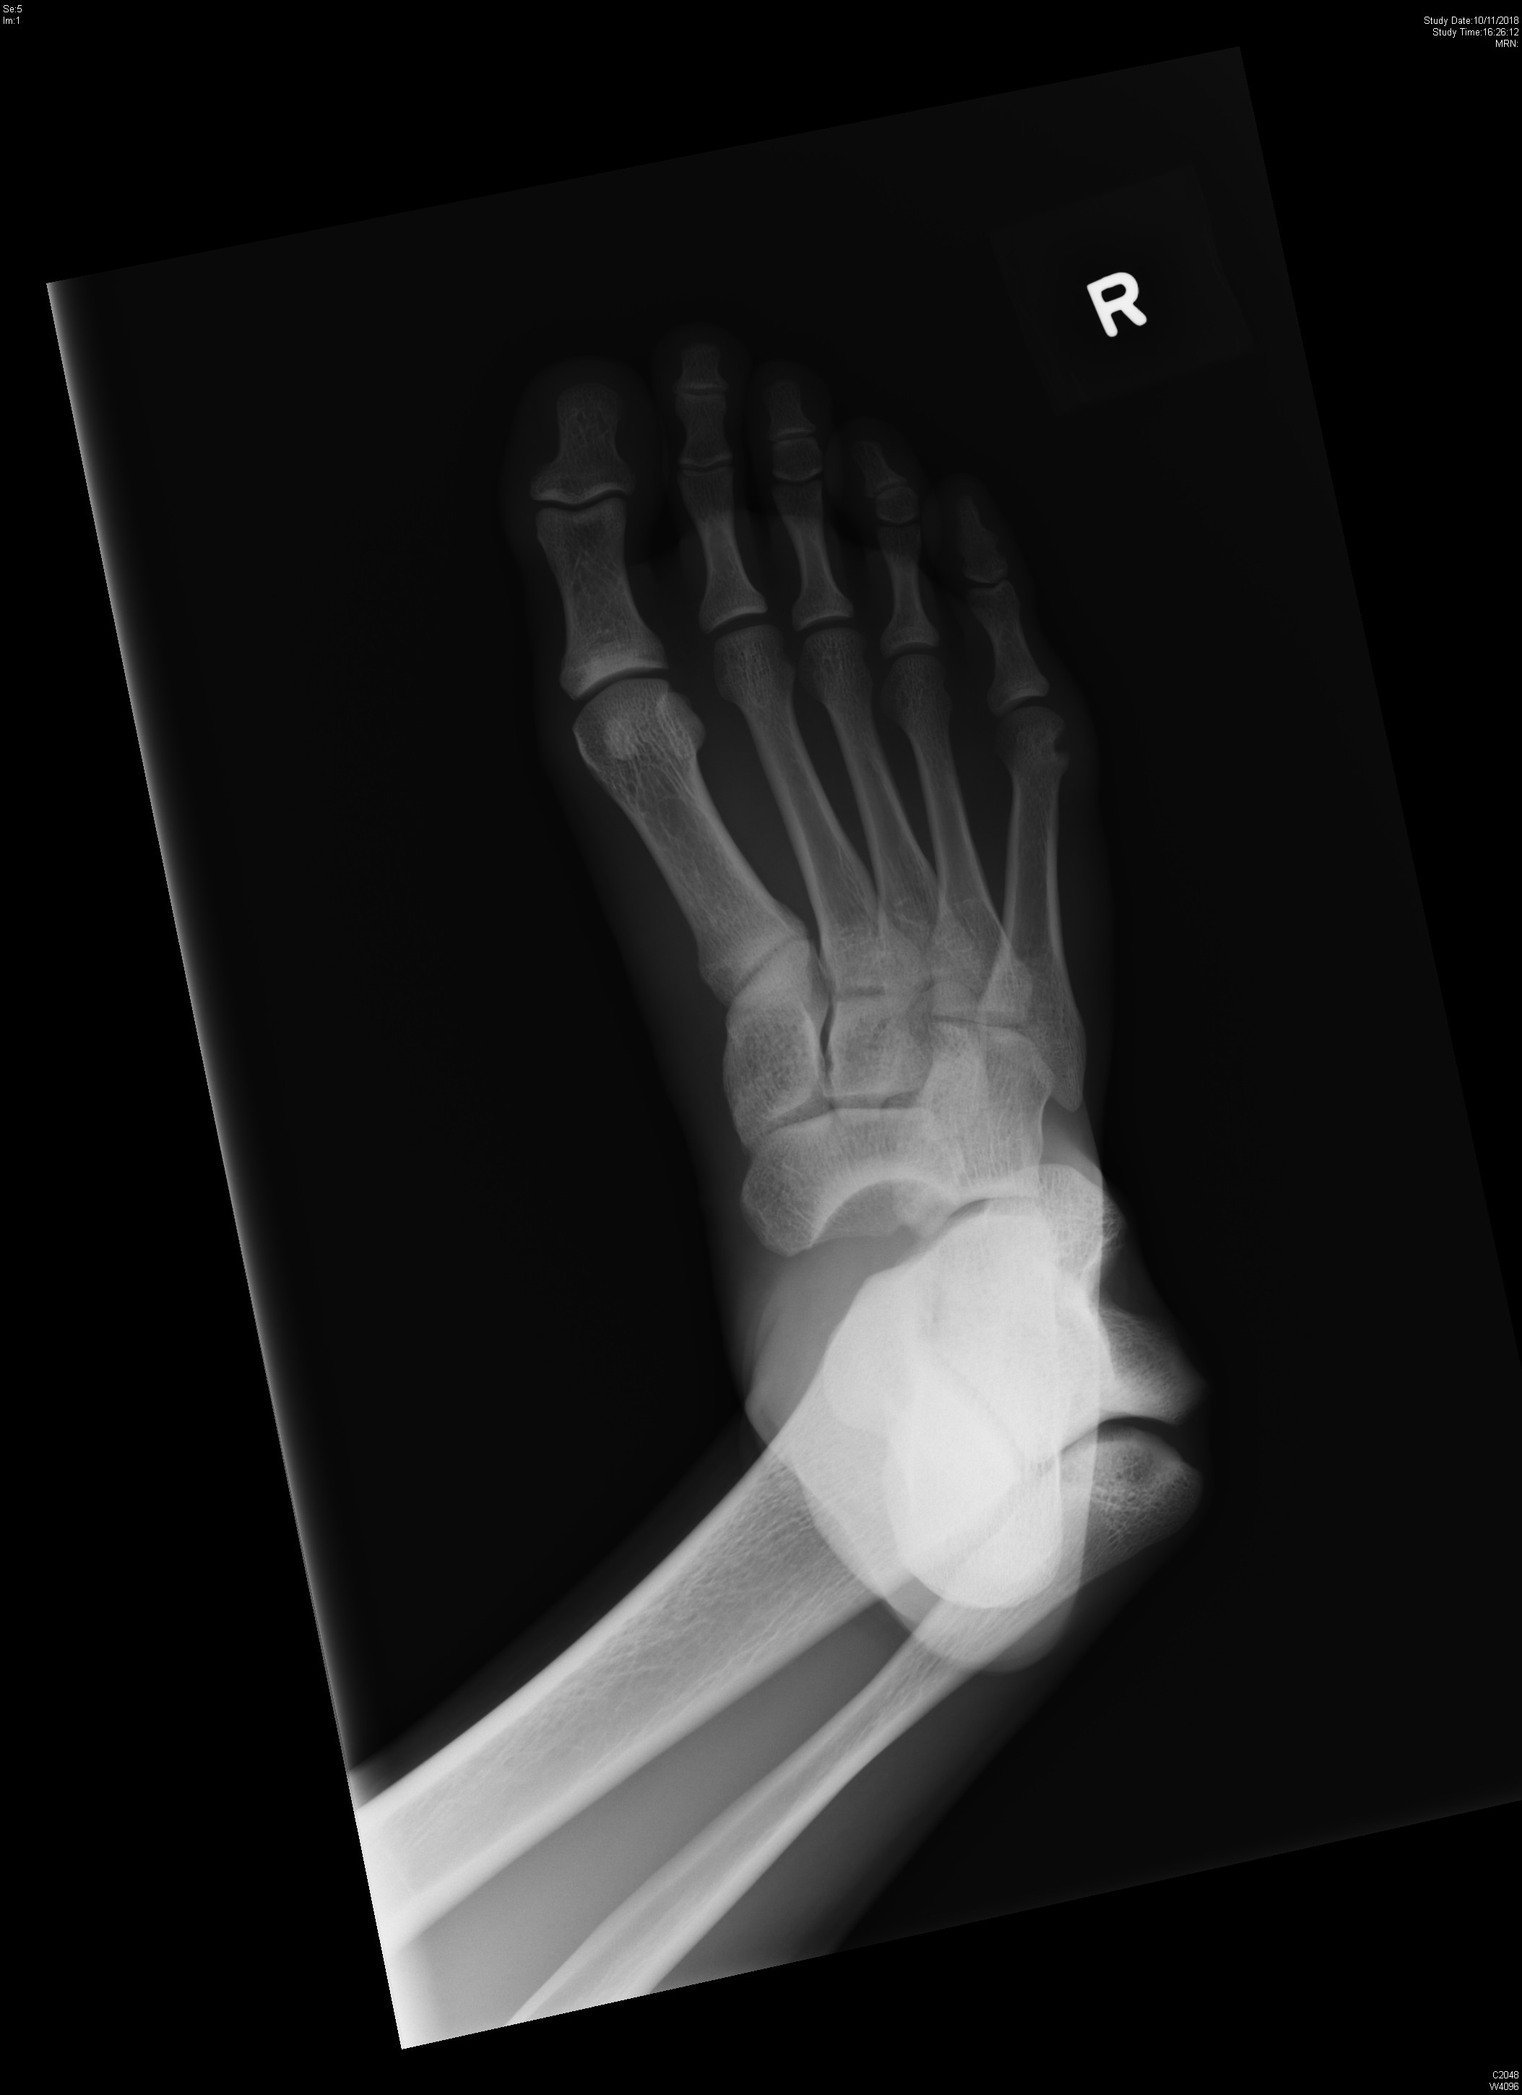

Slide 41
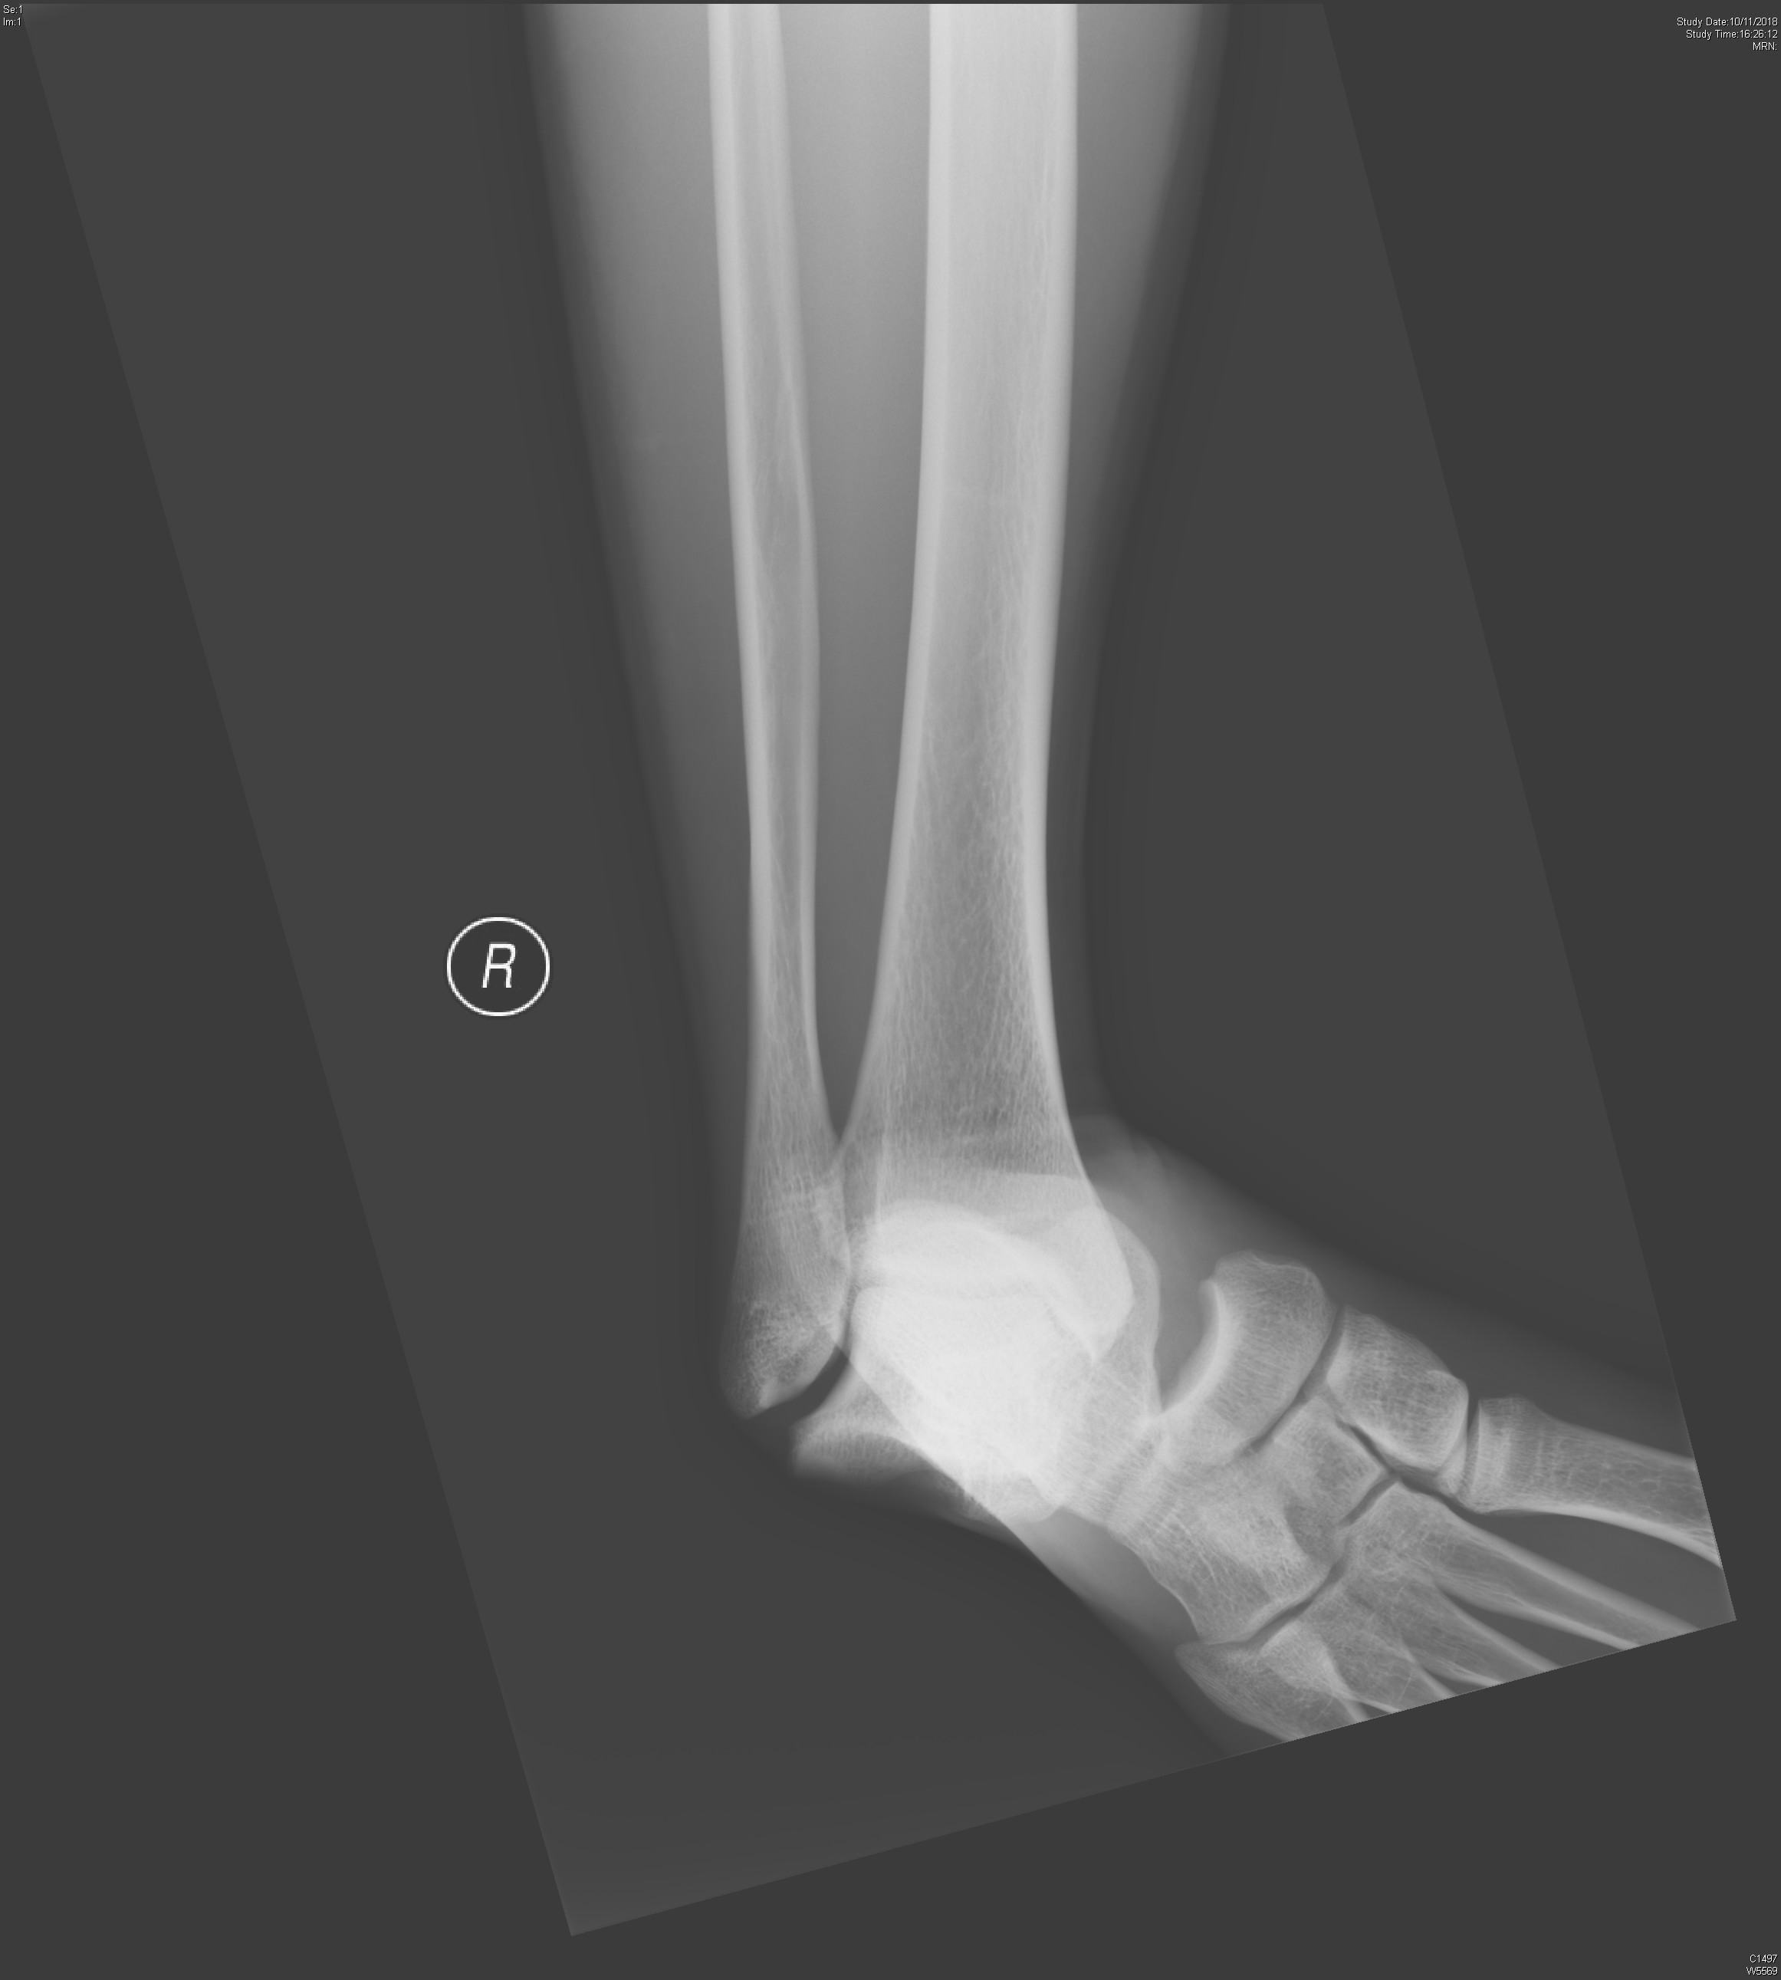

Slide 42
Case 5
Q1. What is the abnormality on XR?

Slide 43
Case 5
Q1. What is the abnormality on XR?
Right talar dislocation

Slide 44
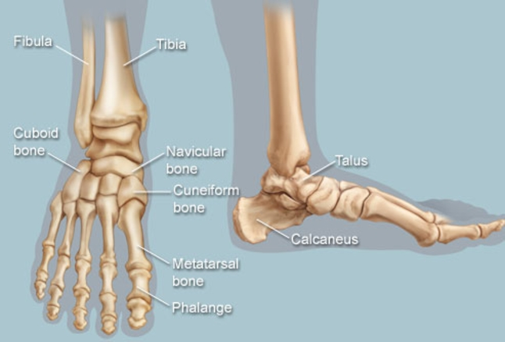
Case 5

Slide 45
Case 5
Q2. What are the types of above dislocation?

Slide 46
Case 5
Q2. What are the types of above dislocation?
Tibiotalar dislocation
Subtalar dislocation
Total talar dislocation
Talonavicular dislocation
​Chopart fracture-dislocation
Fractured calcaneus, cuboid or navicular
Dislocated medially and superiorly

Slide 47
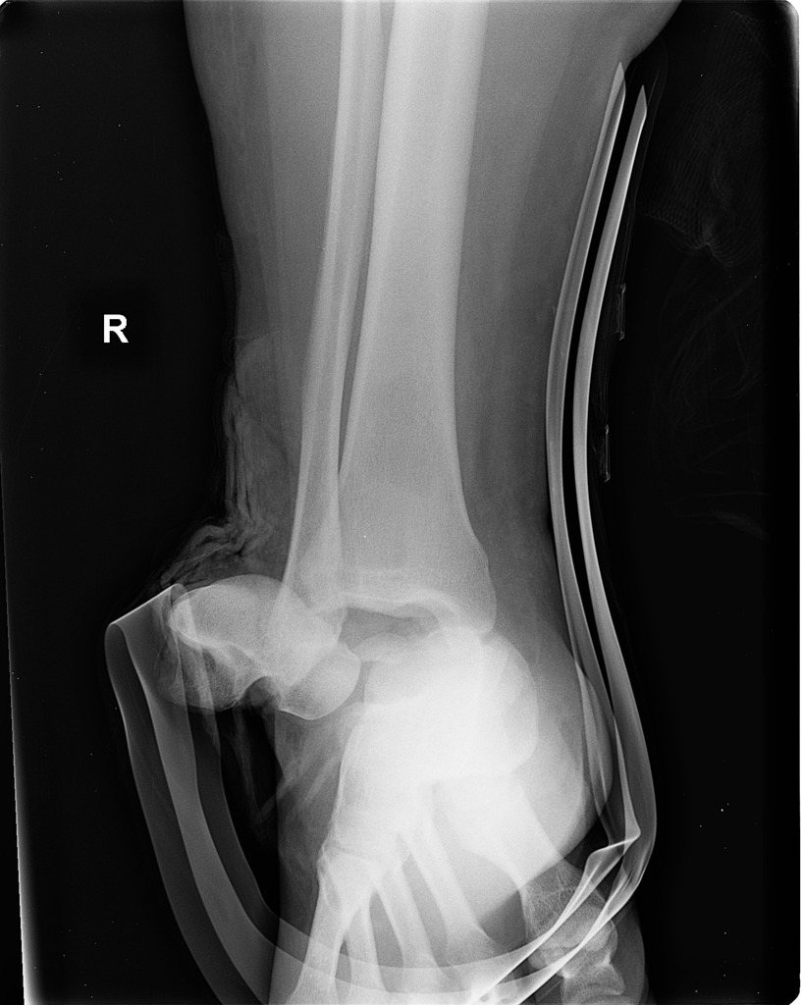
Total talar dislocation

Slide 48
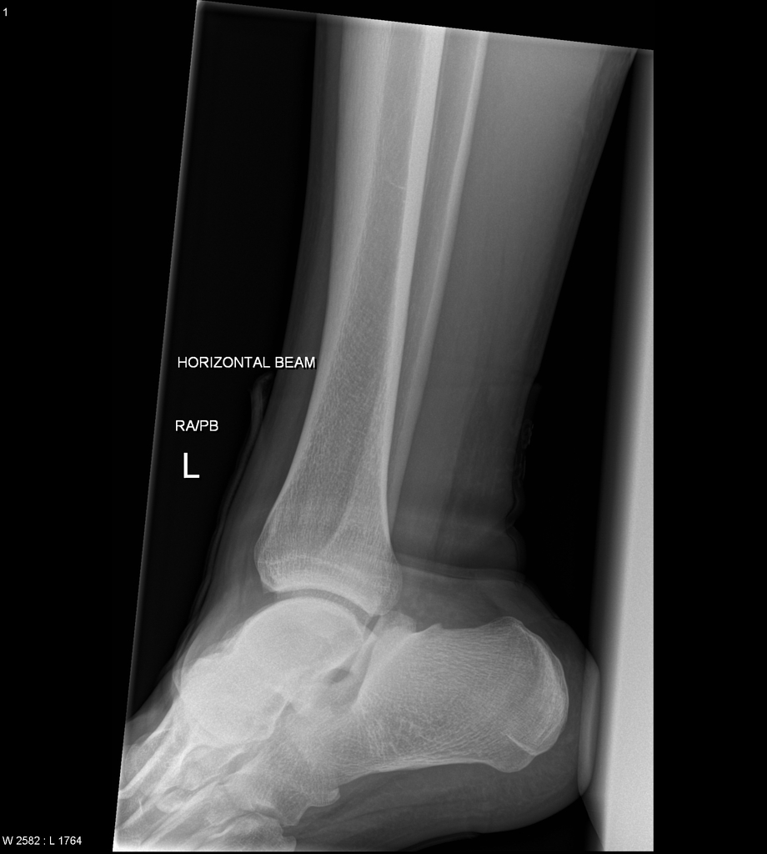
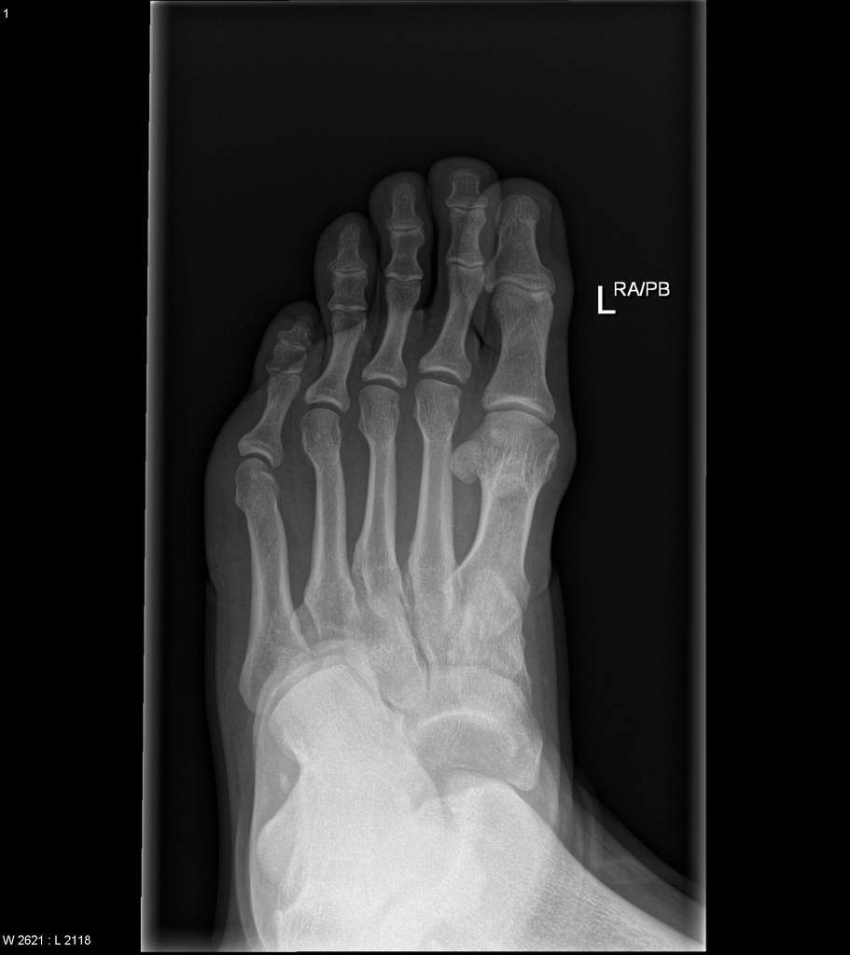
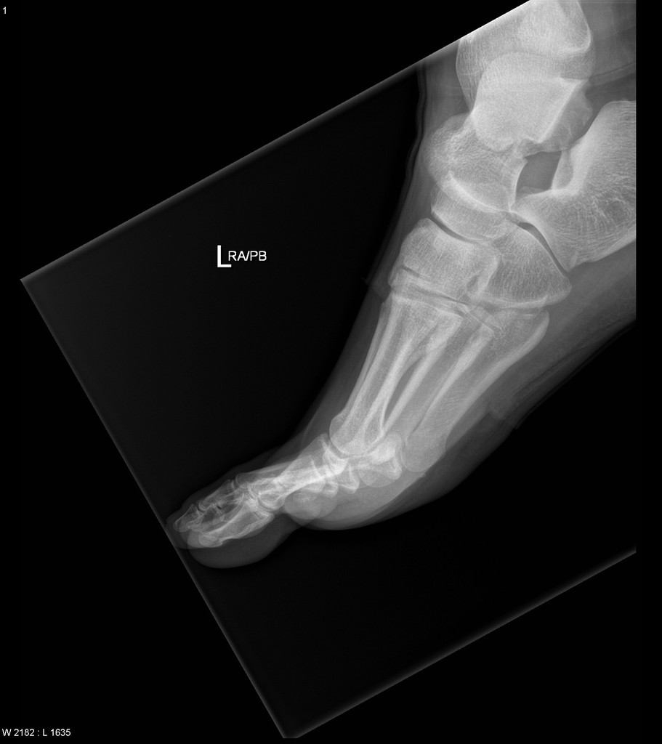
Subtalar dislocation

Slide 49
Case 5
Q3. How should we manage the patient?

Slide 50
Case 5
Q3. How should we manage the patient?
Close reduction in AED
+/- analgesics and sedation (in this case we have given IV tramadol 50 mg and IV dormicum 3 mg for CR)
Admit to Orthopedics ward

Slide 51
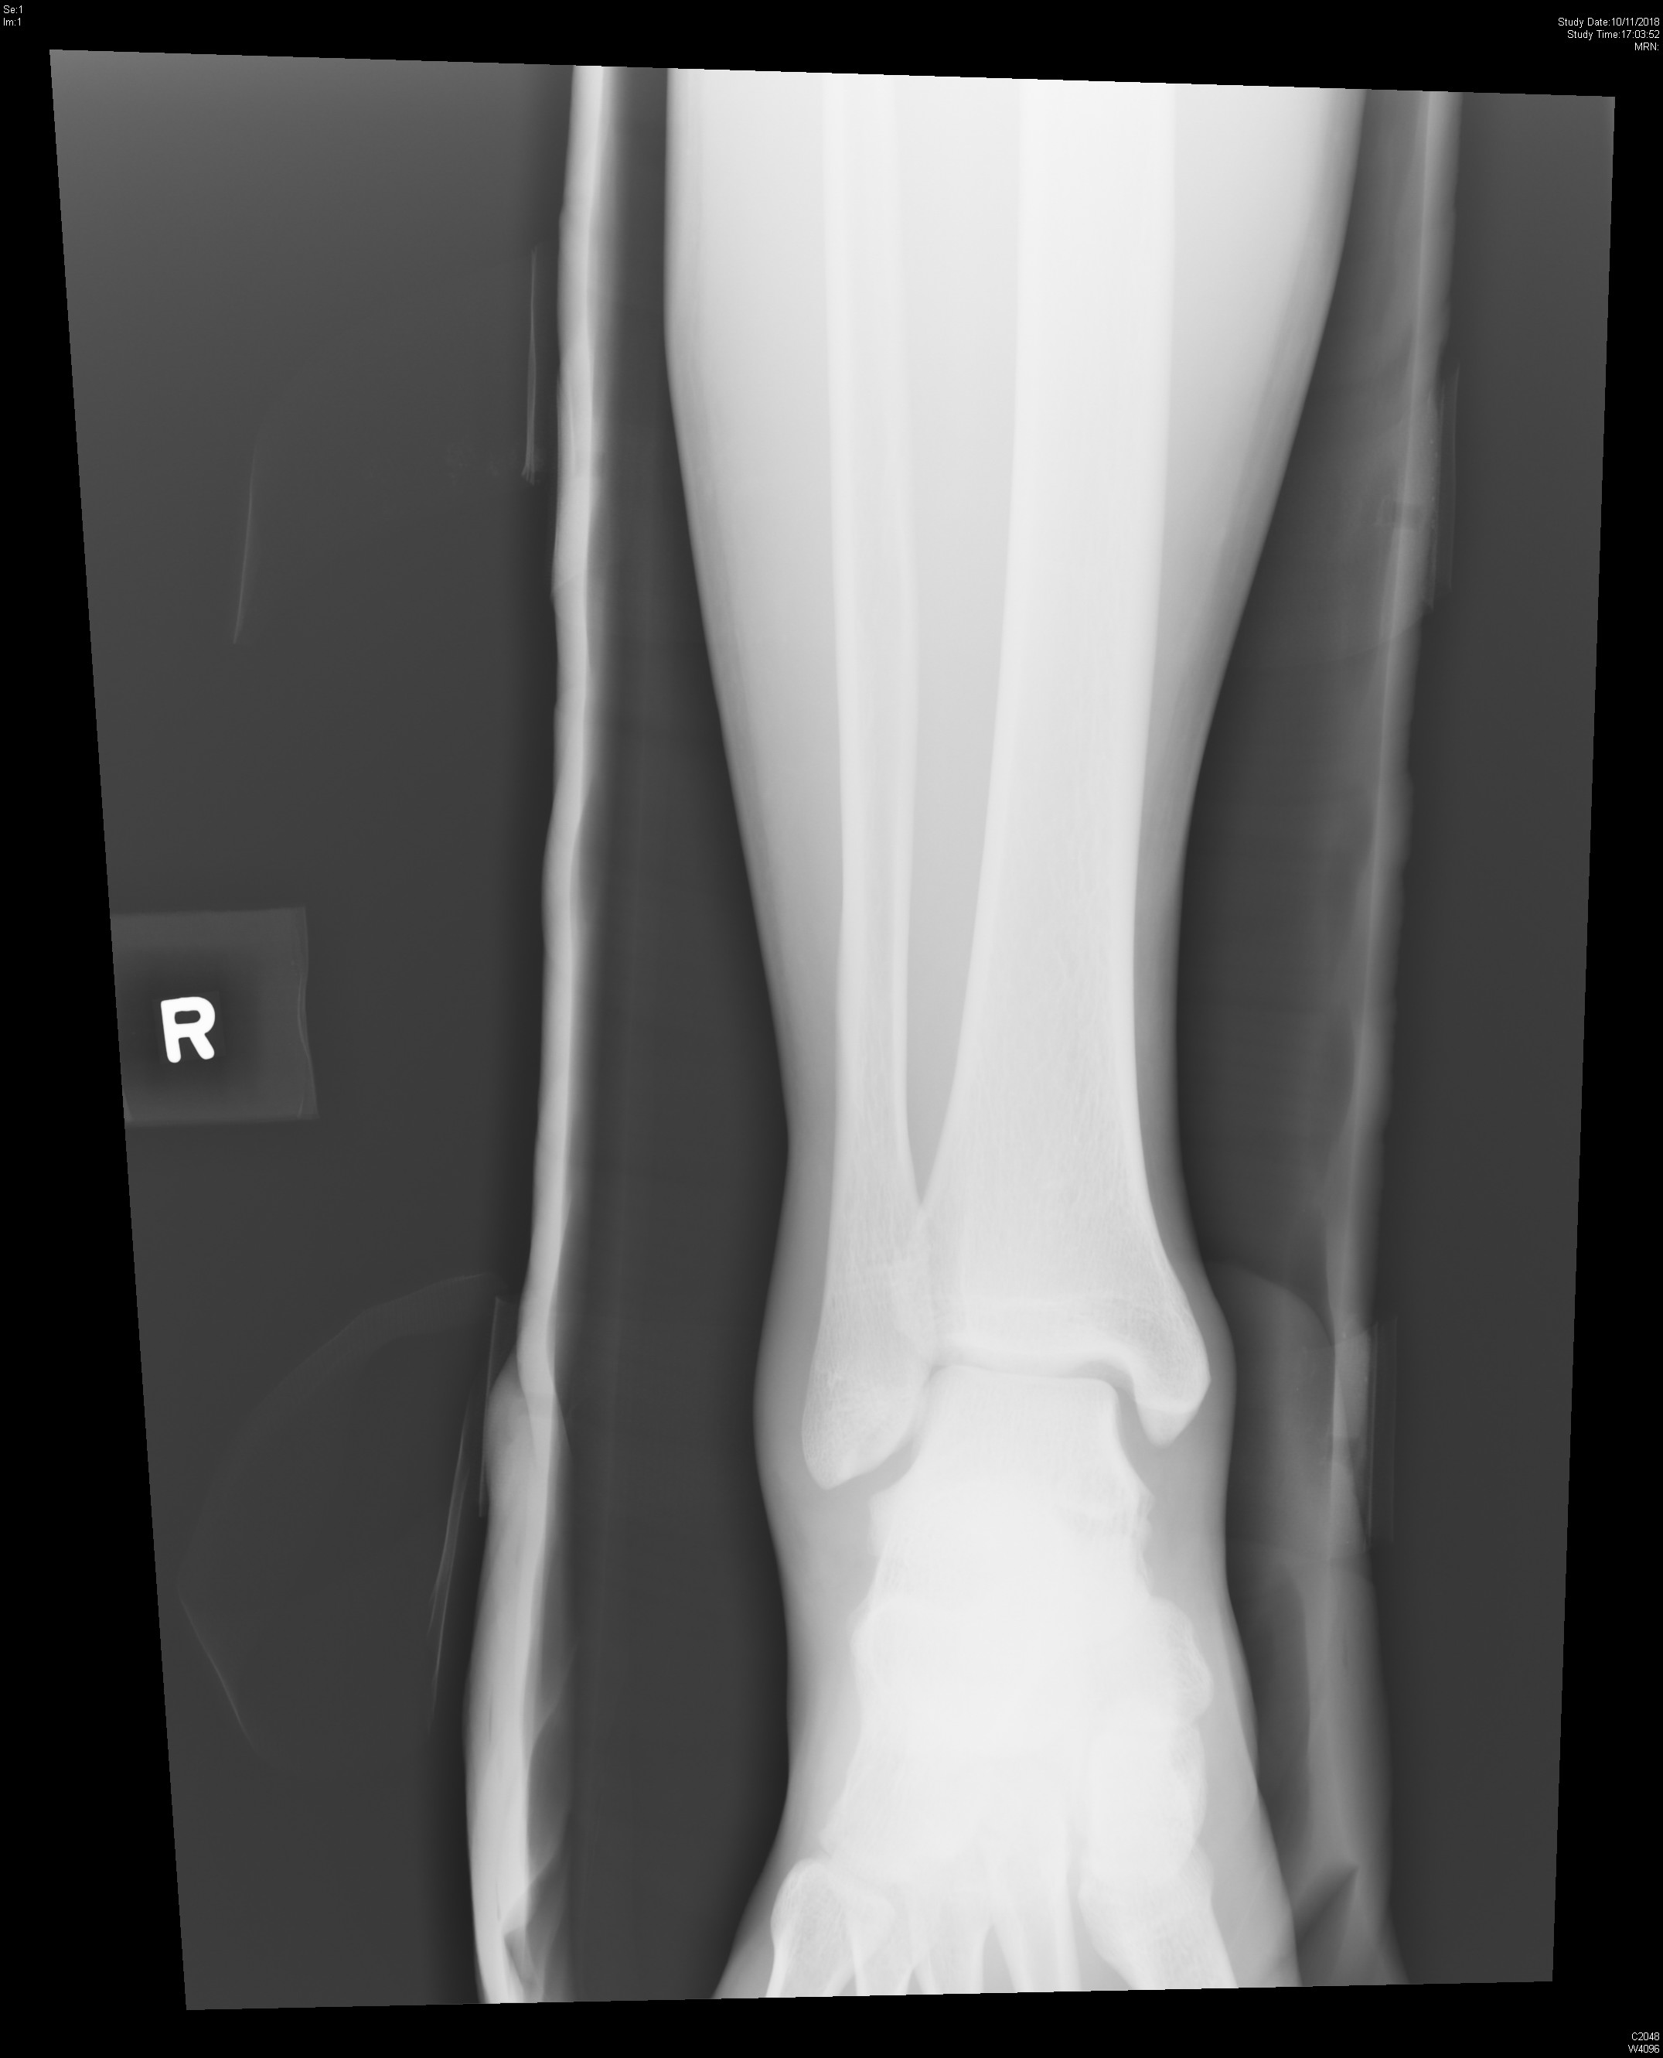
Case 5 – post reduction XR

Slide 52
Case 6
27/F, good past health
C/O left pelvic pain after fall from bed, landing on left side of body
Walk unaided
PE: vitals stable, pain generalized over left pelvis, ? most pain over pubic tubercle; left groin abrasion +, mild tenderness over neck
XR C spine, pelvis and left hip were requested

Slide 53
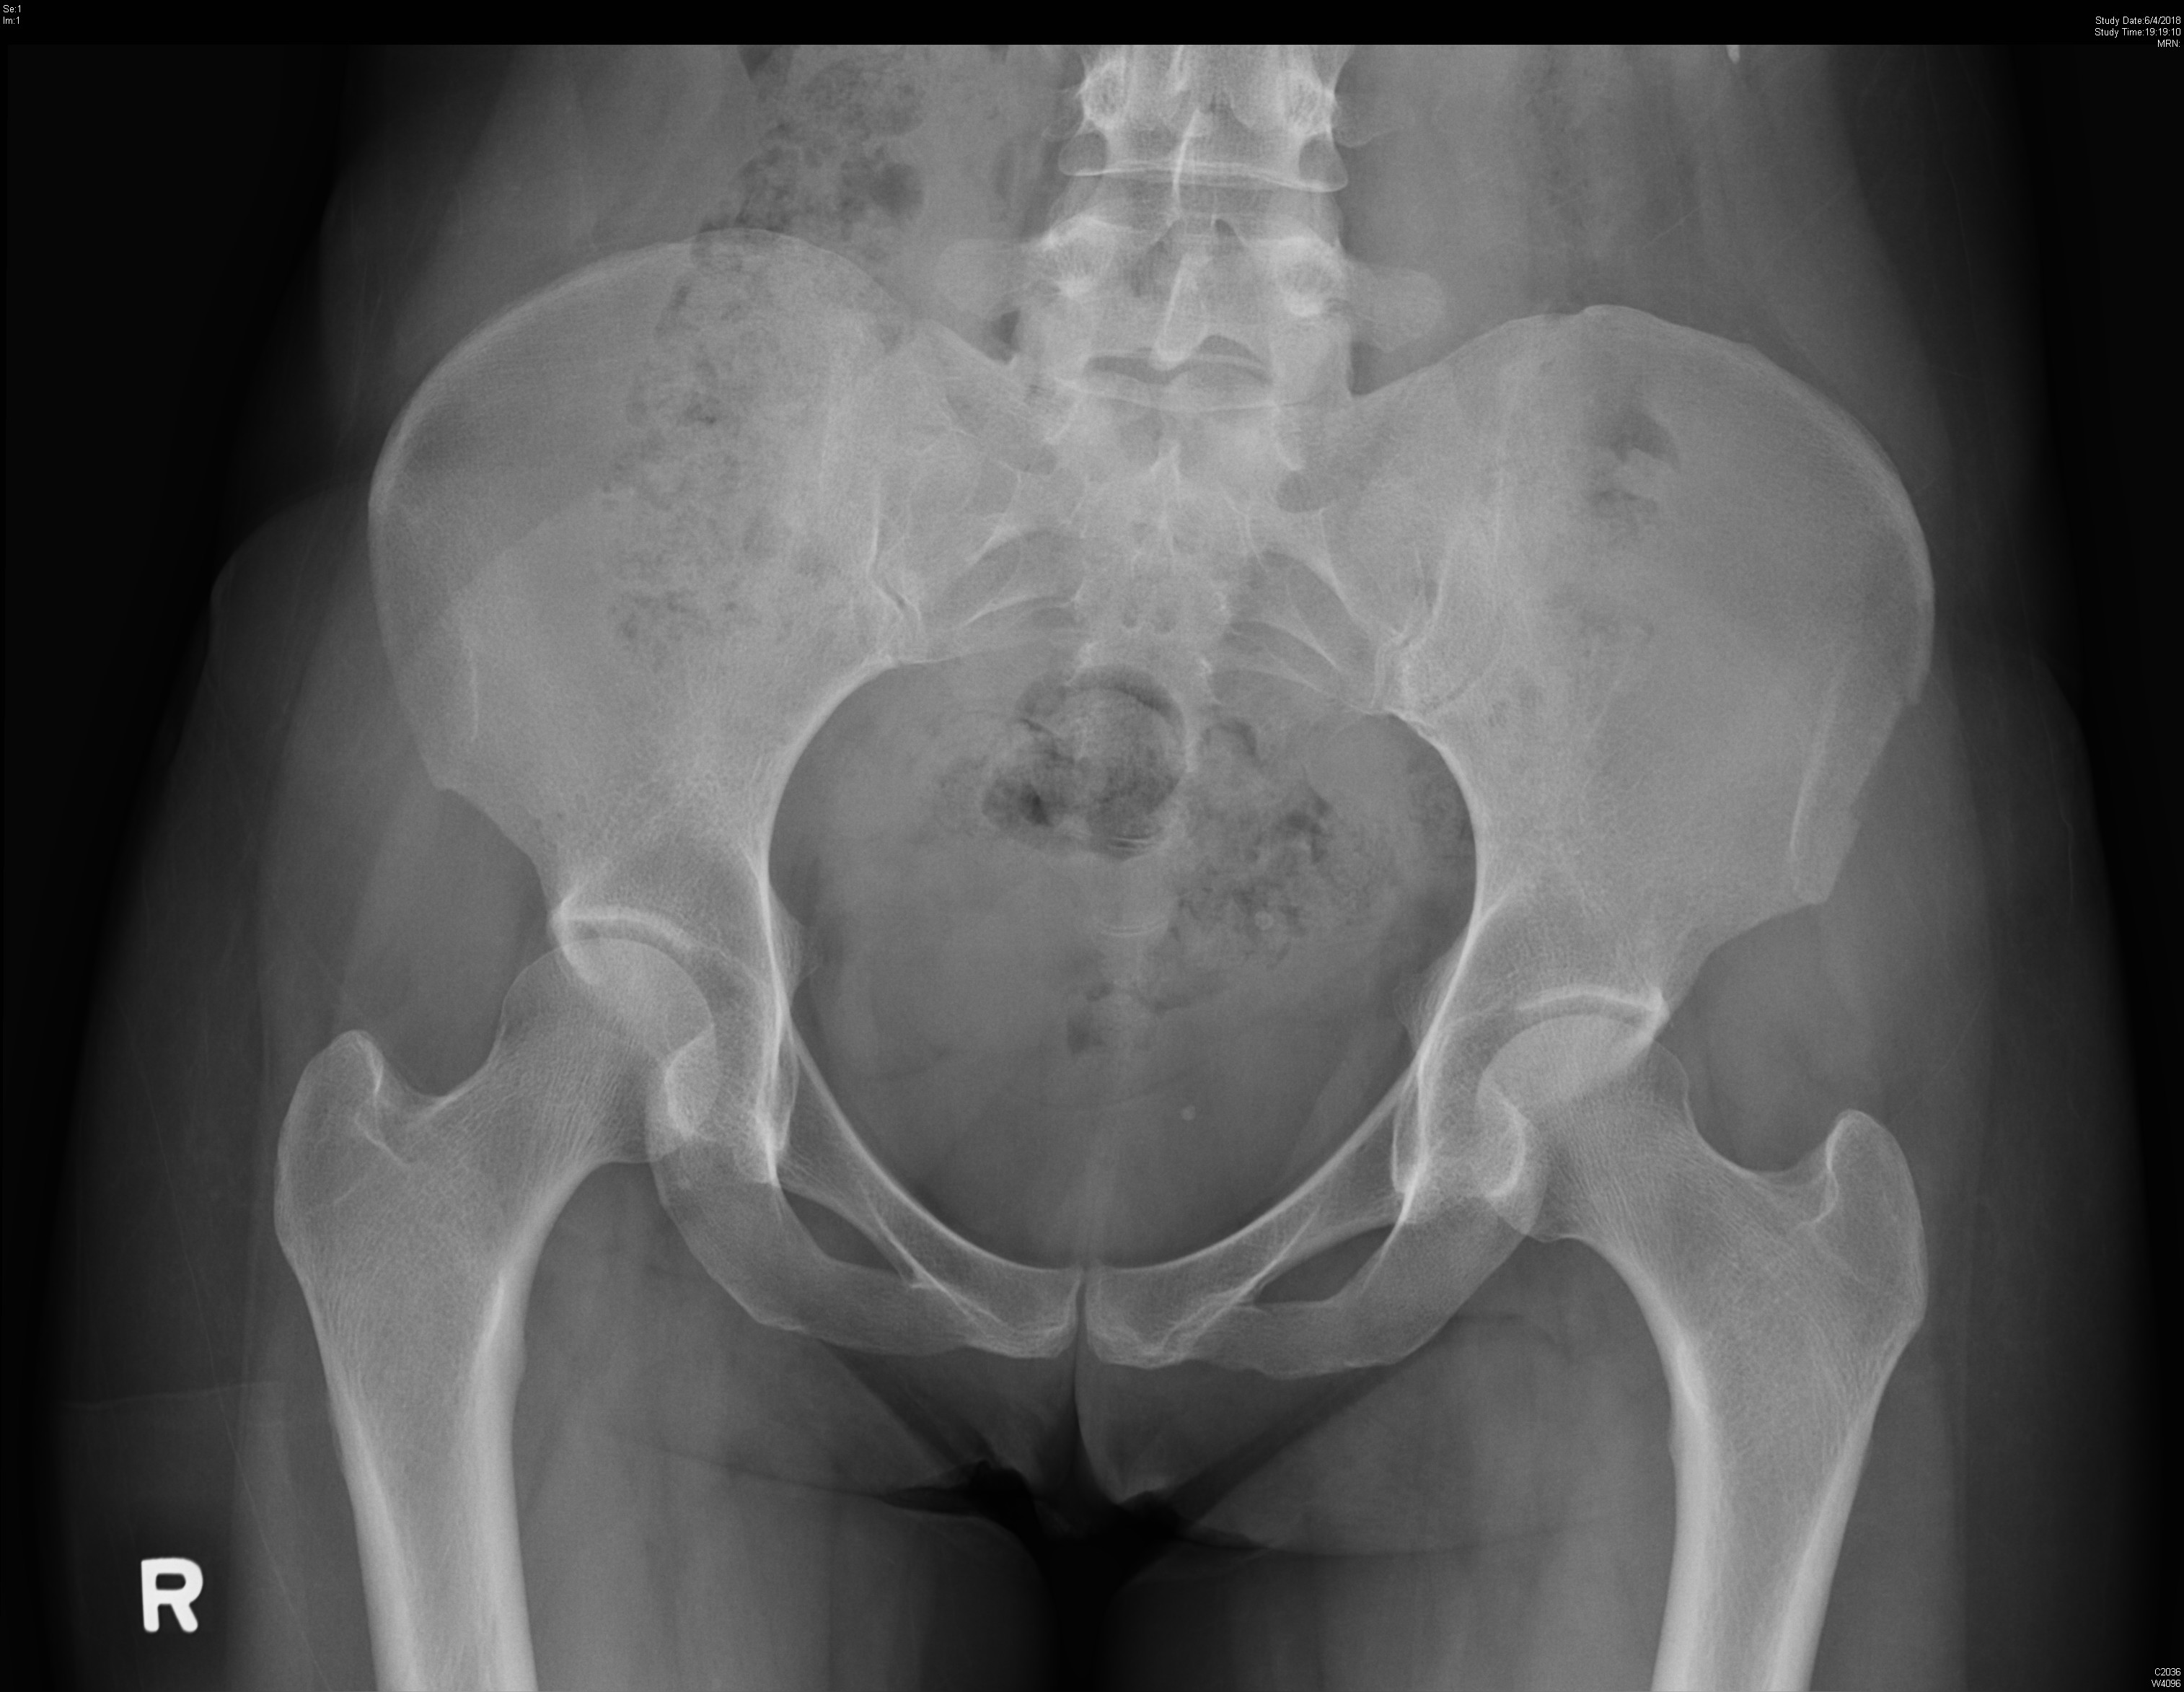
Case 6

Slide 54
Case 6
Q1. What is the abnormality on XR?

Slide 55
Case 6
Q1. What is the abnormality on XR?
Left ASIS fracture
Confirmed that she had most tenderness over left ASIS after XR

Slide 56
Case 6

Slide 57
Case 6
Q2. How do we manage such case?

Slide 58
Case 6
Q2. How do we manage such case?
Stable fracture if no major displacement
Outpatient care with rest, analgesics, walking aid etc if needed
Spontaneous recovery usually within 4-6 weeks
+/- surgery to remove painful fragment etc

Slide 59
References
Guidelines for the diagnosis and management of Brugada Syndrome. The Cardiac Society of Australia and New Zealand. 2011.
Thabouillot O, Bouvier F, Roche NC. De Winter's wave. Emerg Med J. 2017 Dec;34(12):830.
Verouden NJ, Koch KT, Peters RJ, Henriques JP, Baan J, van der Schaaf RJ, Vis MM, Tijssen JG, Piek JJ, Wellens HJ, Wilde AA, de Winter RJ. Persistent precordial "hyperacute" T-waves signify proximal leftanterior descending artery occlusion. Heart. 2009 Oct;95(20):1701-6.
de Winter RW, Adams R, Verouden NJ, de Winter RJ. Precordial junctional ST-segment depression with tall symmetric T-waves signifying proximal LAD occlusion, case reports of STEMI equivalence. J Electrocardiol. 2016 Jan-Feb;49(1):76-80.
Ng VC, Lit AC, Wong OF, Tse ML, Fung HT. Injuries and envenomation by exotic pets in Hong Kong. Hong Kong Med J. 2018 Feb;24(1):48-55.
Bradbury JH, Nixon RW. The acridity of raphides from the edible aroids. Journal of the Science of Food and Agriculture, Volume 76, Issue 4. 26 March 1999.
Moon JM, Lee BK, Chun BJ. Toxicities of raw Alocasia odora. Hum Exp Toxicol. 2011 Oct;30(10):1720-3.
https://www.chp.gov.hk/
Wikipedia
https://www.webmd.com/

