Slide 1
JCM OSCE
5 Jun 2019
YK Ho
CMC

Slide 2
Q1
M/36, metal factory worker, found lying on ground in a park. GCS E4V1M1. BP 123/81 mmHg, P 118/min. RR 16/min. SPO2 98% RA. Temp 36.5C. Pupils equal and reactive 4mm.

Slide 3
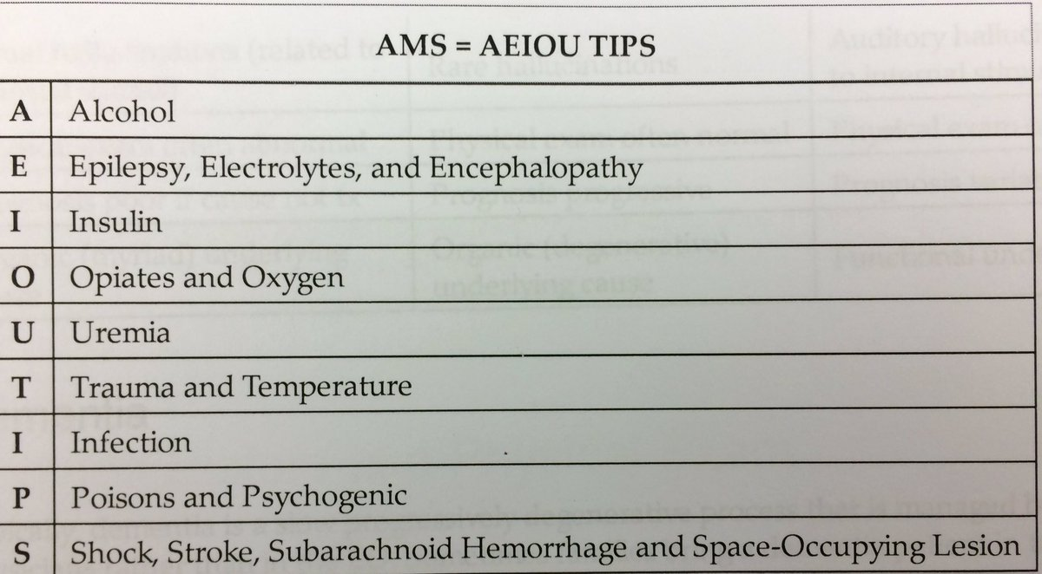
a) List 5 differential diagnoses.
Stroke
CNS infection
Epilepsy
Hypoglycemia
Poisoning
eg. Alcohol, cyanide,
salicylates, TCA…
….

Slide 4
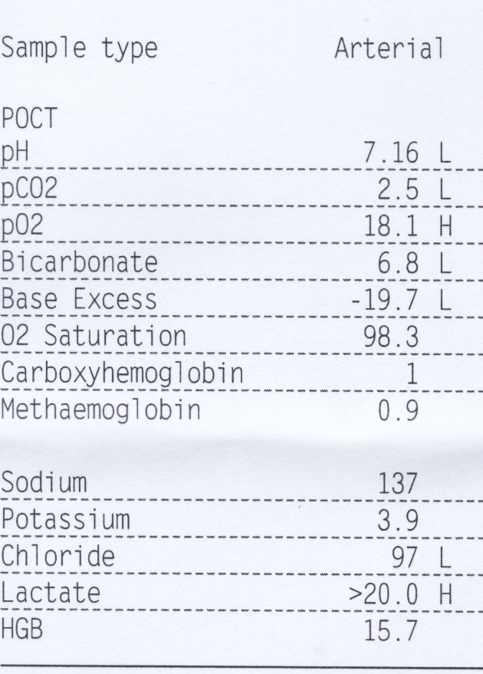
b) POCT was done. What is the anion gap?
Anion gap = [Na+] – [HCO3-] – [Cl-] = 137-6.8-97 = 33.2mmol/L
Reference range 8-16mmol/L

Slide 5
c) What is the diagnosis based on the POCT result?
Lactic acidosis with respiratory compensation
expected pCO₂ at maximal compensation can be calculated from a simple formula
For expected pCO₂ = 1.5 (Actual [HCO₃] ) + 8 mmHg
1mmHg=0.133kPa
This case expected pCO₂ = 1.5 * 6.8 + 8 mmHg = 10.2mmHg = 2.42kPa

Slide 7
d) List 4 further investigations to find out the underlying cause
H’stix
ECG
CXR
Blood tests eg. CBC, LRFT, Troponins, AV PO2 gradient, cyanide concentration

Slide 8
e) What are the sources for cyanide in general?
Fire victims
Occupational exposures during electroplating or stripping
Plants eg. Bitter almond, cassava, bamboo shoot, apricot seeds, lima bean, sorghum
Artificial nail remover containing acetonitrile
Excessive ingestion of laetrile (vit B17) or amygdalin
Drugs eg. nitroprusside

Slide 9
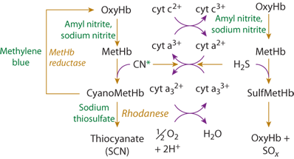
f) What are the specific antidotes for cyanide poisoning?
Hydroxocobalamin (cyanokit)
Bind cyanide to form cyanocobalamin
Sodium nitrite and sodium thiosulphate

Slide 10
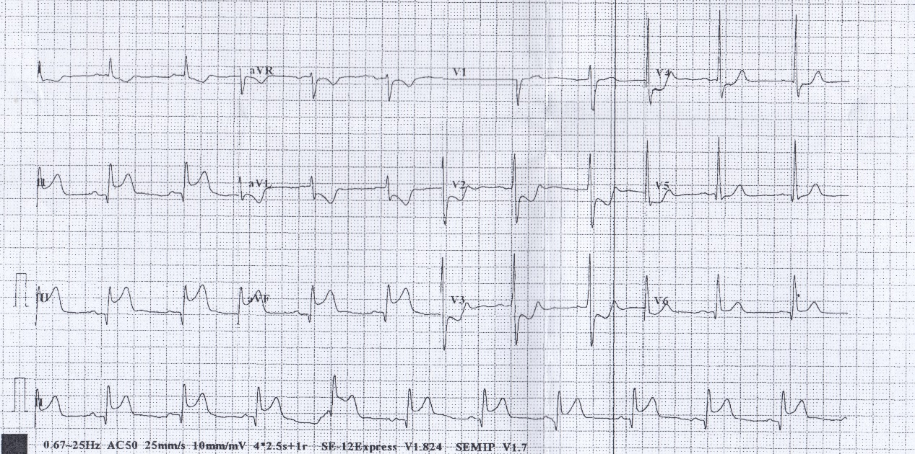
Q2
M/55. Good past health. Attended for retrosternal compressive chest pain for 30 minutes. Vital signs stable. ECG was done.

Slide 11
a) List 2 ECG findings.
ST elevation in leads II, III, aVF.
ST depression (reciprocal change) aVL, V2-5

Slide 12
b) What further investigations are to be done in AED?
CXR
Blood tests incl. CBC, LRFT, troponins, glucose, clotting profile, TFT
Echocardiogram

Slide 13
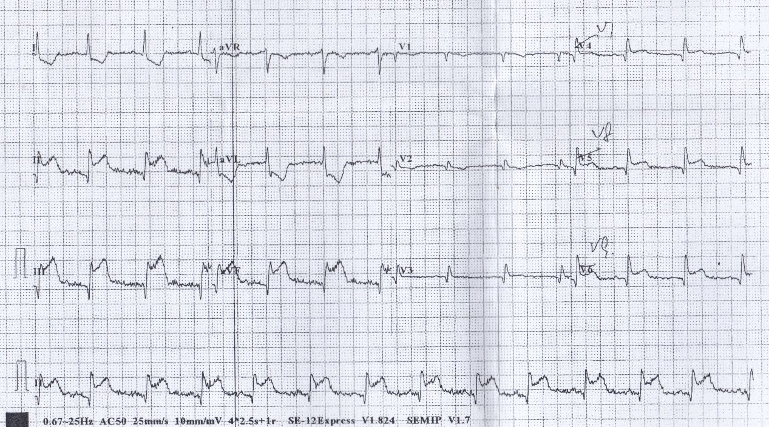
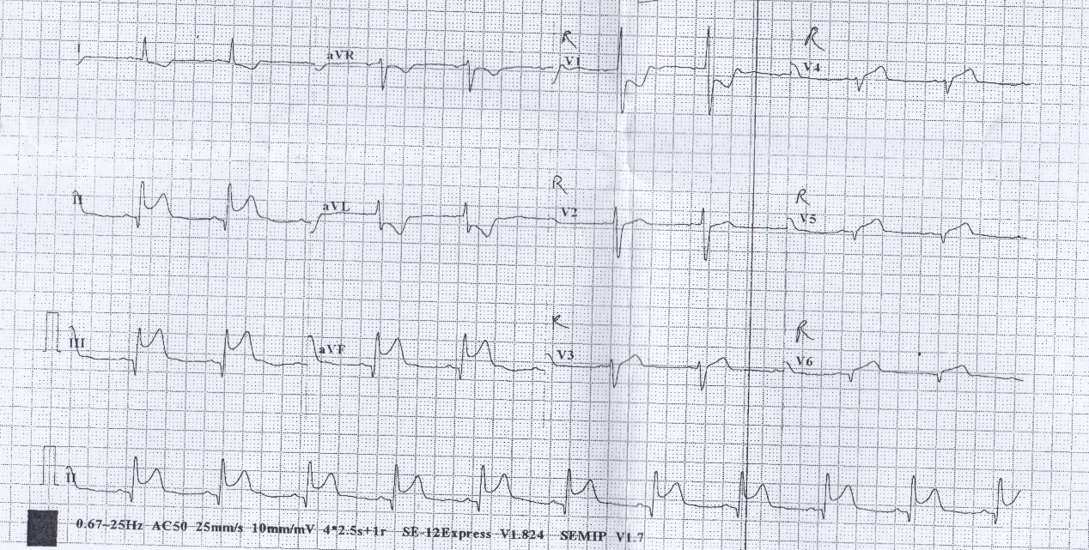

Slide 14
c) What is the diagnosis now?
Inferior posterior STEMI

Slide 17
d) What are the treatments to be done in AED?
Morphine
Nitrates
Aspirin
Oxygen if SpO2 <94%
Thrombolysis / transfer for PPCI

Slide 18
e) What treatment is contraindicated if the disease involved the right ventricle?
Nitrates
RV infarcts are preload dependent. Administration of nitrates may cause sudden hypotension.

Slide 19
Q3
F/40. good past health. attended AED for URI symptoms. CXR was taken.

Slide 21
a) What is the radiological diagnosis?
Right cervical rib

Slide 22
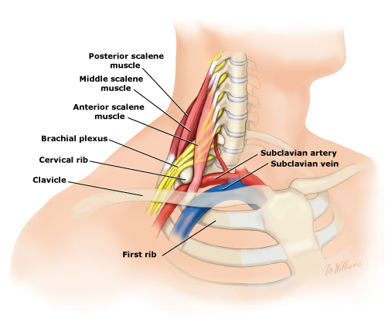
b) What are the usual clinical presentations?
Thoracic Outlet Syndrome:
Compression on brachial plexus: weakness / numbness depending on nerve root involved
Compression on subclavian artery: Raynaud phenomenon Adson’s sign Stroke
Compression on subclavian vein: DVT
Horner syndrome if the sympathetic chain is compressed

Slide 23
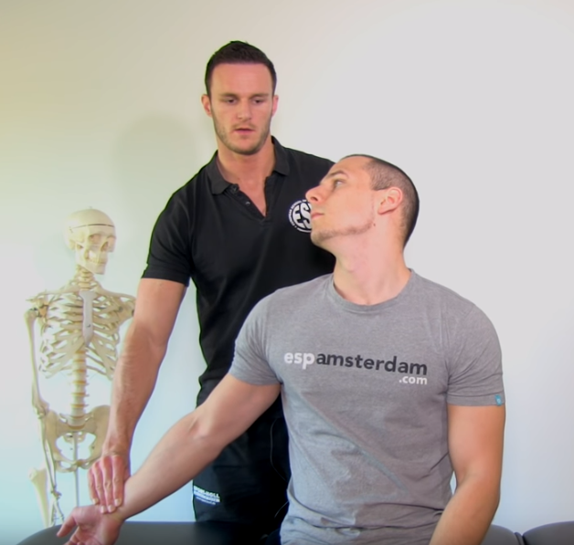
Adson's sign is the loss of the radial pulse in the arm by rotating head to the ipsilateral side with extended neck following deep inspiration.
Adson's sign is no longer used as a positive diagnosis of TOS since many people without TOS will show a positive Adson’s.
https://www.youtube.com/watch?v=-7346RaEGKU

Slide 24
c) What is the treatment option for symptomatic patients?
Surgical excision of cervical rib

Slide 25
Q4
M/52. Good past health. He complained of fever, dysphagia and sore throat for 3 days. A neck XR was taken.

Slide 27
a) What is the radiological finding?
Thickening of prevertebral soft tissue
C2/3: <7 mm
C6/7: <21 mm

Slide 28
b) List 3 differential diagnoses.
Para / Retropharyngeal abscess
Retropharyngeal cellulitis
Retropharyngeal hematoma
Retropharyngeal effusion secondary to acute calcific prevertebral tendinitis
Prevertebral abscess
Tumor
Pseudothickening due to neck flexion / swallowing / expiration

Slide 29
c) List 2 subsequent investigations.
Blood tests eg CBC, blood C/ST
Contrast CT neck

Slide 31
d) What is the diagnosis now?
Rim enhancing lesion in left parapharyngeal space with marked soft tissue swelling, compatible with left parapharyngeal abscess

Slide 33
e) What are the underlying causes for this disease?
Usually, parapharyngeal abscesses arise secondary to oropharyngeal infections that spread either by direct continuity or by lymphatic drainage:
acute and chronic tonsillitis
bursting of peritonsillar abscess
dental infection usually comes from the lower last molar tooth
Bezold abscess (abscess in attachment of SCM muscle secondary to mastoiditis)
petrositis
spread from other deep head and neck spaces (e.g. parotid, retropharyngeal or submandibular spaces)
secondary to penetrating trauma of the neck
iatrogenic e.g. injection of local anesthetic for tonsillectomy or mandibular nerve block

Slide 34
f) What is the definitive treatment?
Incision and drainage

Slide 35
Q5
F/72. Attended for minor head injury by falling over occiput. GCS full. Plain CT brain was done.

Slide 36
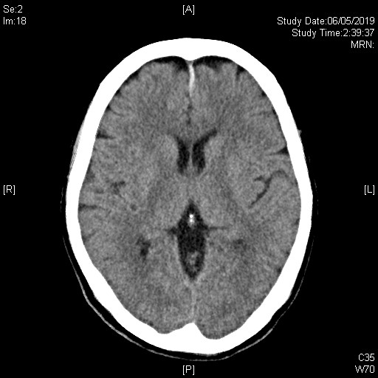

Slide 37
a) What is the radiological diagnosis?
Acute subdural hematoma over anterior falx

Slide 38
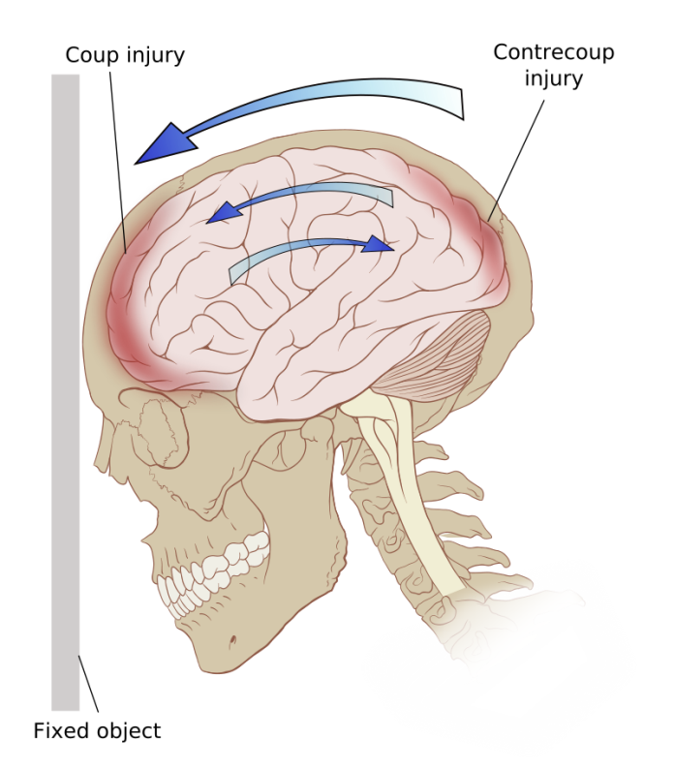
b) What is the mechanism of this injury?
Tearing of bridging veins that cross the subdural space.
Contrecoup injury for this patient

Slide 39
c) What are the common risk factors for this condition?
Elderly
Alcohol abuse
Use of antithrombotic angents eg. Aspirin , warfarin

Slide 40
d) List 4 management for this patient.
Consult neurosurgery
Neuro-observation
Seizure prophylaxis eg. dilantin
Reversal of anticoagulation if any

Slide 41
e) List 3 potential complications.
Brain herniation secondary to expansion of SDH and elevated ICP
Seizures
Persistent impairment such as memory loss, dizziness, headache ,anxiety , and difficulty concentrating, weakness, numbness, dysphasia

Slide 42
Q6
M/50. He slipped and fell and injured his left leg, complaining of left knee pain. XR left knee was done.

Slide 43
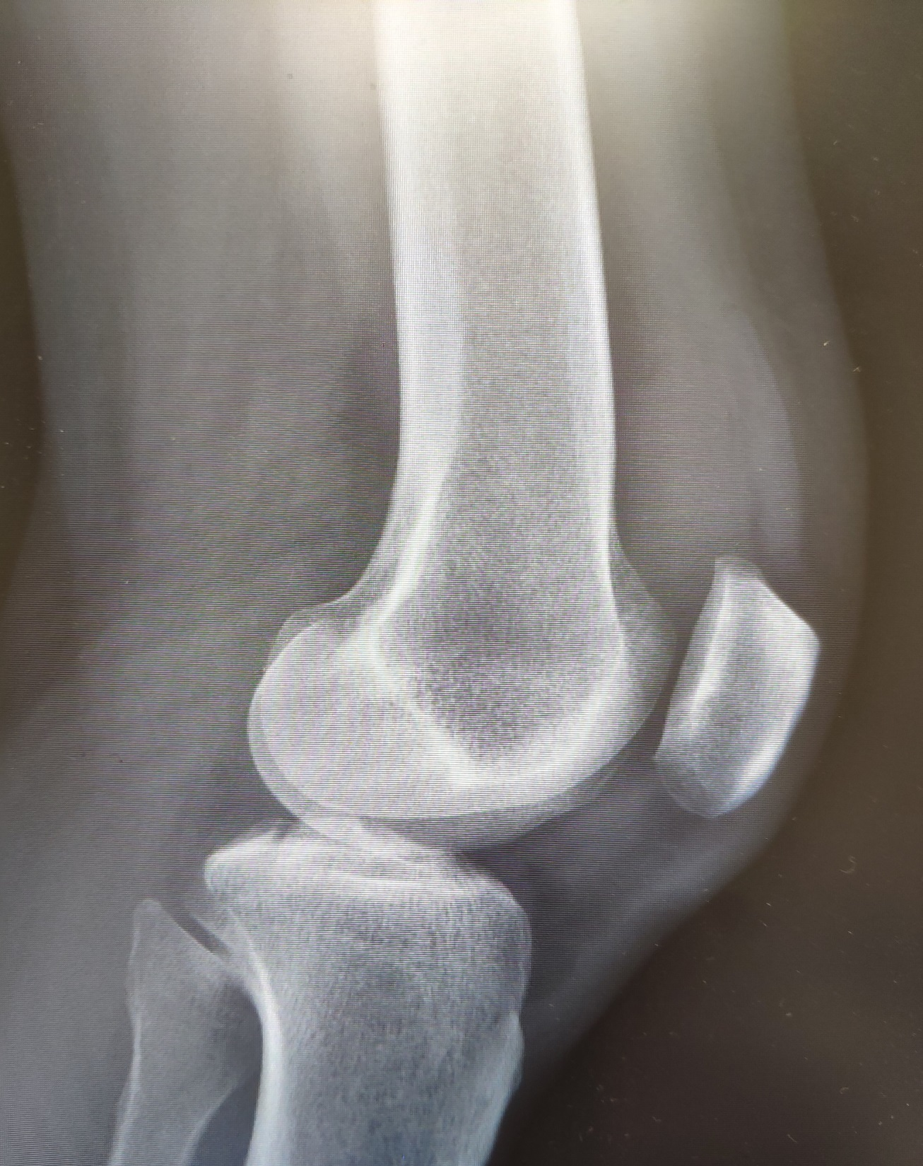

Slide 44
a) What is the radiological diagnosis?
Tibial spine fracture aka tibial eminence fracture
Notes:
an intra-articular fracture of the bony attachment of the ACL on the tibia

Slide 45
b) What is the most common age group for this injury?
8-14
Intercondylar eminence in incompletely ossified and is more prone to failure than ligamentous structures
Failure occurs through deep cancellous bone
Fracture usually confined to intercondylar eminence, but it may propagate to tibial plateau, medial is most common
Notes:
Pediatric specific
Intercondylar eminence in incompletely ossified and is more prone to failure than ligamentous structures
Failure occurs through deep cancellous bone
Fracture usually confined to intercondylar eminence, but it may propagate to tibial plateau, medial is most common

Slide 46
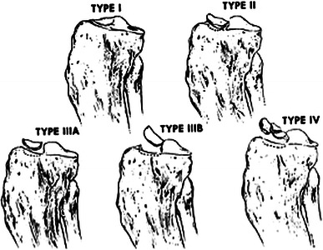
c) Name the classification system for this kind of injury.
Modified Meyers and McKeever Classification
Type I | Nondisplaced (<3mm)
Type II | Minimally displaced with intact posterior hinge
Type IIIA | Completely displaced
Type IIIB | Type III fracture with rotation
Type IV | Completely displaced, rotated, comminuted

Slide 47
d) How to treat this injury non-operatively?
aspiration
when tense hemarthrosis is present, needle aspiration with the injection of lidocaine may help extend the knee
reduction
extend the knee to full extension or hyperextension to observe for fragment reduction
Immobilization
cast is placed at 0 degrees of flexion
cast in extension for 3-4 weeks
Post reduction XR +/- CT/MRI
Notes:
Indications
non-displaced type I and reducible type II fractures

Slide 48
e) What are the complications of this injury?
Loss of motion
very common, especially loss of extension
may be due to displaced fragment impinging on femoral notch
Arthrofibrosis
more common with surgical reconstruction
Growth arrest
from iatrogenic injury during surgery
ACL laxity
incidence
38-100%, more common in operatively treated knees
Lachman's laxity may be noted compared to contralateral limb
functional instability is uncommon
Rate of ACL reconstruction following this injury is 15-25%

Slide 49
References
Uptodate
Radiopaedia
Life in the fast lane
www.orthobullets.com

