Slide 1
JCM SAQ
3th July 2019
AED, TSWH

Slide 2
Question 1 Animal/ Dog bite
Updated COC guideline
Dog/Animal, Patient and Vaccine
Several junior doctors are not familiar with the management of animals bite and indication of rabies vaccination and ask you for help.

Slide 3
Verorab, no. of doses, HRIG
(a) A lady was bitten today by her own dog which has received full vaccination.

Slide 4
Verorab, no. of doses, HRIG
(a) A lady was bitten today by her own dog which has received full vaccination.
    Observe the dog (at home or at Government Kennel) (for 7 days)
      Unremarkable/ not dead: no need for Verorab
      Dead: start Verorab
        Lab +ve: complete whole course of Verorab + HRIG
        Lab -ve: off Verorab

Slide 6
(b) A man with unremarkable past health was bitten by a dog in Malaysia two days ago and did not seek medical help.

Slide 7
(b) A man with unremarkable past health was bitten by a dog in Malaysia two days ago and did not seek medical help.
Start whole course of Verorab (4 doses) and HRIG

Slide 9
(c) A man was bitten by a dog in mainland China three days ago and went to Hospital in China and received vaccination on the same day.
He gave you the details of the vaccination: Human Diploid Cell Vaccine (HDCV)

Slide 10
(c) A man was bitten by a dog in mainland China three days ago and went to Hospital in China and received vaccination on the same day.
He gave you the details of the vaccination: Human Diploid Cell Vaccine (HDCV)
Start Verorab today but this dose as the Day 3 dose of usual Verorab course.

Slide 12
(d) A man with good past health was bitten by a dog in mainland China three days ago and went to Hospital in China and received vaccination on the same day. He throw away the vaccination record and cannot give you the details of the vaccination

Slide 13
(d) A man with good past health was bitten by a dog in mainland China three days ago and went to Hospital in China and received vaccination on the same day. He throw away the vaccination record and cannot give you the details of the vaccination
Start full course of Verorab today with today dose as Day 0.

Slide 15
(e) A woman with SLE on steroid for a long time was bitten by a bat/ bats over her left hand and right leg when she went to a cave today.

Slide 16
(e) A woman with SLE on steroid for a long time was bitten by a bat/ bats over her left hand and right leg when she went to a cave today.
Start whole course of Verorab (5 doses) and HRIG.

Slide 17
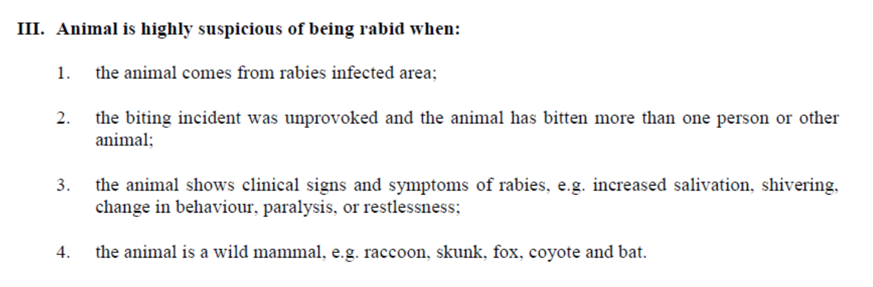

Slide 18
(f) A man with good past health noticed there was a bat in his room. He was awake and conscious all along. There was no obvious wound over his body.

Slide 19
(f) A man with good past health noticed there was a bat in his room. He was awake and conscious all along. There was no obvious wound over his body.
There is no need to have Verorab or HRIG.

Slide 20
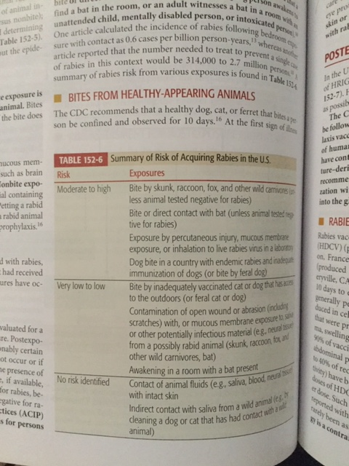

Slide 21
(g) A man is receiving a course of Verorab. But he forgot to come back to AED 2 days ago for Day 7 dose.

Slide 22
(g) A man is receiving a course of Verorab. But he forgot to come back to AED 2 days ago for Day 7 dose.
Continue the Verorab course and today dose as Day 7 dose.

Slide 23
(h) A man has been received full course of Verorab 3 years ago was bitten by a dog in Hong Kong today but he felt that the dog could not be caught as he forgot how the dog looks like.

Slide 24
(h) A man has been received full course of Verorab 3 years ago was bitten by a dog in Hong Kong today but he felt that the dog could not be caught as he forgot how the dog looks like.
2 doses of Verorab (Day 0 and day 3)

Slide 26
Don’t forget the antibiotics
Dog bite wound with antibiotics prophylaxis
Mainstay: Augmentin
Penicillin allergy:
(adults) doxycycline +/- metronidazole;
(children) clindamycin + septrin (cotrimoxazole)

Slide 27
Also Rabies Antibody Test

Slide 28
Question 2
A 72-year old man complaint of sudden onset left side weakness 30 minutes ago. His wife found that he was sitting on floor and vomited undigested food.
PMH:
Hypertension
Diabetes Mellitus
Hyperlipidemia

Slide 29
Vital signs:
BP 42 / 28 mmHg, Pulse rate 90/min
Body Temp.36.4 C
SpO2 100% on Room Air

Slide 30
Physical examination:
PEARL 3mm, R side sluggish
No facial asymmetry
Limb power:
5|0
5|4-
Plantar reflex:
Left side upgoing; Right side downgoing

Slide 31
(a) You worry the patient had acute stroke. What is the definition of stroke?

Slide 32
(a) You worry the patient had acute stroke. What is the definition of stroke?
A stroke is the acute neurologic injury that occurs as a result of brain ischemia and hemorrhage

Slide 33
(b) Can you give five diagnoses of stroke mimics?

Slide 34
(b) Can you give five diagnoses of stroke mimics?
Hypoglycemia
Brain/ CNS tumour or abscess
Post-ictal state/ Todd paralysis
Migraine
Multiple Sclerosis
and others

Slide 35
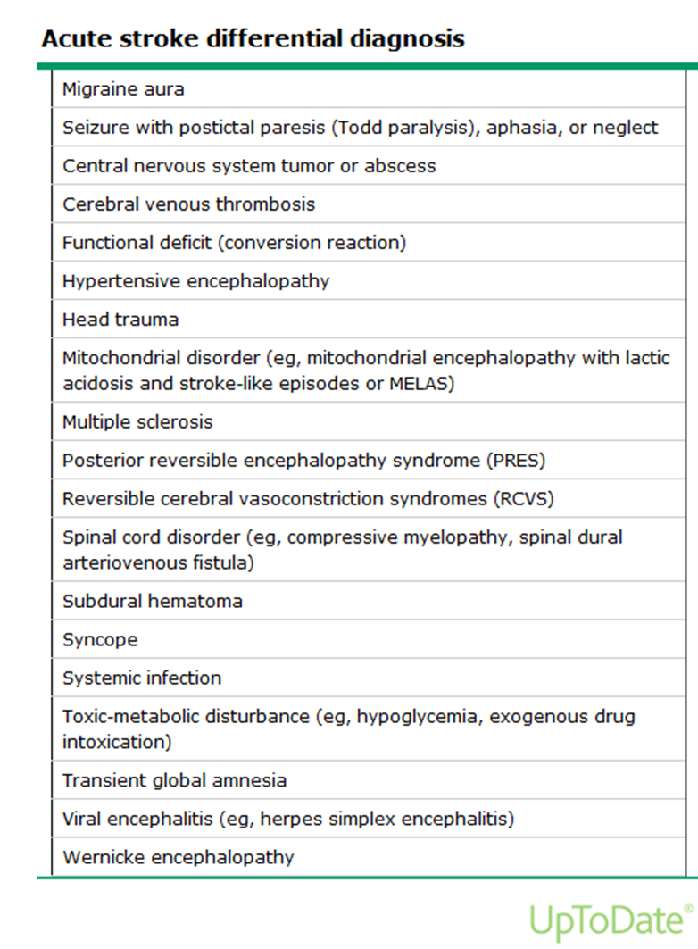

Slide 36
(c) What are the early sign of cerebral ischemia in non-contrast CTB, please give 4?

Slide 37
(c) What are the early sign of cerebral ischemia in non-contrast CTB, please give 4?
(Practice of Emergency Medicine)
Hypoattenuation involving one third or more of the Middle Cerebral Artery (MCA) territory.
Obscuration of lentiform nucleus
Cortical sulcal effacement
Focal parenchymal hypoattenuation
Loss of insular ribbon/ obscuration of Sylvian fissure
Hyperatten uation of large vessels e.g. Dense MCA sign
Loss of grey-white matter differentiation in basal ganglion.

Slide 38
At the resuscitation room, BP on right arm was 42/28 mmHg. Then the nurse took BP over left arm and was 54/37. After that, the nurse took blood pressure over left thigh and was 104/55.
A CXR also performed

Slide 39
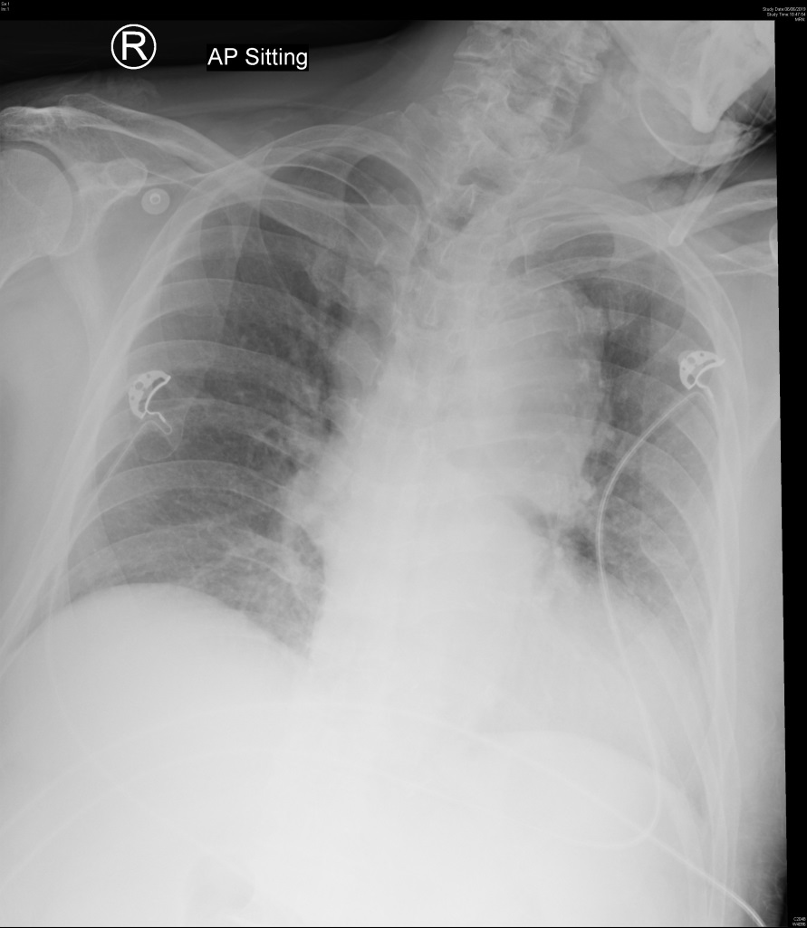

Slide 40
(d) Please comment the CXR and what do you worry with this CXR together with the above-findings and why?
Can you write down four other ‘typical’ findings in CXR for this condition?
What is the imaging of choice to diagnose this condition?

Slide 41
Mediastinum is widened
Acute aortic dissection is suspected in view of discrepancy of blood pressure between upper limbs and lower limbs

Slide 42
Left pleural effusion,
right sided tracheal deviation,
Separation of calcification at aortic arch (calcium sign),
double aortic knob sign,
pericardial effusion displacement of a nasogastric tube
CT aortogram

Slide 43
Possible chest X-ray findings
Widened mediastinum (80%)
Double aortic knob sign (present in 40% of patients)
Diffuse enlargement of the aorta with poor definition or irregularity of the aortic contour
Inward displacement of aortic wall calcification by more than 10 mm
Tracheal displacement to the right
Pleural effusion (more common on the left side; suggests leakage)
Pericardial effusion
Cardiac enlargement
Displacement of a nasogastric tube
Left apical opacity

Slide 44
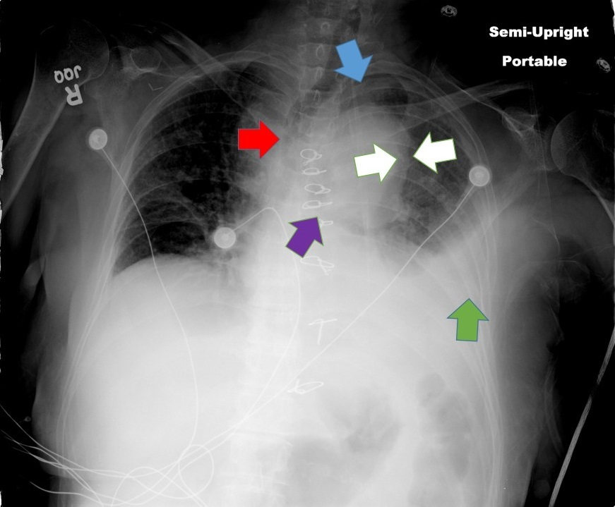
CXR sign of aortic dissection
rightward deviation of the trachea (red arrow); left apical pleural capping (blue arrow); aortic “double-calcium” sign (between white arrows); depression of the left bronchus (purple arrow); pleural effusion (green arrow); widened mediastinum

Slide 45
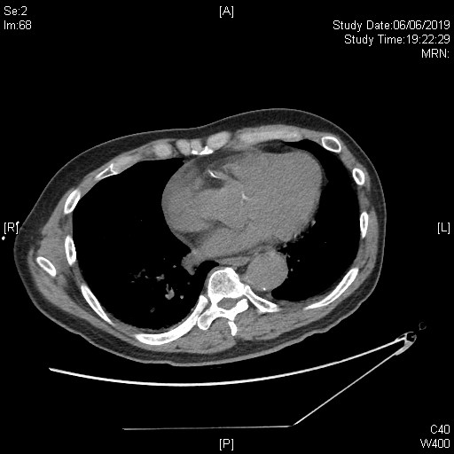
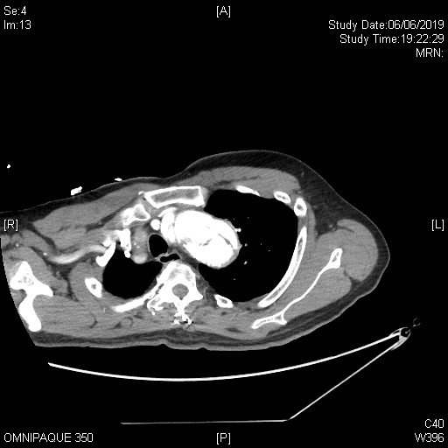
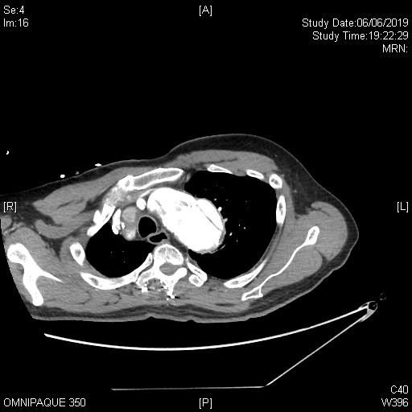
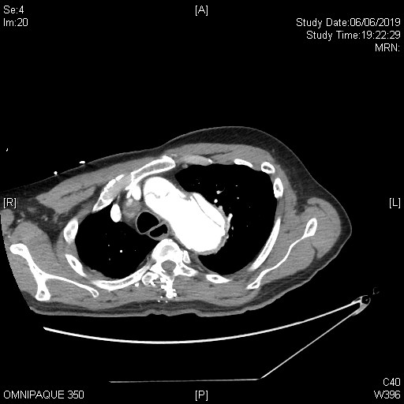

Slide 46
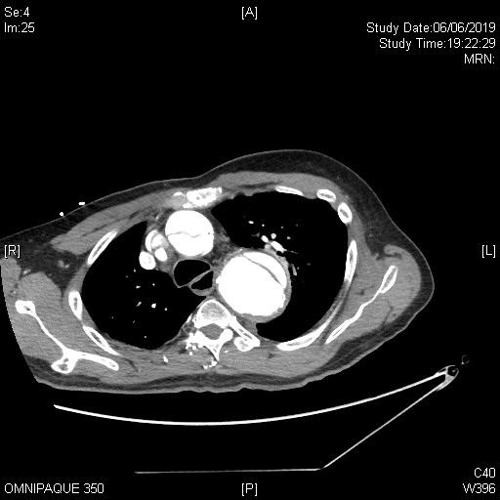
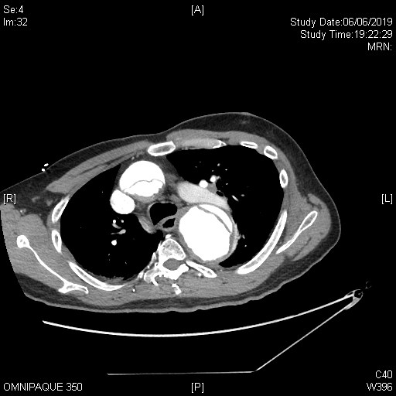
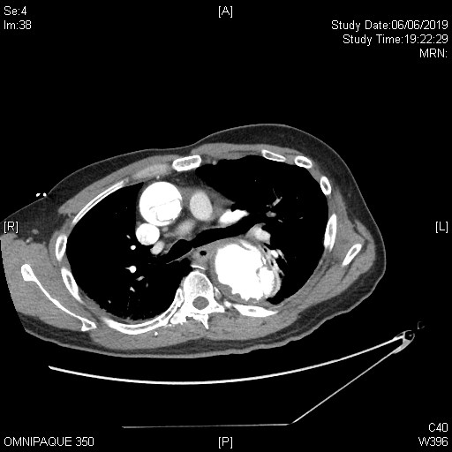

Slide 47
e) What is the diagnosis?
What branch(es) are involved (from the CT findings and the clinically findings)

Slide 48
e) What is the diagnosis?
What branch(es) are involved (from the CT findings and the clinically findings)
Standford Type A (DeBakey type I) aortic dissection.
Brachio-cephalic trunk, (left common carotid artery), left subclavian artery
Right hemiparesis, both ULs low BP

Slide 49
Question 3
40 year old man, good past health
C/O: increased occipital headache for 1 day, vomiting and blurred bilateral vision
BP: 207/157
PE: GCS full, no focal neurology, neck soft
RFT: Cr 238

Slide 50
What is the clinical diagnosis?

Slide 51
What is the clinical diagnosis?
The clinical diagnosis is hypertensive encephalopathy

Slide 52
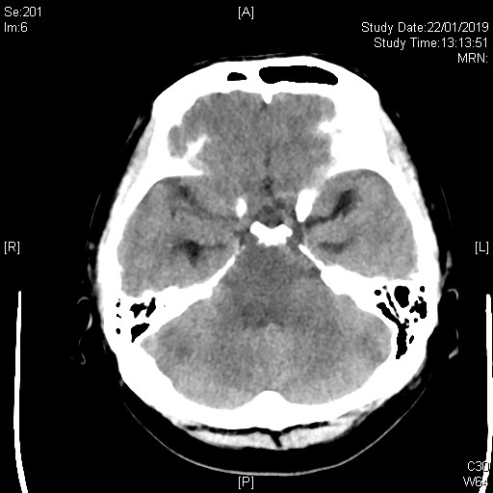
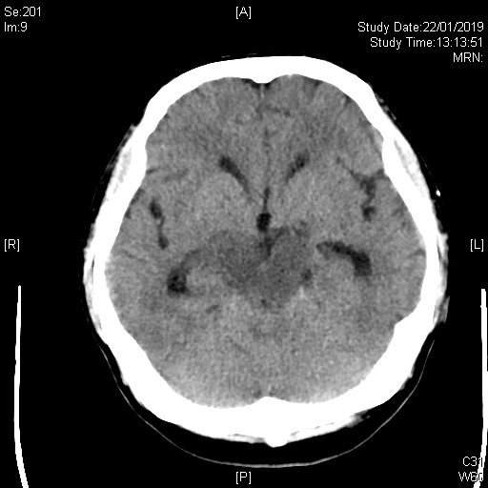
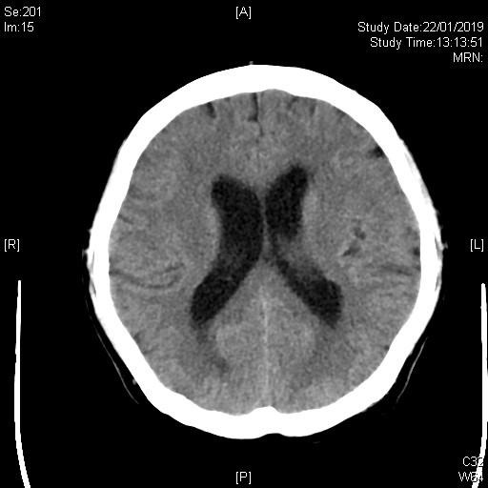
CT Brain performed

Slide 53
(b) Describe the CT brain.
What is the most likely diagnosis based on the radiological findings combined with the clinical picture?

Slide 54
(b) Describe the CT brain.
What is the most likely diagnosis based on the radiological findings combined with the clinical picture?
Hypodensity predominant over pons and medulla
Based on the radiological findings, the most likely condition is:
Posterior reversible encephalopathy syndrome (PRES) or,
Reversible posterior leukoencephalopathy syndrome (RPLS)

Slide 55
Pathophysiology of PRES is poorly understood
Related to hypertensive encephalopathy & acute elevation of BP
Increased CPP + endothelial damage + impaired autoregulation
If properly recognized and treated, clinical syndrome resolved completely within few weeks

Slide 56
(c) Apart from hypertension, what are the other possible risk factors for this condition?
Other risk factors for PRES:
Eclampsia
Renal failure
Immunosuppressants (e.g. cyclosporin, tacrolimus, chemotherapy)
Autoimmune diseases (e.g. SLE, TTP)
Sepsis

Slide 57
(d) What are the possible clinical manifestations?

Slide 58
(d) What are the possible clinical manifestations?
(CCCV=cephagia, convulsions, confusion & vision loss)
Headache
Seizures
Altered consciousness (somnolence, confusion or even coma)
Visual disturbance (hemianopia, visual neglect, hallucinations or even cortical blindness)

Slide 59
(e) What further Ix should be done?

Slide 60
(e) What further Ix should be done?
MRI brain & FU interval MRI
MRI finding in PRES: vasogenic edema in the subcortical white matter, predominantly focused posteriorly
Diffusion-weighted imaging (DWI) can differentiate PRES from stroke
Follow-up imaging is necessary to expect resolutions of findings within few weeks

Slide 61
Wide range of differential diagnoses:
Posterior circulation stroke
Infectious, paraneoplastic or autoimmune encephalitis (usually cortex affected more)
Acute demyelinating encephalomyelitis
Metabolic or toxic encehalopathies

Slide 62
(f) How do you treat the condition?

Slide 63
(f) How do you treat the condition?
Protect airway & treat seizure if necessary
Treat malignant hypertension (initial fall <25%)
  E.g. labetolol
  Avoid nitroglycerin (dilates cerebral arteries & worsen autoregulation failure)
Remove triggers (e.g. withhold offending medications or delivery of fetus in eclampsia)

Slide 64
Question 4
69 year old man
Found acute confusion 2 hours ago by family
Recently DAMA from medical ward; admitted for same condition
On multiple PCMs

Slide 65
BP: 186/116 P: 132/min temp: 37.8C
GCS E2V2M5
Pupils: 4mm bilaterally
Dry and red skin

Slide 66
(a) What is the toxidrome of this patient?

Slide 67
(a) What is the toxidrome of this patient?
Anticholinergic toxidrome
Toxins are tropane alkaloids (solanaceous alkaloids) e.g. atropine, scopolamine, hyoscine

Slide 68
(b) Give 2 examples of herbal medicine that would give rise to this toxidrome

Slide 69
(b) Give 2 examples of herbal medicine that would give rise to this toxidrome
洋金花 (白花曼陀羅Datura Metel L)
天仙子 (seeds of Hyosyamus niger L)
顛茄
毒參茄

Slide 70
(c) What antidote can be given? How should it be given?

Slide 71
(c) What antidote can be given? How should it be given?
The antidote is physostigmine
Given in 0.5mg increments up to 1-2mg in adults & 0.02mg/Kg (max 0.5mg) in children
Repeated dosing may be needed if adequate response not achieved and no adverse effects

Slide 72
(d) What caution should taken when administering the antidote?

Slide 73
(d) What caution should taken when administering the antidote?
Cardiac & SpO2 monitoring required
Slow infusion over 5min (too rapid administration may cause bradycardia and seizure)
Atropine standby (in case of excessive cholinergic toxicity)
Contraindicated in TCA overdose, widen QRS, bradycardia

Slide 74
Question 5
73 year old man
C/O: LBP for few months; increased pain for 2 days and could not get up from floor
Noted low grade fever
PE: lumbar spine tenderness, no LL neurology
L-spine X-ray findings of ‘degenerative changes’ documented in A&E notes

Slide 75
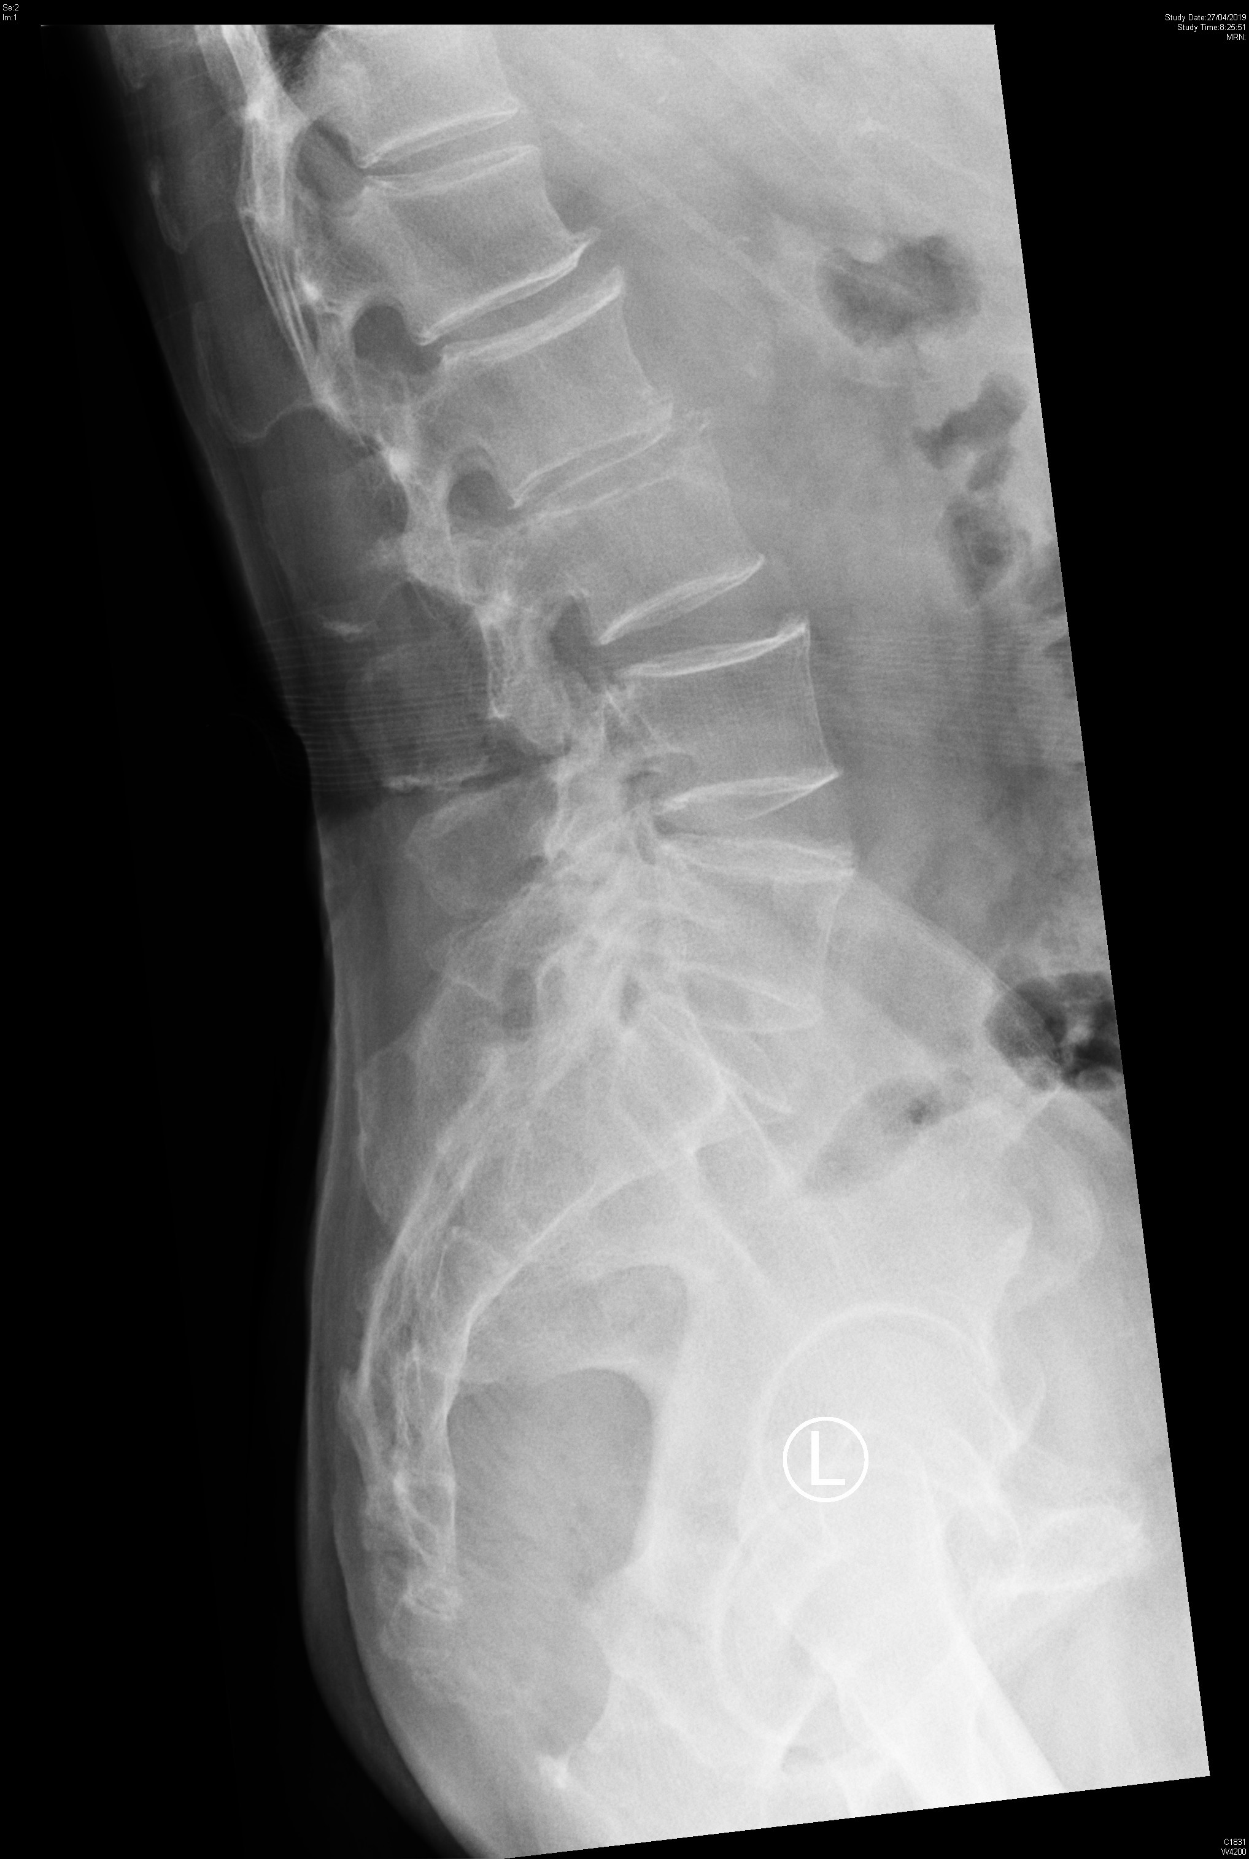
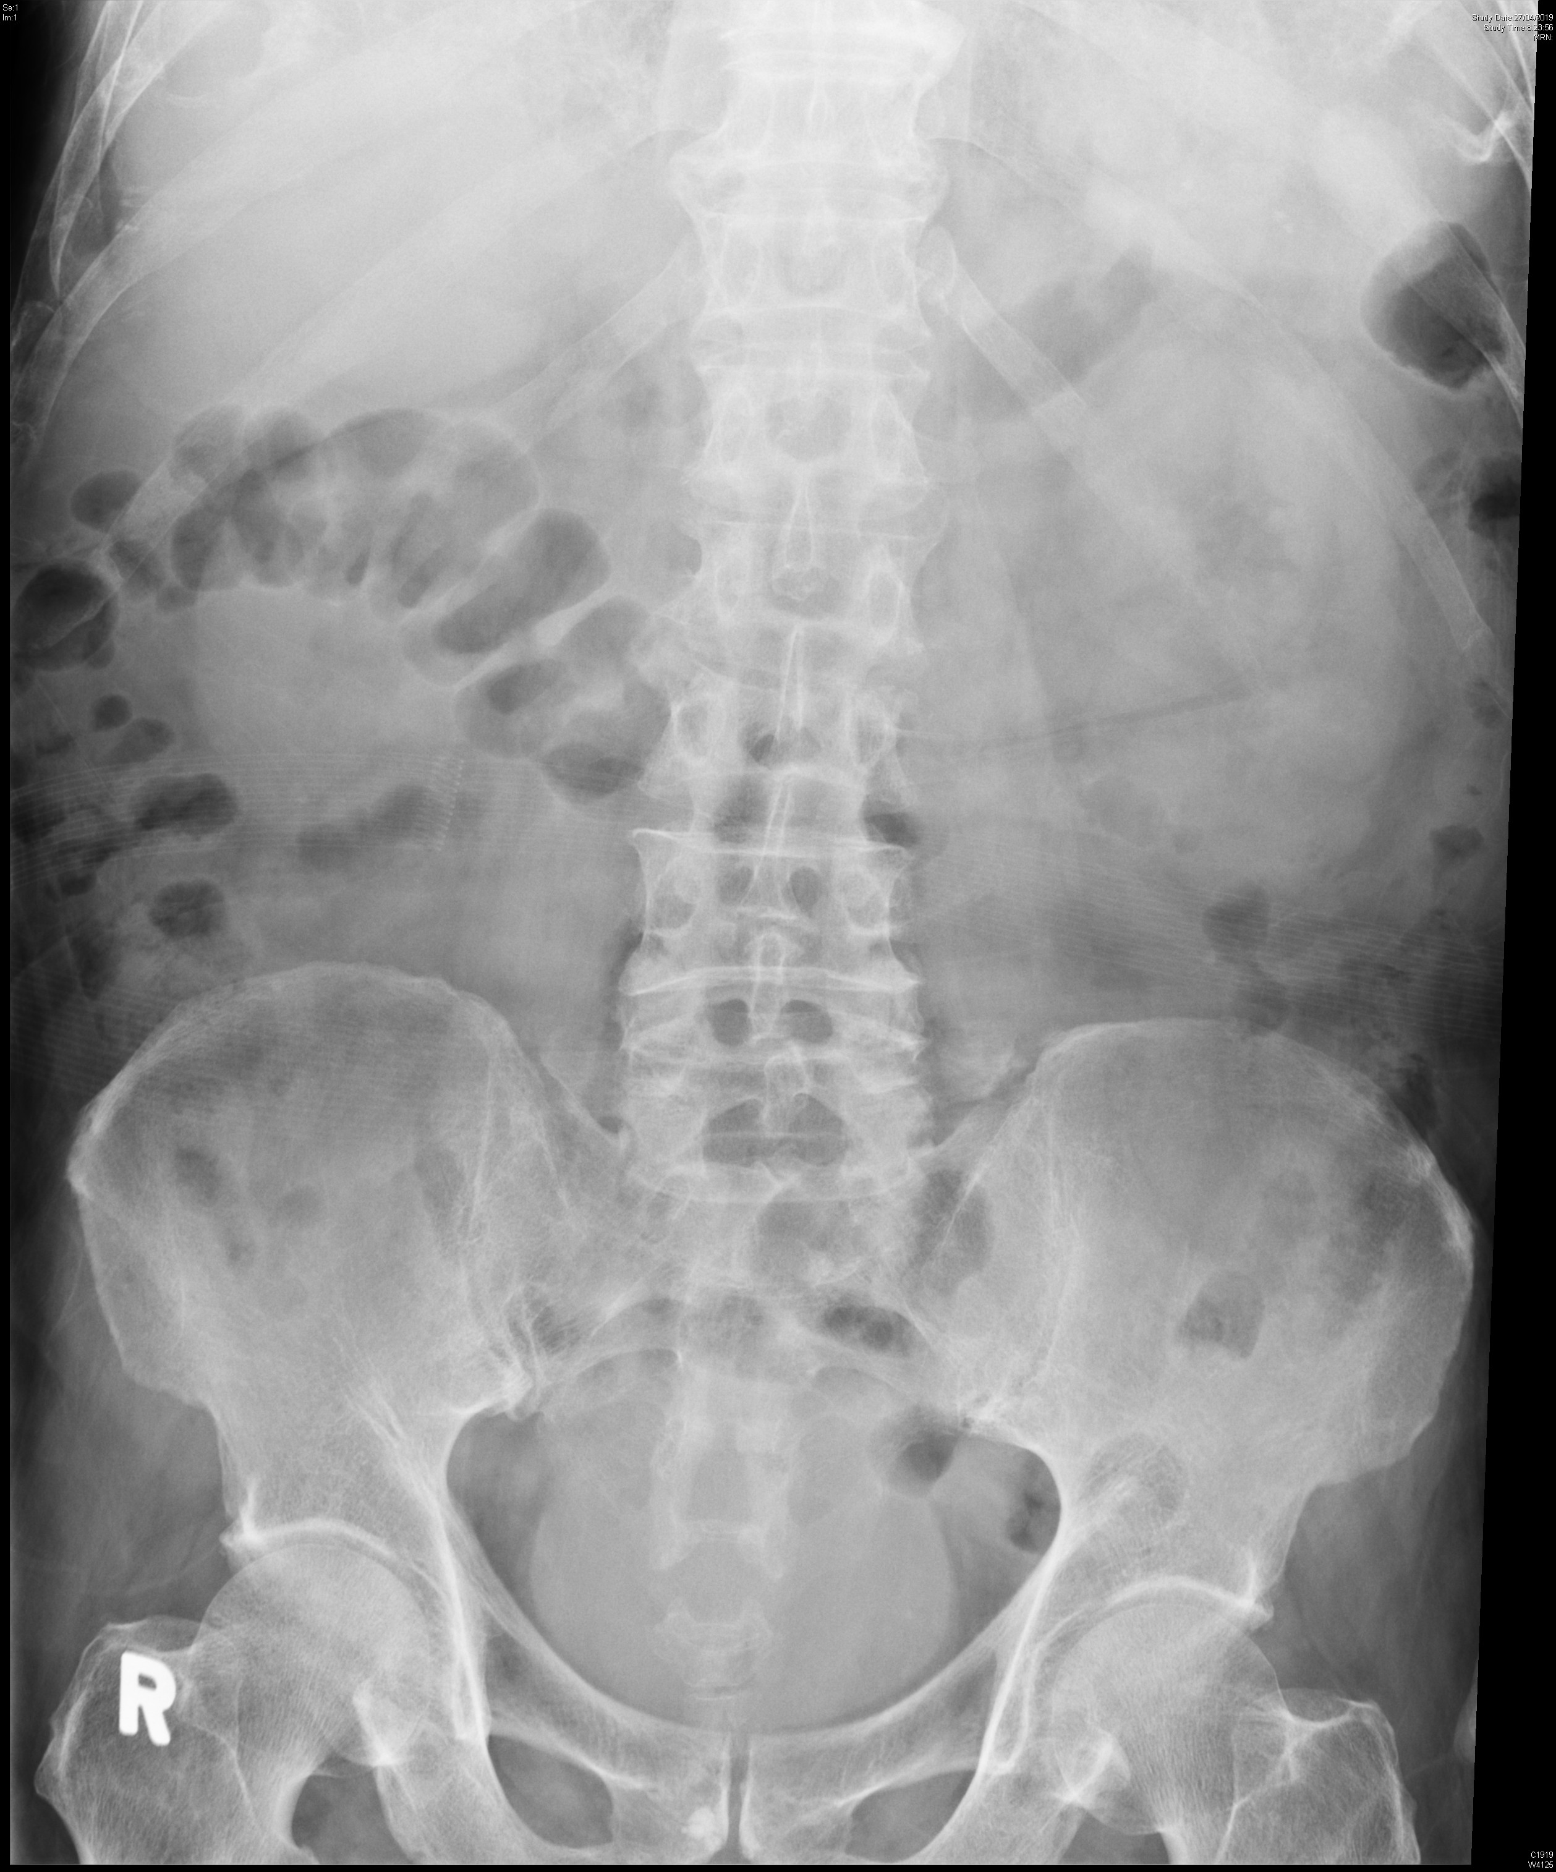

Slide 76
(a) Describe the radiological findings

Slide 77
(a) Describe the radiological findings
Ill defined upper end plate of L3 & lower end plate of L2
Narrowing of L2/L3 disk space
Bulging of R Psoas shadow

Slide 78
(b) What is the likely diagnosis?

Slide 79
(b) What is the likely diagnosis?
Infective spondylodisciitis with psoas abscess (vertebral osteomyelitis)

Slide 80
(c) What are the next steps of investigation?

Slide 81
(c) What are the next steps of investigation?
Imaging: MRI preferred (most sensitive), CT (may miss early cases), bone scans (non-specific)
Blood test: CBC, CRP/ ESR (for monitoring of treatment success)
Blood culture (to guide antibiotics choice)
CT guided biopsy (if blood culture-ve)
Open biopsy (if blood culture & CT guided biopsy both -ve & no alternative diagnosis)

Slide 82
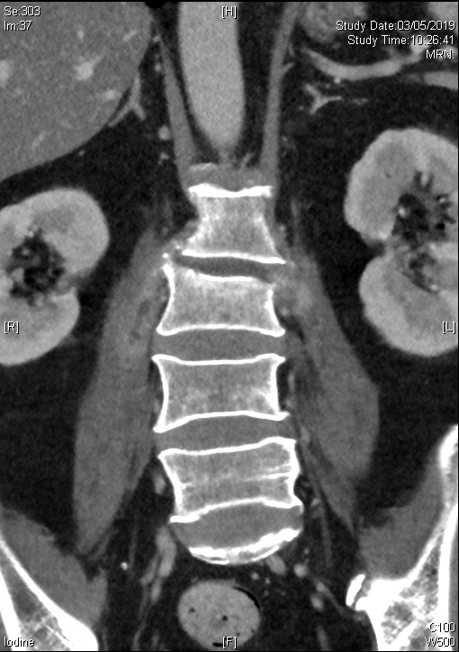
Contrast CT L-spine & sacrum done:
-L2/3 spondylodiscittis extending into epidural space
-Psoas abscess in adjacent region

Slide 83
(d) What are the criteria for choosing surgical rather than medical treatment for this condition?

Slide 84
(d) What are the criteria for choosing surgical rather than medical treatment for this condition?
Most cases can be treated with pathogen directed antibiotics (empirical if septic or culture-ve) for around 6 weeks ; nonoperative treatments successful in up to 80% of cases
Indications for surgical treatment:
  Focal neurological deficits
  Epidural or paravertebral abscess
  Possible cord compression
  Persistence or recurrence of disease despite medical treatment

Slide 85
(e) If blood culture showed gram-positive organisms, and cannot be explained by an obvious source, what concurrent condition should be evaluated?

Slide 86
(e) If blood culture showed gram-positive organisms, and cannot be explained by an obvious source, what concurrent condition should be evaluated?
Evaluation for concurrent infective endocarditis is required if:
Age> 75
Predisposing heart condition
Heart failure
Positive blood cultures of gram-positive organisms (especially non-pyogenic streptococci or staphylococci)

Slide 87
(f) What are the red flags of non-traumatic back pain?

Slide 88
(f) What are the red flags of non-traumatic back pain?
Possible malignancy or infection
  Age < 20 or > 50 years
  History of cancer
  Constitutional symptoms (fever, chills, weight loss)
  Recent bacterial infection
  IV drug use
  Immunosuppression
  Pain worse at night or when supine

Slide 89
Significant neurological deficits
  Severe or progressive sensory alteration or weakness
  Bladder or bowel dysfunction
  Major LL weakness/ saddle anesthesia/ loss of anal sphincter tone

