Slide 1
JCM OSCE
PWH A&E
7 August 2019

Slide 2
Case 1
A 70-year-old man presents with low back pain for 1 month, with increased severity for 1 week.
Vital signs at triage:
BP 120/75, P 70, Temp 37.8 C, SpO2 98%
Physical examination showed tenderness on lumbar spine. Both lower limbs power Grade 4; both upper limbs power Grade 5.

Slide 3
Describe the x-ray findings

Slide 4
Describe the x-ray findings.
Rims of radiolucency over bilateral psoas shadows
Decreased L1/2 disc space
Depressed L2 superior endplate
Retrolisthesis L1/2
Degenerative changes in lumbar spine

Slide 5
Describe the CT findings.

Slide 6
Describe the CT findings.
Numerous gas densities in L1 and L2 vertebral bodies, L1/2 disc, intraspinal canal and bilateral psoas muscles.
Focal erosions at L1/2 with depressed L2 superior endplate.
Degenerative changes in the spine.

Slide 7
What is the likely diagnosis?

Slide 8
What is the likely diagnosis?
Infective spondylodiscitis of L1-L2 with intraspinal and psoas extensions.

Slide 9
What are the possible pathogens?

Slide 10
What are the possible pathogens?
●Enteric gram-negative bacilli, particularly following urinary tract instrumentation
●Pyogenic streptococci, including groups B and C/G, especially in patients with diabetes mellitus
●Pseudomonas aeruginosa, coagulase-negative staphylococci, and Candida spp, especially in association with intravascular access, sepsis, or injection drug use
●Nonpyogenic streptococci, including viridans group, milleri group, Streptococcus bovis, and enterococci
●Tuberculous infection

Slide 11
How would you manage the patient in A&E?

Slide 12
How would you manage the patient in A&E?
Blood for CBC, ESR, CRP (WBC may be elevated or normal. ESR and CRP are useful for following the efficacy of therapy.
Blood culture, urine culture
Analgesic
Empirical IV antibiotics (after blood culture): Vancomycin plus (cefotaxime, ceftazidime, ceftriaxone, cefepime or ciprofloxacin)
Admit orthopaedics

Slide 13
How would the patient be investigated after admission?

Slide 14
How would the patient be investigated after admission?
Spinal imaging (MRI spine preferred) (CT may miss early destructive changes and has a high false negative rate for epidural abscess)
CT-guided needle biopsy of affected bone +/- aspiration of abscess (if blood culture is negative and surgical intervention is not warranted)

Slide 15
What are the indications for surgical intervention?

Slide 16
What are the indications for surgical intervention?
Surgical intervention if:
Presence of neurologic deficits
Presence of epidural or paravertebral abscesses in need of drainage
Threatened or actual cord compression due to vertebral collapse and/or spinal instability
Progression, persistence, or recurrence of disease (as documented by persistently positive blood cultures or worsening pain) despite appropriate antimicrobial therapy

Slide 17
Case 2
A 62-year-old presents with sore throat, dry cough and low-grade fever for 2 days.
Physical examination showed hoarseness of voice, congested pharynx and clear chest. No stridor.
Vital signs: BP 107/77, P 95, Temp 37.7C, SpO2 96% RA

Slide 18
What are the differential diagnosis?

Slide 19
What are the differential diagnosis?
Acute epiglottitis
Peritonsillar abscess (Quinsy)
Retropharygeal abscess
Ludwig angina
Angioedema
Diphtheria

Slide 20
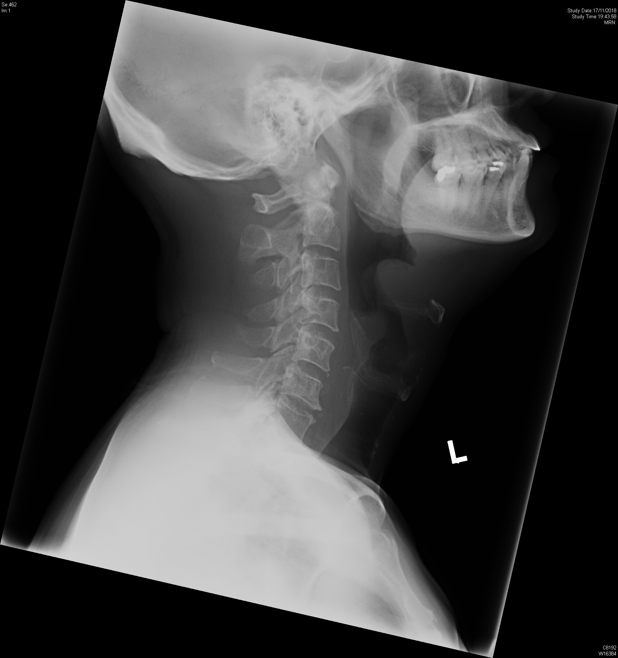
Describe the X-ray finding. What is the likely diagnosis? What is the diagnostic sensitivity of a true lateral X-ray?

Slide 21
Describe the X-ray finding. What is the likely diagnosis? What is the diagnostic sensitivity of a true lateral X-ray?
This shows the “ thumb print” sign suggesting the diagnosis of epiglottitis. (It is caused by a thickened free edge of the epiglottis, which causes it appear more radiopaque than normal, resembling the distal thumb.)
The true lateral X-ray has a diagnostic sensitivity of about 75%

Slide 22
What are the common aetiological agents?

Slide 23
What are the common aetiological agents?
Haemophilus influenza type B (HiB)
Group A beta haemolytic streptococci
Haemophilus parainfluenza
Streptococcus pneumonia
Staphylococcus aureus

Slide 24
How would you manage this patient in A&E?

Slide 25
How would you manage this patient in A&E?
Avoid lying the patient flat and vigorous throat examination.
Supplementary O2 via face mask.
IV line + IV antibiotic )Zinacef 1.5g or Augmentin 1.2g or 3rd generation cephaolosporin), after sepsis work up.
Consult ENT surgeon for direct diagnostic visualization of supraglottic are by means of indirect laryngoscopy or flexible laryngoscopy.
Consult ICU for monitoring in ICU where provision is made for emergency tracheal intubation or tracheostomy should cardinal signs of upper airway obstruction developed.
Prophylactic intubation is not warranted in all patients.
RSI should not be performed in the ED unless in critical condition after prompt and careful collaborative evaluation by a highly experienced anaesthetist and an emergency physician.

Slide 26
How will you manage if the patient deteriorates into respiratory arrest in ED before transfer?

Slide 27
How will you manage if the patient deteriorates into respiratory arrest in ED before transfer?
Open the airway by proper positioning.
BVM ventilation
Intubate with an ET tube approximately one or two sizes smaller than estimated.
If intubation failed, perform cricothyrotomy for establishment of a temporary emergency airway.
Adrenaline nebulizer (5ml 1:1000) can be considered in order to buy time to prepare for emergency intubation by experienced personnel. It should be given continuously. Stopping the adrenaline nebulizer abruptly will aggravate the upper airway obstruction.

Slide 28
What would you manage differently if the patient were a child?

Slide 29
What would you manage differently if the patient were a child?
Avoid any maneuvers that will agitate the child (eg. O2 mask, separation from mother, throat examination, forced recumbency, fearful events like temperature, venipuncture)
Oxygen, if needed, should be held nearby but not by a tight fitting mask.
Allow the child to assume his/ her preferred posture of comfort
Lateral neck x-ray is not necessary and by disturbing the child may add to the danger of sudden laryngeal obstruction.
Prepare equipment for bag-valve mask (BVM) ventilation, endotracheal intubation and needle cricothyrotomy (or min-tracheostomy)
Alert paediatrician, anaesthetist, ENT surgeon.
Arrange prophylactic endotracheal intubation in operating theatre (after slow gaseous anaesthetic induction with spontaneous breathing)

Slide 30
Case 3
A 74-year-old lady fell from bed at 4am. She then complained of left shoulder pain, left chest wall pain and left buttock pain.
Physical examination showed diffuse tenderness on left lower chest wall. Abdominal examination showed mild tenderness on LUQ. There was no tenderness on left shoulder. Active range of motion of left shoulder was full.
Vital signs: BP 147/108, P 56, Temp 37.3 C, SpO2 97% RA
She complained of persistent left lower chest wall pain despite 2 doses of IM tramadol 50mg.

Slide 31
Blood test showed haemoglobin 9.6 (baseline Hb 8 months ago: 12.7) FAST scan showed free intraperitoneal fluid in Morrison’s pouch and perihepatic area. CXR was clear. There was no pneumothorax, pleural effusion or rib fracture. CT abdomen with contrast was requested.

Slide 32
Describe the CT findings.

Slide 34
Describe the CT findings.
Severe ruptured spleen with perisplenic hematoma
No active extravasation to suggest active bleeding
Moderate amount of fluid in right perihepatic region, may represent haemorrhage

Slide 35
She complained of left shoulder pain despite the lack of signs of shoulder injury. What is the cause of the pain? What is the name of the sign?

Slide 36
She complained of left shoulder pain despite the lack of signs of shoulder injury. What is the cause of the pain? What is the name of the sign?
It is pain referred to the left shoulder due to irritation of the phrenic nerve from blood adjacent to the left hemidiaphragm.
It is known as “Kehr’s sign”.

Slide 37
Name a grading system for this injury. What is the grading for this patient?

Slide 38
The American Association for the Surgery of Trauma (AAST) splenic injury scale. Grade V
Grade | Description of splenic injury
I | Subcapsular hematoma <10 percent surface area. Parenchymal laceration <1 cm in depth. Capsular tear.
II | Subcapsular hematoma 10 to 50 percent surface area; intraparenchymal hematoma <5 cm. Parenchymal laceration 1 to 3 cm in depth.
III | Subcapsular hematoma >50 percent of surface area; ruptured subcapsular or intraparenchymal hematoma ≥5 cm. Parenchymal laceration >3 cm in depth.
IV | Any injury in the presence of a splenic vascular injury or active bleeding confined within splenic capsule. Parenchymal laceration involving segmental or hilar vessels producing >25 percent of devascularization
V | Any injury in the presence of splenic vascular injury with active bleeding extending beyond the spleen into the peritoneum. Shattered spleen.

Slide 39
How should patients with injury of this organ be managed in general?

Slide 40
How should patients with injury of this organ be managed in general?
Laparotomy is indicated in haemodynamically unstable patients with a positive FAST scan or generalized peritonitis.
Haemodynamically stable patients with low grade (I to II) blunt or penetrating splenic injuries without any evidence for other intra-abdominal injuries, active contrast extravasation, or a blush on CT, may be initially observed safely.
Patients with active contrast extravasation or contrast blush on CT scan , or those with high grade (III, IV) splenic injuries should be considered for embolization.
Grade V injuries are generally unsuitable for embolization due to vascular disruption.
Failure of embolization indicates the need for surgery.

Slide 41
When and what drugs should be given to this patient to reduce the risk of post-operative sepsis?

Slide 42
When and what drugs should be given to this patient to reduce the risk of post-operative sepsis?
Vaccination should be given after the 14th post-splenectomy day.
Pneumocccal vaccine
Haemophilus influenza type b vaccine
Meningococcal groups A, C, W 135, Y vaccine
Meningococcal group B vaccine
Seasonal influenza vaccine
Daily antibiotic prophylaxis (penicillin or amoxicillin) for at least one year following splenectomy.

Slide 43
Case 4
A 43-year-old lady, good past health, presents with headache for 2 days, with increased severity for 1 hour, associated with vomiting.
No history of head injury.
Physical examination showed power 1/5 on right side and power 3/5 on left side.
GCS E4V1M6, BP 113/70, P 75, Temp 35.3 C, SpO2 97% 2L

Slide 44
Describe the CT findings.

Slide 46
Describe the CT findings.
Acute subarachnoid haemorrhage in basal cisterns, extending to bilateral Sylvian fissures, left cerebral sulci, anterior interhemispheric fissure, prepontine cistern.
Acute blood within the third and fourth ventricles.
Flaring of ventricular temporal horns suggestive of early hydrocephalus

Slide 47
What specific physical signs will you look for?

Slide 48
What specific physical signs will you look for?
Meningism
Nuchal rigidity - more pronounced on flexion
Kernig’s sign – pain in hamstrings following extension of the knee from a flexed position with the hip flexed to 90
Brudzinski’s sign – involuntary hip flexion on passive flexion of the patient’s neck while in a supine position
Retinal subhyaloid haemorrhage in fundoscopy

Slide 49
What are the risk factors for the above diagnosis?

Slide 50
What are the risk factors for the above diagnosis?
Modifiable risk factors:
Hypertension
Smoking
Heavy alcohol consumption
Oral contraceptives (OCPs)
Cocaine
Non modifiable risk factors:
Autosomal dominant polycystic kidney disease
Fibromuscular dysplasia
Arteriovenous malformations
Connective tissue disorders (Ehlers-Danlos syndrome, Marfan syndrome)

Slide 51
Name 2 clinical grading systems for the above diagnosis.

Slide 52
Hunt and Hess grading (Grade 4)
Grade | Clinical condition
1 | Asymptomatic or mild headache and slight nuchal rigidity
2 | Moderate to severe headache, stiff neck, no neurologic deficit except cranial nerve palsy
3 | Drowsy or confused, mild focal neurologic deficit
4 | Stupor, moderate or severe hemiparesis
5 | Deep coma, decerebrate posturing

Slide 53
World Federation of Neurological Surgeons grading (Grade 4)
Grade | GCS score | Motor deficit
1 | 15 | Absent
2 | 13 to 14 | Absent
3 | 13 to 14 | Present
4 | 7 to 12 | Present or absent
5 | 3 to 6 | Present or absent

Slide 54
What treatment can be given in A&E?

Slide 55
What treatment can be given in A&E?
Nimodipine 60 mg every four hours
Intravenous fluid (usually normal saline) (To keep patient hydrated to minimize the effects of vasospasm and cerebral salt wasting.)
Discontinue antithrombotic. (Reverse any anticoagulant effect with appropriate agents, such as Vitamin K1, FFP, PCC)
Control blood pressure. (According to 2012 American Stroke Association guidelines, keep systolic blood pressure < 160mm Hg, preferably with labetalol, nicardipine or enalapril.)
May consider antiepileptic drugs in higher risk patients with poor neurologic grade, unsecured aneurysm, and associated intracerebral hemorrhage. Avoid phenytoin due to its association with worse neurologic and cognitive outcome after SAH.
May consider tranexamic acid when definitive treatment of the aneurysm is unavoidably delayed and there are no other contraindications.

Slide 56
What further investigations may be requested?

Slide 57
What further investigations may be requested?
CT angiogram of brain
Transcranial Doppler ultrasonography
Digital subtraction angiogram (if high clinical suspicion of aneurysm and aneurysm not detected on CTA)

Slide 58
What are the definitive and operative treatments?

Slide 59
What are the definitive and operative treatments?
Endovascular coiling
Surgical clipping
Ventricular catheter insertion for drainage of cerebrospinal fluid

Slide 60
What are the potential complications?

Slide 61
What are the potential complications?
Vasospasm
Rebleeding
Hydrocephalus
Seizure
Delayed cerebral ischemia (DCI) / delayed ischemic neurological deficit (DIND)
Hyponatremia ( SIADH/ cerebral salt wasting)

Slide 62
Case 5
A 70-year-old had history of loss of consciousness twice in 2010. Holter exam done in 2010 was unremarkable. He first attended GOPC because his wife noticed he was snoring and having difficulty breathing during his sleep. He is then referred from GOPC for “abnormal ECG”. He does not have chest pain, dyspnea or palpitation recently.
Physical examination : Dual heart sounds, no murmur, chest clear, no ankle edema
Vital signs: BP 175/95, P 93, Temp 37.5 C, SpO2 99% RA

Slide 63
Describe the ECG. What is the likely diagnosis and which type?

Slide 64
Describe the ECG. What is the likely diagnosis and which type?
Sinus rhythm
Coved type ST elevation >2mm that descends with an upward convexity to an inverted T wave in leads V1 to V2
Type 1 Brugada ECG pattern

Slide 65
What is the pathogenesis of the above diagnosis?

Slide 66
What is the pathogenesis of the above diagnosis?
Autosomal dominant inheritance with variable expression
Mutations in the SCN genes SCN5A and SCN10A
Defective myocardial sodium channels reduce sodium inflow currents, thereby reducing the duration of normal action potentials

Slide 67
What are the provoking factors?

Slide 68
What are the provoking factors?
Fever
Sodium channel blocker (flecainide, ajmaline, procainamide)
Beta blockers
Tricyclic antidepressants
Lithium
Local anaesthetics
Alcohol
Cocaine
Hyperkalemia

Slide 69
What is the definitive treatment?

Slide 70
What is the definitive treatment?
Implantable cardioverter-defibrillator

Slide 71
Case 6
A 21-year-old medical student presents with mild bloating sensation in throat after eating noodles this afternoon. No odynophagia. No vomiting. No chest pain. No fever. No dyspnea.
Physical examination: chest clear, abdomen soft, throat clear
Vital signs: BP 116/75, P 84, Temp 36.8 C, SpO2 97% RA

Slide 72
Describe the x-ray findings. What is the diagnosis?

Slide 73
Describe the x-ray findings. What is the diagnosis?
Rims of radiolucency outlining mediastinum and tracking up soft tissues of the neck
Pneumomediastinum

Slide 74
What specific physical signs will you look for?

Slide 75
What specific physical signs will you look for?
Subcutaneous emphysema
(30 to 90 percent of patients) – This is typically detected in the neck or precordial area and is moderately sensitive and highly specific for SPM.
Hamman's sign
(12 to 50 percent of patients) – This is a crunching, rasping sound, synchronous with the heartbeat, heard over the precordium mainly during systole and particularly in the left lateral decubitus position, and in many occasions associated with muffling of heart sounds

Slide 76
What are the causes of the above diagnosis?

Slide 77
What are the causes of the above diagnosis?
Vigorous vomiting, coughing, crying, screaming
Valsalva maneuver (lifting heavy objects, blowing balloons, labour)
Scuba diving
Respiratory diseases (COPD, asthma,
Infections (Upper and lower respiratory tract infection, deep neck infection)
Inhalation of helium, irritant gases, drugs (eg. cocaine)
Foreign body aspiration, oesophageal rupture (Boerhaaves’s syndrome), gastric perforation
Trauma (neck, chest)
Iatrogenic (intubation, positive pressure ventilation, bronchoscopy)

Slide 78
How will you treat this patient?

Slide 79
How will you treat this patient?
Treat conservatively as this is a case of uncomplicated spontaneous pneumomediastinum.
Analgesic
Rest
Avoid maneuver that increase pulmonary pressure (Valsalva or forced expiration)
CT thorax and neck
Treat underlying cause

