Slide 1
JCM 4/9/2019
A&E, HKUSZH

Slide 2
Case 1
A 39-year-old man, who was a tourist from Australia, presented to the emergency department (ED) with generalized convulsion. He had no history of medical significance or trauma to head or neck. At the ED, the convulsion had resolved.
GCS was 10.
A plain CT scan of the brain was done.

Slide 3
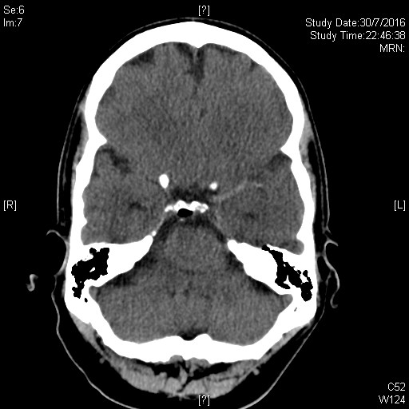
Q1.1 What is the significant finding?

Slide 4
Case 1 Cont’d
The finding was not recognized.
He was admitted for observation with a provisional diagnosis of first seizure for investigation.
His GCS did not improve.
CT scan was repeated and an angiogram followed.

Slide 5
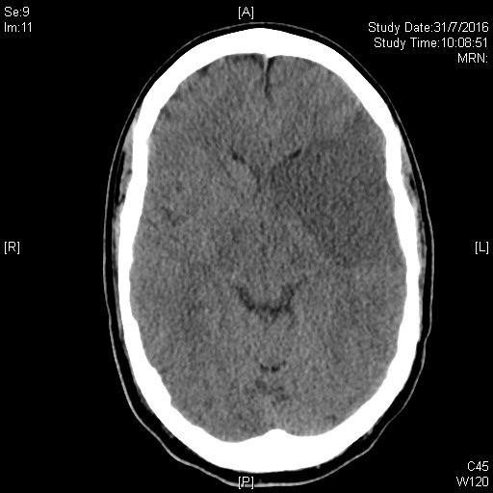
Q1.2 What is the finding?

Slide 6
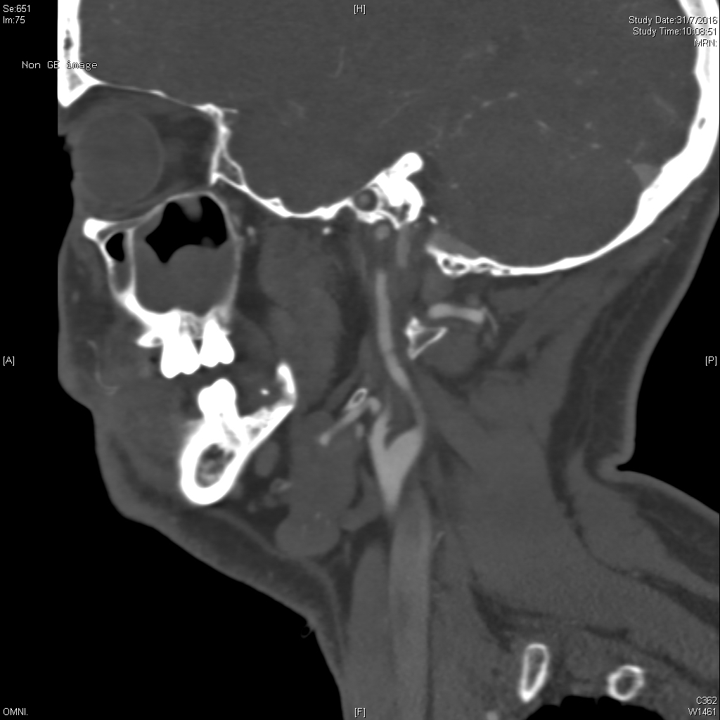
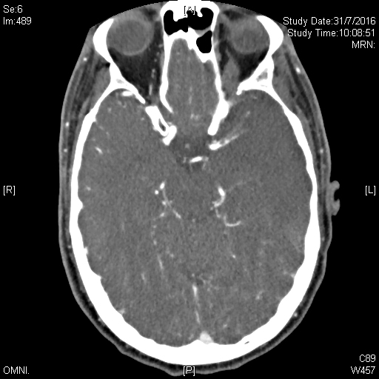
Q1.3 What are the angiogram findings and final diagnosis?

Slide 7
Case 2
70 year old man
Hx of recent cardiac catheterization
Bilateral feet pain with palpable pulses

Slide 8
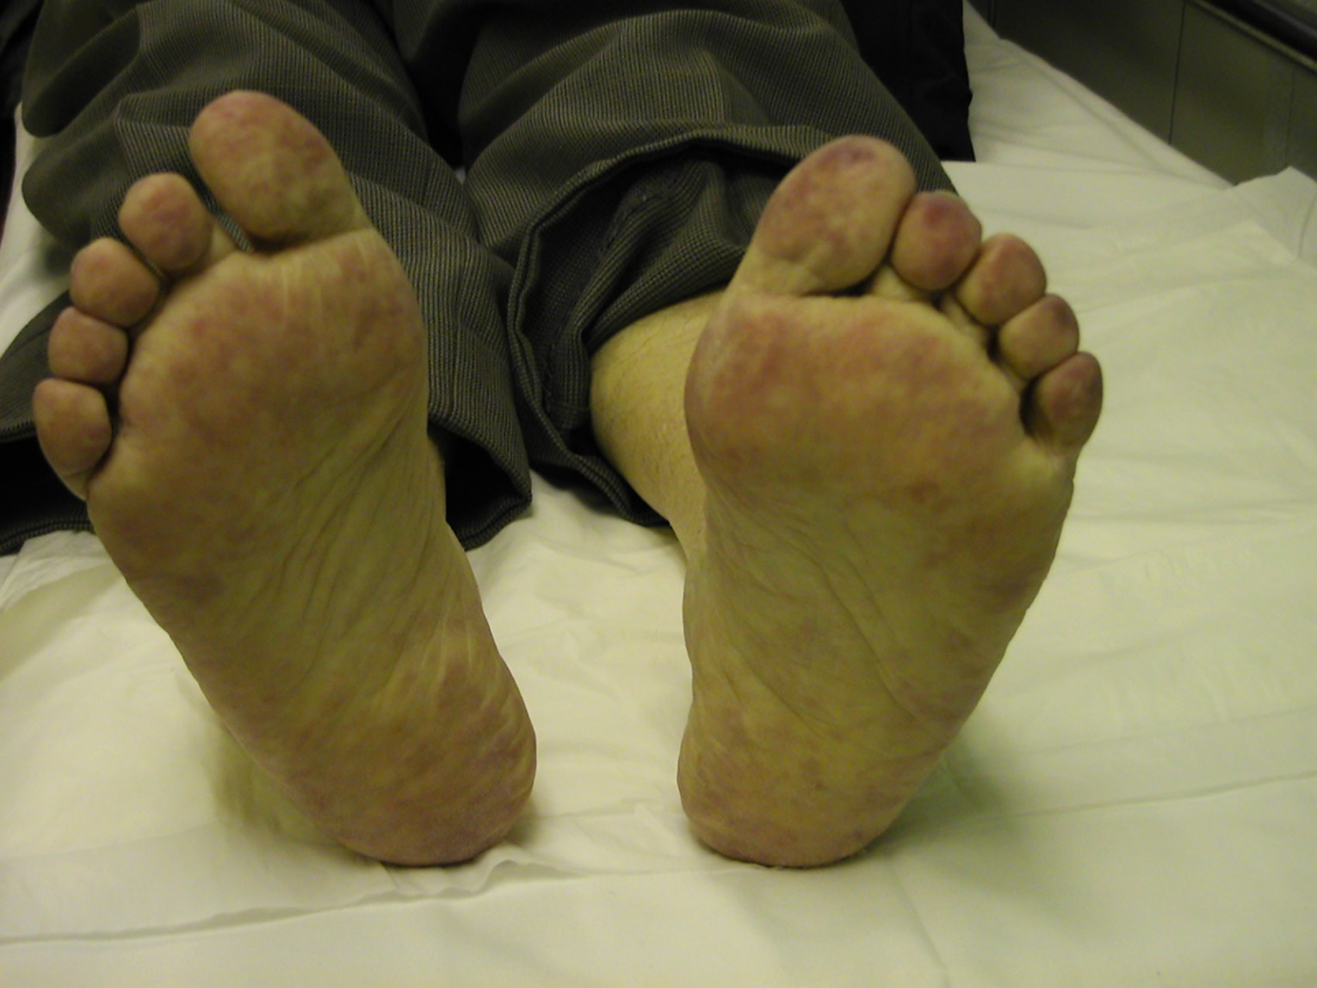
Q2.1 Describe the findings and your diagnosis

Slide 9
Case 3
50 year old woman
Hx of recent gastric operation
Vomiting, weakness and drowsiness with respiratory depression and dehydration

Slide 10
Q3.1 Explain the i-stat findings (in room air)
RG 7 mmol/l
Na 132 mmol/l
K 3.5 mmol/l
Ionic Ca 1.10 mmol/
pH 7.60
pCO2 8.5 kPa
pO2 7.5 kPa
HCO3 55 mmol/l
BE 35

Slide 11
Q3.2
What treatment can be commenced in the ED and explain the rationale?

Slide 12
Case 4
Newly diagnosed DM
RG 27 mmol/l
HbA1c 4%

Slide 13
Q4.1
What does the HbA1c level demonstrate and reasons?

Slide 14
Case 5
M 29. Business man from Guangdong.
Presented with fever for 20 days. Persistent despite Augmentin. No insect or animal bite. PE well except low grade fever. CXR clear.
Admitted to EM ward for fever for investigation.

Slide 15
Q5.1
What are your differential diagnoses? Explain your reasoning.

Slide 16
Q5.2
In the EM ward, what specific histories would you elicit from this patient to guide your diagnosis?

Slide 17
Case 5 Cont’d
His CBP returned as below:
WCC = 8.44
Hb = 15.1
Plt = 167
Neutrophil = 3.57
Lymphocyte = 4.33 (53%)
Monocyte = 0.51
Eosinophil = 0.01
Basophil = 0.02
No abnormal cells / lymphocytes
ESR = 25

Slide 18
Q5. 3
What is your observation and ddx?

Slide 19
Case 5 Cont’d
Further hx:
He ate goat placenta several times a year as a kind of health supplement.
Q5.4
What is the likely infective cause of his fever for 20 days?

