Slide 1
JCM 4/9/2019
A&E, HKUSZH

Slide 2
Case 1
A 39-year-old man, who was a tourist from Australia, presented to the emergency department (ED) with generalized convulsion. He had no history of medical significance or trauma to head or neck. At the ED, the convulsion had resolved.
GCS was 10.
A plain CT scan of the brain was done.

Slide 3
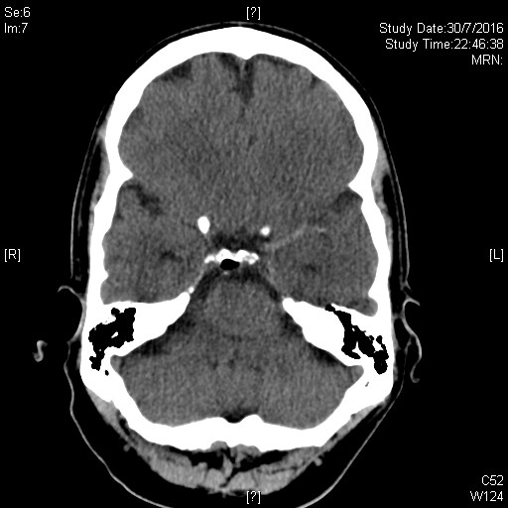
Q1.1 What is the significant finding?

Slide 4
A1.1 Hyperdense left middle cerebral artery

Slide 5
Case 1 Cont’d
The finding was not recognized.
He was admitted for observation with a provisional diagnosis of first seizure for investigation.
His GCS did not improve.
CT scan was repeated and an angiogram followed.

Slide 6
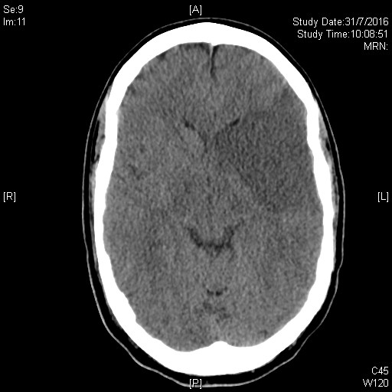
Q1.2 What is the finding?

Slide 7
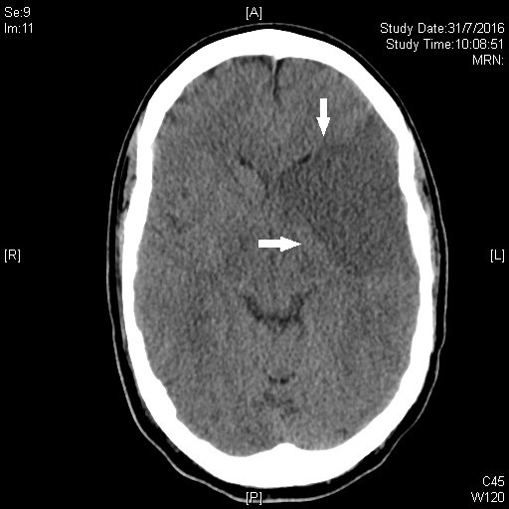
A1.2 Massive infarct at the left MCA territory

Slide 8
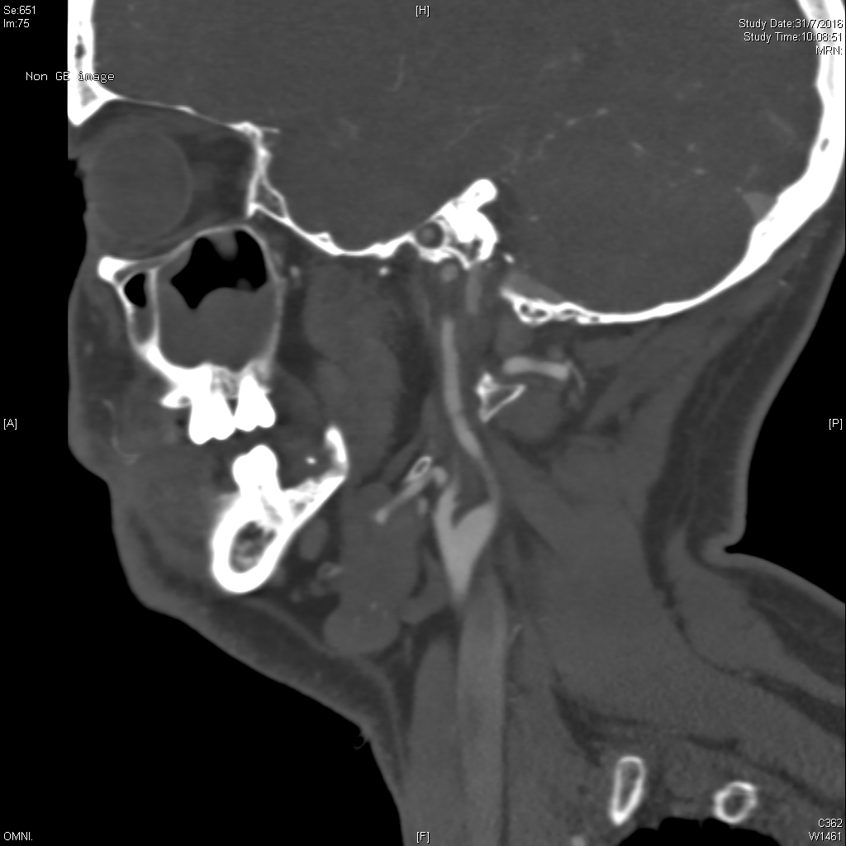
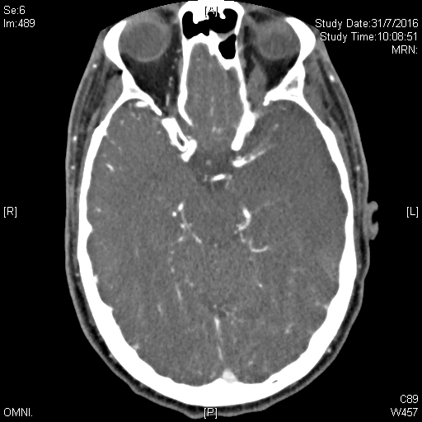
Q1.3 What are the angiogram findings and final diagnosis?

Slide 9
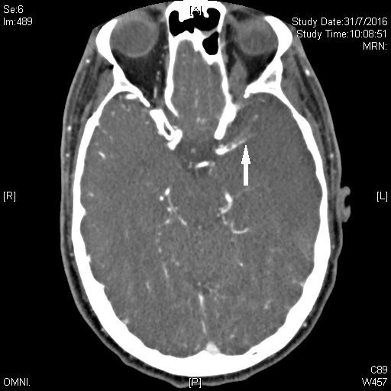
A1.3 Attenuation and heterogeneous opacification of the left internal carotid artery suspicious of dissection and near-complete thrombosis at M1 to M2 branch of the left MCA.

Slide 10
A1.3 Dissection of L internal carotid artery (spontaneous)
Prophylactic decompressive craniectomy and external ventricular drainage was performed. His family requested his transfer back to his home country for further treatment.

Slide 11
Internal carotid artery dissection
Carotid artery dissection is a condition whereby the layers of the carotid artery are spontaneously separated. This potentially compromises blood flow to certain areas of the brain and can lead to a stroke.
The most common cause of strokes in younger patients
It occurs spontaneously when a tear occurs in the intimal layer of the carotid artery creating an intramural hematoma. This tear can be spontaneous or caused by trauma, either blunt or penetrating trauma.
Blunt trauma can be significant (e.g., motor vehicle collision), or it can seem minimal (e.g., chiropractic manipulation being the most classic example)
"Idiopathic" is the most common cause of spontaneous carotid dissections in which a family history of dissection significantly increases one's risk. Marfan syndrome, Ehlers-Danlos Syndrome, fibromuscular dysplasia and other connective tissue disorders also increase the risk of this disease.
An elongated styloid process, which is called Eagle Syndrome, can also cause a spontaneous internal carotid artery dissection.
Presentation variable. Classic: ipsilateral pain on face, eye or neck. Horner Sx if the hematoma compresses the adjacent sympathetic nerve fibres. The dx should be considered in young strokes.

Slide 12
Case 2
70 year old man
Hx of recent cardiac catheterization
Bilateral feet pain with palpable pulses

Slide 13
Q2.1 Describe the findings and your diagnosis

Slide 14
A2.1
Purplish patchy mottling of both feet i.e. livedo reticularis
Diagnosis: Cholesterol embolization syndrome

Slide 15
Cholesterol embolization syndrome
The triad of foot pain, livedo reticularis and palpable peripheral pulses after vascular procedures is considered pathognomonic.
Due to disruption of vascular plague with release of subendothelial cholesterol crystals into the blood stream causing widespread small vessel occlusion.
Can affect multiple organs
Treatment is supportive.
Prognosis depends on extent of the systemic disease. Usually poor with high mortality (70-80%)

Slide 16
Case 3
50 year old woman
Hx of recent gastric operation
Vomiting, weakness and drowsiness with respiratory depression and dehydration

Slide 17
Q3.1 Explain the i-stat findings (in room air)
RG 7 mmol/l
Na 132 mmol/l
K 3.5 mmol/l
Ionic Ca 1.10 mmol/
pH 7.60
pCO2 8.5 kPa
pO2 7.5 kPa
HCO3 55 mmol/l
BE 35

Slide 18
A3.1
Metabolic alkalosis as a result of loss of HCl from vomiting.
Compensation of metabolic alkalosis by hypoventilation and CO2 retention.
Hypoventilation also leads to hypoxemia.
Both CO2 retention and hypoxemia cause drowsiness.
The relatively low Na and K contribute to weakness.

Slide 19
Q3.2
What treatment can be commenced in the ED and explain the rationale?

Slide 20
A3.2
ABC (careful administration of oxygen)
IV 0.9% NaCl
Loss of HCl
For every H+ secreted into the gut, a HCO3 ion is released into serum.
KCl is also lost into the gut.
Dehydration and hypokalemia leads to increased renal Na reabsorption. However there is no Cl to accompany the Na. To maintain electrochemical neutrality, H+ and K+ are lost fr kidneys. This maintains the alkalosis.
Saline provides rehydration and Cl, thus enable the kidneys conserve H+ and improve the alkalosis.

Slide 21
Case 4
Newly diagnosed DM
RG 27 mmol/l
HbA1c 4%

Slide 22
Q4.1
What does the HbA1c level demonstrate and reasons?

Slide 23
A4.1
Inappropriately low HbA1c level in a hyperglycemic patient.
Causes:
Lab error
Hemolytic anemia
Chronic blood loss
Chronic renal failure
Hemoglobin variant e.g. Hb S, C, J

Slide 24
Case 5
M 29. Business man from Guangdong.
Presented with fever for 20 days. Persistent despite Augmentin. No insect or animal bite. PE well except low grade fever. CXR clear.
Admitted to EM ward for fever for investigation.

Slide 25
Q5.1
What are your differential diagnoses? Explain your reasoning.

Slide 26
A5.1
The patient has fever for 20 days already. What are the key ddx?
It is not an acute self limiting febrile illness which is usually acute viral infection; It is not a fulminant/rapidly fatal acute sepsis; there are no localizing signs suggesting a focus of local infection; It does not fit into typical pattern of illness especially in defined group of hosts: hospital acquired fever, immunodeficient host fever; HIV related fever;
It nearly fits the dx of FUO.
Therefore, the ddx are Infection; Neoplasm; Autoimmune or collagen-vascular disorders; Miscellaneous

Slide 27
Q5.2
In the EM ward, what specific histories would you elicit from this patient to guide your diagnosis?

Slide 28
A5.2
Comprehensive Hx taking (serial focused Hx): forgotten events need specific prodding;
Always list travel itinerary, food/drink habits, hobbies, occupation, animal exposure, drugs & vaccines.
Past history & family history: often give clues for difficult cases
Past surgical operations & artificial implant
No symptom is irrelevant; atypical manifestation is common

Slide 29
Case 5 Cont’d
His CBP returned as below:
WCC = 8.44
Hb = 15.1
Plt = 167
Neutrophil = 3.57
Lymphocyte = 4.33 (53%)
Monocyte = 0.51
Eosinophil = 0.01
Basophil = 0.02
No abnormal cells / lymphocytes
ESR = 25

Slide 30
Q5. 3
What is your observation and ddx?

Slide 31
A5.3
This patient is unusual because most patients with any form of severe stress such as fever will have lymphopenia; Instead he has lymphocytosis which can be Clonal: malignant or premalignant but no abnormal lymphocytes are seen on blood smear. Thus it is more likely to be reactive lymphocytosis;
And the causes include
1. Viruses esp. infectious mononucleosis-like : primary EBV, CMV, HIV, HHV6, VZV, HTLV1; enterovirus, toxoplasmosis, adenovirus, mumps, hepatitis, rubella, measles, influenza;
2. Pertussis;
3. Cat scratch disease: Bartonella henselae;
4. Chronic rickettsial or Coxiella infection, brucellosis, syphilis;
5. Mycobacteriosis especially tuberculosis;
6. Toxoplasmosis, babesiosis;
7. Hypersensitivity (drug reaction); Persistent polyclonal B cell lymphocytosis;
8. Postsplenectomy lymphocytosis

Slide 32
Case 5 Cont’d
Further hx:
He ate goat placenta several times a year as a kind of health supplement.
Q5.4
What is the likely infective cause of his fever for 20 days?

Slide 33
A5.4
Brucellosis
Brucella melitensis, abortus and suis are the major human pathogens. Though the first two species contribute to the bulk of human disease, B. melitensis is the most important epidemic strain in China.
The bacteria can enter the host via inhalation, ingestion or direct contact after host exposure to infected animals or their products e.g. milk or internal organs like the placenta.
Though brucellosis is a zoonotic disease, infected patients may present to emergency departments in urban setting. Uncommon dietary habits due to cultural difference should be enquired in patents presented with non-specific symptoms like prolonged fever.

