Slide 1
JCM Nov 2019
Union Hospital

Slide 2
Case 1-My eye
A middle aged lady attended to us for foreign body sensation in eye
No pain, tearing, redness, blurring of vision
Examination:
PERL, VA normal, stain negative

Slide 3
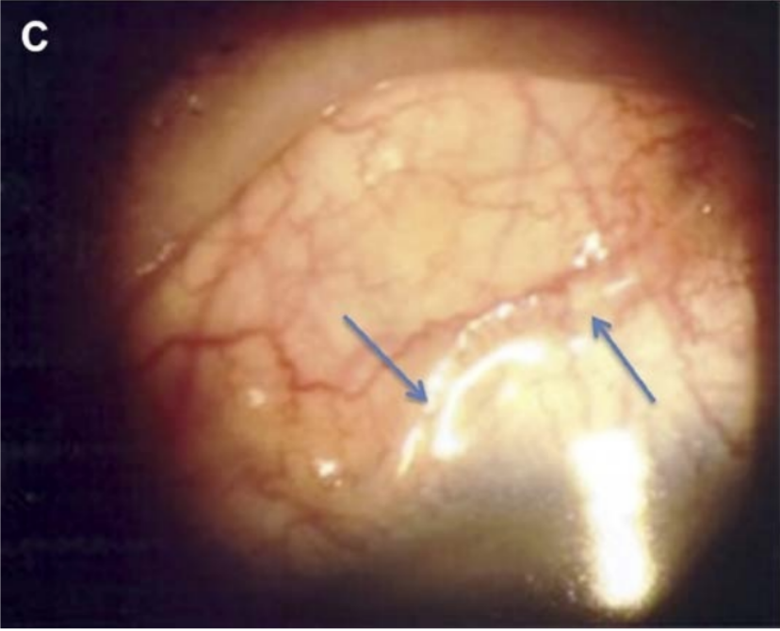
Human Ocular Dirofilariasis in Hong Kong
(Optom Vis Sci 2016;93:545Y548)

Slide 4
What is the diagnosis? (1 mark)

Slide 5
What other history will you like to ask? (2 marks)

Slide 6
How is it transmitted? (2 marks)

Slide 7
Can you name other site on involvement of the disease? (2 marks)

Slide 8
What are the management for this patient? (2 marks)

Slide 9
Case 2-my mouth
M/44
Good past health
Recent dental extraction
Right gum swelling and pain
Fever
Seen us 2 days ago

Slide 10
Examinations
Right angle of jaw swelling, erythema and tenderness
BP 143/80
P 81
Temp 36.1

Slide 11
What is the most likely diagnosis?
How will you dispose of the patient?

Slide 12
CT scan was performed
What are the findings? (1 mark), what is the diagnosis? (1 mark)

Slide 13
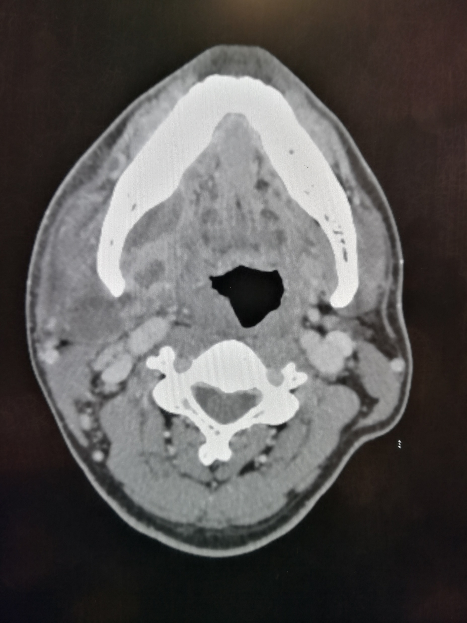

Slide 14
What are the common sites of infective neck abscess formation? (4 marks)

Slide 15
Case 3-A middle age man with abdomen and back pain
M/50, good past health
Sudden onset of lower abdominal pain radiate to back
Nausea
No diarrhea/vomiting/urinary symptoms
BP 176/99
Lower abdominal tenderness +ve
No loin tenderness
Urine mutlistix: RBC ++, WBC -ve

Slide 16
Admitted with CT done, what are the findings? (3 marks)

Slide 17
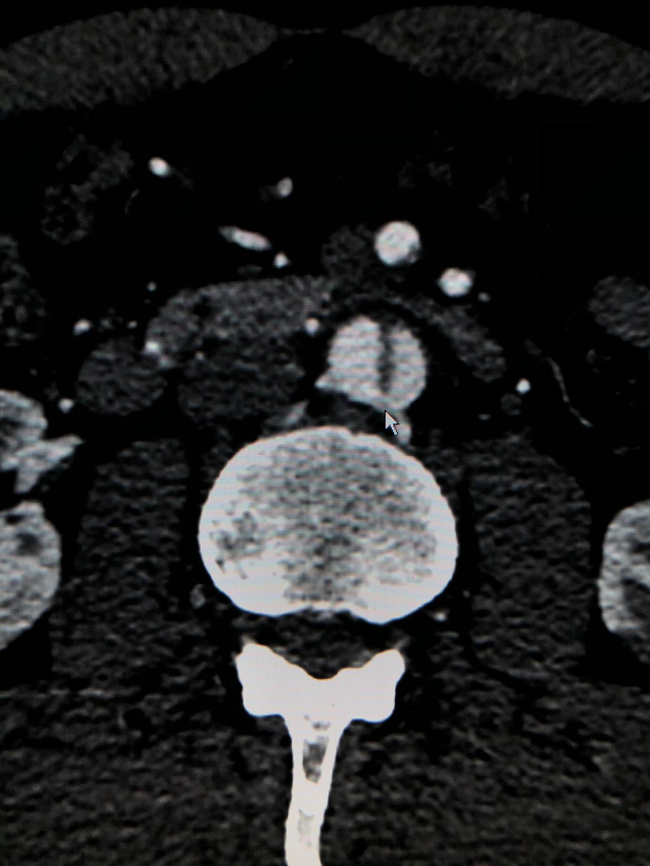
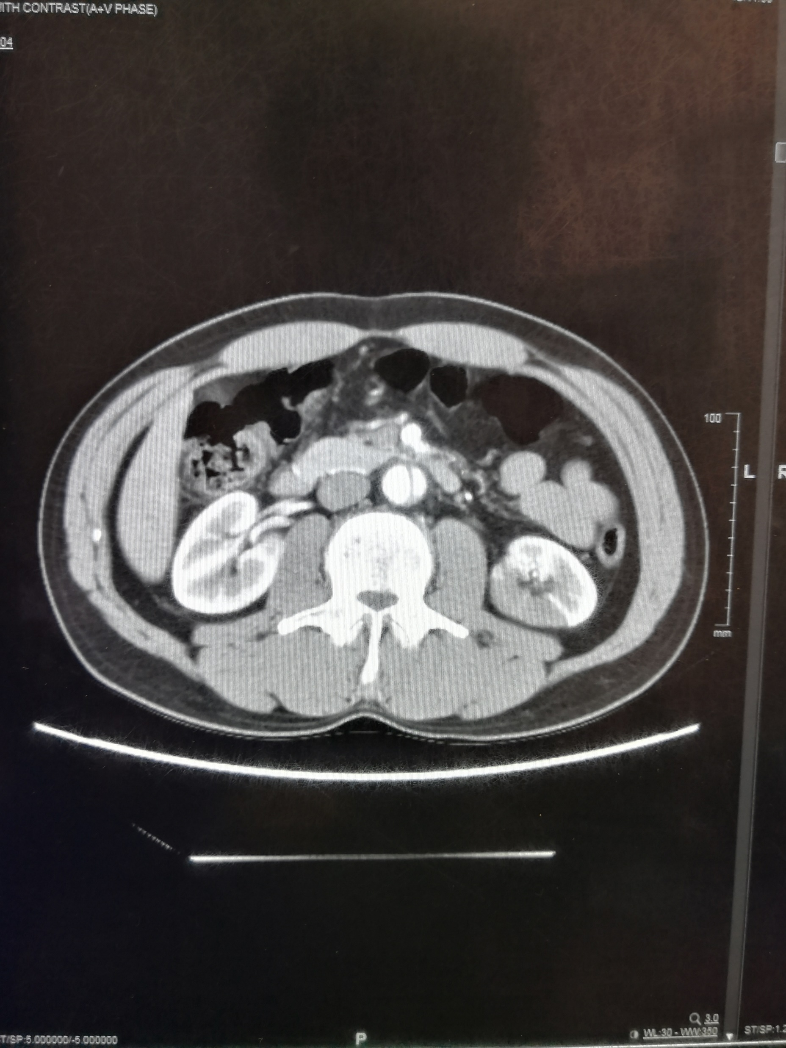

Slide 18
CT thorax was added also, shown no abnormality

Slide 19
On the way back from CT suite to ward, he developed sudden onset of headache and confusion.
Back to CT suite for CT angiogram

Slide 20
What are the findings? (1 mark)

Slide 21
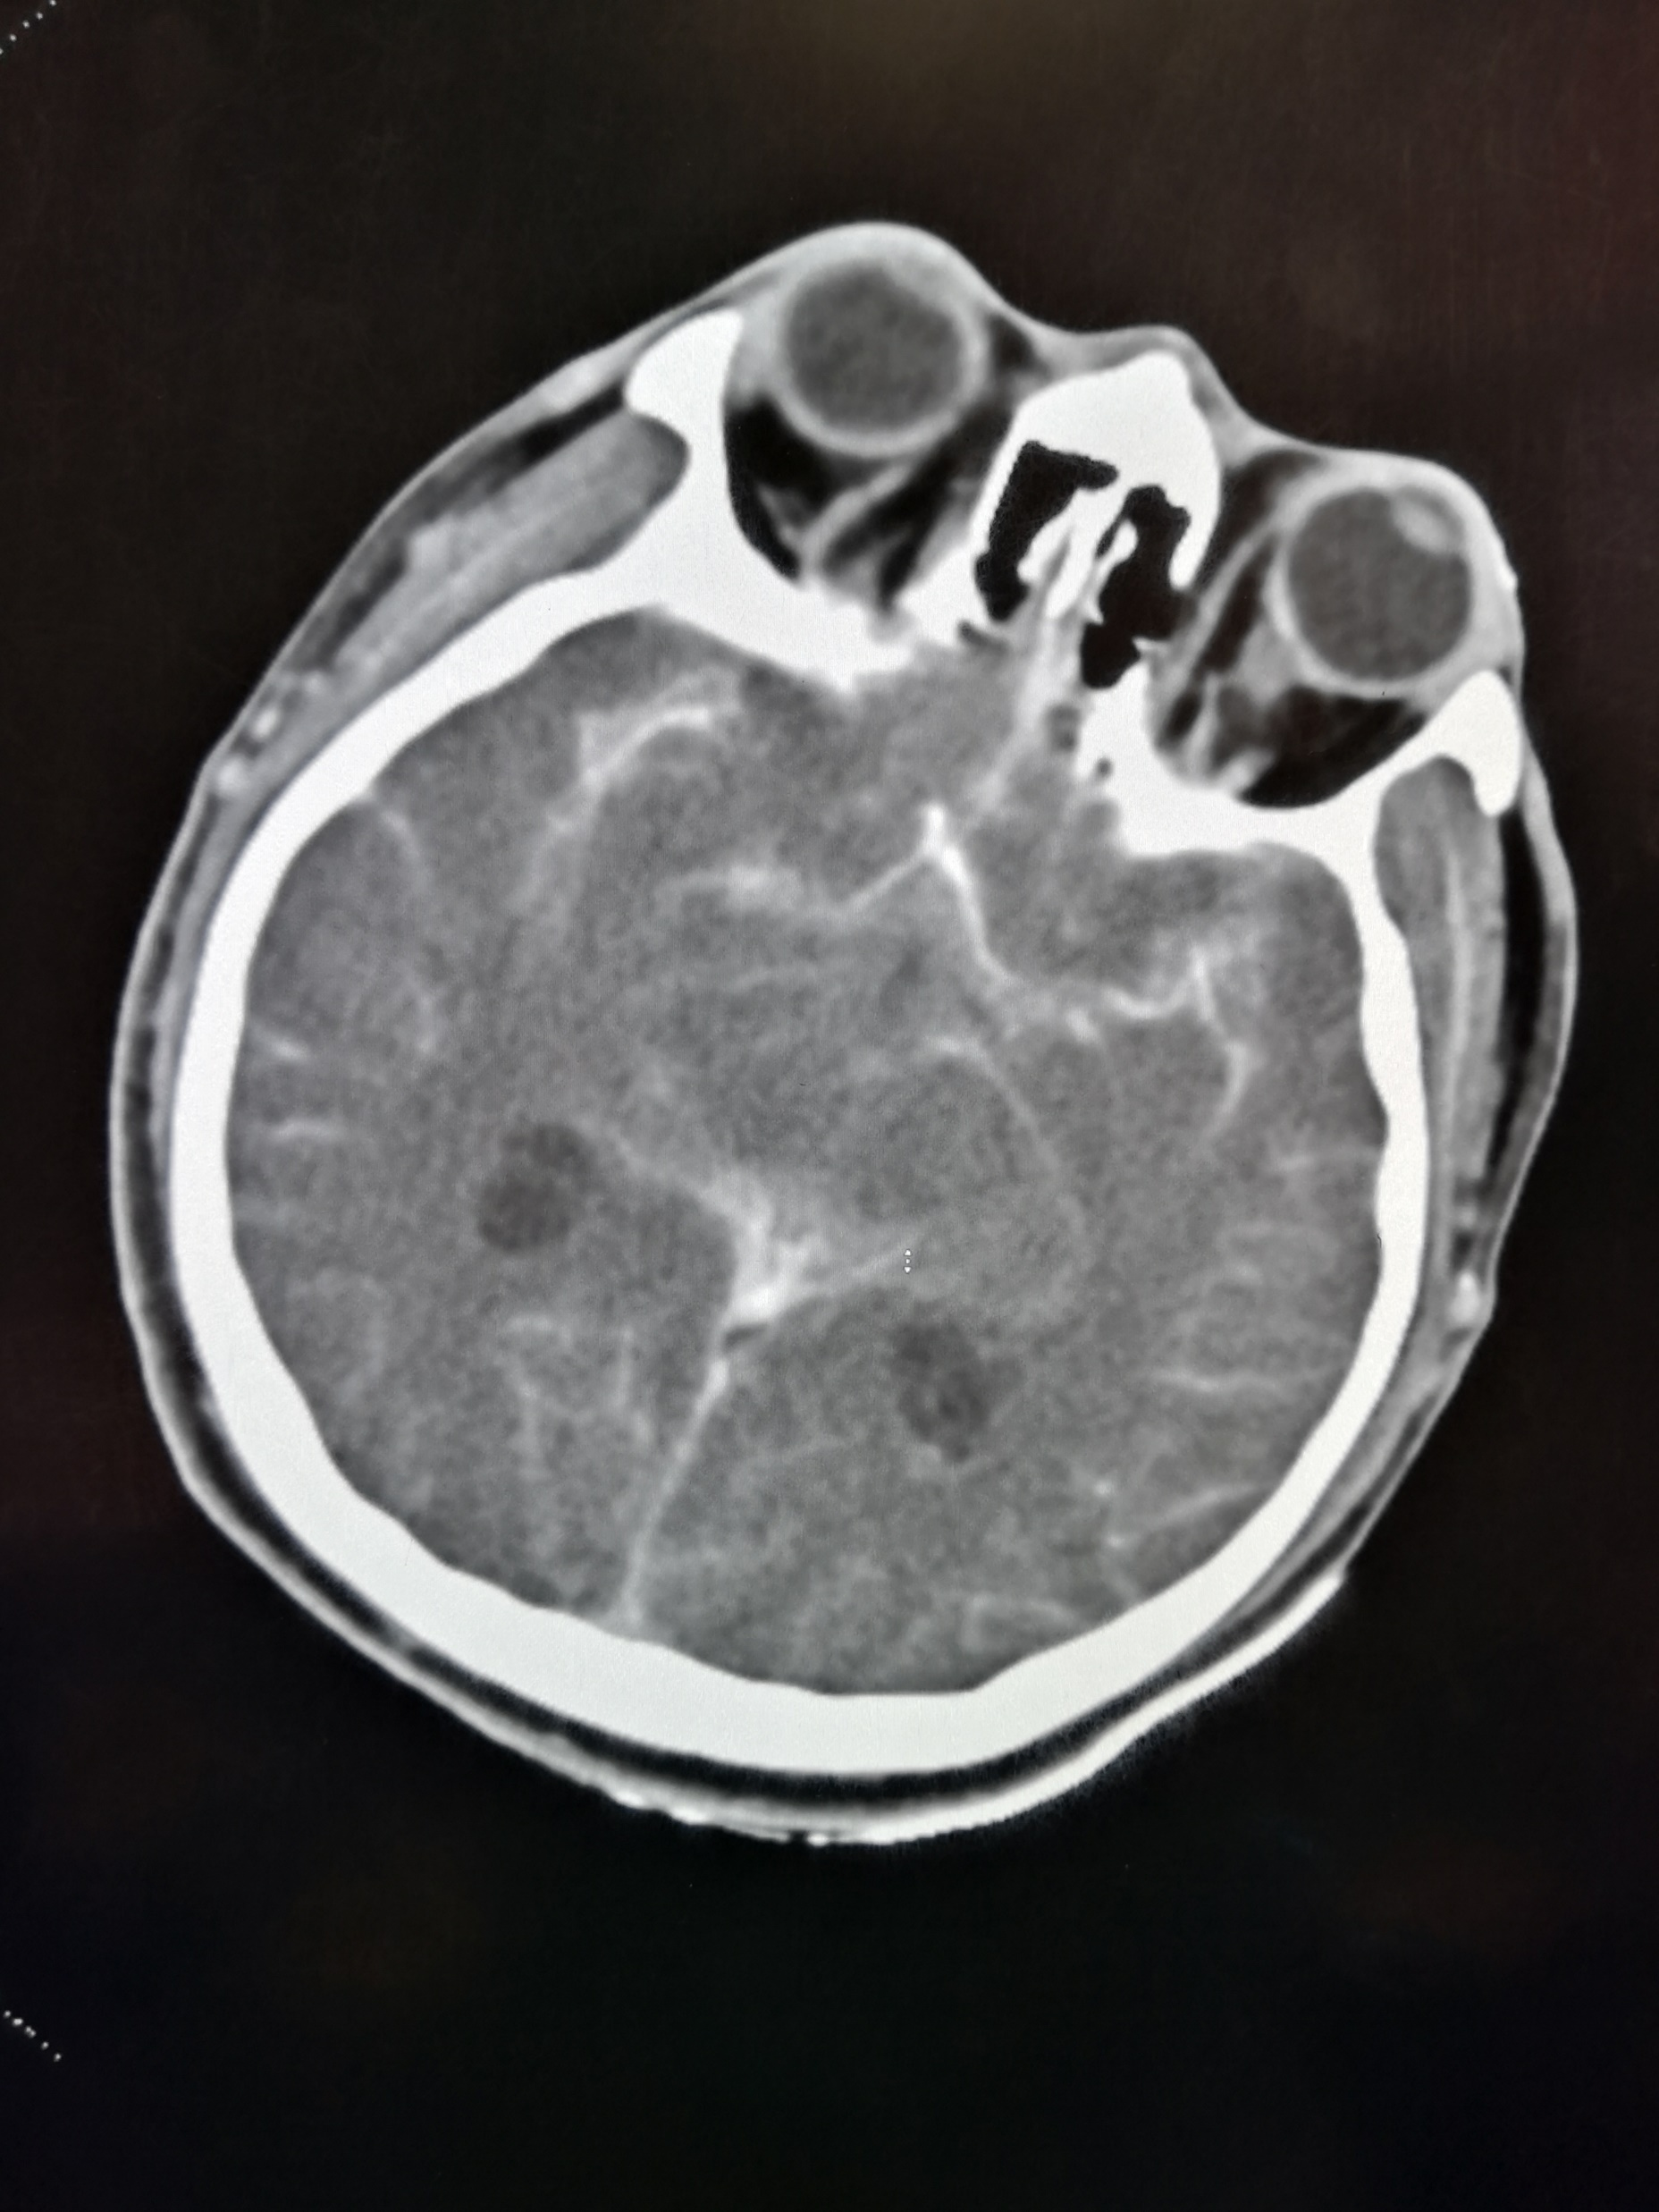

Slide 22
MRA was performed 1 year before as body check, which is entirely normal

Slide 23
Can you suggest one possible causes of the CT findings? (1 mark)

Slide 24
Case 4-Another X ray again
F/52
Good past health
Cough, sputum and fever for 13 days
Seen GP and given augmentin and azithromycin
CXR taken by GP shown left lobar pneumonia

Slide 25
What is your disposal to this patient? (1mark)

Slide 26
CXR shown left lingular lobe pneumonia with cavitation
Sputum shown Pseudomonas Aeruginosa
She was put on IV antibiotics

Slide 27
All went well, but she complained of left sided chest pain about 1 week into admission.
What will you order? (1 mark)

Slide 28
Can you describe the findings? (4 marks)

Slide 29
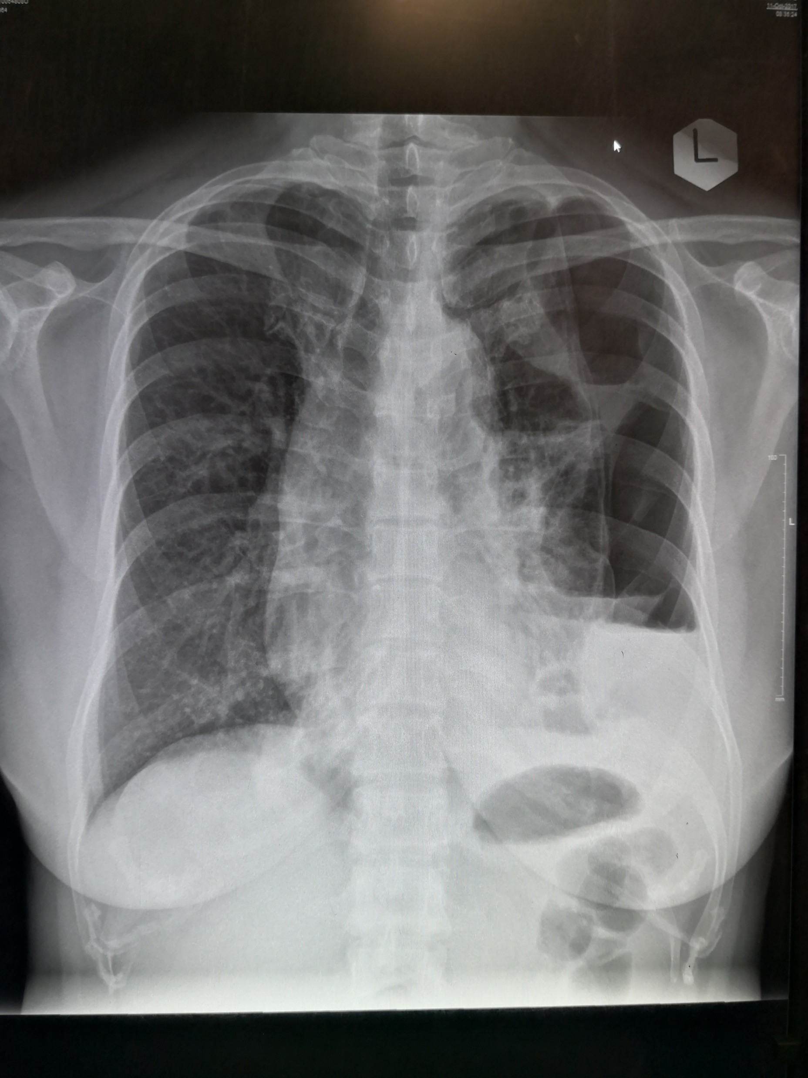

Slide 30
What is your next action? (1 mark)

Slide 31
What are the common organisms causing secondary spontaneous pneumothorax? (2 marks)

Slide 32
The end
Thank you

