Slide 1
JCM Nov 2019
Union Hospital

Slide 2
Case 1-My eye
A middle aged lady attended to us for foreign body sensation in eye
No pain, tearing, redness, blurring of vision
Examination:
PERL, VA normal, stain negative

Slide 3
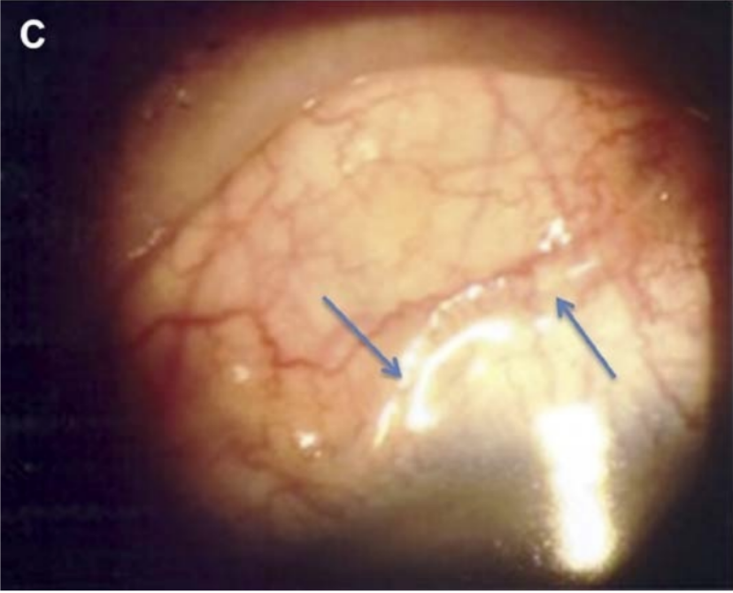
Human Ocular Dirofilariasis in Hong Kong
(Optom Vis Sci 2016;93:545Y548)

Slide 4
What is the diagnosis? (1 mark)

Slide 5
Subconjunctival worm (Human dirofilariasis)

Slide 6
What other history will you like to ask? (2 marks)

Slide 7
Any contact with wild animals, such as dogs, racoon (1 mark)
Any mosquito bites (1 mark)

Slide 8
How is it transmitted? (2 marks)

Slide 9
Dirofilariasis is a vector-borne disease transmitted by mosquitoes (1 mark)
Dog is a common hosts
  One of the species of Dirofilaria, Dirofilaria hongkonggenesis, was found in 3% of stray dog in Hong Kong (To KK, Wong SS, Poon RW, Trendell-Smith NJ, Ngan AH, Lam JW, Tang TH, AhChong AK, Kan JC, Chan KH, Yuen KY. A novel Dirofilaria species causing human and canine infections in Hong Kong. J Clin Microbiol 2012;50:3534Y41)

Slide 10
Can you name other site on involvement of the disease? (2 marks)

Slide 11
Subcutaneous tissues such as breast, buccal mucosa. (D. repens, D. hongkongenesis) (1 mark)
Pulmonary tissues (D. immitis) (1 mark)

Slide 12
What are the management for this patient? (2 marks)

Slide 13
Inform ophthalmologists. Surgical removal under LA
Routine antibiotics not indicated.
Doxycycline and ivermectin if evidence of other sites of infection

Slide 14
Case 2-my mouth
M/44
Good past health
Recent dental extraction
Right gum swelling and pain
Fever
Seen us 2 days ago

Slide 15
Examinations
Right angle of jaw swelling, erythema and tenderness
BP 143/80
P 81
Temp 36.1

Slide 16
What is the most likely diagnosis?
How will you dispose of the patient?

Slide 17
Admitted to ENT surgeon

Slide 18
CT scan was performed
What are the findings? (1 mark), what is the diagnosis? (1 mark)

Slide 19
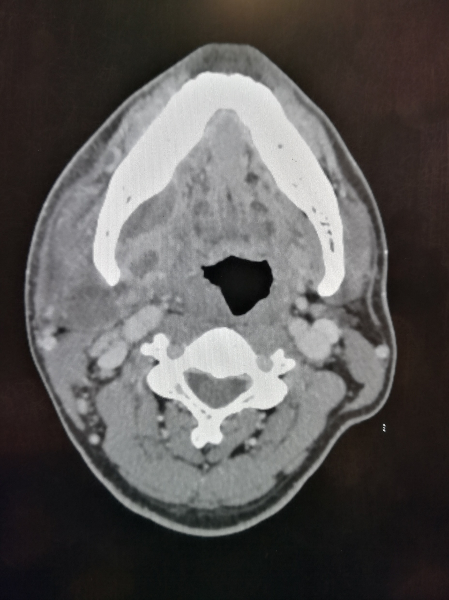

Slide 20
Irregular hypodense hypoenchancing (30.7mm x 12.6mm x 25.8mm) in regions medial to the right side of mandible (1 mark)
Another one in the right parapharyngeal space, extends down to the submandibular space, lateral to the right submandibular gland and anterior to the sternocleidomastoid muscle (42.9mm 18.6mm X 23.2mm) (1 mark)
Features are suggestive of abscess formation (1 mark)

Slide 21
What are the common sites of infective neck abscess formation? (4 marks)

Slide 22
Any 4 (1 marks each)
Gum areas
Floor of mouth
Salivary glands
Tonsils
Retropharyngeal spaces
epiglottis

Slide 23
Case 3-A middle age man with abdomen and back pain
M/50, good past health
Sudden onset of lower abdominal pain radiate to back
Nausea
No diarrhea/vomiting/urinary symptoms
BP 176/99
Lower abdominal tenderness +ve
No loin tenderness
Urine mutlistix: RBC ++, WBC -ve

Slide 24
Admitted with CT done, what are the findings? (3 marks)

Slide 25
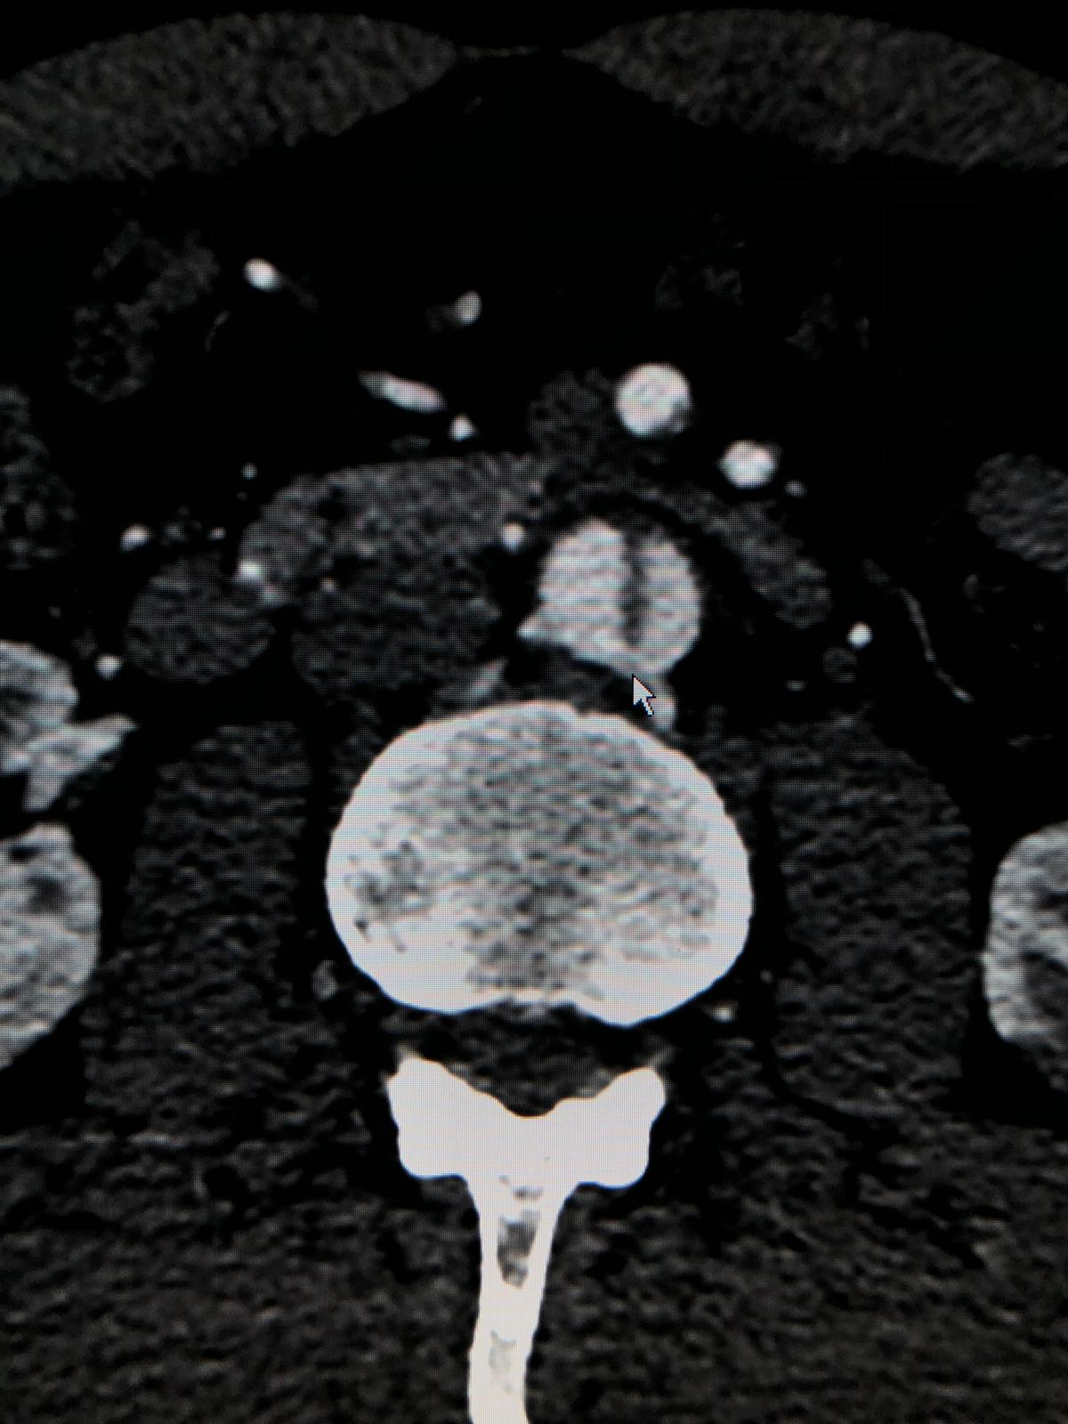
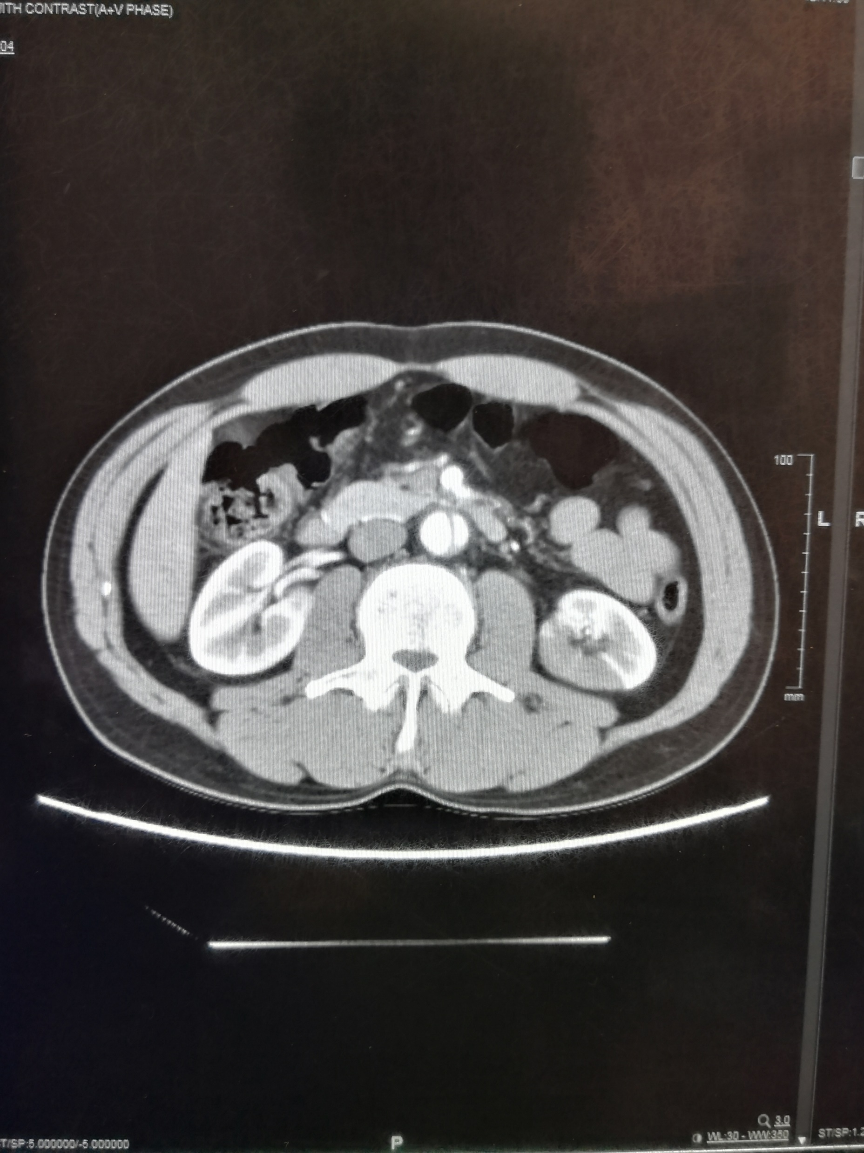

Slide 26
Extensive aortic dissection involving the abdominal aorta (and the iliac artery. Started from superior mesenteric artery and extends to bilateral iliac arteries)
Focal perforation of the dissection flap near the upper end of dissection
Multiple patchy hypoenchancement in the left kidney, compatible with left renal infarcts
(1 mark each)

Slide 27
CT thorax was added also, shown no abnormality

Slide 28
On the way back from CT suite to ward, he developed sudden onset of headache and confusion.
Back to CT suite for CT angiogram

Slide 29
What are the findings? (1 mark)

Slide 30
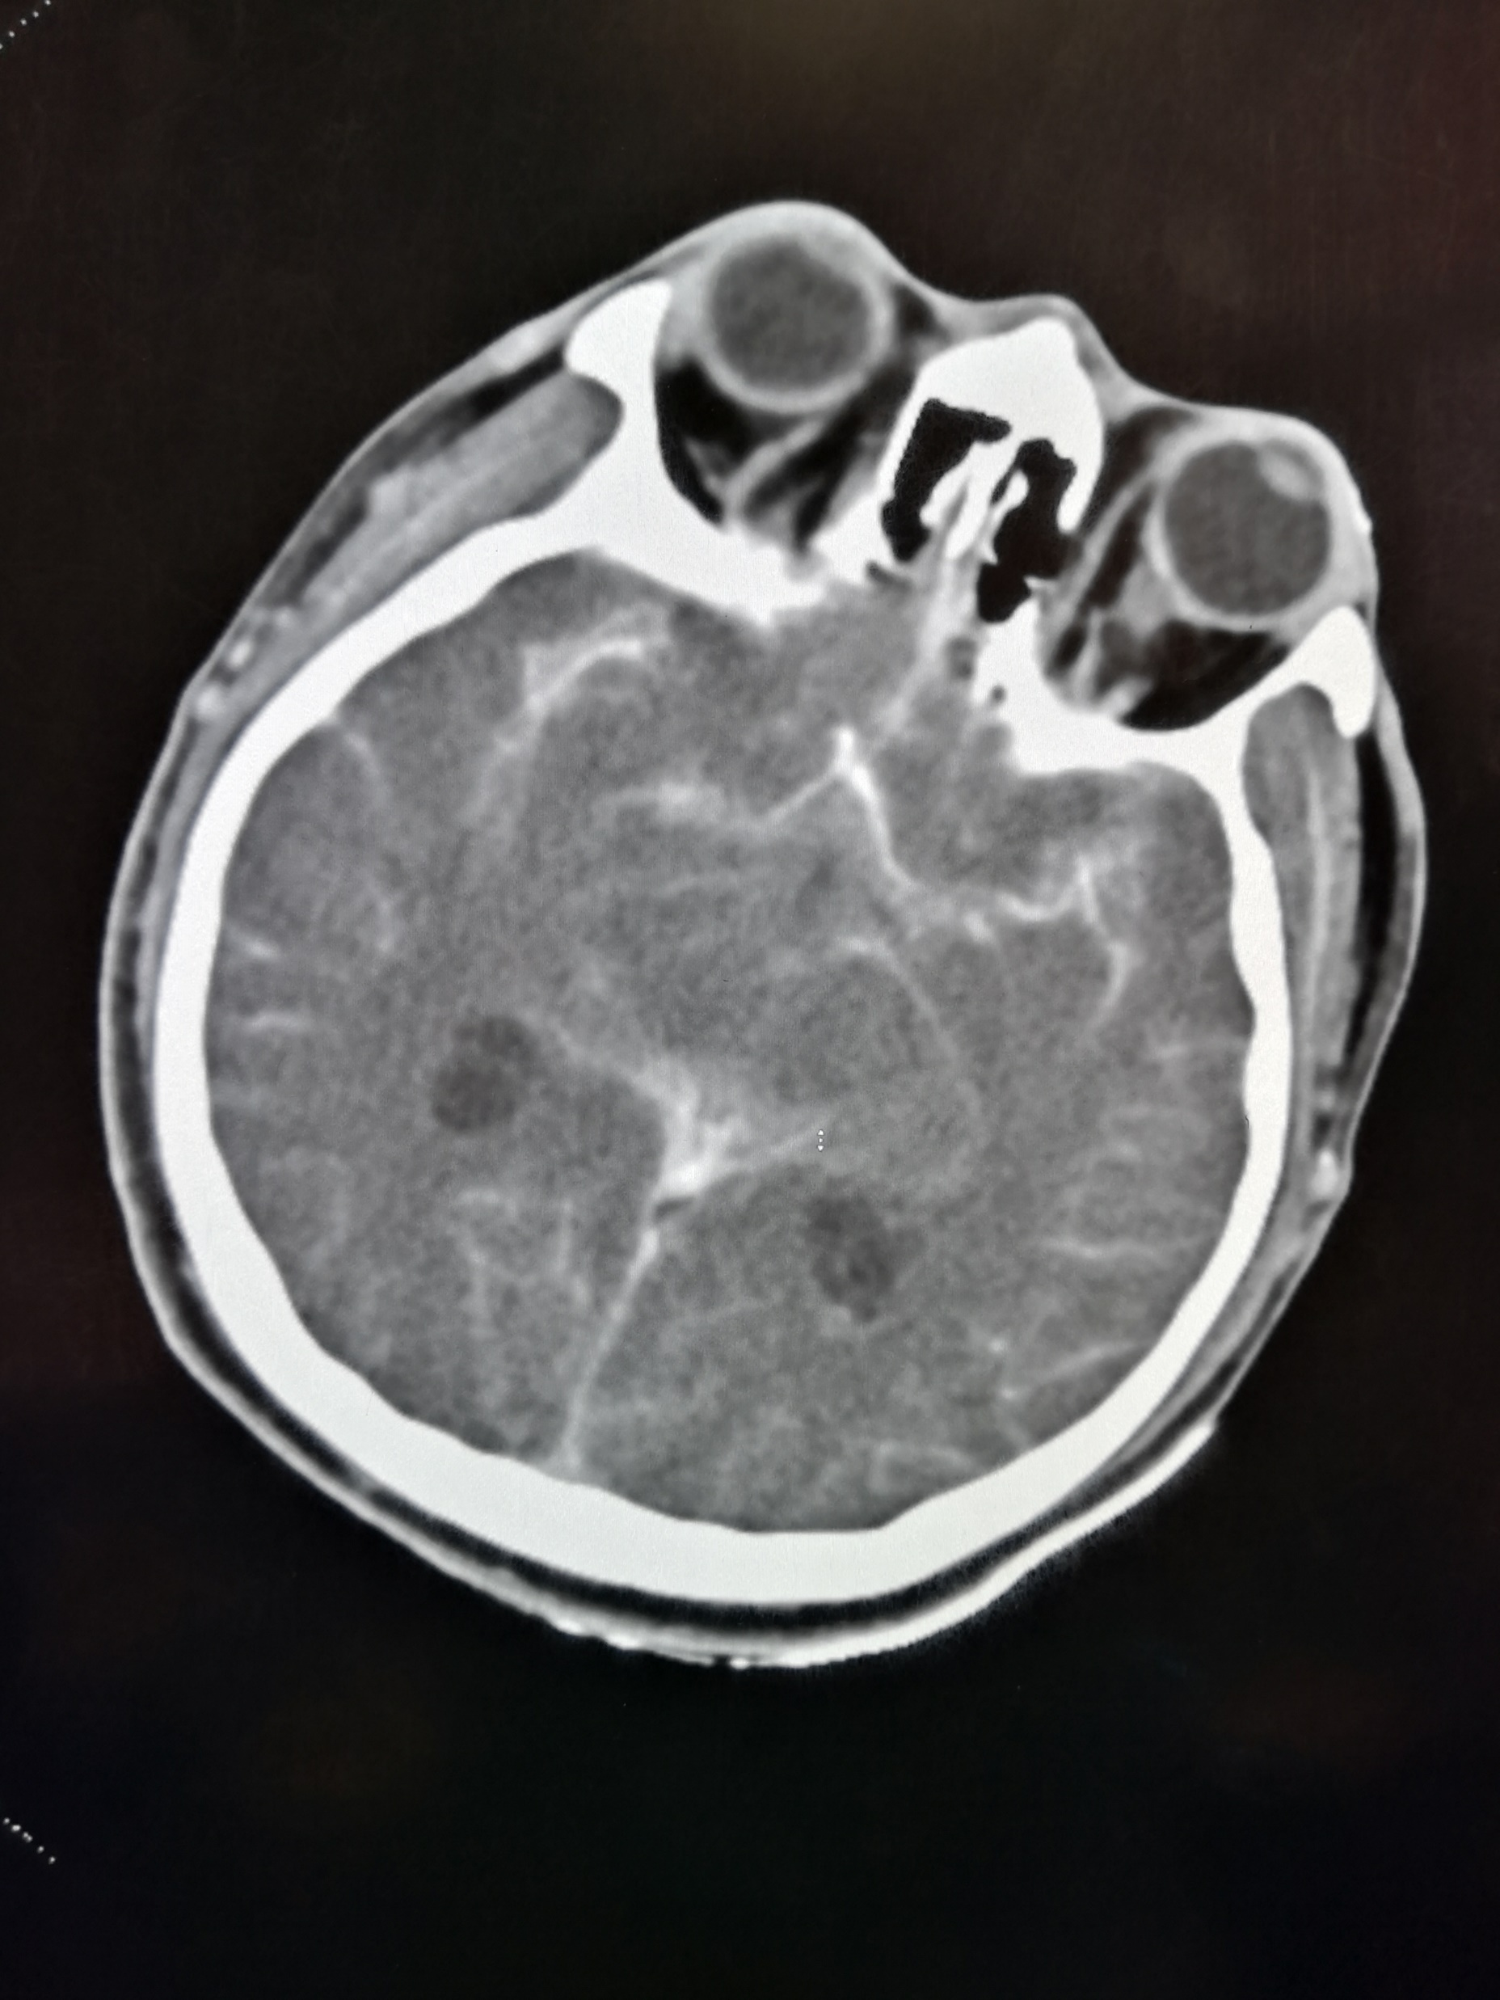

Slide 31
Subarachnoid haemorrhage involving both cerebral and cerebellar suluci (1 mark)

Slide 32
MRA was performed 1 year before as body check, which is entirely normal

Slide 33
Can you suggest one possible causes of the CT findings? (1 mark)

Slide 34
Extensive dissection to the vertebral artery (1 mark)

Slide 35
Case 4-Another X ray again
F/52
Good past health
Cough, sputum and fever for 13 days
Seen GP and given augmentin and azithromycin
CXR taken by GP shown left lobar pneumonia

Slide 36
What is your disposal to this patient? (1mark)

Slide 37
Admitted for further management

Slide 38
CXR shown left lingular lobe pneumonia with cavitation
Sputum shown Pseudomonas Aeruginosa
She was put on IV antibiotics

Slide 39
All went well, but she complained of left sided chest pain about 1 week into admission.
What will you order? (1 mark)

Slide 40
CXR (1 mark)

Slide 41
Can you describe the findings? (4 marks)

Slide 42
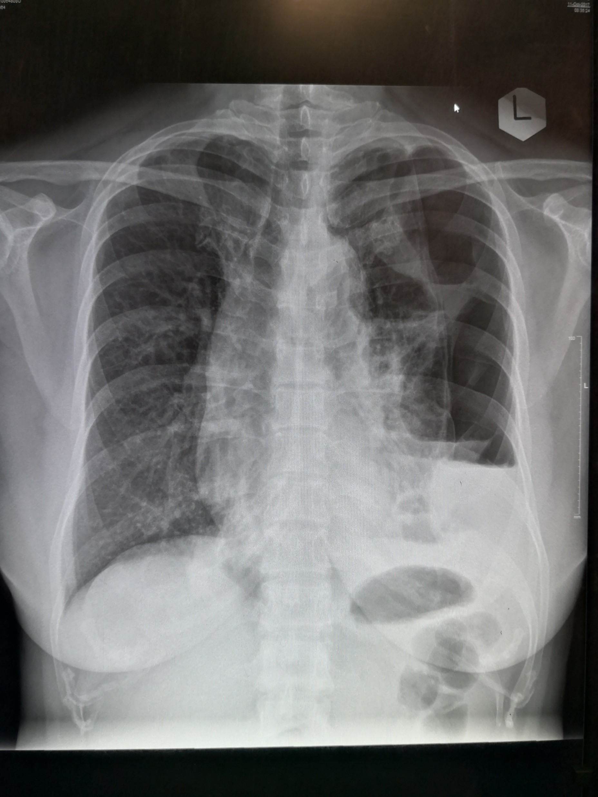

Slide 43
Any 4 (1 mark each)
Left lneumothorax
Cystic cavities in the left lung with air fluid levels
Trachea deviated to right side
Blunted left CP angle
Left hemidiaphragm effaced (silhouettes sign)
Air space opacity in the right lower zone

Slide 44
What is your next action? (1 mark)

Slide 45
Chest drain insertion (1 mark)

Slide 46
What are the common organisms causing secondary spontaneous pneumothorax? (2 marks)

Slide 47
Pneumocystis carinii pneumonia
Tuberculosis
Necrotising pneumonia (S. pneumoniae, S. aureus, MRSA, P. aeruginosa)

Slide 48
The end
Thank you

