Slide 1
JCM
OSCE
UCH 4th March 2020

Slide 2
Case 1
A 15-year-old boy presented to Accident and Emergency Department with on and off headache for 2 months and intermittent nausea.
CT brain has been performed with 2 sections shown.

Slide 3
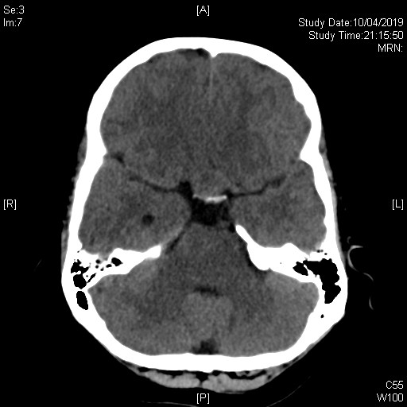

Slide 4
Case 1 - Questions
Describe the abnormality
What is the likely diagnosis?
What visual field problem the patient may experience?
What are the probable hormonal axis problems you need to look for?
What hormonal disease he may suffer after surgical excision of the lesion?
What is the probable diagnosis if the patient experiences polyuria and hypernatremia after surgical intervention?

Slide 5
Case 2
A 20 year-old badminton player presented with low back pain after landing from a jump during a ball game. He was so painful that he could not walk.
There was no bony tenderness and no lower limb neurological deficit.
X-ray LS spine was done.

Slide 6
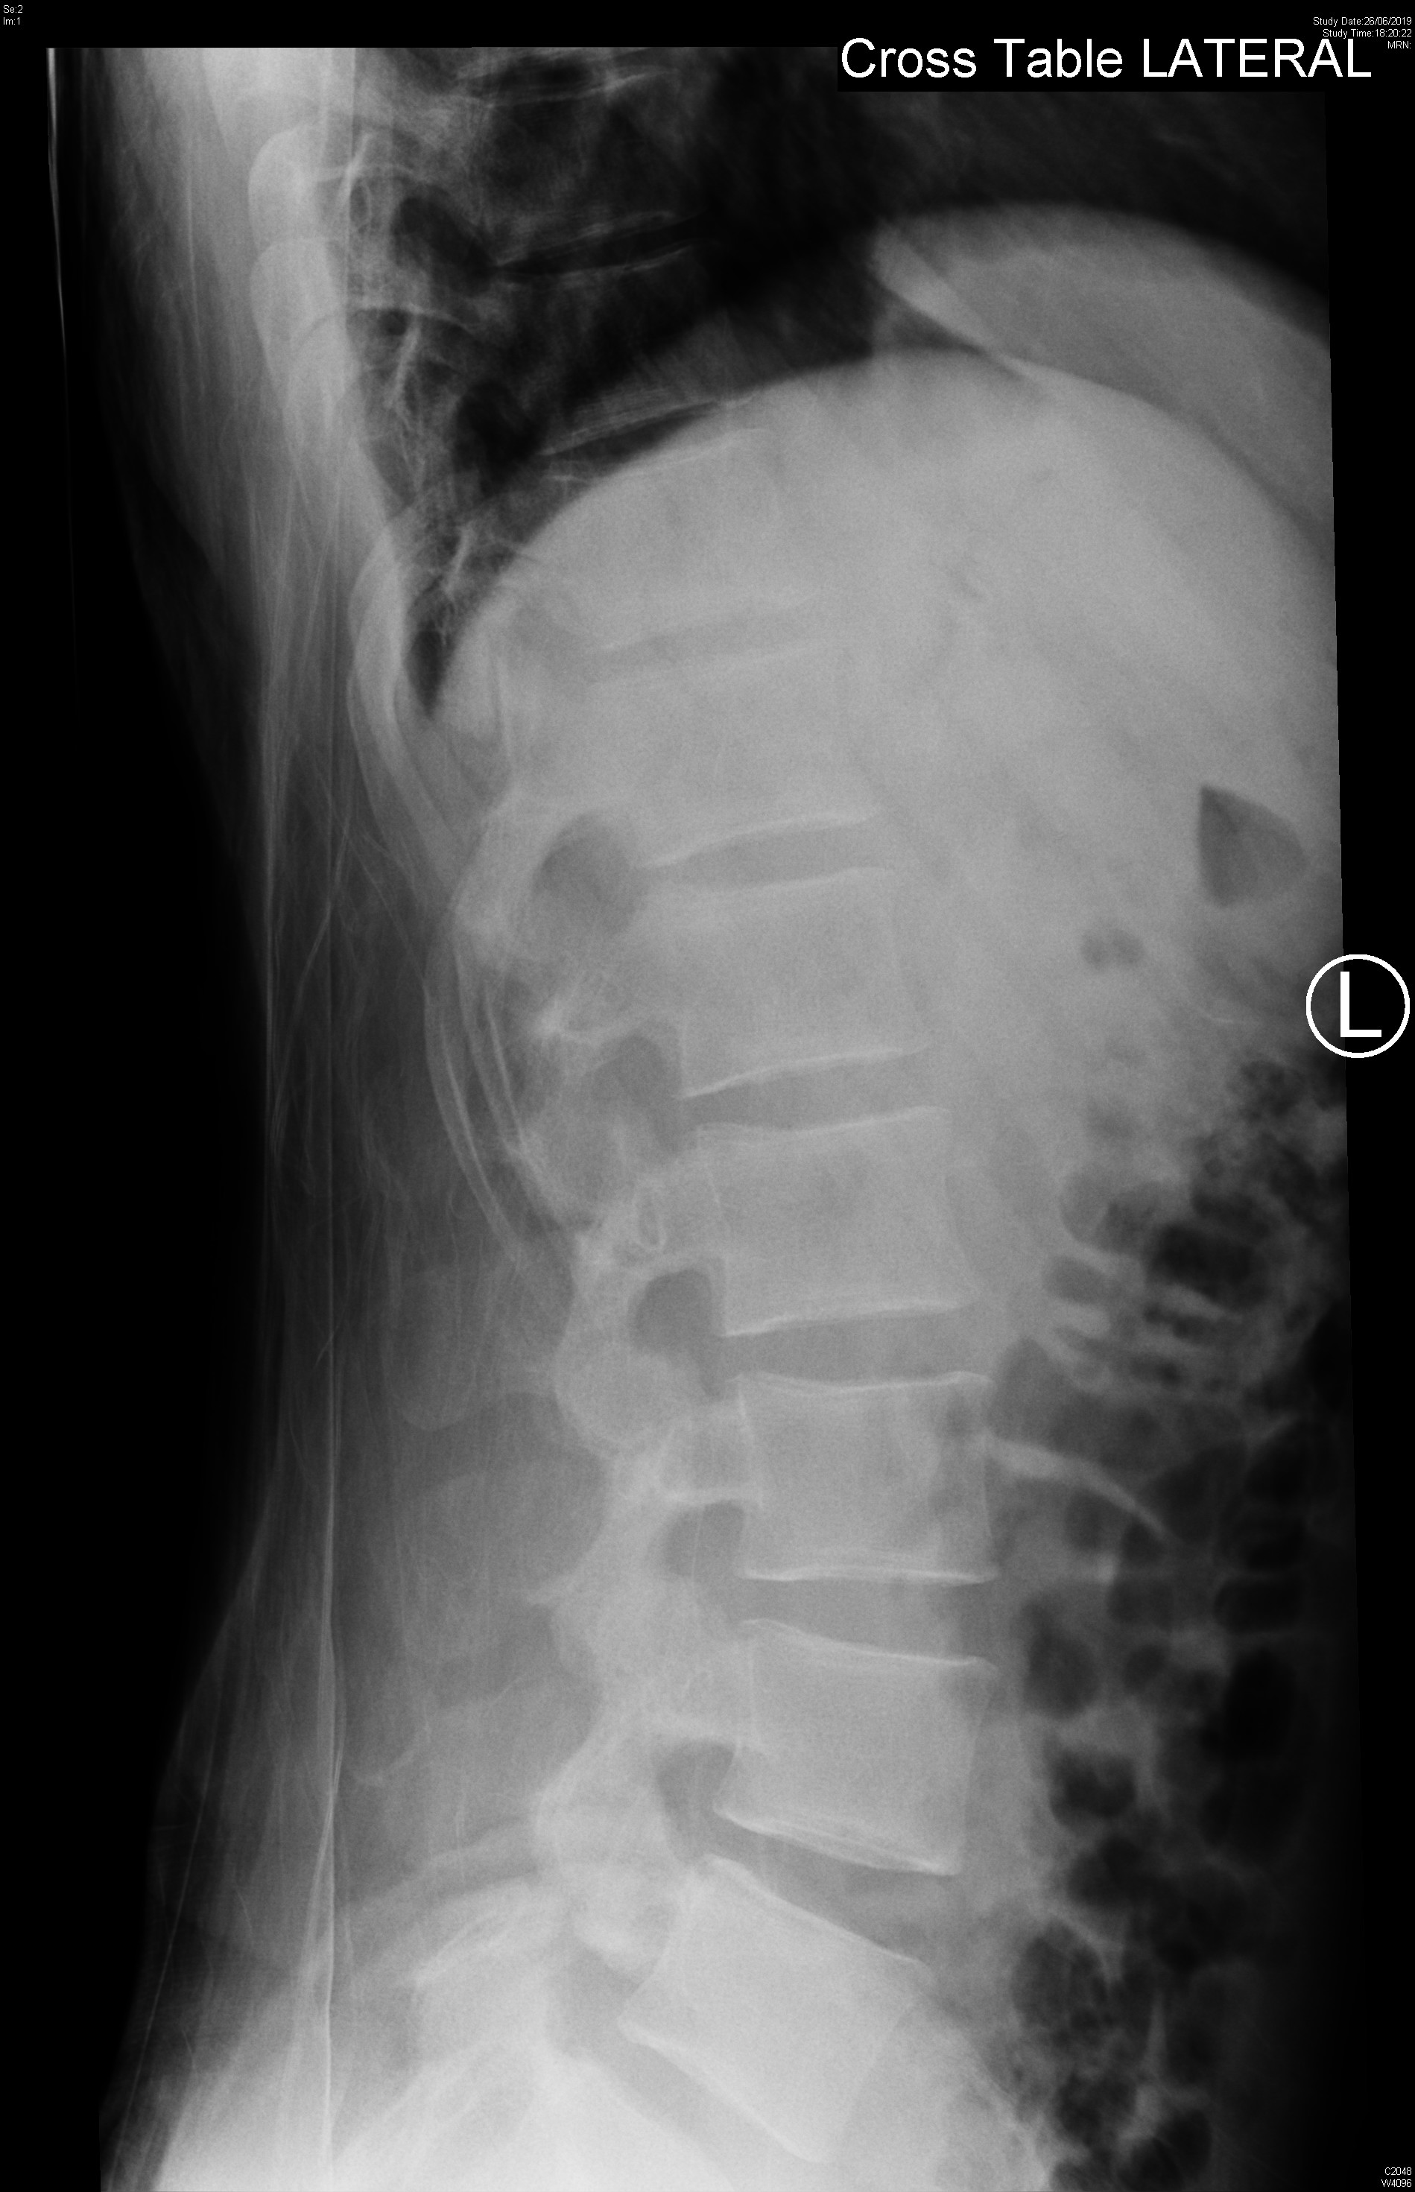
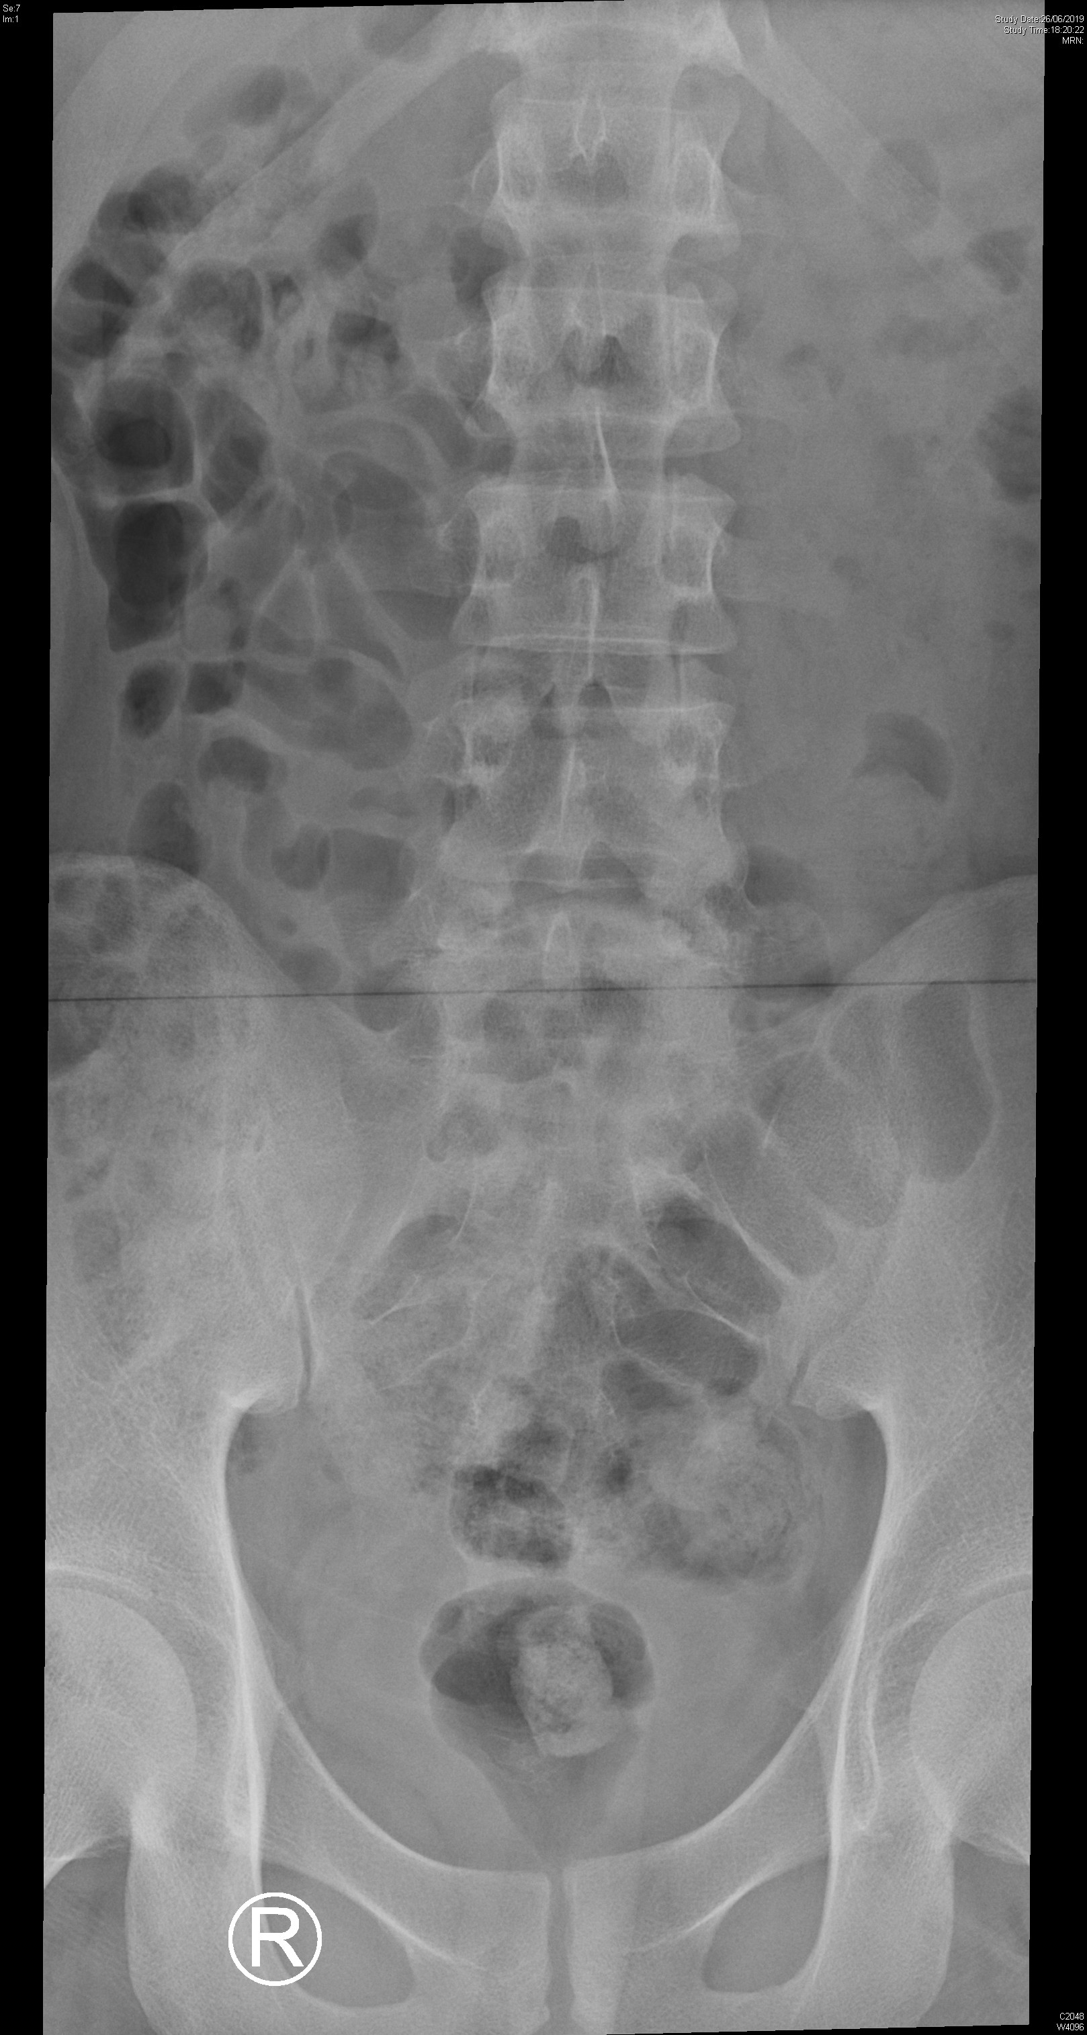
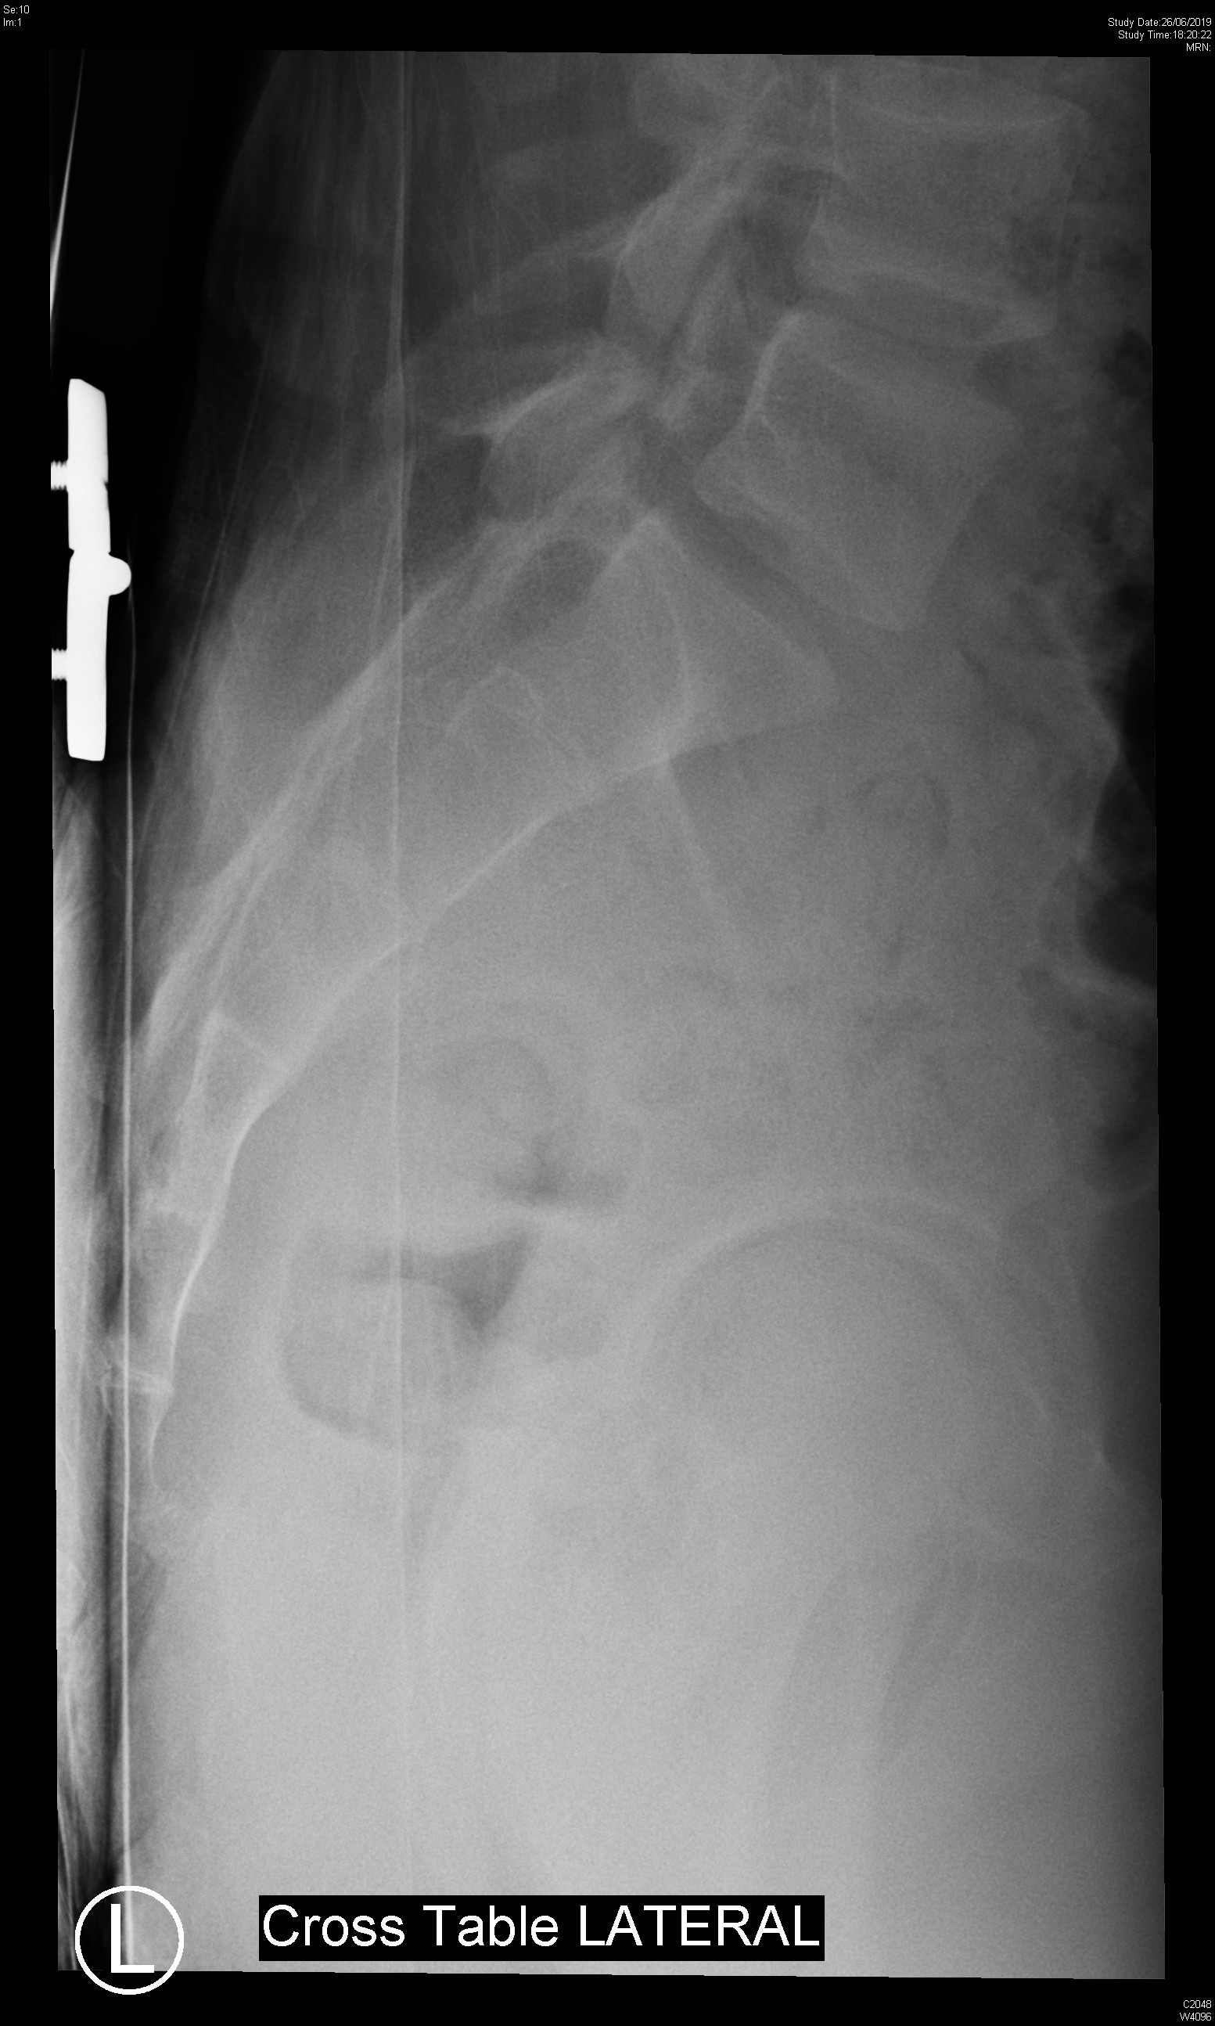

Slide 7
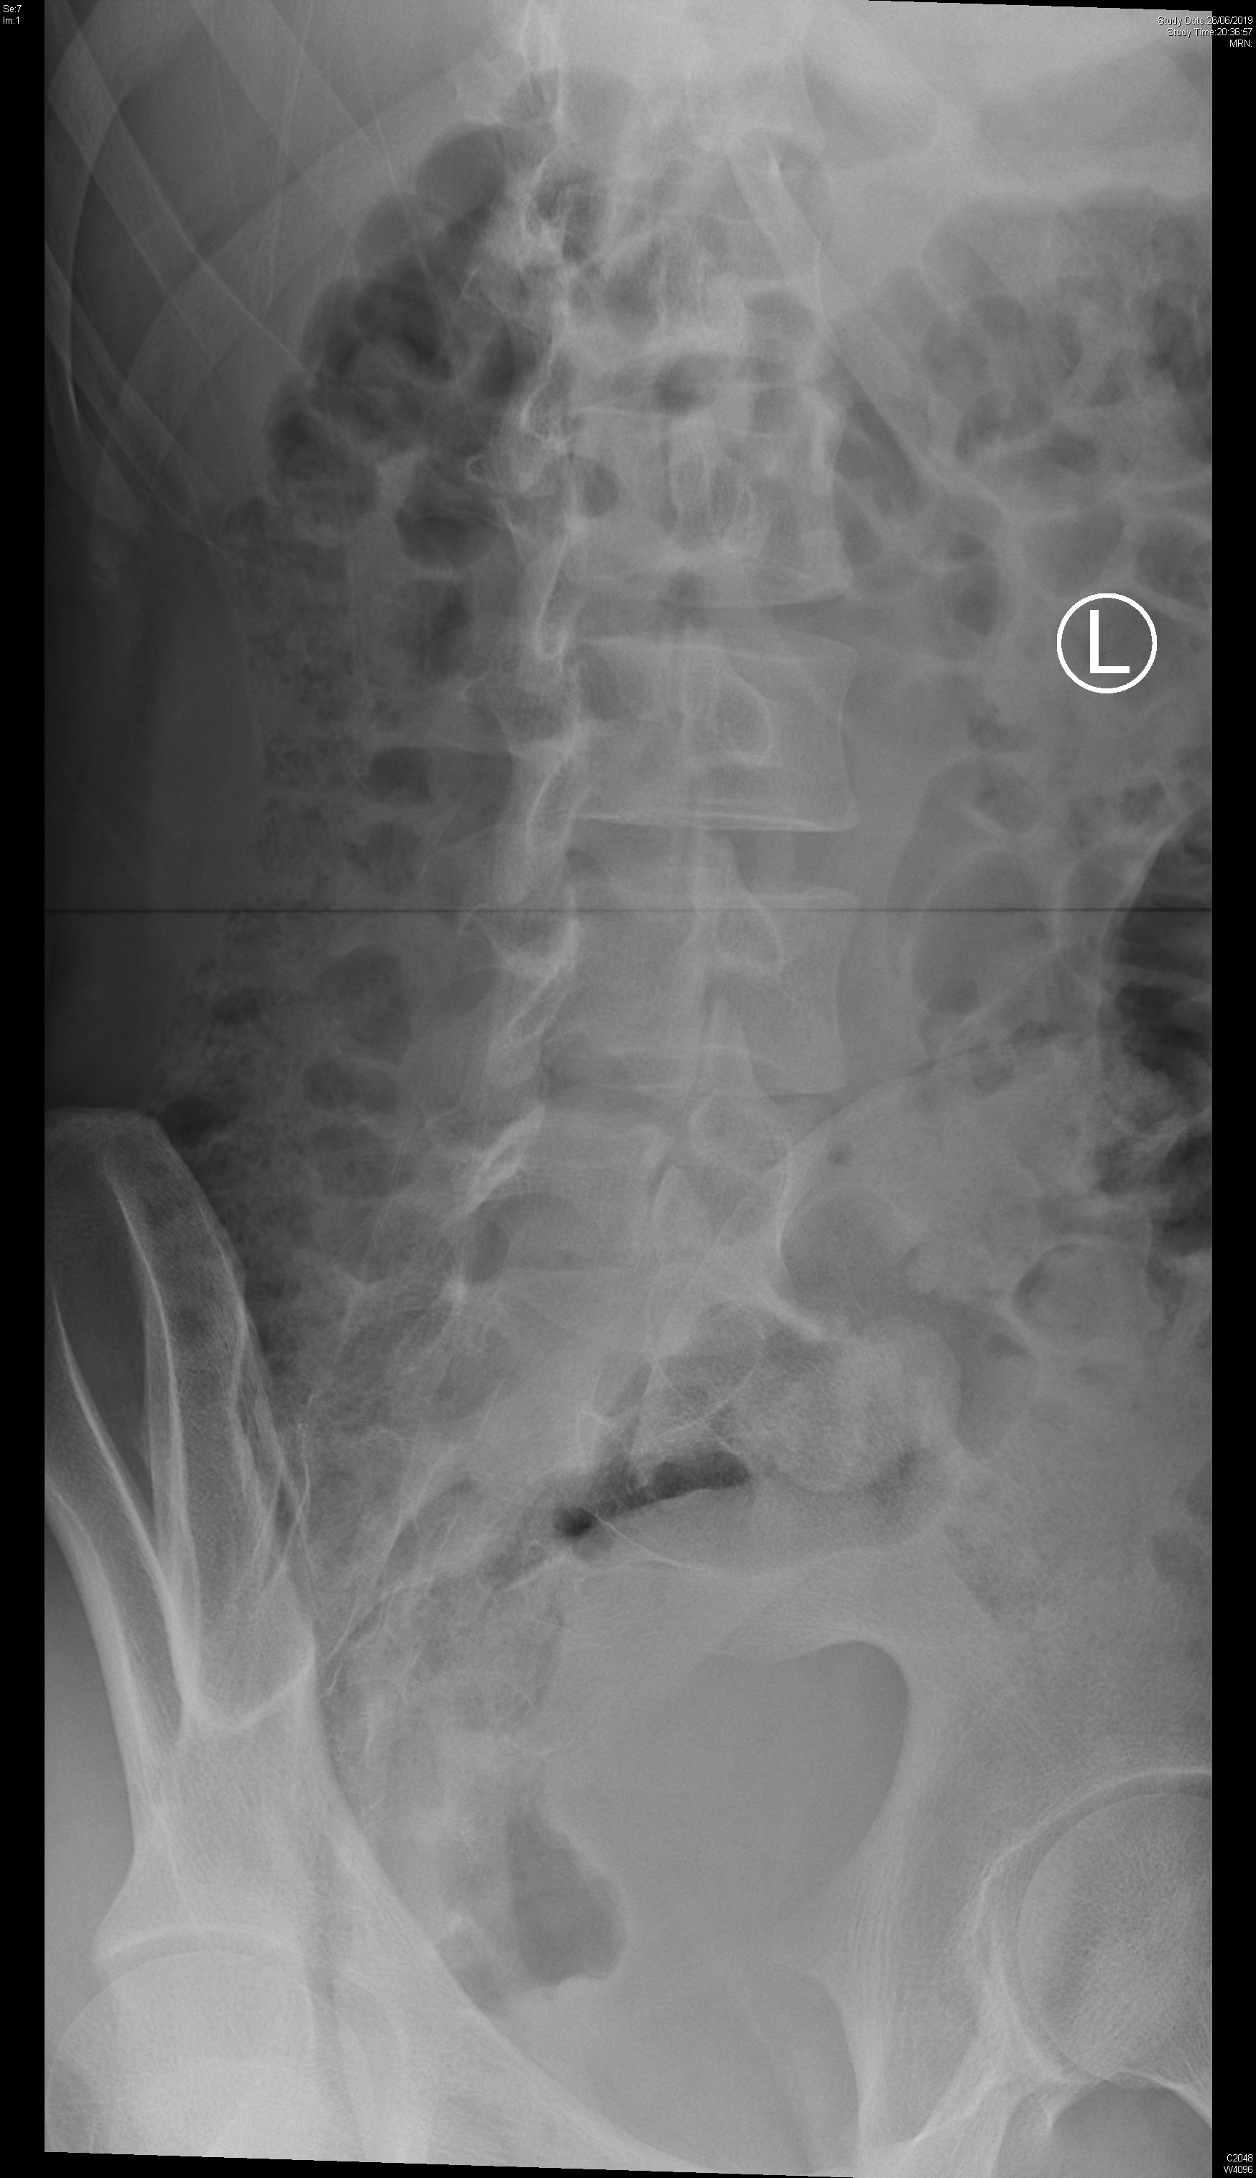
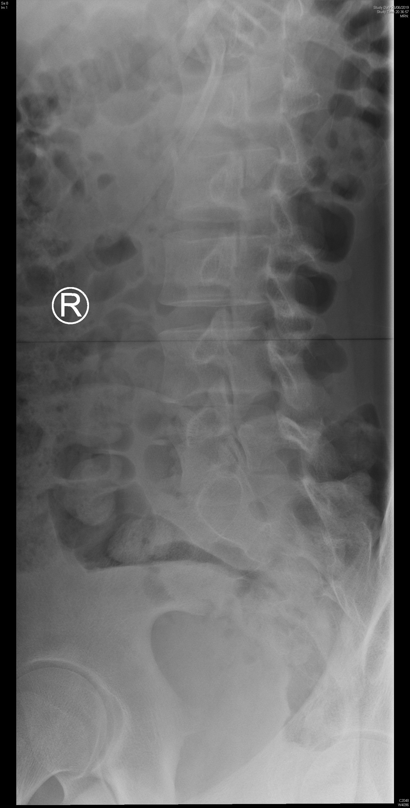

Slide 8
Case 2 - Questions
What is the X-ray abnormality?
What is the view of the second set of X-ray?
To assess the stability of his lumbar spine, what additional view of x-ray can be ordered?
Name two likely causes of this x-ray condition in our patient?
What is the management?

Slide 9
Case 3
A 90 year-old man presented with sudden onset of back and chest pain.
His BP was 87/58, pulse 68/min.
A CXR was done.

Slide 10
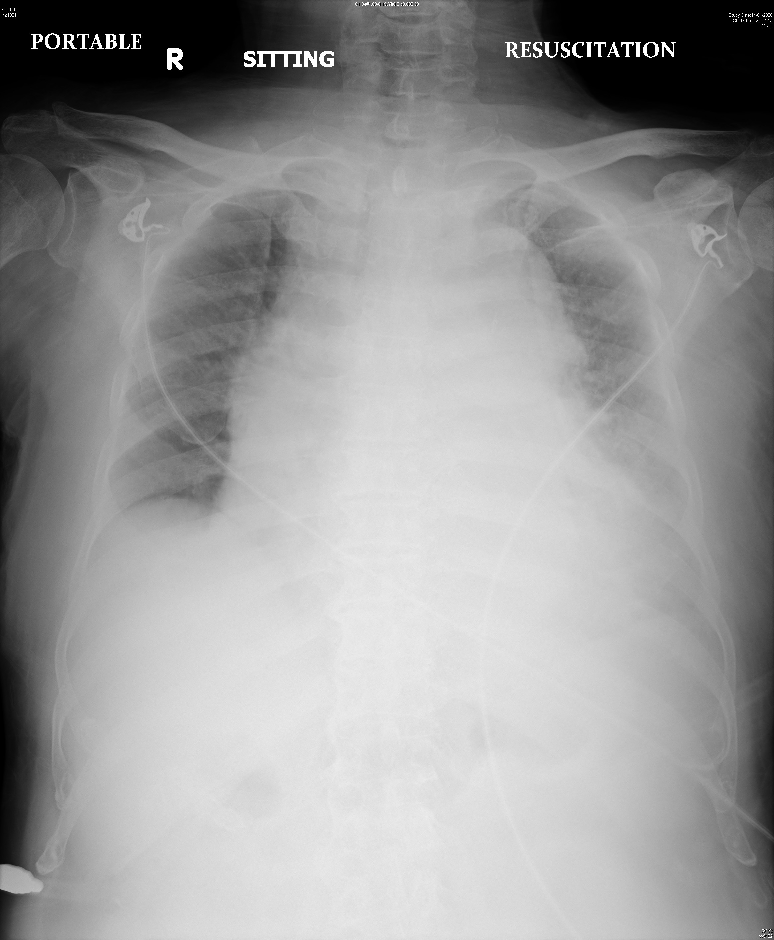

Slide 11
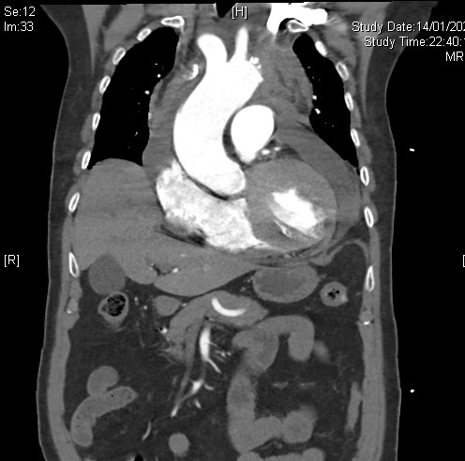
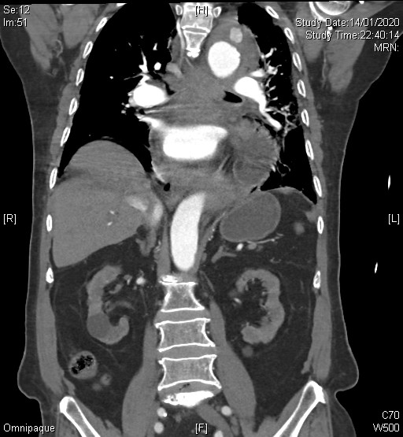
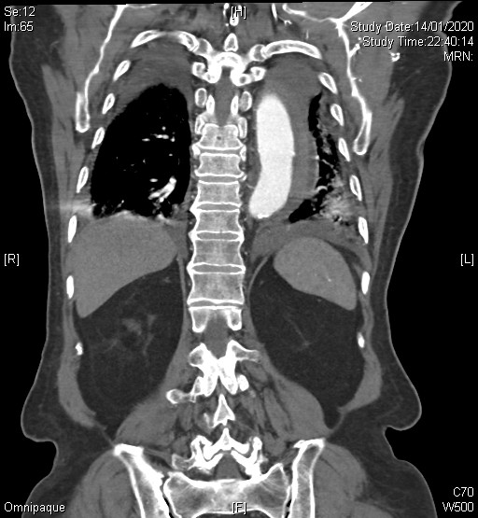

Slide 12
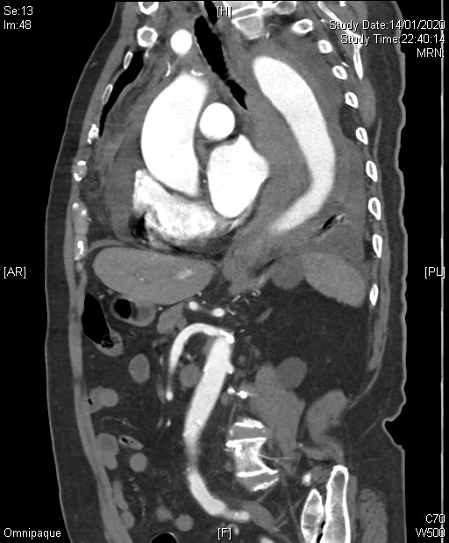
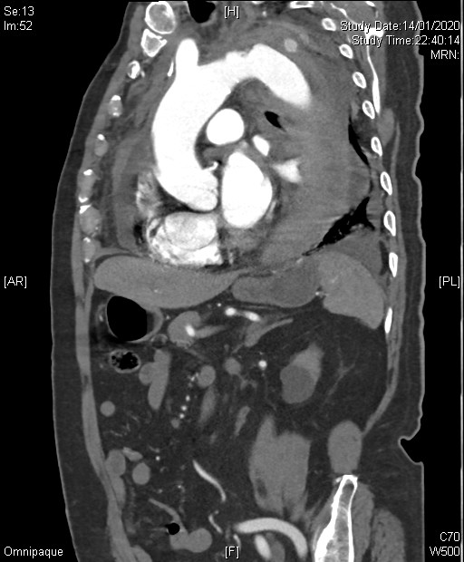
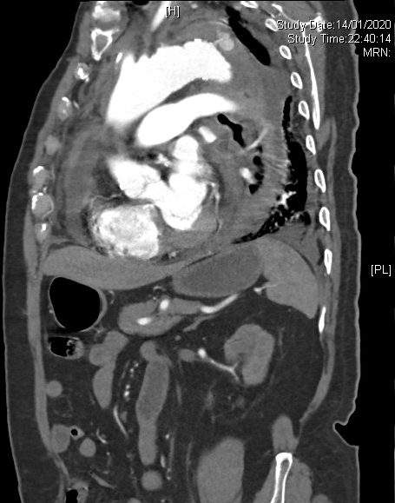

Slide 13
Case 3 - Questions
Name three CXR abnormalities.
Name two useful bedside investigations and what to look for.
Name two most significant CT findings?
What is the diagnosis?

Slide 14
Case 4
A 32 years old man complained of left side chest pain for 3 days.
Vital signs are normal.
The pain was sharp in nature, and worsen on lying down and increase with breathing.
An ECG was done.

Slide 15
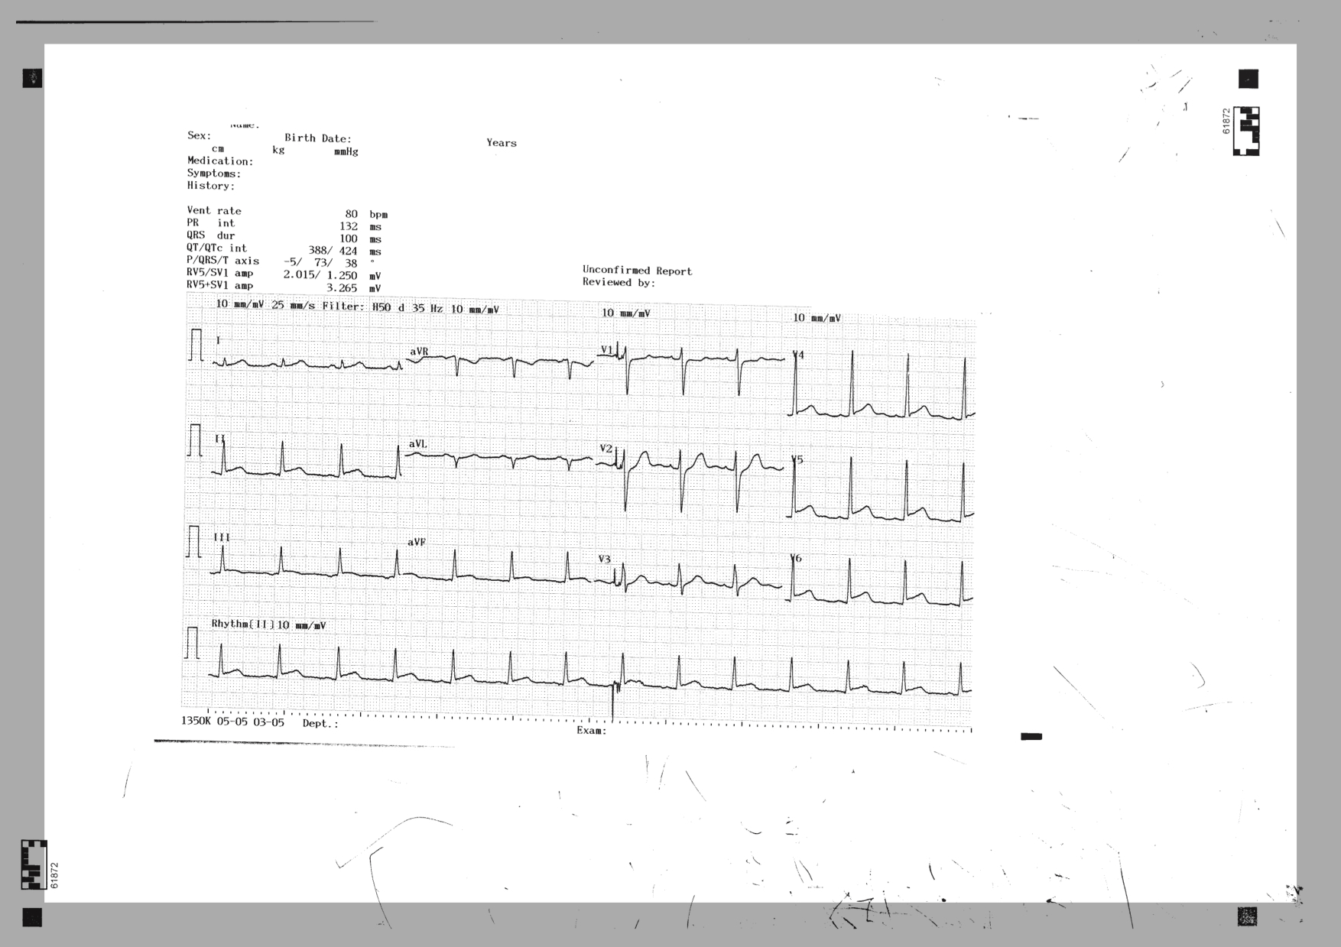

Slide 16
Case 4 - Questions
1) What is the clinical diagnosis
2) Name two ECG features associated with this diagnosis shown above
3) Name two medical treatments for this condition
4) What are the three components of Dressler’s syndrome

Slide 17
Case 5
A 14 years old boy tripped and sprained left ankle at pool side.
He complained of pain and swelling in the ankle. Physical examination revealed local tenderness and swelling. He was unable to walk.
A X-ray was done.

Slide 18
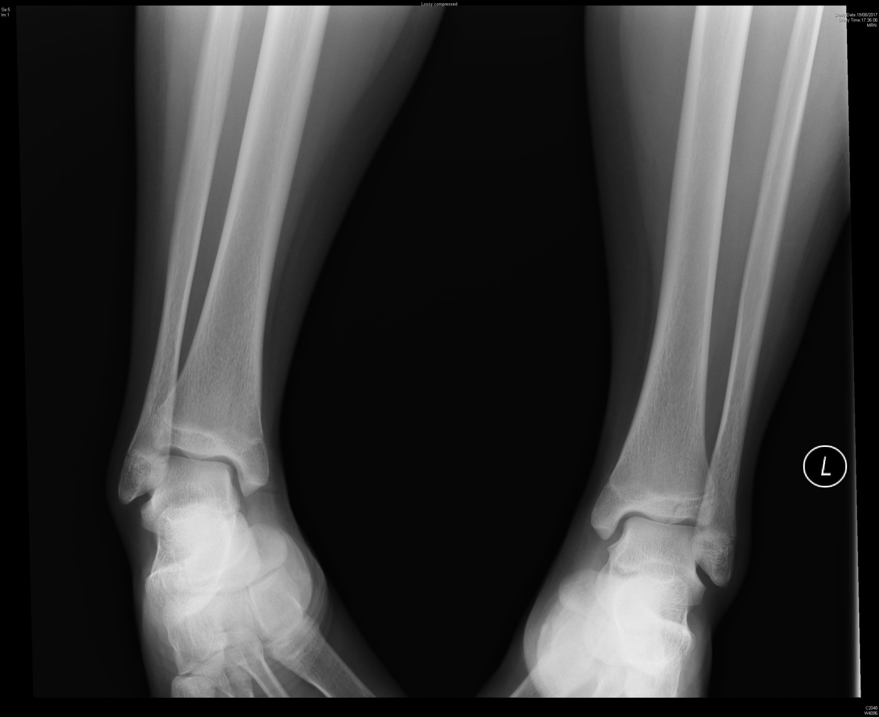

Slide 19
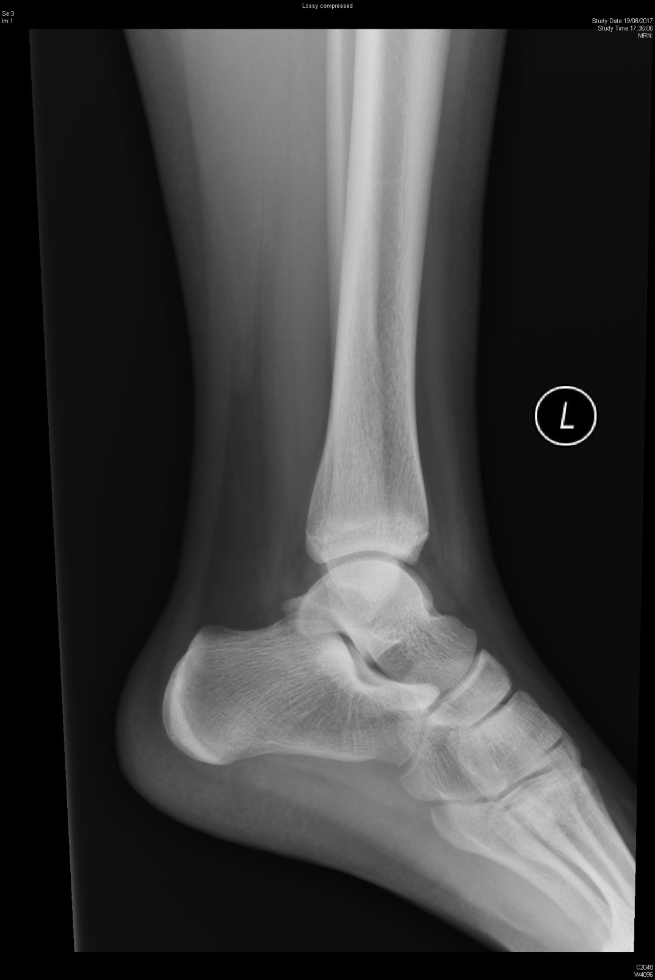
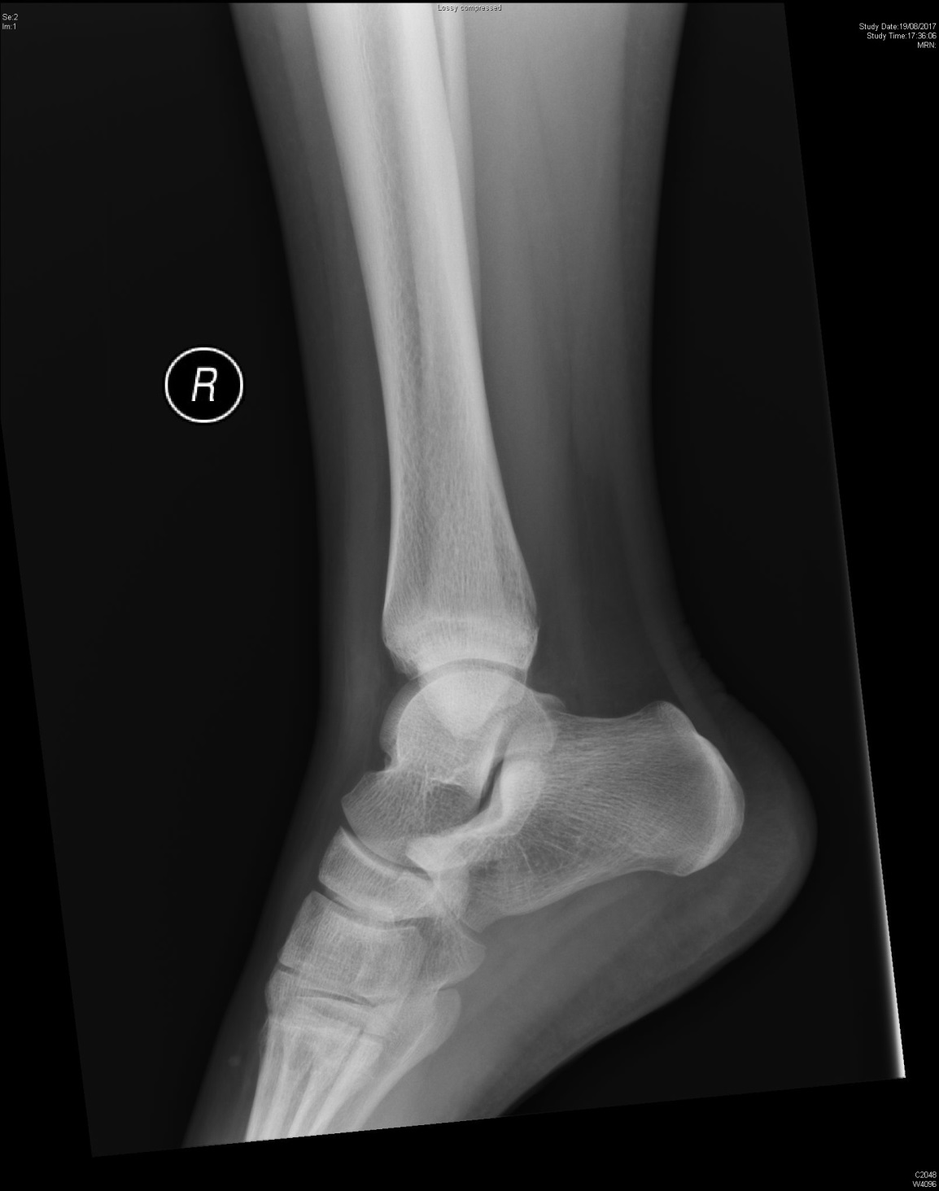

Slide 20
Case 5 - Questions
1) What is the diagnosis?
2) What is the Salter-Harris type?
3) What is the mechanism of this injury?
4) What is the indication of operative management?

