Slide 1
4th March 2020 JCM
OSCE
UCH

Slide 2
Case 1
A 15-year-old boy presented to Accident and Emergency Department with on and off headache for 2 months and intermittent nausea.
CT brain has been performed with 2 sections shown.

Slide 3
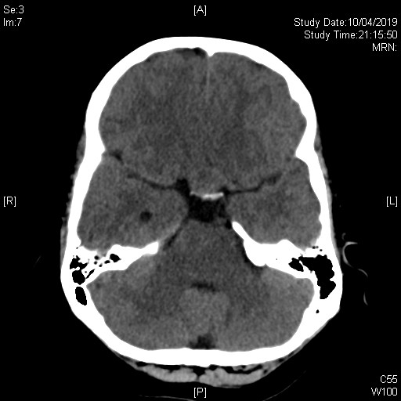

Slide 4
Case 1
Describe the abnormality
An oval shaped isodense lesion situated in the sella and extending to the suprasella region
What is the likely diagnosis?
Pituitary tumor/adenoma
What visual field problem the patient may experience?
Bitemporal hemianopia
What are the probable hormonal axis problems you need to look for?
Thyrotropic, gonodotropic, adrenocorticotropic, growth hormone
What hormonal disease he may suffer after surgical excision of the lesion?
Panhyopituitarism
What is the probable diagnosis if the patient experiences polyuria and hypernatremia after surgical intervention?
Diabetes insipidus

Slide 5
Case 2
A 20 year-old badminton player presented with low back pain after landing from a jump during a ball game. He was so painful that he could not walk.
There was no bony tenderness and no lower limb neurological deficit.
X-ray LS spine was done.

Slide 6
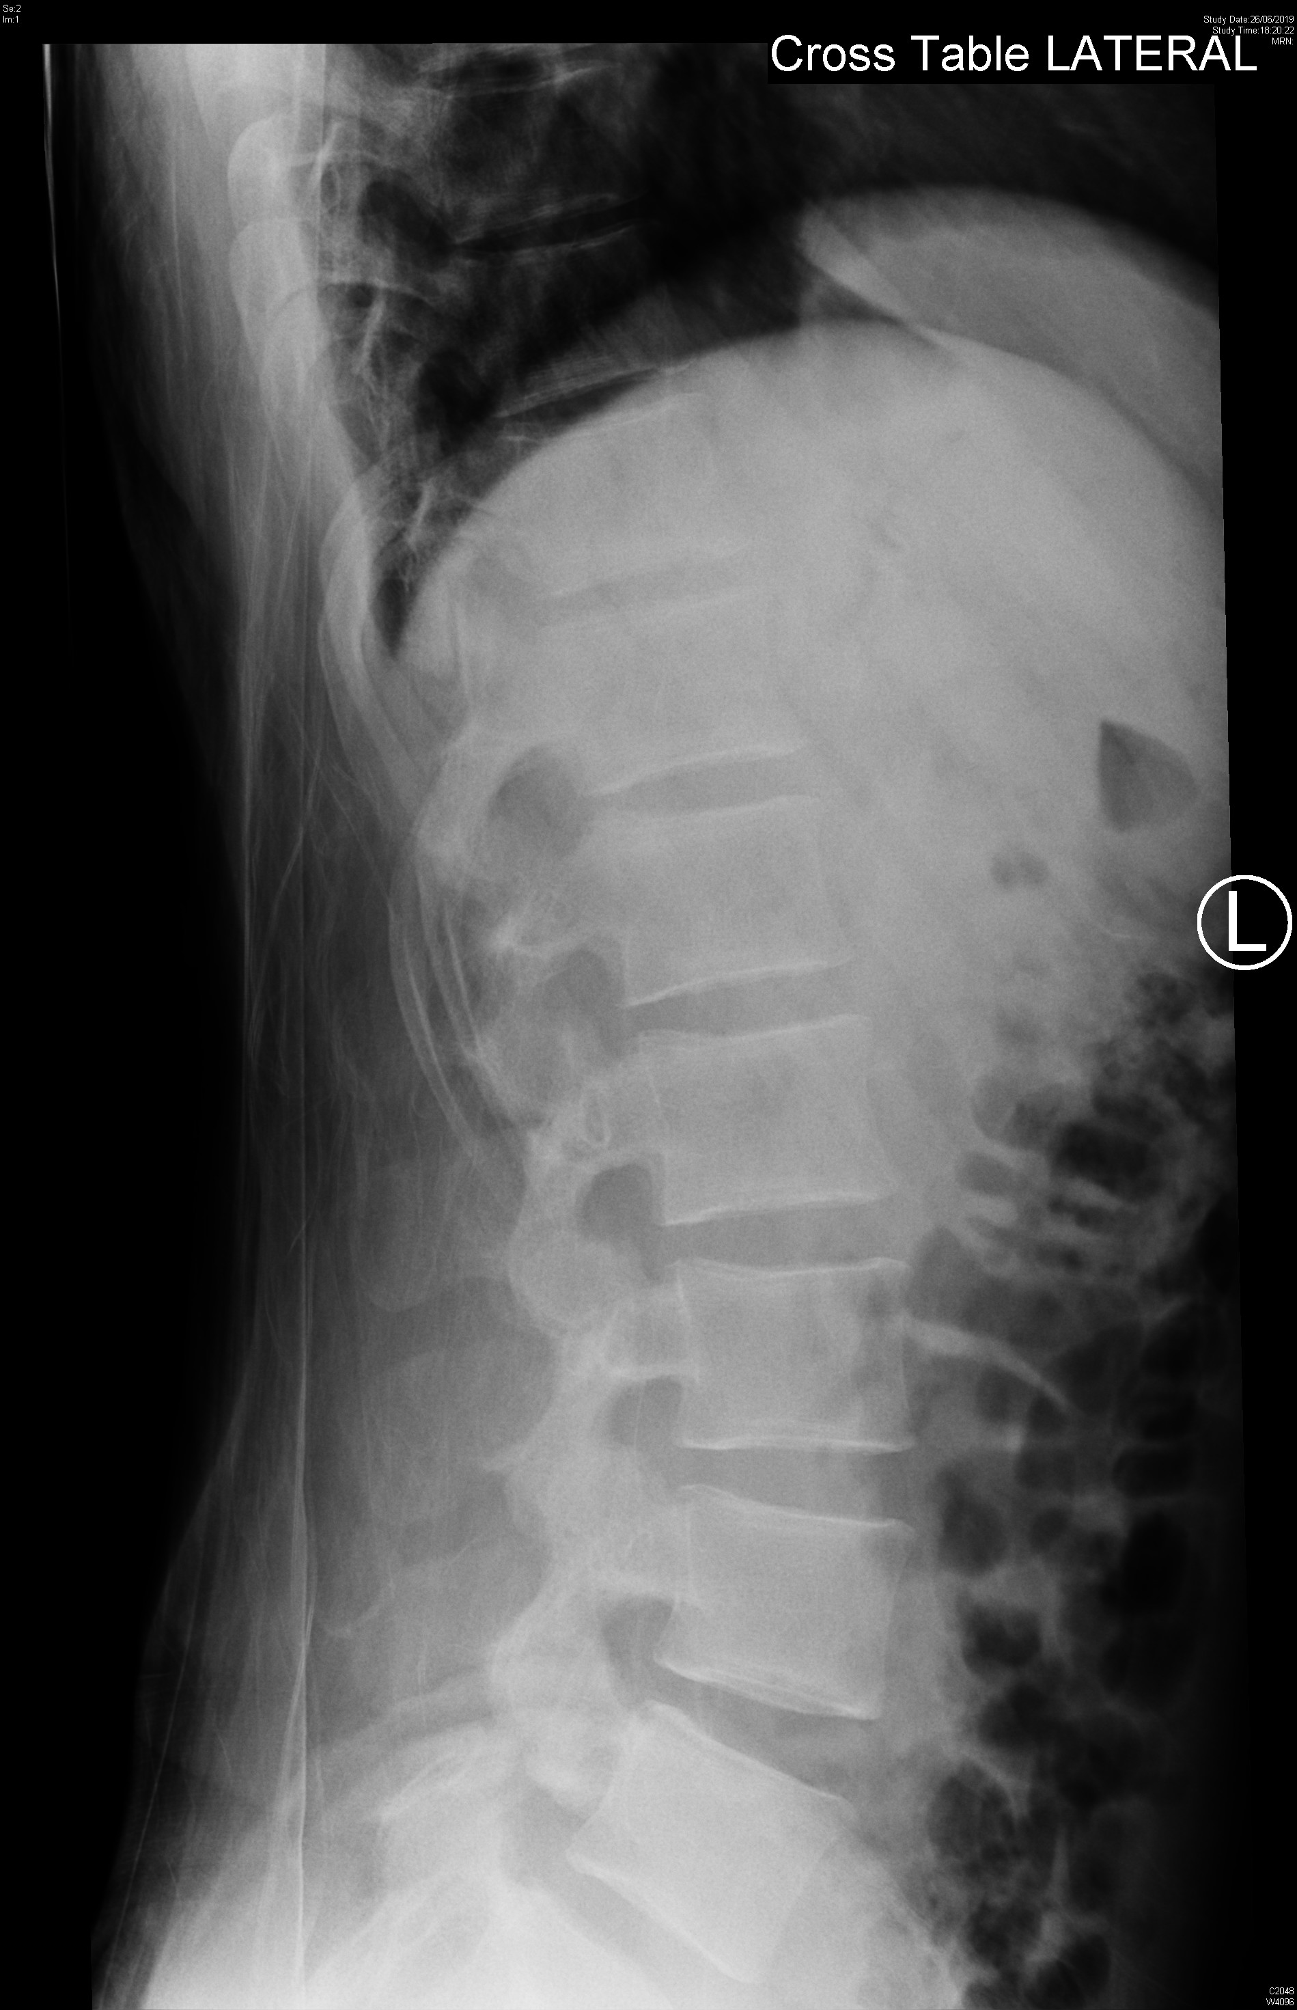
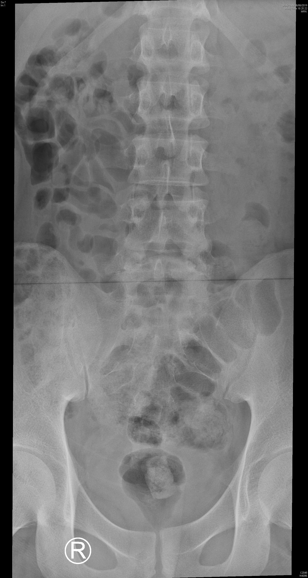
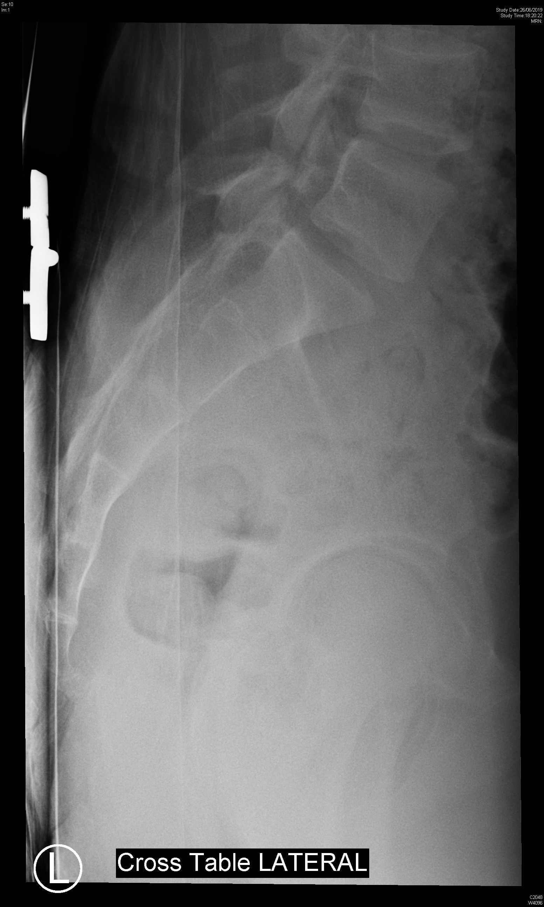

Slide 7
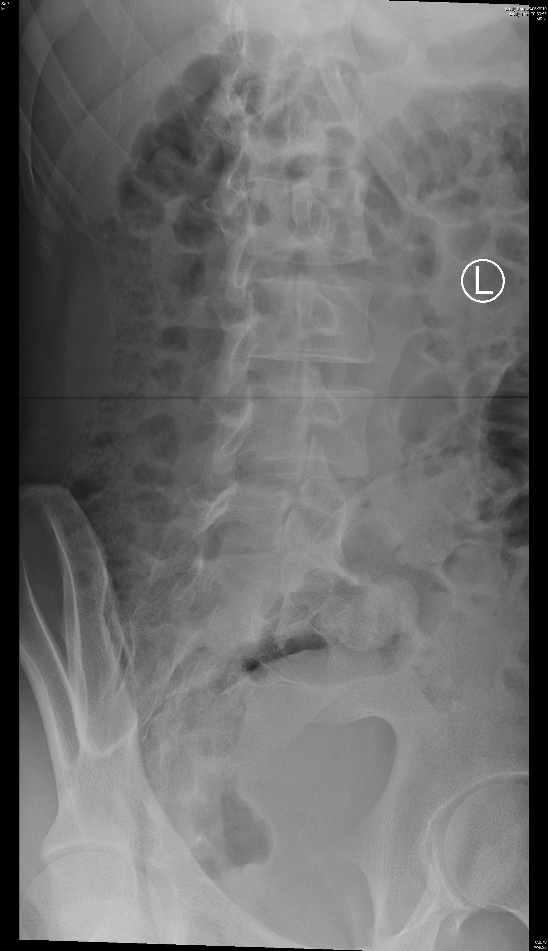
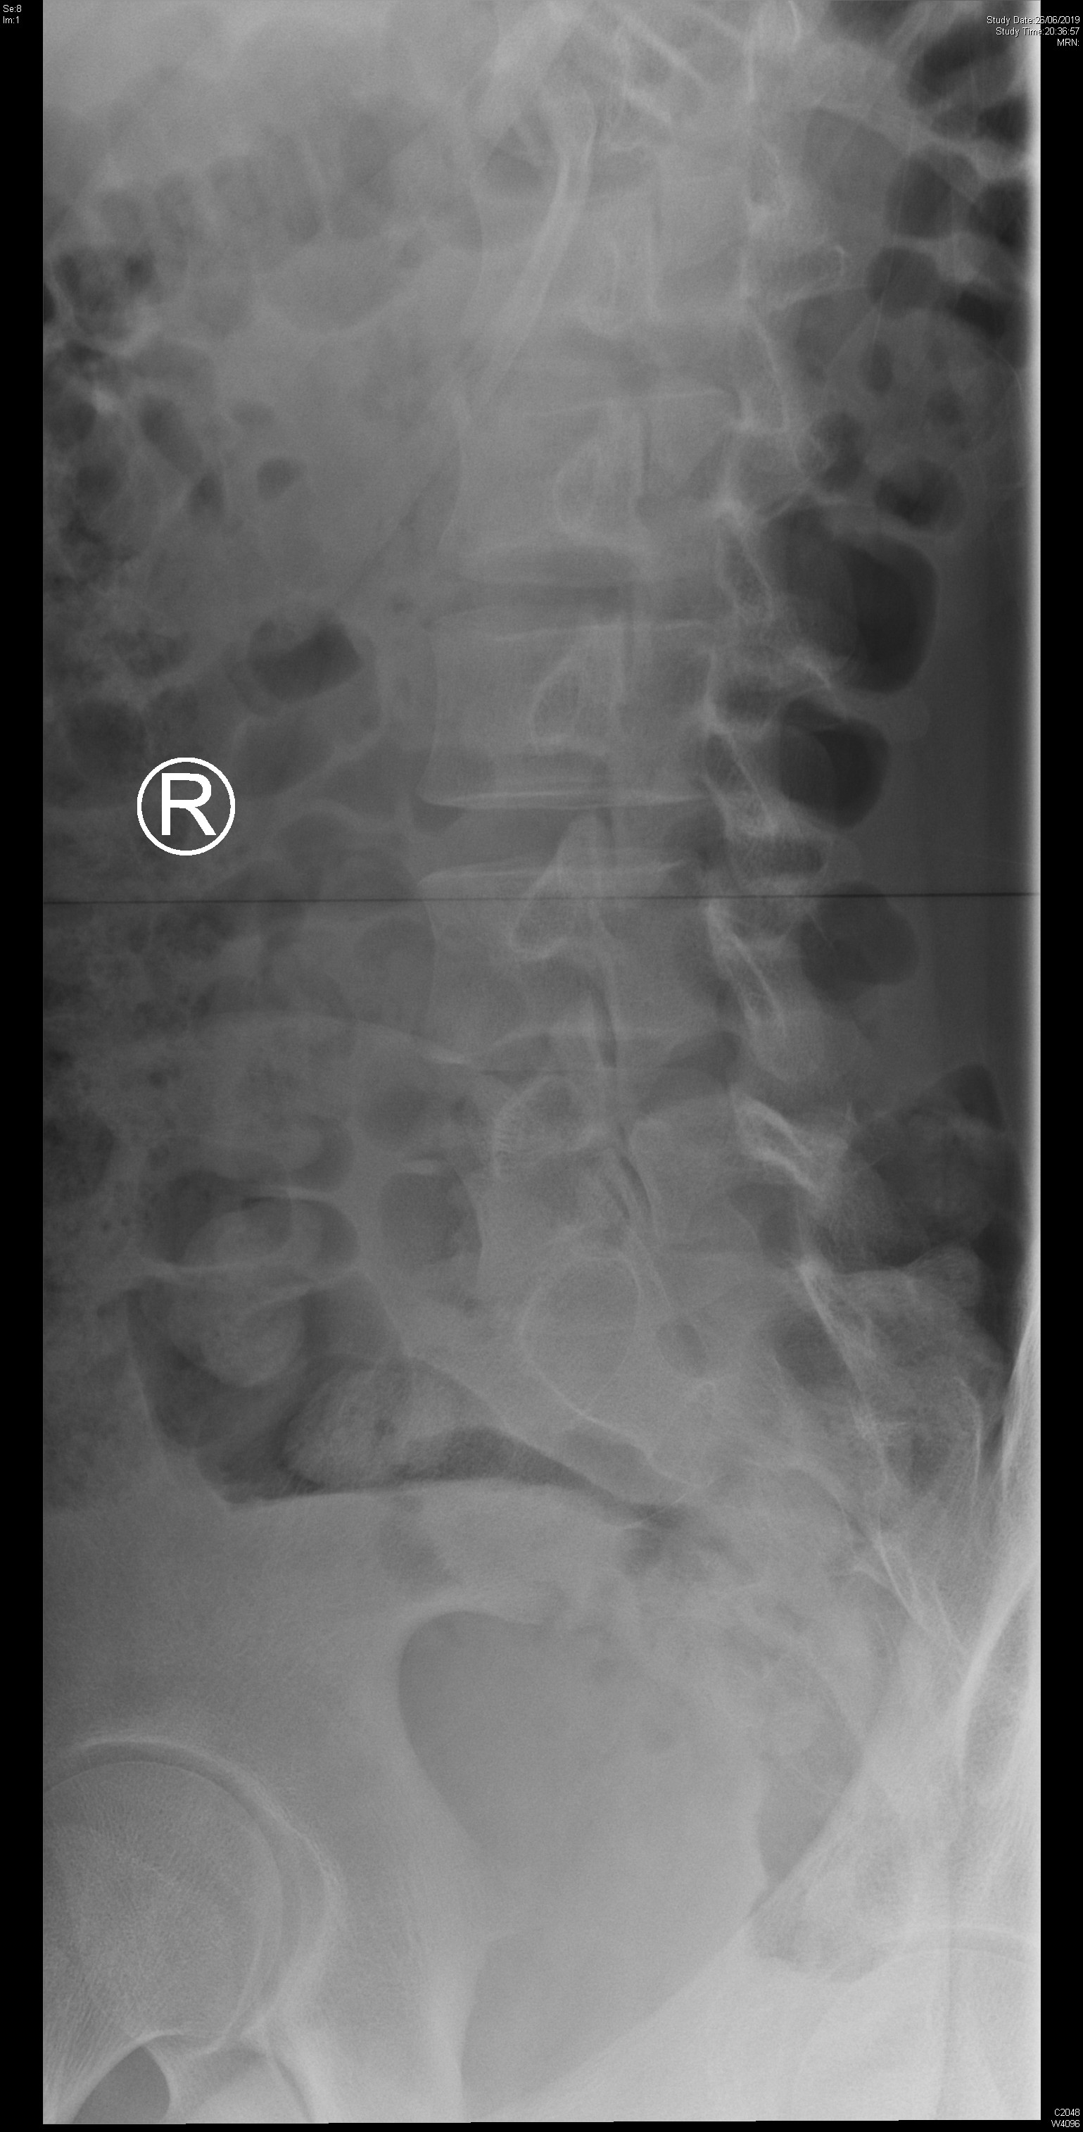

Slide 8
Case 2
What is the X-ray abnormality?
L5 pars interarticularis defect
What is the view of the second set of X-ray?
Lateral oblique views
To assess the stability of his lumbar spine, what additional view of x-ray can be ordered?
Flexion and extension views
Name two likely causes of this x-ray condition in our patient?
Stress fracture
Congenital defect
What is the management?
Symptomatic treatment with physiotherapy
Refer Orthopaedic clinic FU

Slide 9
Case 3
A 90 year-old man presented with sudden onset of back and chest pain.
His BP was 87/58, pulse 68/min.
A CXR was done.

Slide 10
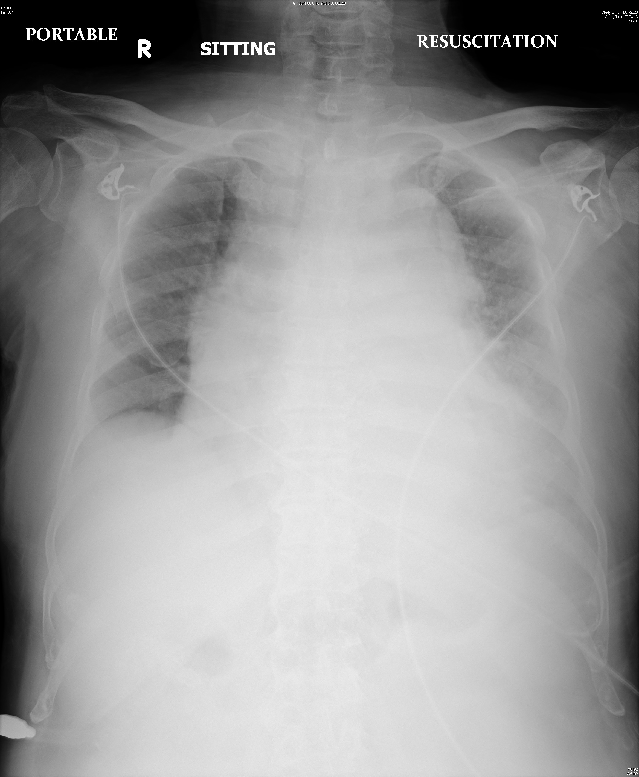

Slide 11
Case 3
Name three CXR abnormalities.
Widen mediastinum
Cardiomegaly
Left lower zone hazziness
Name two useful bedside investigations and what to look for.
ECG to look for acute ischemic change, low QRS voltage, electrical alternans
US to look for pericardial effusion, dilated aortic root with dissection flap

Slide 12
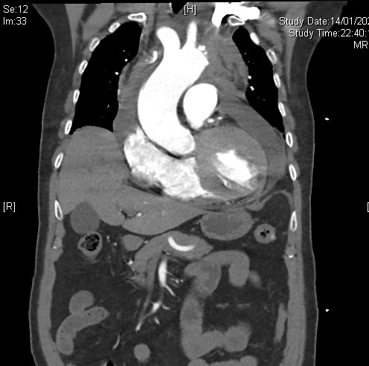
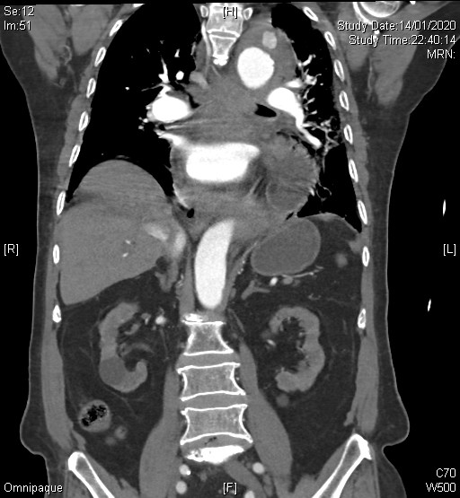
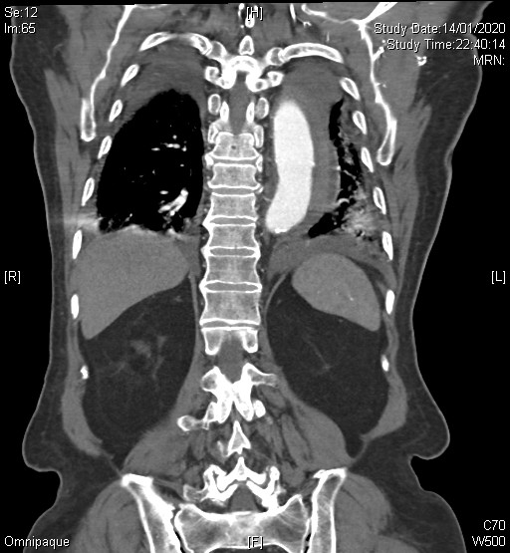

Slide 13
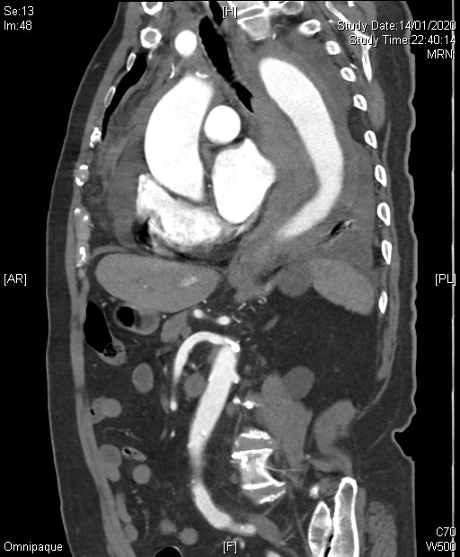
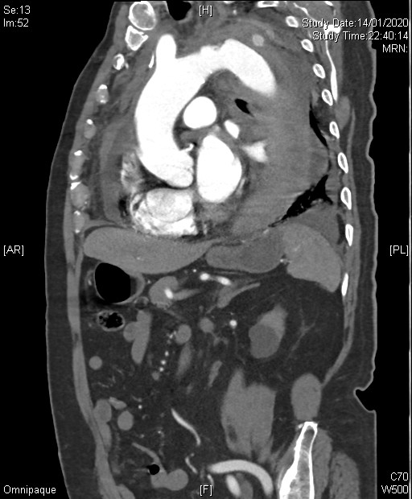
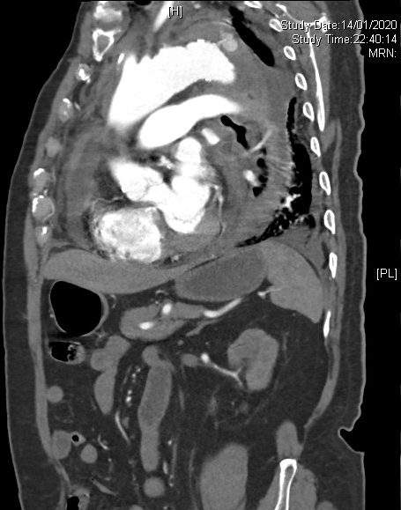

Slide 14
Case 3
Name three CXR abnormalities.
Wide mediastinum
Cardiomegaly
Left lower zone hazziness
Name two useful bedside investigations and what to look for.
ECG to look for acute ischemic change, low QRS voltage, electrical alternans
US to look for pericardial effusion, dilated aortic root with dissection flap
Name two most significant CT findings?
Aortic contour disruption at aortic arch with contrast extravasation
Pericardial effusion
What is the diagnosis?
Aortic rupture with active bleeding

Slide 15
Case 4
A 32 years old man complained of left side chest pain for 3 days.
Vital signs are normal.
The pain was sharp in nature, and worsen on lying down and increase with breathing.
An ECG was done.

Slide 16
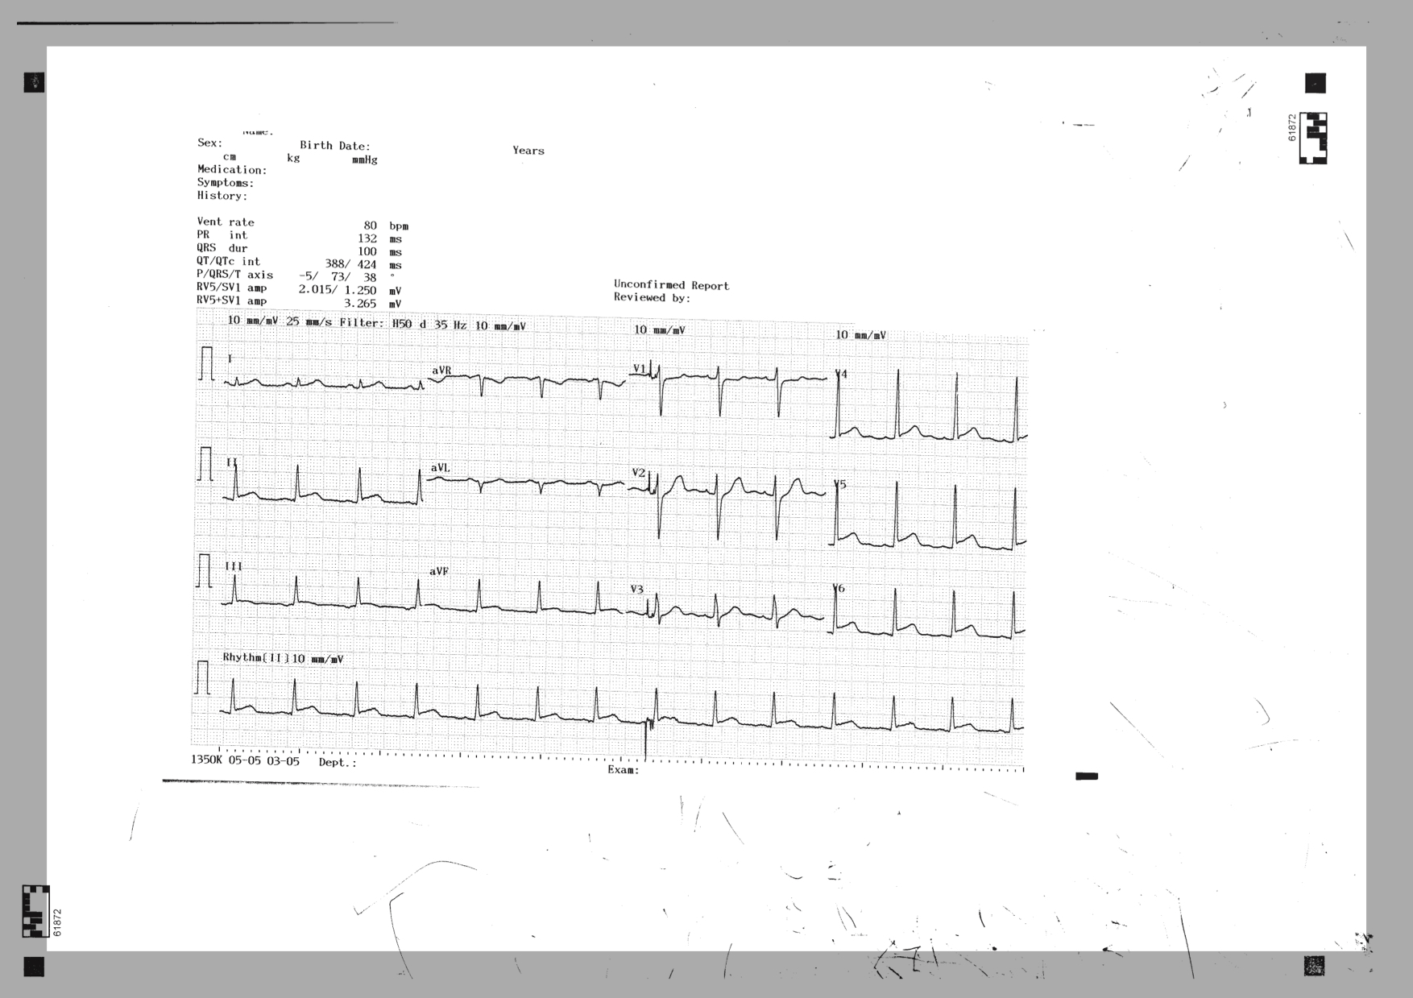

Slide 17
Case 4 - Questions
What is the clinical diagnosis
Acute pericarditis
2) Name two ECG features associated with this diagnosis shown above
Diffuse (concave) ST elevation over II, III, aVF, V4-6
PR depression over II, III, aVF, V4-6
(Reciprocal ST depression and PR elevation in V1, aVR)

Slide 18
Name two medical treatments for this condition
High dose NSAID
(ibuprofen 1600-3200mg/day or
(aspirin 2-4g/day in case of post-MI)
Colchicine
(prevent relapse)
What are the three components of Dressler’s syndrome
Fever, Pleurisy, and Pericarditis

Slide 19
Case 5
A 14 years old boy tripped and sprained left ankle at pool side.
He complained of pain and swelling in the ankle. Physical examination revealed local tenderness and swelling. He was unable to walk.
A X-ray was done.

Slide 20
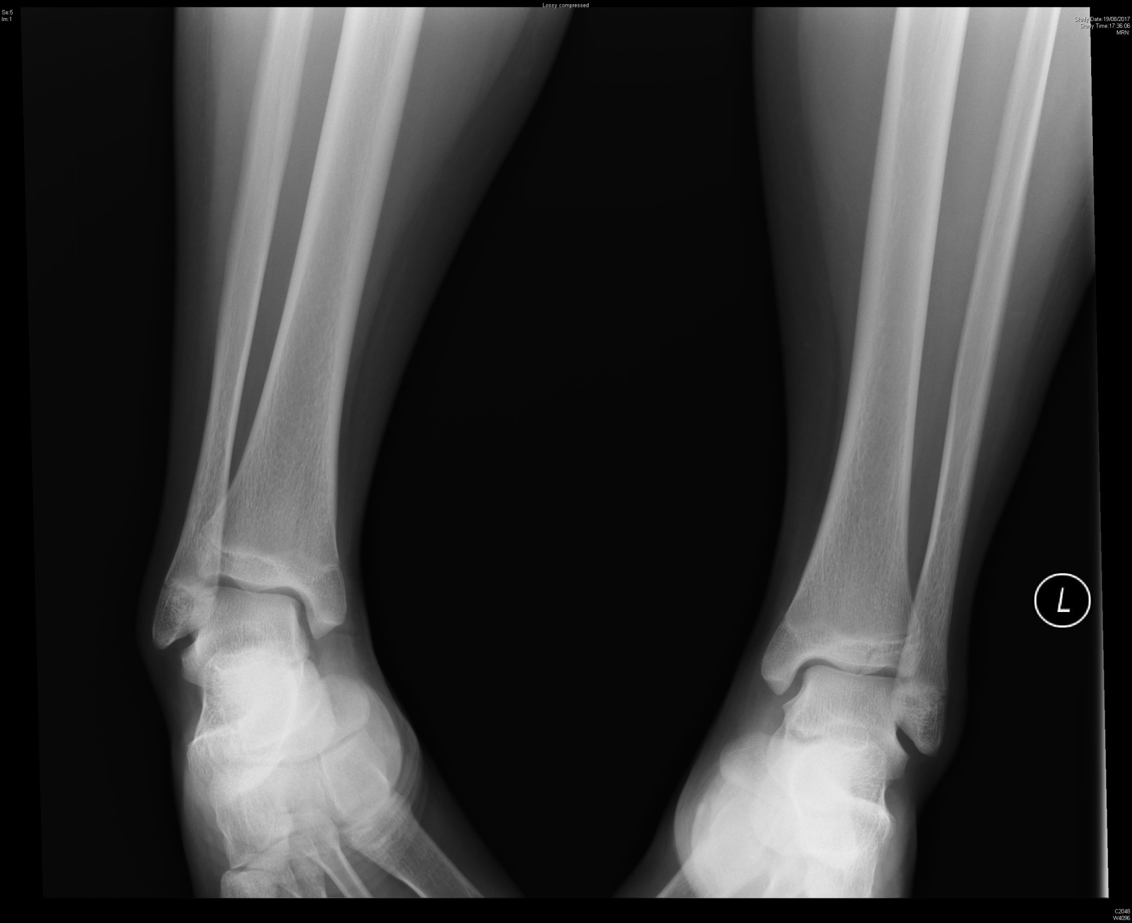

Slide 21
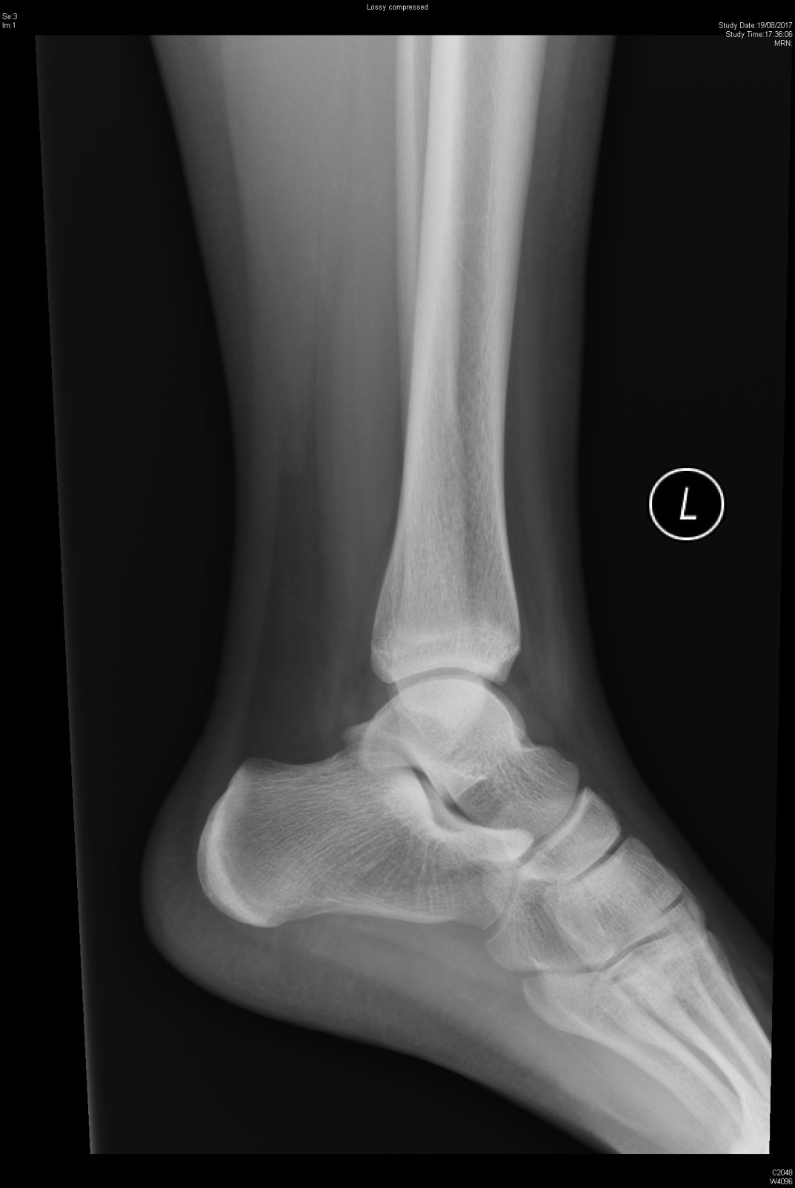
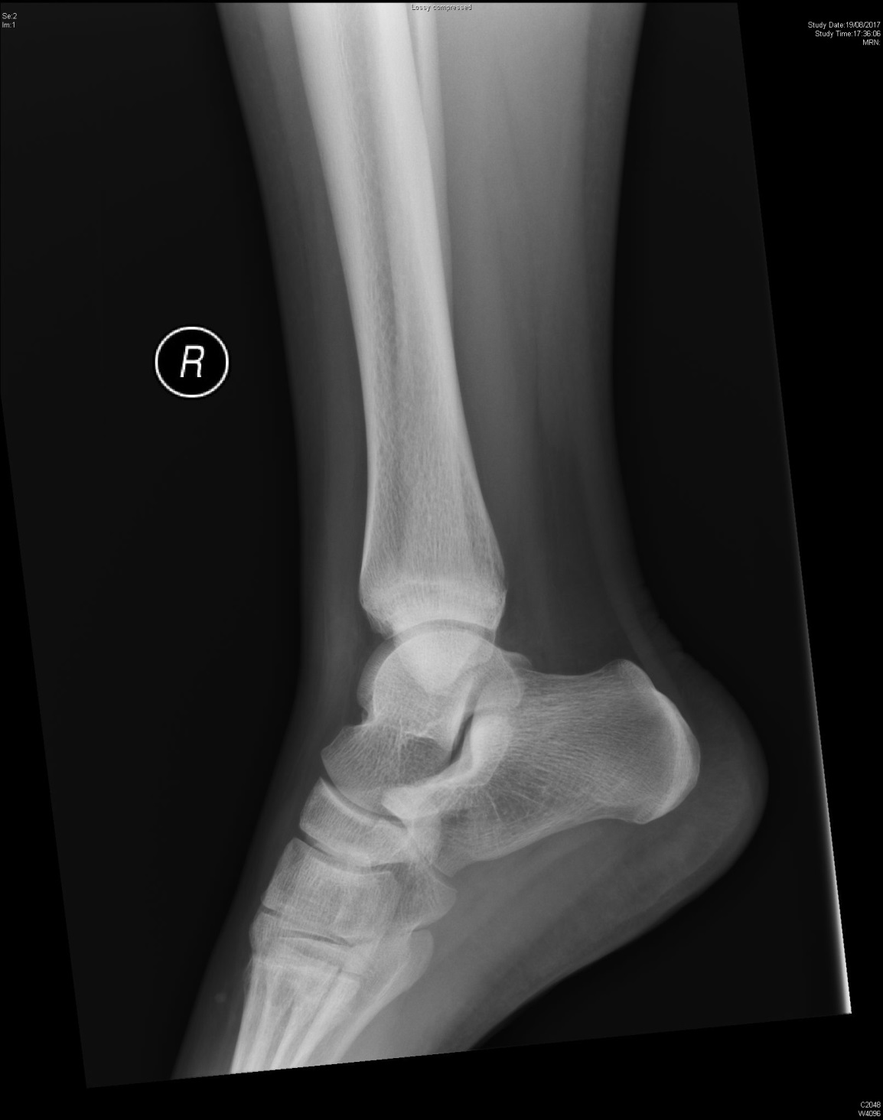

Slide 22
Case 5 - Questions
What is the diagnosis?
Tillaux fracture
What is the Salter-Harris type?
Salter-Harris type III

Slide 23
What is the mechanism of this injury?
Supination-external rotation injury
What is the indication of operative management?
ORIF if > 2mm displacement

