Slide 1
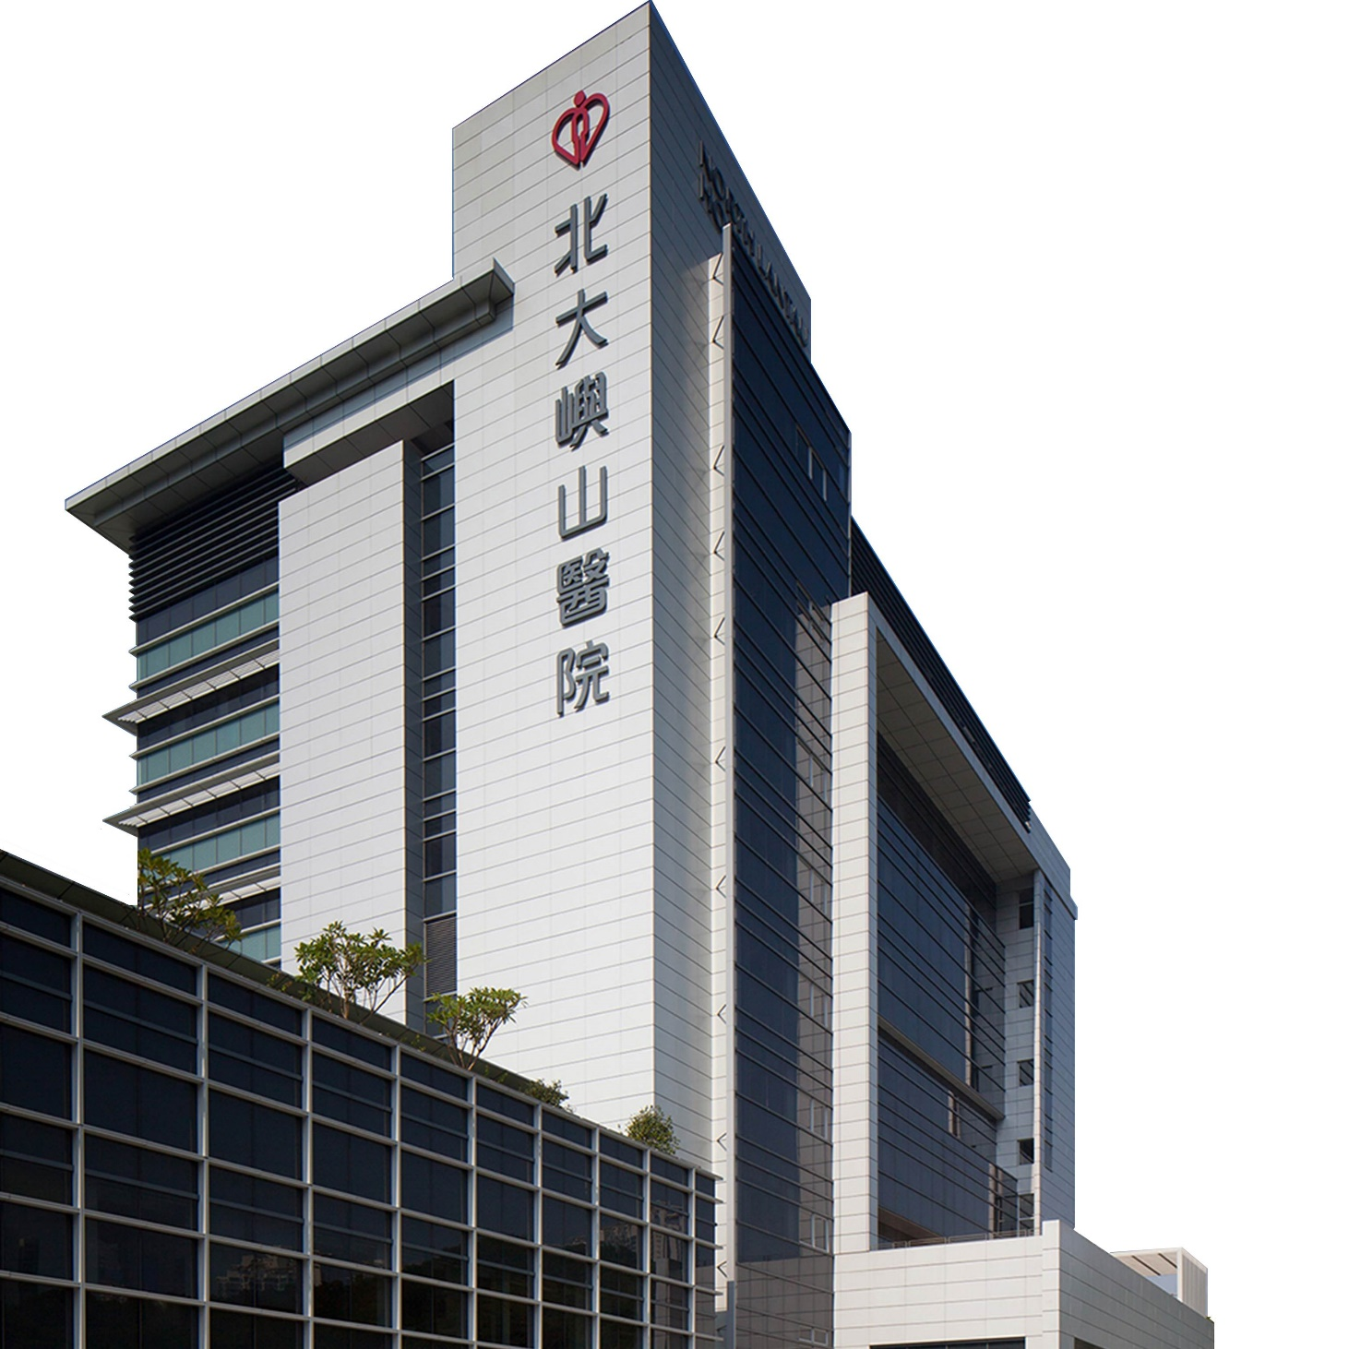
JCM OSCE Q&As
NLTH AED
1 April 2020

Slide 2

CASE 1
59/M
Known HT
Presented with non exertional precordial chest pain x 1hr
In Triage
  BP 190/110 (L arm) P104 bpm
  BP 181/104 (R arm) P106 bpm
  SpO2 98% (RA)
  Full GCS
  ECG sinus tachycardia with no acute ischaemic changes

Slide 3
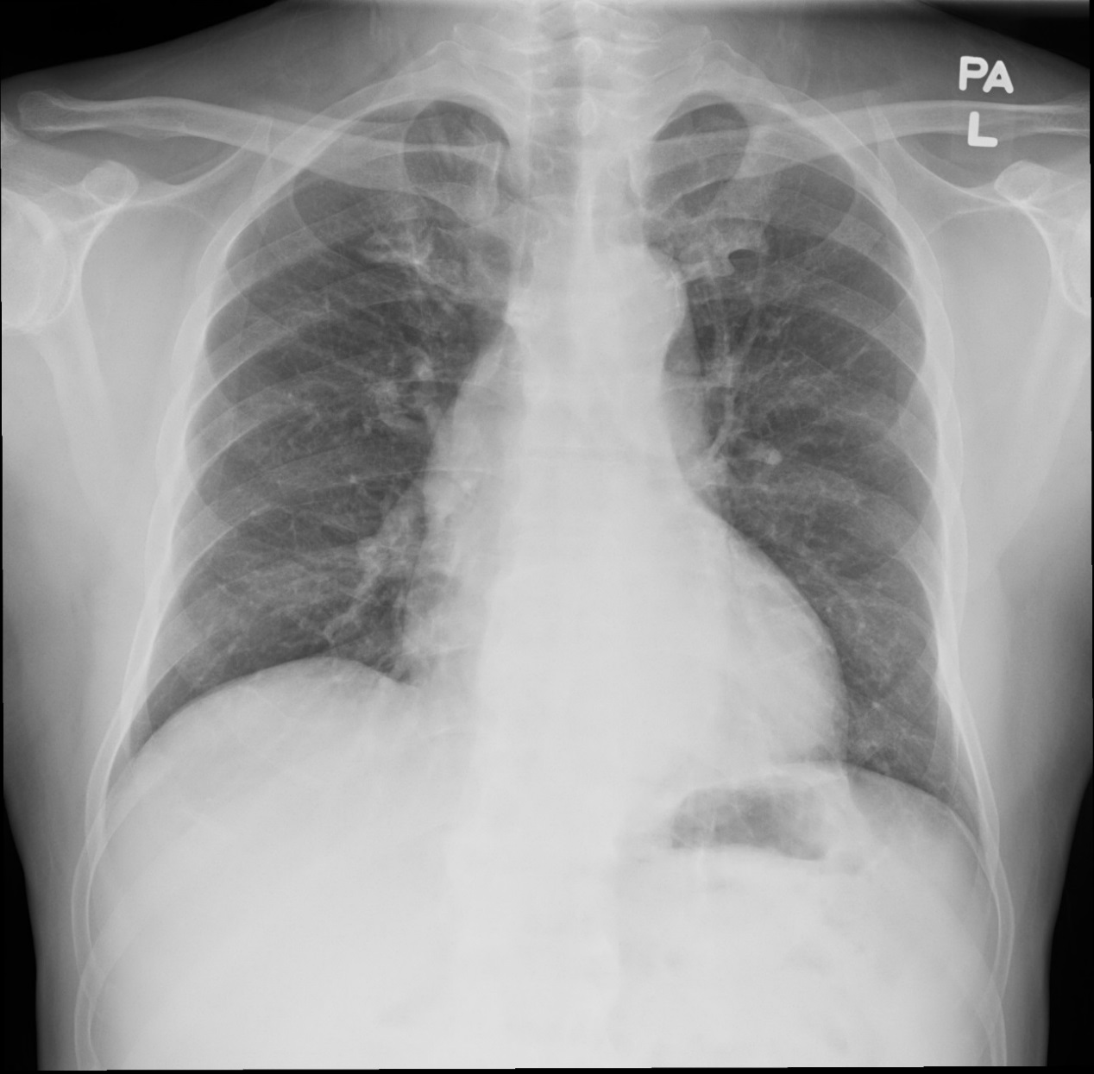
Question 1
Q1. What is the normal mediastinum width in CXR? (1 mark)
<8 cm or <1/3rd the transthoracic distance at the level of the aortic knob on a supine AP film
  <6cm in a standing PA film
6cm

Slide 4
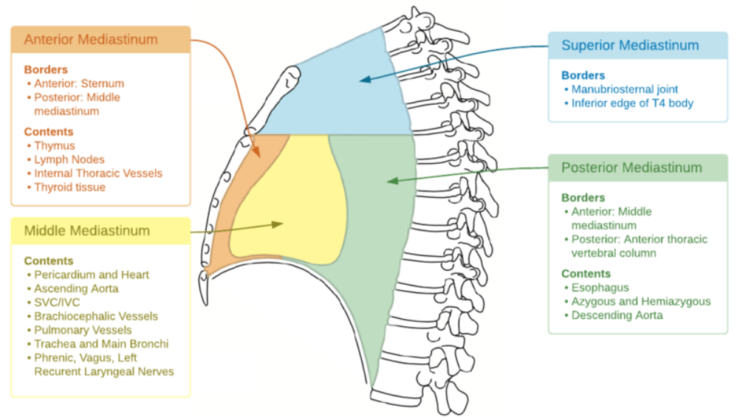
Question 2
Q2. Name 5 causes of widened mediastinum on CXR. (2.5 marks)
Technical
  Rotation, incomplete inspiration, or an AP view
Aorta
  Aortic dissection/aneurysm, atherosclerotic unfolding
Retrosternal goitre
Tumour
  Lymphoma, thymoma, teratoma
Infection/inflammation
  Mediastinitis

Slide 5
Question 3
Bedside echo was performed.
Q3a. Name the Echo views (2 marks)
  Parasternal Long Axis (PLAX)
  Parasternal Short Axis (PSAX), aortic valve level
Q3b. Name 3 abnormalities from Echo (1.5 marks)
  Dilated aortic root
  Trivial AR
  Bicuspid aortic valve
Clip 1a: Image045.avi
Clip 1b: Image048.avi
Clip 1c: Image046.avi
Clip 2a: Image051.avi
Clip 2b: Image052.avi
Clip 2c: Image053.avi

Slide 6
Question 4
Q4. Suggest 2 additional USG views that can be helpful to make the diagnosis (2 marks)
Suprasternal view
    Suprasternal view.mp4
  Abdominal USG
Clip 3a: Image063.avi
Clip 3b: Image064.avi
Clip 3c: Image065.avi
Clip 3d: Image066.avi
Clip 3e: Image078.avi
Clip 3f: Image079.avi

Slide 7
Question 5
Q5. What is the radiological diagnosis in CT thorax? (1 mark)
Ascending aortic aneurysm
Clip 4a: MOV_0236A.mp4
Clip 4b: MOV_0237A.mp4
Clip 4c: MOV_0238A.mp4
Clip 4d: MOV_0239A.mp4

Slide 8
CASE 2
34/F Domestic helper from Philippines
Good past health
Date of admission 16/1/2020
Presented with fever, multiple joint pain, cough and RN for few days
Back from Philippines 3/1/2020

Slide 9
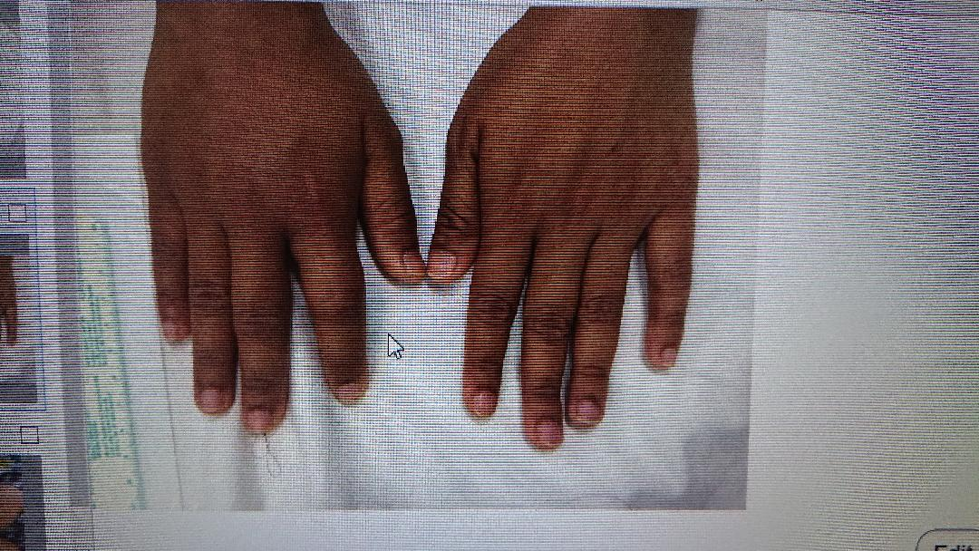
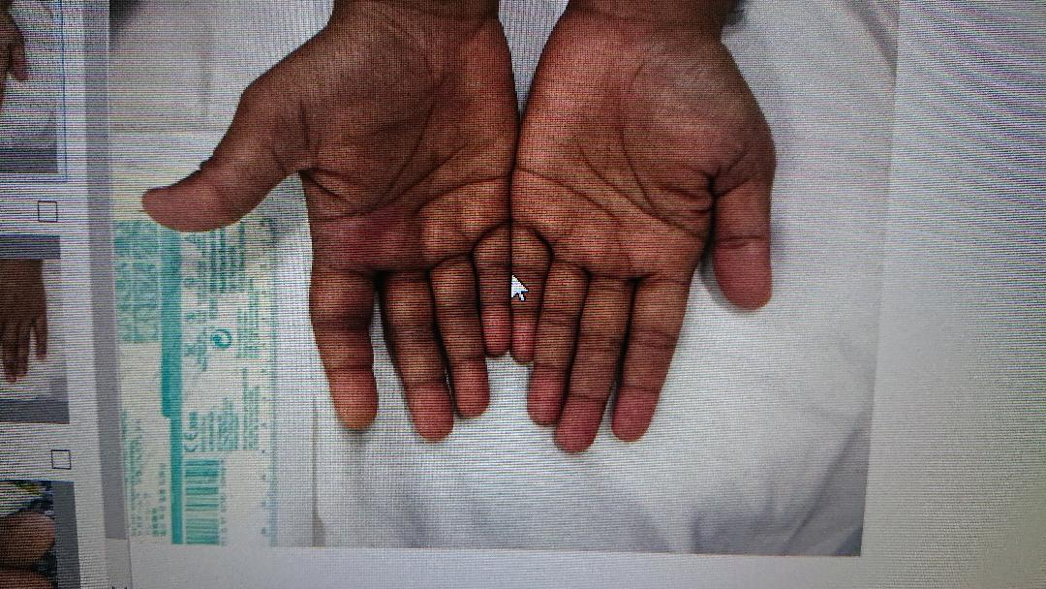
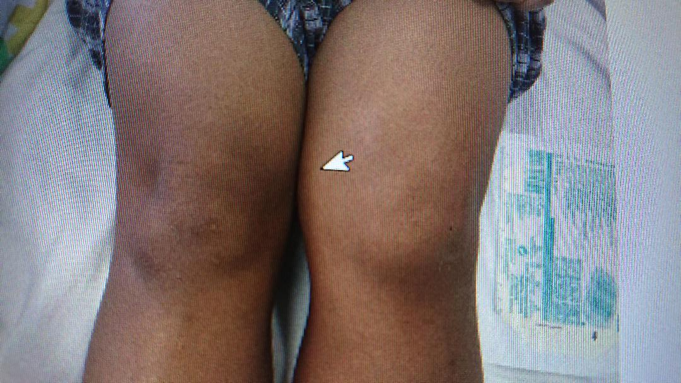

Slide 10
Question 1
Q1. Name 4 DDx (2 marks)
  Rheumatological: Rheumatoid arthritis
  Degenerative: Osteoarthritis
  Metabolic: Gouty arthritis
  Inherited: Haemophilia
  Infective
    Parasite: Malaria
    Bacterial: Mycoplasma, Gonorrhea, Syphilis, Staphylococcus, Streptococcus
    Virus: HIV……

Slide 11
Question 2
Q2. Suggest 5 blood tests to narrow down your DDx (2.5 marks)
  Blood x C/ST
  Blood x Dengue
  Blood x Zika
  Blood x Chikungunya
  Blood x EIA syphilis
  Blood x RF
  Blood x autoimmune markers
Notes:
CBC

Slide 12
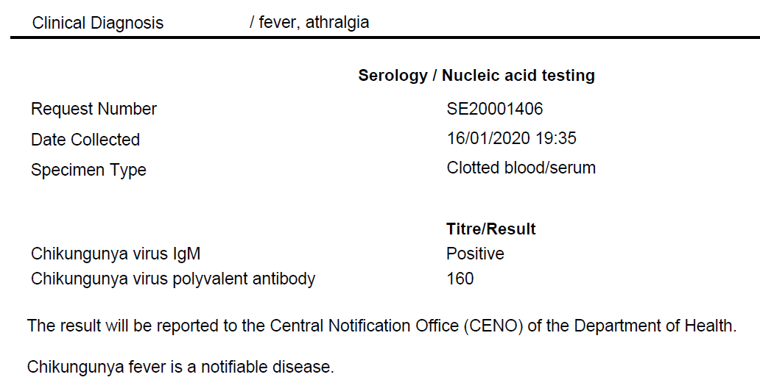
Question 3
Q3. Name 4 countries in Asia where this infection has been reported (2 marks)

Slide 13
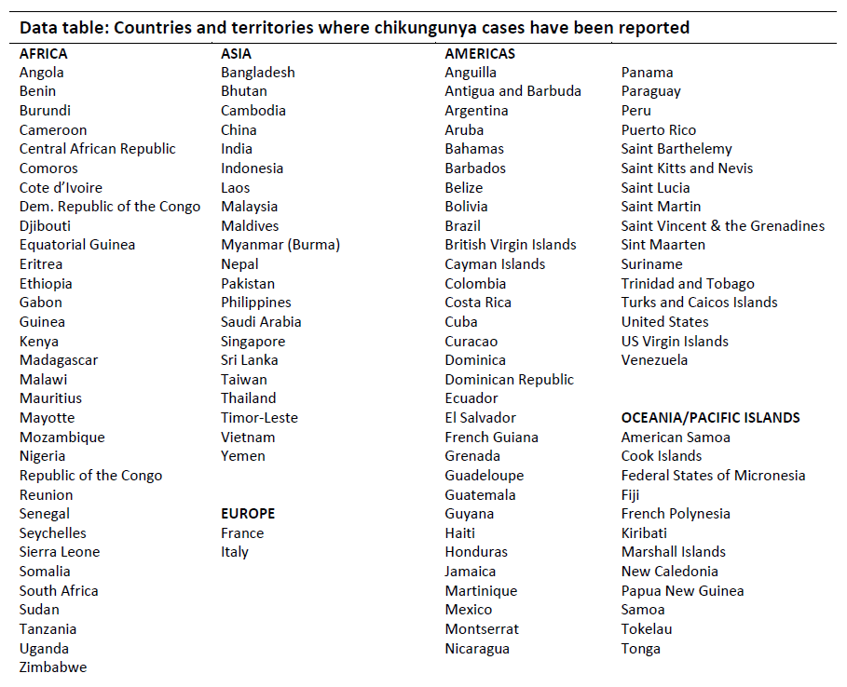
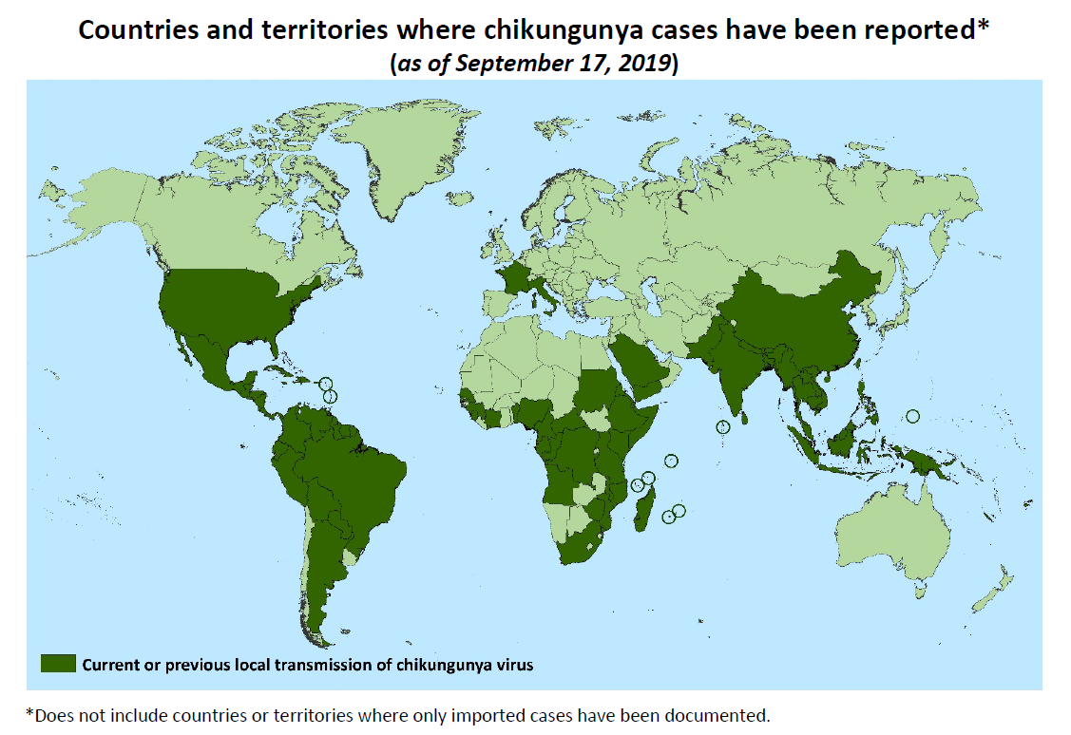
Ref CDC website

Slide 14
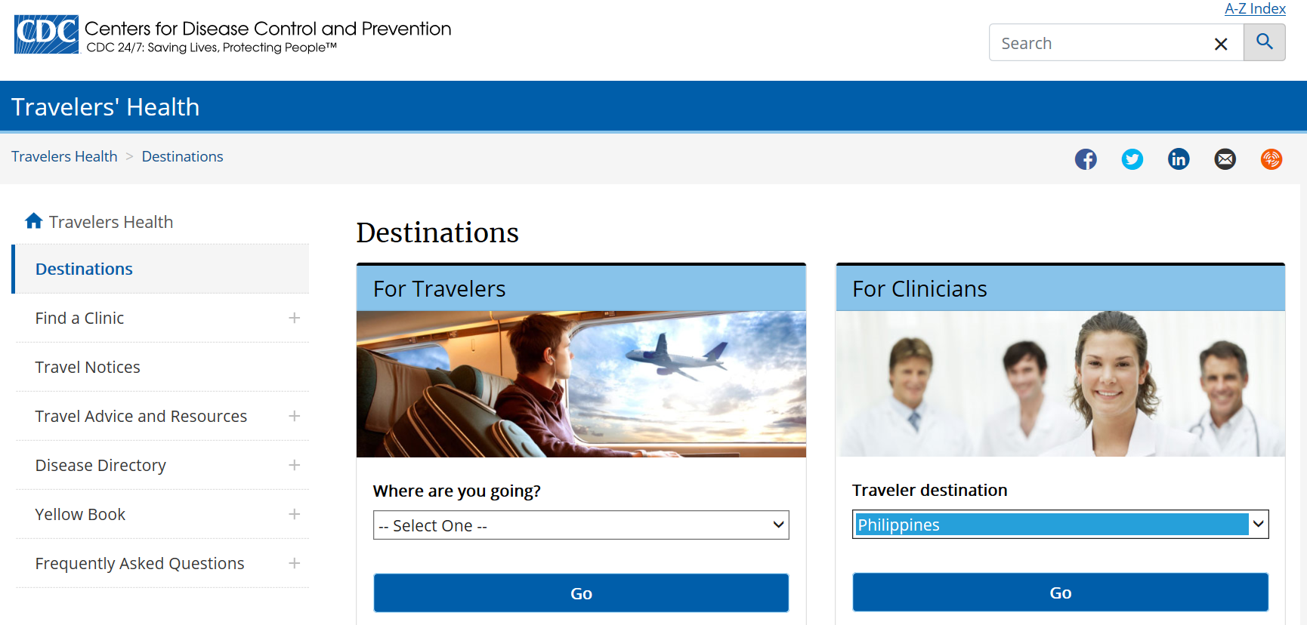
https://wwwnc.cdc.gov/travel

Slide 15
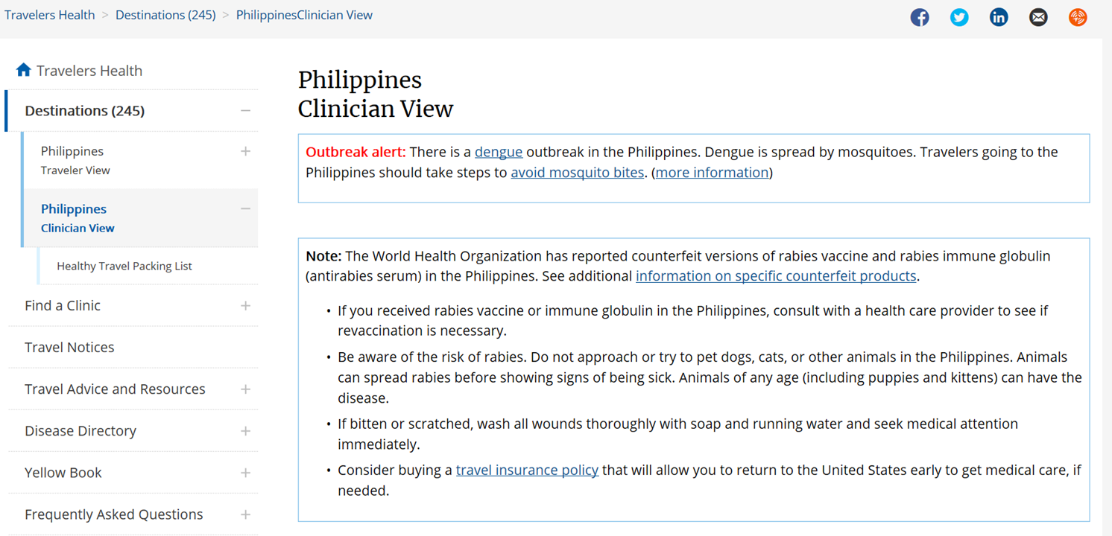

Slide 16
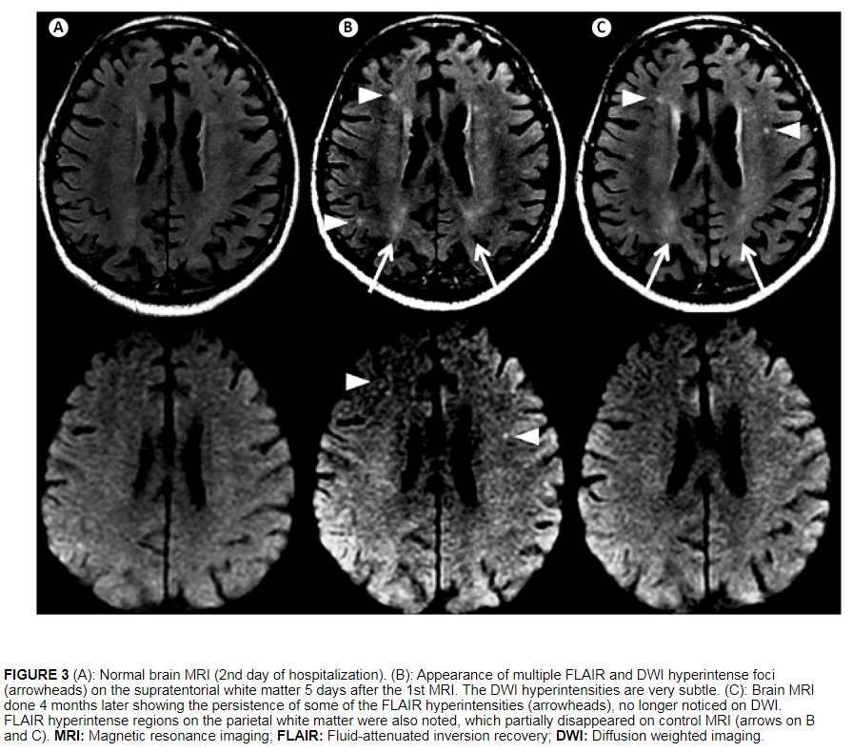
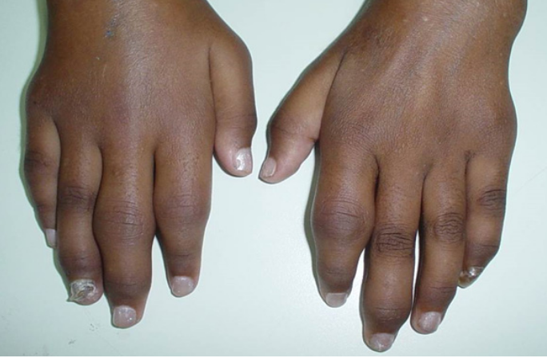
Question 4
Q4a. Name 2 acute severe complications (1 mark)
  CNS: Meningoencephalitis, GBS
  Abd: Acute hepatitis, AKI
Q4b. Name 1 chronic complication (1 mark) and 1 treatment option (0.5 marks)
  Chronic arthritis and arthralgia
  Disease-modifying antirheumatic drug (DMARD)
Rev. Soc. Bras. Med. Trop. vol.50 no.3 Uberaba May/June 2017
Notes:
Eg MTX

Slide 17
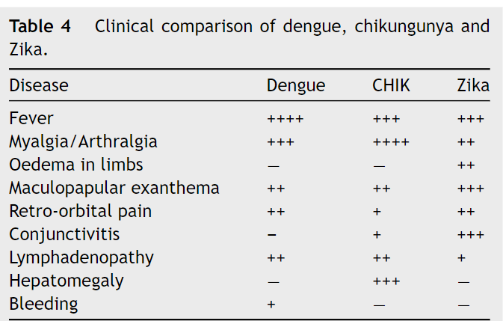

Question 5
Q5. Name 2 clinical presentations more commonly seen in Chikungunya vs other mosquitoes borne infection (1 mark)
Myalgia/arthralgia
Hepatomegaly

Slide 18
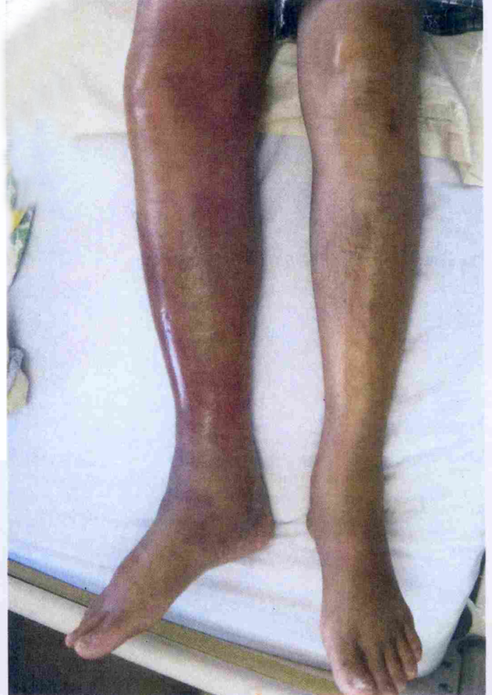
CASE 3
M/53
PMHx:
  Alcoholic liver cirrhosis (Child-Pugh B)
  Recent ultrasound showed hepatosplenomegaly with
  fatty infiltrate and cirrhotic change
  Rheumatoid arthritis (inactive) on prednisolone 5mg daily
  Other usual medications: aldactone and thiamine
Attended AED for right leg swelling & pain x 3/7
Low grade fever+

Slide 19
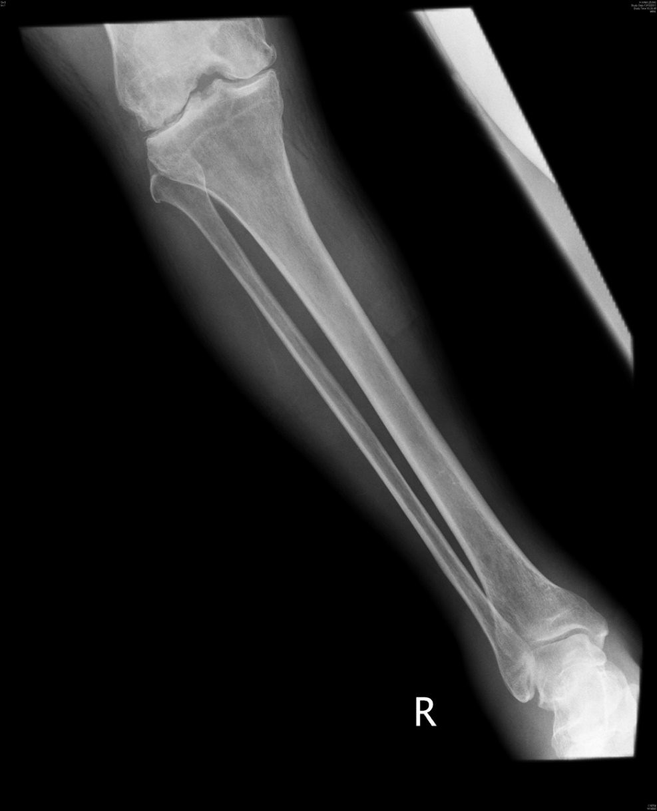
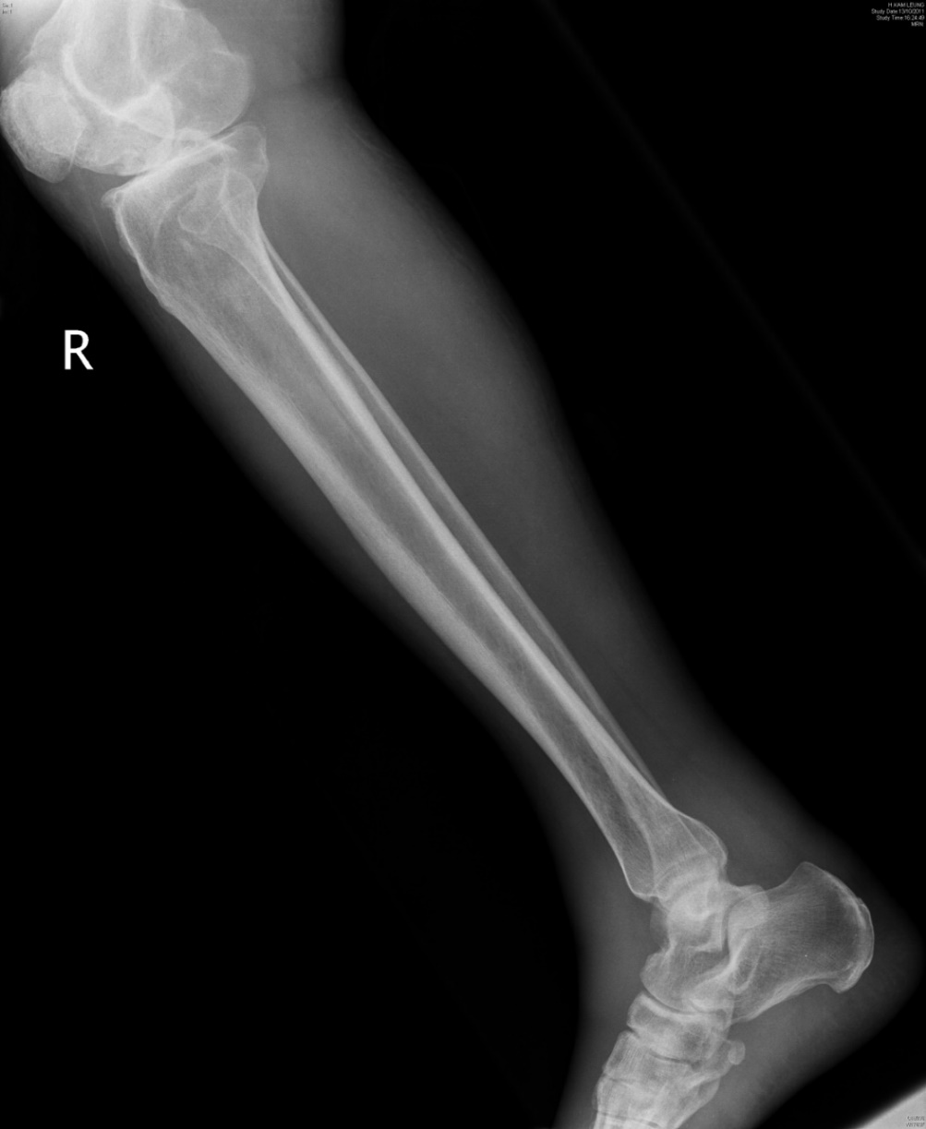
X-ray of Right Leg
X-ray of right leg
X-ray of right leg showed no gas.

Slide 20
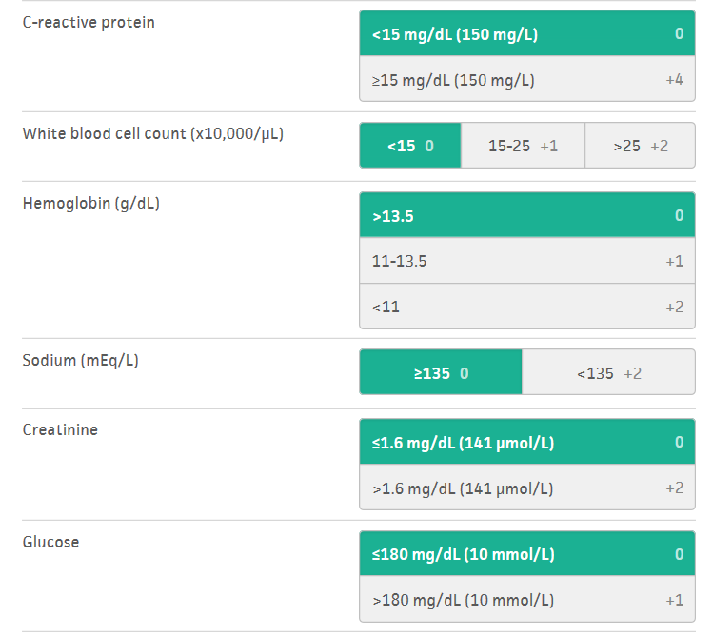
Question 1
Q1. What clinical predictive score can be used to differentiate simple cellulitis from necrotizing fasciitis? (1 mark)
Laboratory Risk Indicator for Necrotizng Fasciitis (LRINEC score)
  Based on laboratory indictors including WCC, Hb, Na, glucose, creatinine and C-reactive protein
  Crit Care Med. 2004;32(7):1535-41.
https://www.mdcalc.com/lrinec-score-necrotizing-soft-tissue-infection

Slide 21
Question 2
Patient developed septic shock in AED.
Q2. What are the elements in the Hour-1 Bundle recommended by the Surviving Sepsis Campaign?( 2.5 marks)

Slide 22
Measure lactate level, Remeasure lactate if the initial lactate level is levated (>2mmol/L)
Obtain blood cultures before administering antibiotics
Administer broad-spectrum antibiotics
  Augmentin plus Quinolone in this case
Begin rapid administration of 30ml/kg crystalloid for hypotension or lactate >=4mmol/L
Apply vasopressor if hypotensive during or after fluid resuscitation to maintain a mean arterial pressure >=65mmHg

Slide 23
Question 3
Q3. If toxic shock syndrome is suspected, what are the possible treatments apart from surgery? (1 mark)
Combination of Clindamycin and IVIG (Clin Infect Disc 2018;67(9):1434 -36)
Alternative agent: Linezolid
**For patients with NF complicated with Streptococcal Toxic Shock Syndrome **

Slide 24
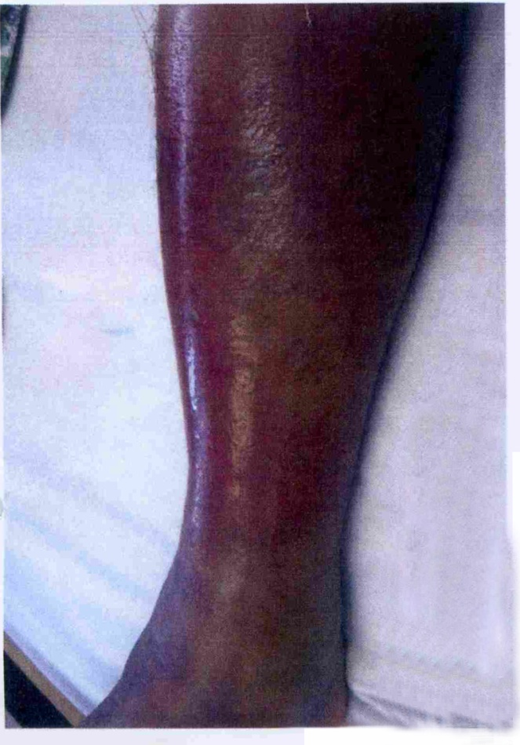
Progress
BP supported by Dopamine infusion
Blood culture taken and given IV Augmentin in AED
Admitted to Orthopedic ward
Noticed increasing swelling and erythema over right lower limb progressing to lateral thigh
Needle aspiration of right foot dorsum and medial malleolus by Orthopedic surgeon on admission, revealed no frank pus

Slide 25
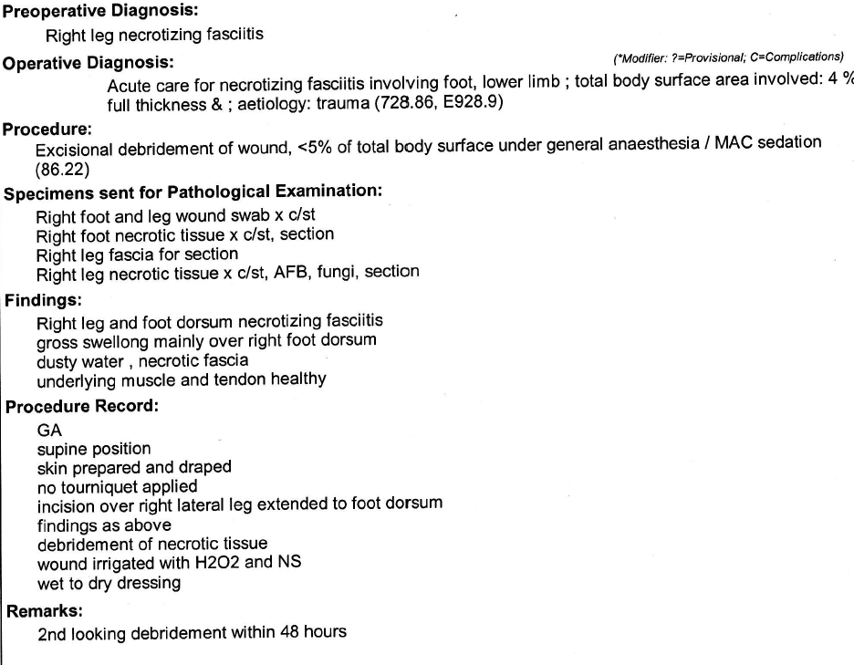
Progress
Emergency operation done
Post-op transferred to ICU
Needle aspirate and blood culture showed a non-Vibrio vulnificus species

Slide 26
Question 4 & 5
The patient reported raw seafood consumption and episode of diarrhea before the onset of right leg infection. There was no injury, no fresh/sea water contact and no external wound over right leg.
Q4. What is the mostly likely Vibrio species causing the infection in the patient? (1 mark)
Q5. Name 3 other Vibrio species (apart from Vibrio vulnificus and the species mentioned in Q4) which are related to necrotizing fasciitis? (1.5 marks)

Slide 27
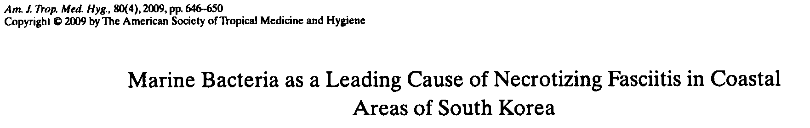
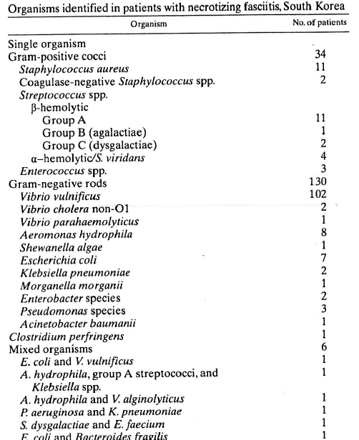
Necrotizing Fasciitis related to Marine Bacteria

Slide 28
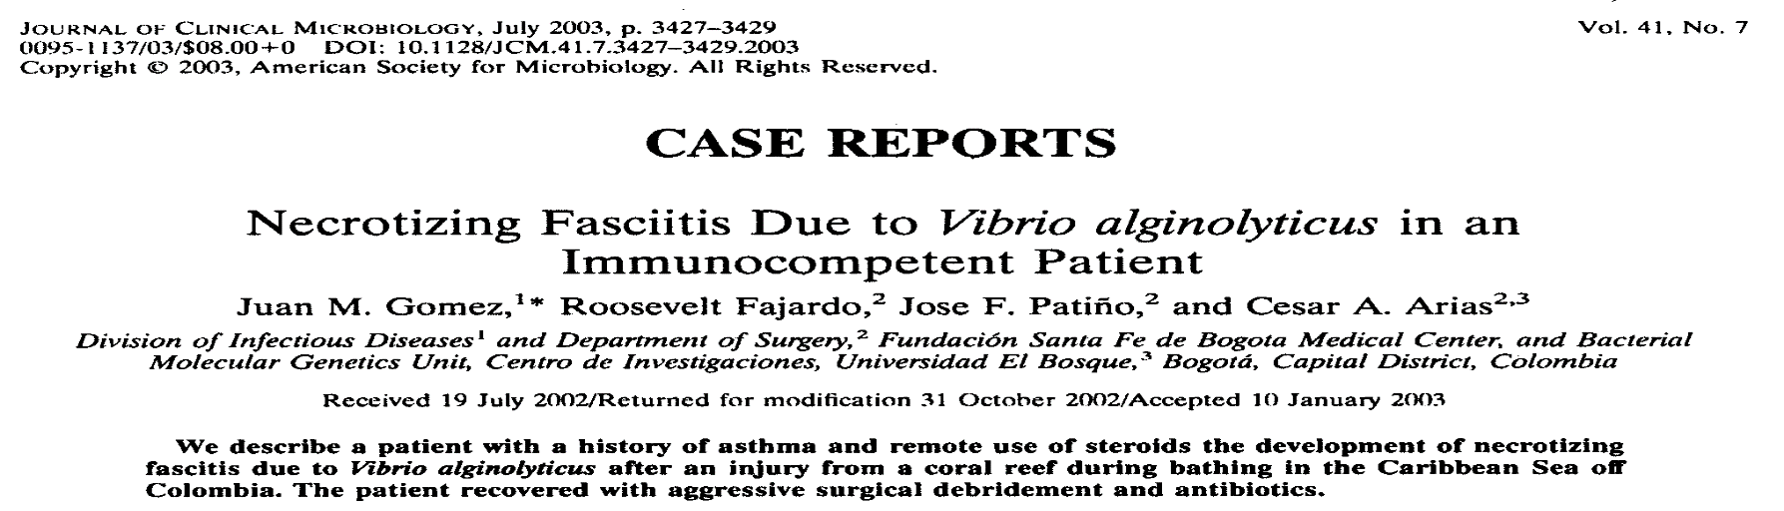
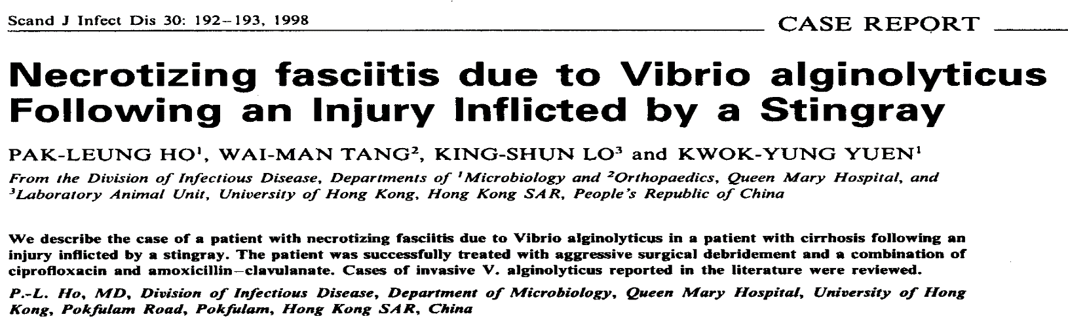
Necrotizing fasciitis by Vibrio species
Notes:
48/F; hx of asthma
28

Slide 29
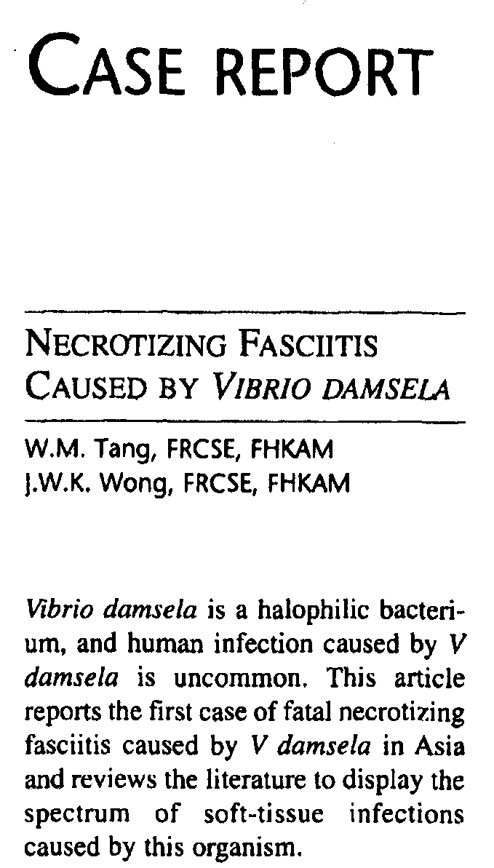
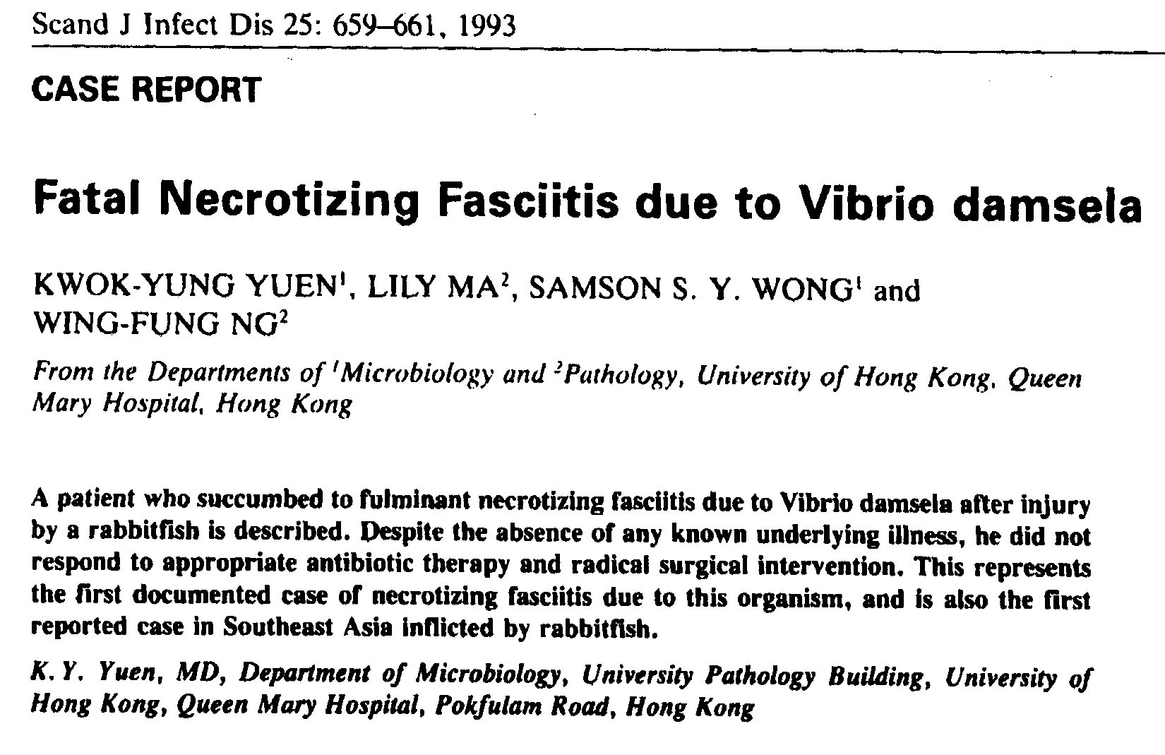
Necrotizing fasciitis by Vibrio species
Orthopedics 1999;12:443-4

Slide 31
Question 4 & 5
Q4. What is the mostly likely Vibrio species causing the infection in the patient? (1 mark)
Vibrio cholera Non-O1, Non-0139
Q5. Name 3 other Vibrio species (apart from Vibrio vulnificus and the species mentioned in Q4) which are related to necrotizing fasciitis? (1.5 marks)
Vibrio parahemolyticus
Vibrio alginalyticus
Vibrio damsela
**Reported cases in literature of NF due to V. parahemolyticus, V. alginalyticus and V. damsela were related to injuries by marine animals or wound infection**

Slide 32
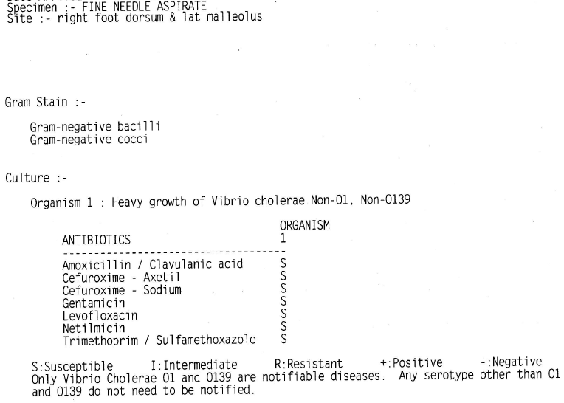
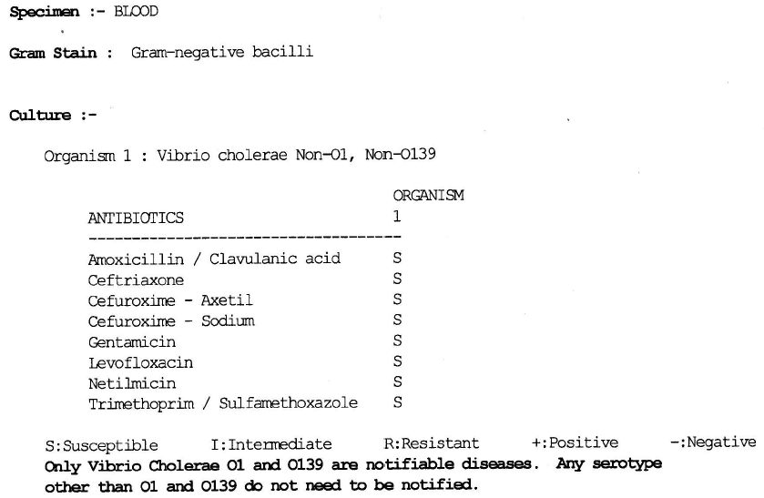
Needle aspirate & Blood C/ST of the patient
Vibrio cholera Non-O1, Non-0139

Slide 33
Question 6
Q6. What are the risk factors for infections due to this Vibrio species? (1 mark)

Slide 34
Infection can be caused cutaneous contact or consumption of raw seafood

Slide 35
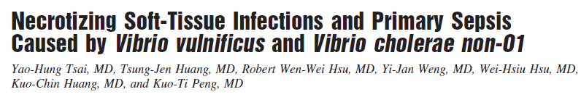
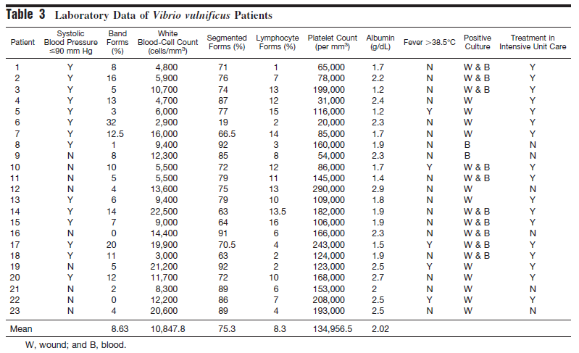
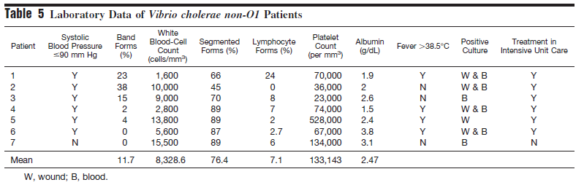
Higher incident of bacteremia (compared with Vibrio vulnificus)
Blood culture positive in 52% of patients with V. vulnificus infection Vs 86% of patients with V. cholera non-O1 infections
Notes:
V. Cholera non O1 causes bacteremia more often than V. vulnificus

Slide 36
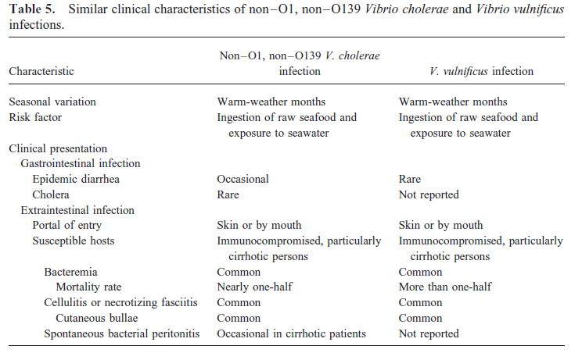
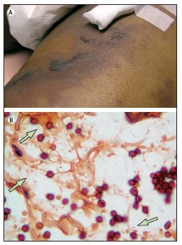
Non-O1, non-O139 V. cholerae Vs V. vulnificus
Lancet Infect Dis 2008;8:399
Notes:
Tissue section of patients with NF caused by V. vulnificus showing curvilinear Gram-negative bacilli on background of necrotic fibres with minimal neutrophilic reaction

Slide 37
Question 6
Q6. What are the risk factors for infection due to this Vibrio species? (1 mark)
Liver cirrhosis/ chronic liver disease
Alcoholism

Slide 38
Question 7
Q7. What are the prognostic factors of mortality in this patient particular for infections from this Vibrio species? ( 1 mark)

Slide 39
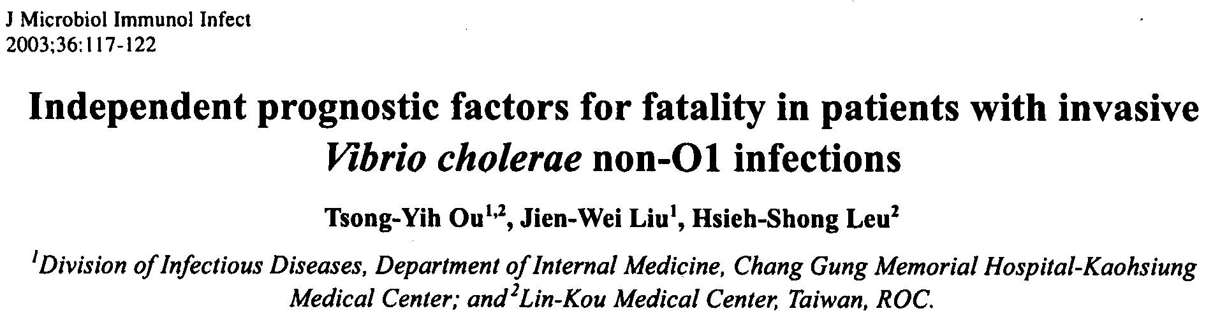
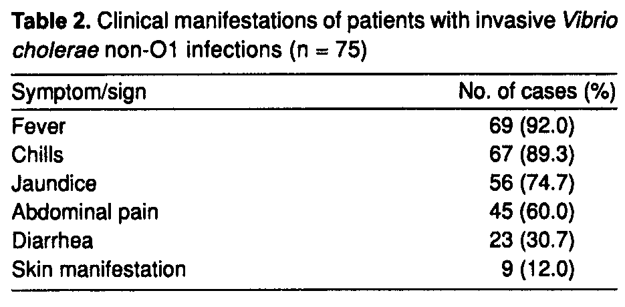
Retrospective study of invasive V.cholerae non-O1 infections between 1998 to 2001
73 patients with a total 75 episodes of infections
Overall mortality rate: 36%

Slide 40
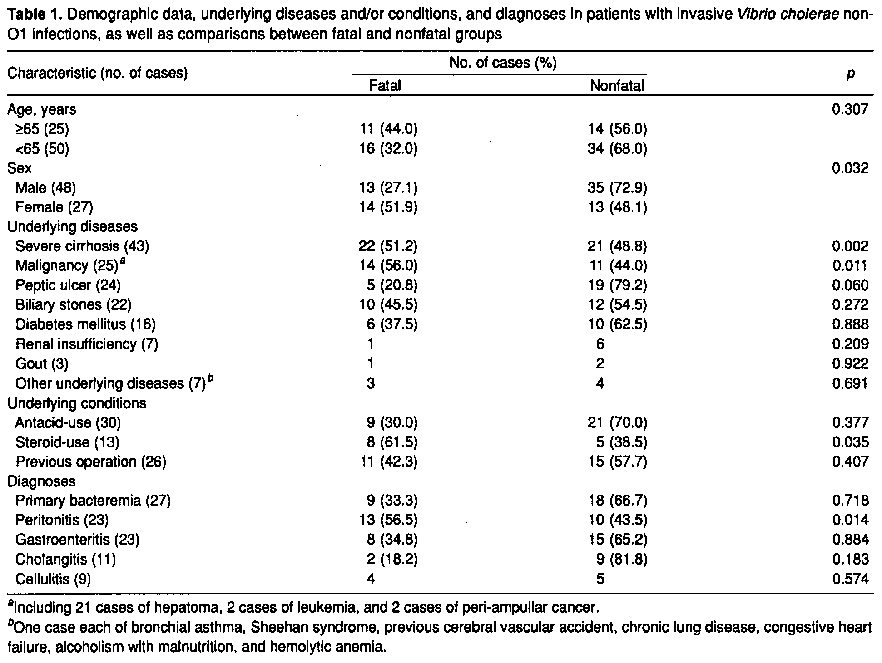
Independent risk factors for fatality:
➔ Liver cirrhosis (OR 14)
➔ Underlying malignancy (OR 3.9)
➔ Steroid use (OR 12)

Slide 41
Question 7
Q7. What are the prognostic factors of mortality in this patient particular for the infections from this Vibrio species? (1 mark)
Underlying liver cirrhosis
Use of steroid

Slide 42
Question 8
Q8. What is/are other potential complications from bacteremia of this Vibrio species? (1 mark)

Slide 43
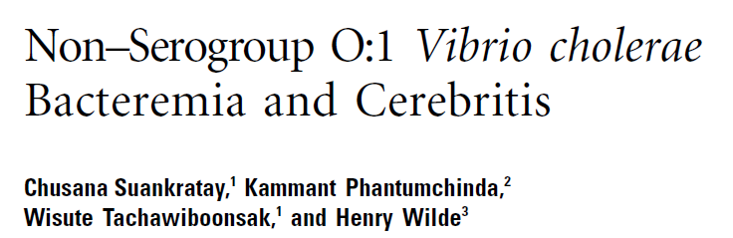
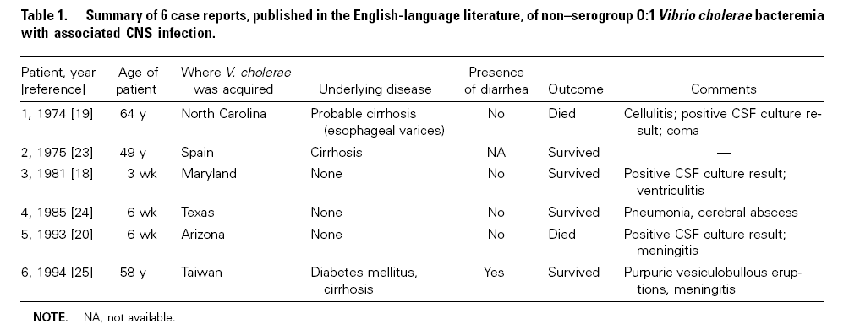
CNS complications from non-serogroup O1 V. cholerae bactermia
Clinical Infectious Disease 2001;32:e117-9
Notes:
CT brain showed small enhancing lesions at right frontal, frontotemporal cortex and left insula lobes + low density area involving basal ganglia and bilateral thalamic region extending upward to periventricular white matter and right frontal area

Slide 44
Question 8
Q8. What is/are other potential complications from bacteremia of this Vibrio species? (1 mark)
CNS infections
  Meningitis
  Cerebritis
  Ventriculitis
  Cerebral abscess

Slide 45
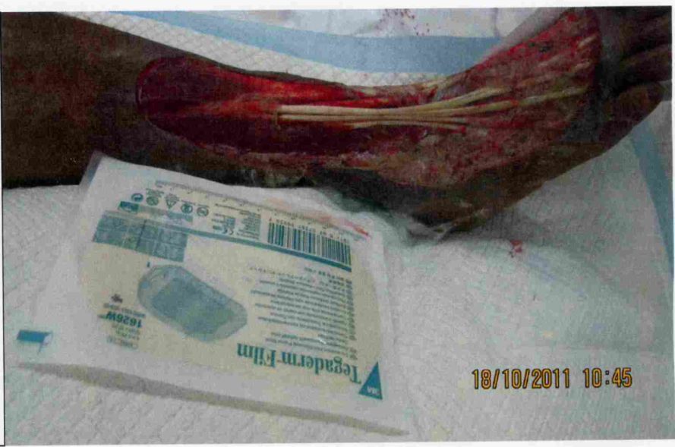
Progress of the pateint
Repeated debridement done
Condition improved and hemodynamic stabilized with antibiotic therapy and surgical treatment

Slide 46
CASE 4
M/69
PMHx:
  HBV cirrhosis
  HCC with wedge resection done, latest CT: no recurrence
Attended AED for chills and left chest wall pain x 4/7
No fever
No cough/ SOB
No injury
No TOCC
Vital signs in AED:
  BP 123/85
  Pulse 139 bpm
  Temp 36.5C
  RR 22
  SpO2 96% on RA
  GCS full
POCT:
  H’stix high
  pH 7.38, BE-2.0

Slide 47
ECG

Slide 48
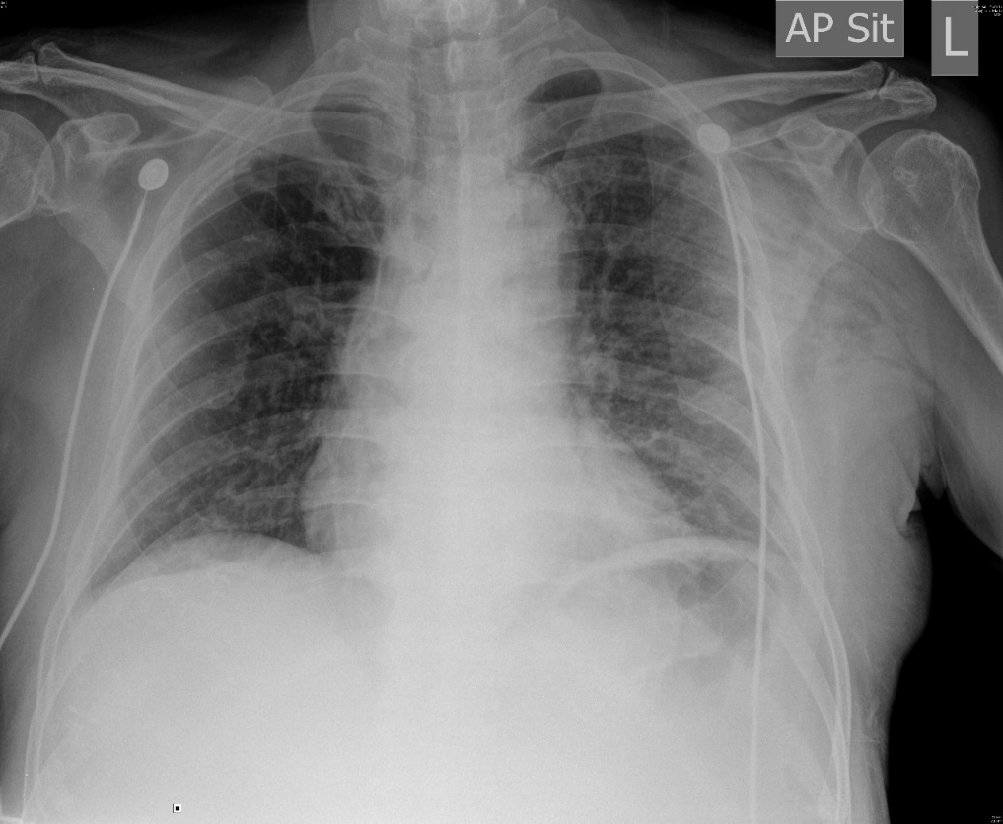
Please describe the CXR.

Slide 49
CXR
  Subcutaneous emphysema over left side chest wall

Slide 50
Question 1
Q1. What are the possible causes of the abnormal finding in the CXR? (1.5 marks)
Penetrating injury
Secondary to pneumothorax
Gas-forming bacteria infection

Slide 51
The patient developed fever and septic shock soon after admission and CT thorax was performed.

Slide 52
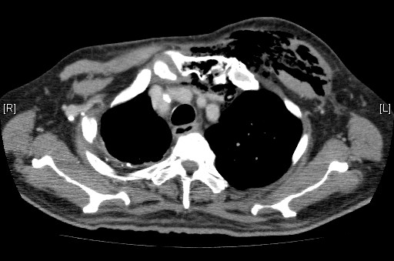
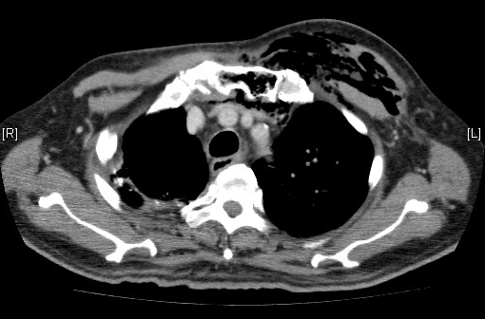
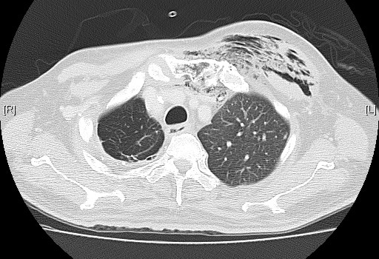
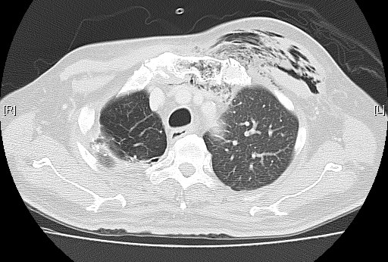

Slide 53
Question 2
Q2. Describe the findings in the CT thorax. (1.5 marks)
Extensive subcutaneous emphysema over left side chest wall
Air lucencies over the anterior mediastinum
Air lucencies also present in the marrow cavity of the manubrium of the sternum and the left sternoclavicular joint
Suspected bony distruction of the left sternoclavicular joint
No pneumothorax

Slide 54
Question 3
Q3. Please give 2 most likely diagnoses for the radiological findings. (1 mark)
Chest wall intramuscular abscess
Necrotizing fasciitis of chest wall

Slide 55
Question 4
Q4. What is the mostly source of the infection? (1 mark)
Spread from left sternoclavicular joint infection

Slide 56
Question 5
Q5. What are other the potential complications from this condition? (2 marks)
Mediastinitis
Empyema
**Because of the joint capsule is unable to distend, infection can quickly spread beyond joint to the adjacent structures**

Slide 57
Question 6
Q6. What are the risk factors for this infectious condition? (1 mark)
Diabetes mellitus
Chronic steroid use and other immunosuppression states
Intravenous drug abuse
Central venous catheter insertion

Slide 58
Question 7
Q7. What are the treatments for the patient? (2 marks)
Fluid resuscitation and hemodynamic support with inotropes
Early board spectrum antibiotics
Control blood glucose level
Surgical debridement
Surgical resection of sternoclavular joint for infection complicated with osteomyelitis/ uncontrolled sepsis

Slide 59
SCJ
  Synovial lined
  Composed of:
    Inferior, medial clavicular head
    Superior lacteral notce of manubrium
    Cartilage of first
SCJ infections
  Rare form of septic arthritis
  Believed to be secondary infection from hematogenous spread
  As the joint capsule is unable to distend, infection can quickly spreads beyond the joint to subcutaneous tissue, mediastinum and pleural cavity
  Reported in association with CVC insertion, IVDA, local trauma, immunocompromised due to DM, steroid use and HIV infection
  Most common organism: Staphylococcus aureus

Slide 60
Sternoclavicular joint (SCJ) infection
Clinical presentations:
  Chest wall pain
  Localized swelling
  Fever
  +/- draining sinus tract
CT imaging:
  Increased joint fluid
  Air and abscess in surrounding tissues
  Bone destruction

Slide 61
Management
Rare condition
Optimal treatment based on expert opinion, e.g. conservative management with antibiotic therapy, surgical resection of SCJ
Surgical resection of SCJ with muscle flap reconstruction is purposed in some overseas centers
Case series showed minimal functional impairment at long-term follow-up after surgery

Slide 62
Progress of the patient
Emergency operation done
  Intraoperative findings: multiple intramuscular abscesses in left pectoralis major muscle
  Incision and drainage done
  No SCJ resection done
Subsequently multiple debridement performed
Sepsis under control with antibiotic treatment after operation
Flap reconstruction of left chest wall subsequently performed
Eventually discharged with total length of stay about 2 months

Slide 63
JCM OSCE Q&As
NLTH AED
1 April 2020

