Slide 1
Joint Clinical Meeting & Didactic Lectures (JCM) OSCE Questions
3 Jun, 2020
Prepared by KWH AED

Slide 2
Case 1
54/F, history of recurrent dizziness and palpitation c/o palpitation, dizziness and chest discomfort
BP 157/99, Pulse 240, afebrile, GCS 15

Slide 3
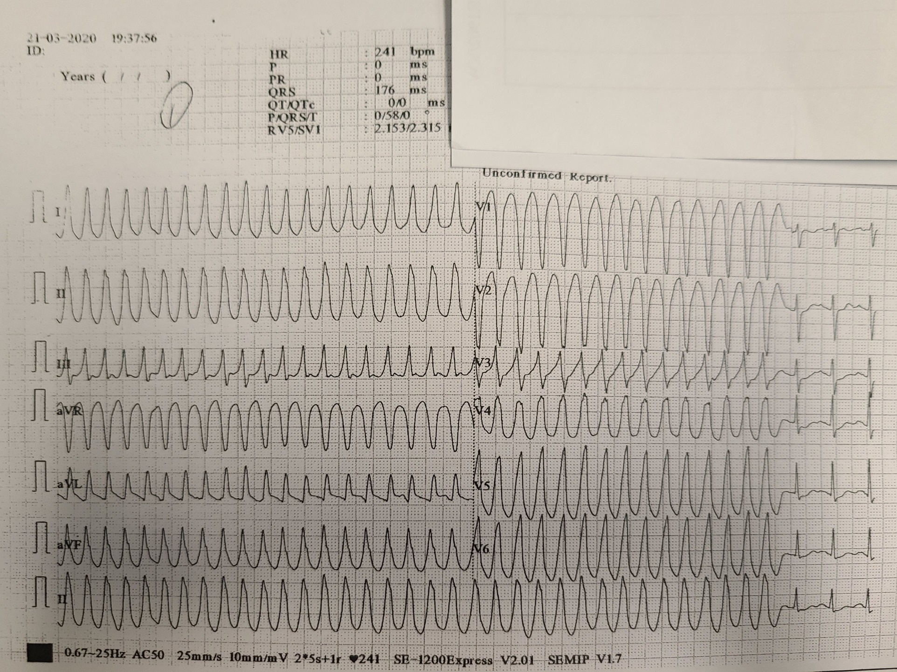
-1/ Give 4 findings of this ECG

Slide 4
2/ what is the ECG diagnosis?
3/ What treatments would you give if the initial rhythm persist?
4/ What is the definitive treatment?

Slide 5
Case 2
12/M
Fever x 5 days
Headache, eye pain and vomiting
URI symptoms and epistaxis
PE:BP 150/69, P 136, Temp 37
Partial ptosis of both eyes

Slide 6
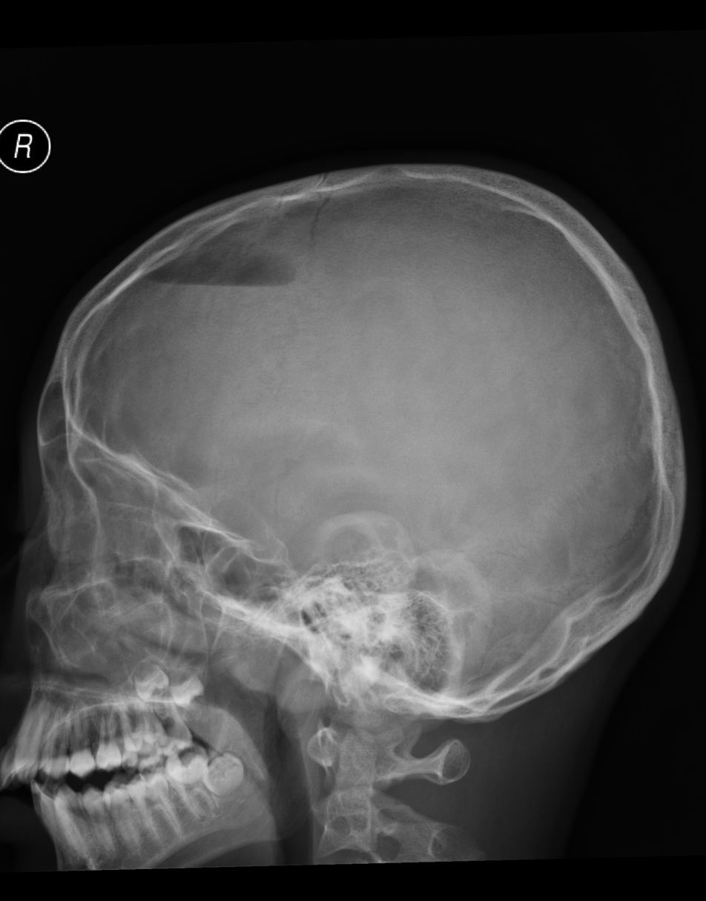
- Describe the abnormality in the Skull X-rays.

Slide 7
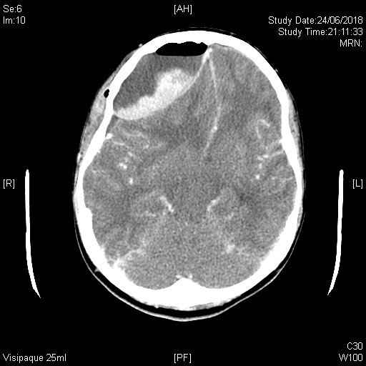
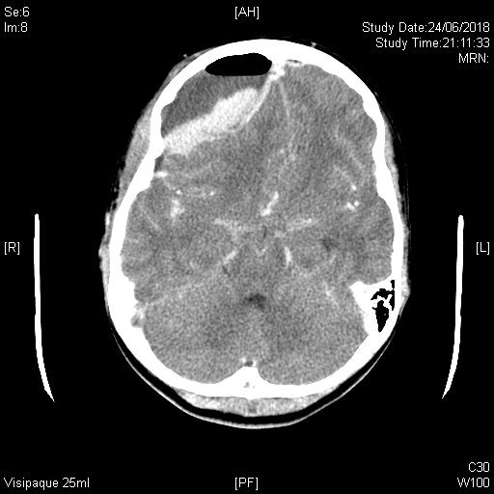
Describe the abnormalities in this contrast CT brain.

Slide 8
What is the diagnosis?
What are the pathogenic sources of your diagnosis?
What is the definitive management of this case?

Slide 9
Case 3
48/M
History of substance abuse.
Presented with confusion and head injury.
Also complained of chest discomfort
BP 154/93 P 95 Temp 36.5
Uncooperative and irritable

Slide 10
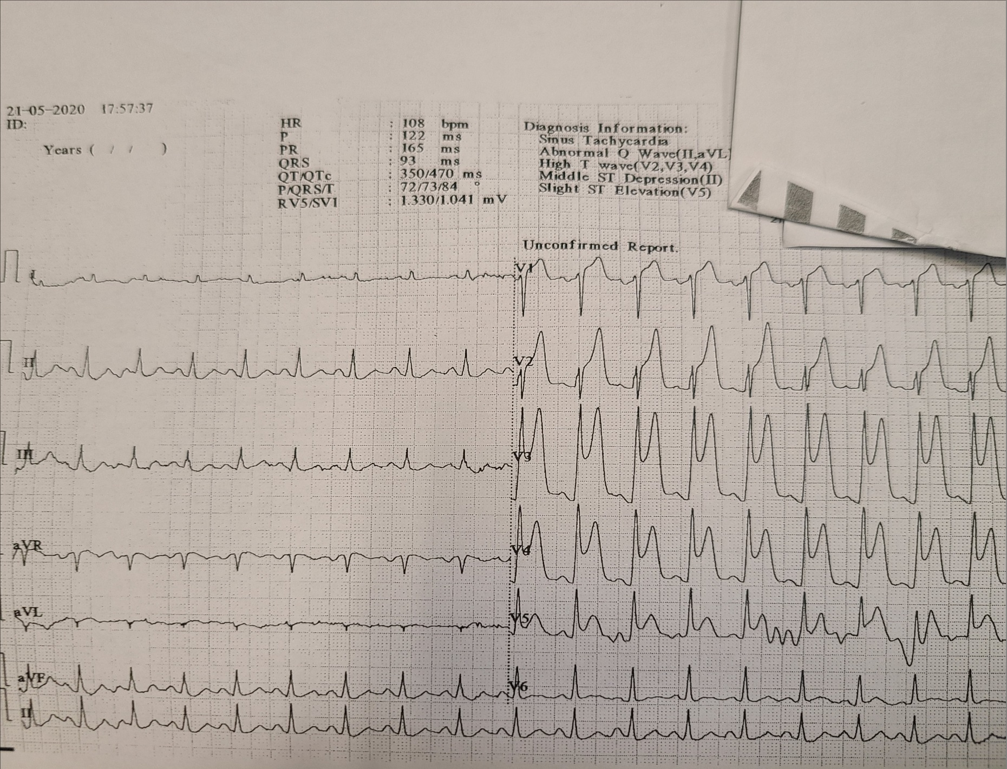
Describe the abnormalities of the ECG.

Slide 11
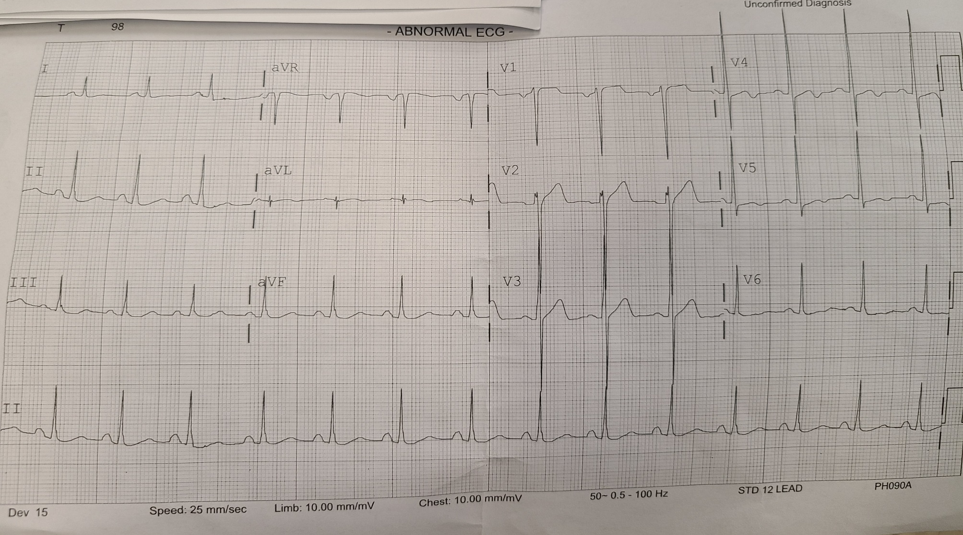
2nd ECG is performed less than 1 hour later in CCU What is the difference?

Slide 12
Name one recreational drug that is well known to cause the above complication?
What are the mechanisms of this drug in causing MI?
According to Universal Definition of MI, Which Type of MI does this case belongs to?

Slide 13
Case 4
72/M, history of CA rectum, refused operation
c/o decrease GC, abd pain and vomiting x 1 day
PE: BP 96/60, P 113, afebrile
abdomen tenderness and guarding +

Slide 14
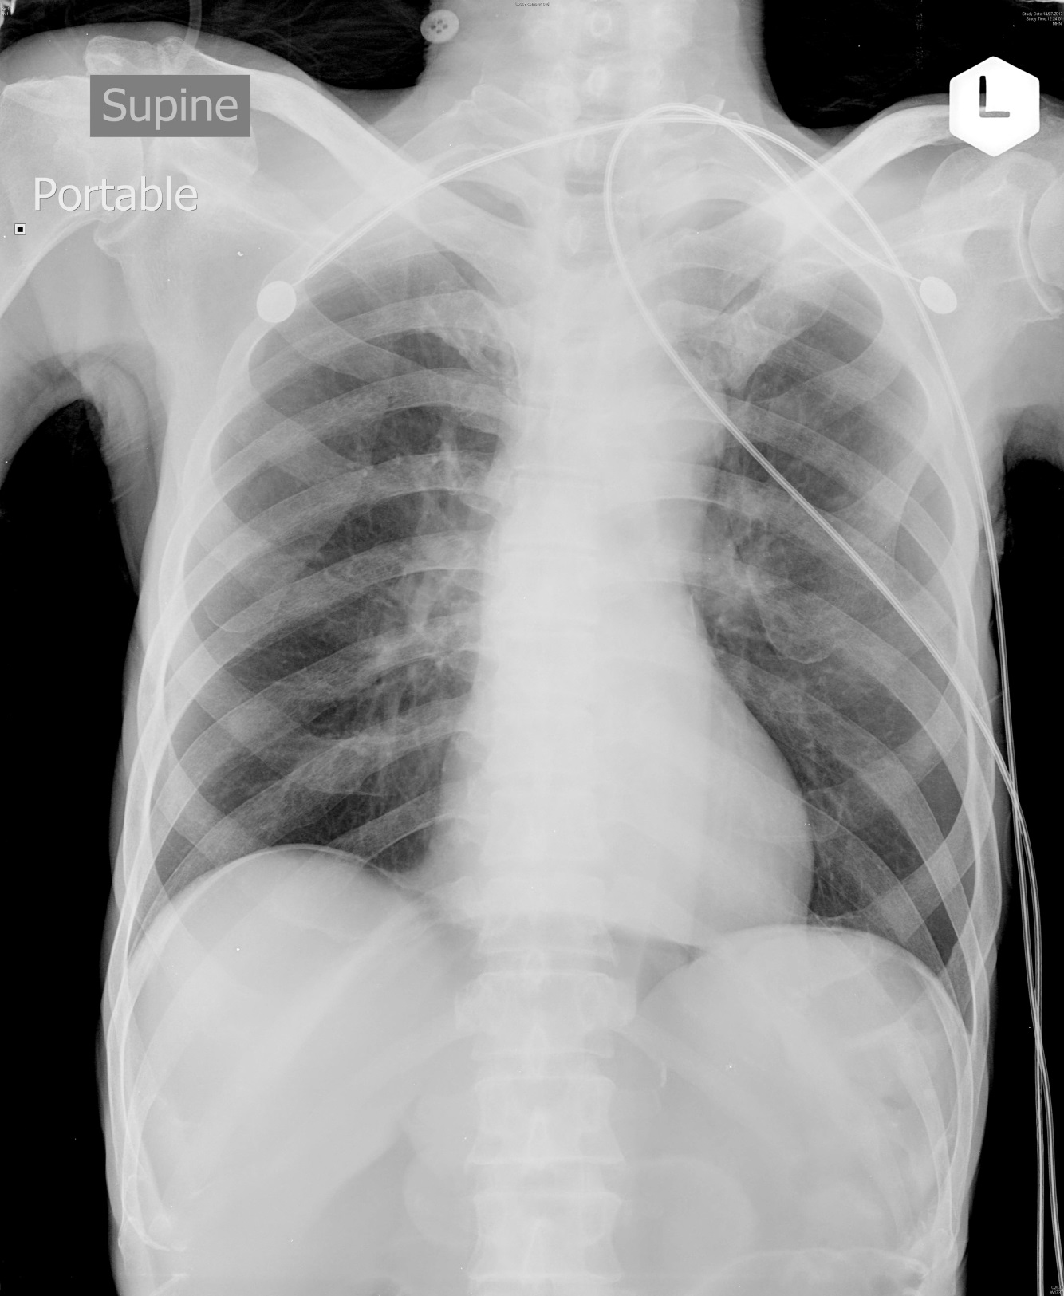
Name 2 abnormalities in this CXR.

Slide 15
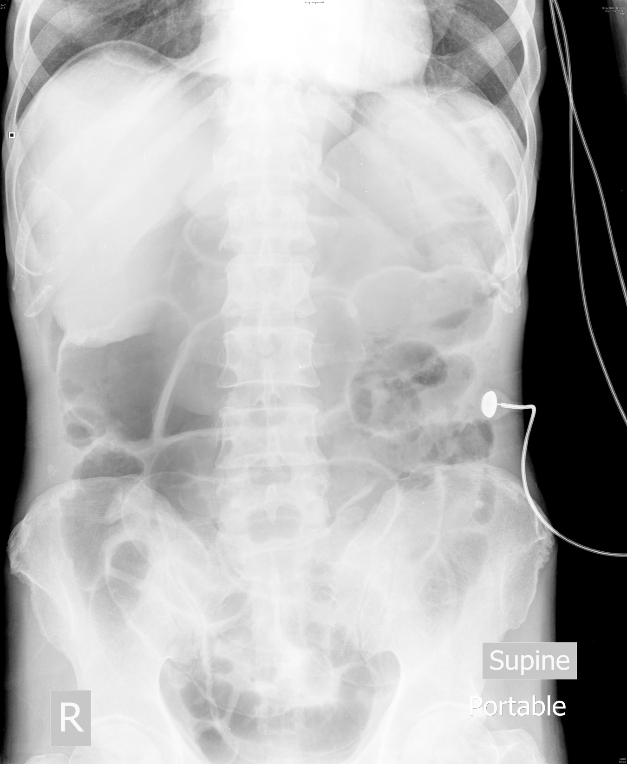
Name one additional sign in this AXR.

Slide 16
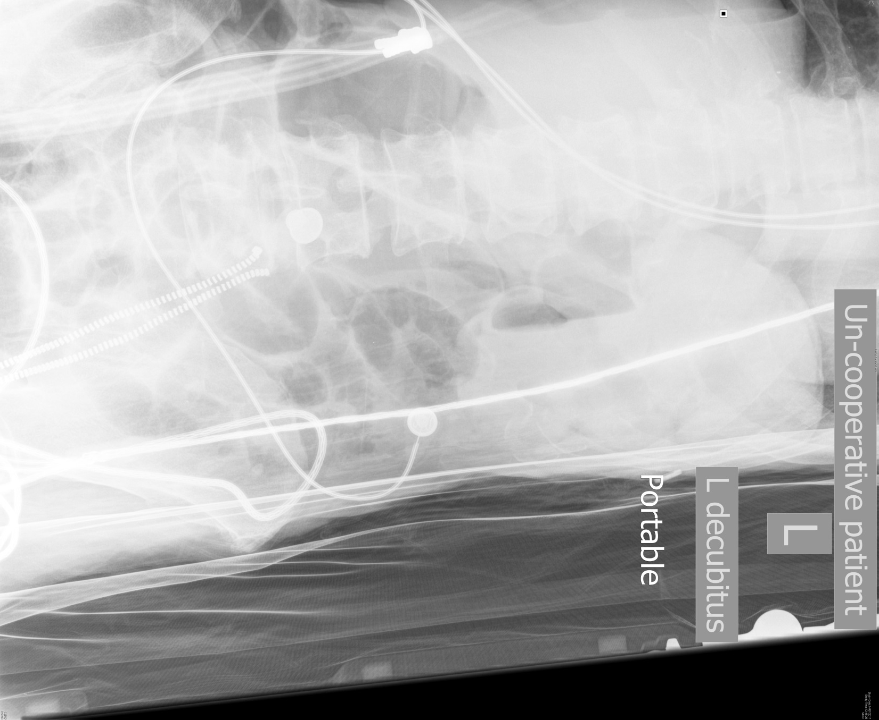
What are the abnormalities in this AXR?

Slide 17
What will be your management? Name 4.

