Slide 1
OSCE Answer – YCH
Dr Lo CH
6/5/2020

Slide 2
Case 1
14m / F
FTNSD
Fever, cough, noisy breathing and SOB on DOA
TOCC negative
Pulse 140bpm SpO2 97% (RA)
Temp 38.3
X rays were performed

Slide 3
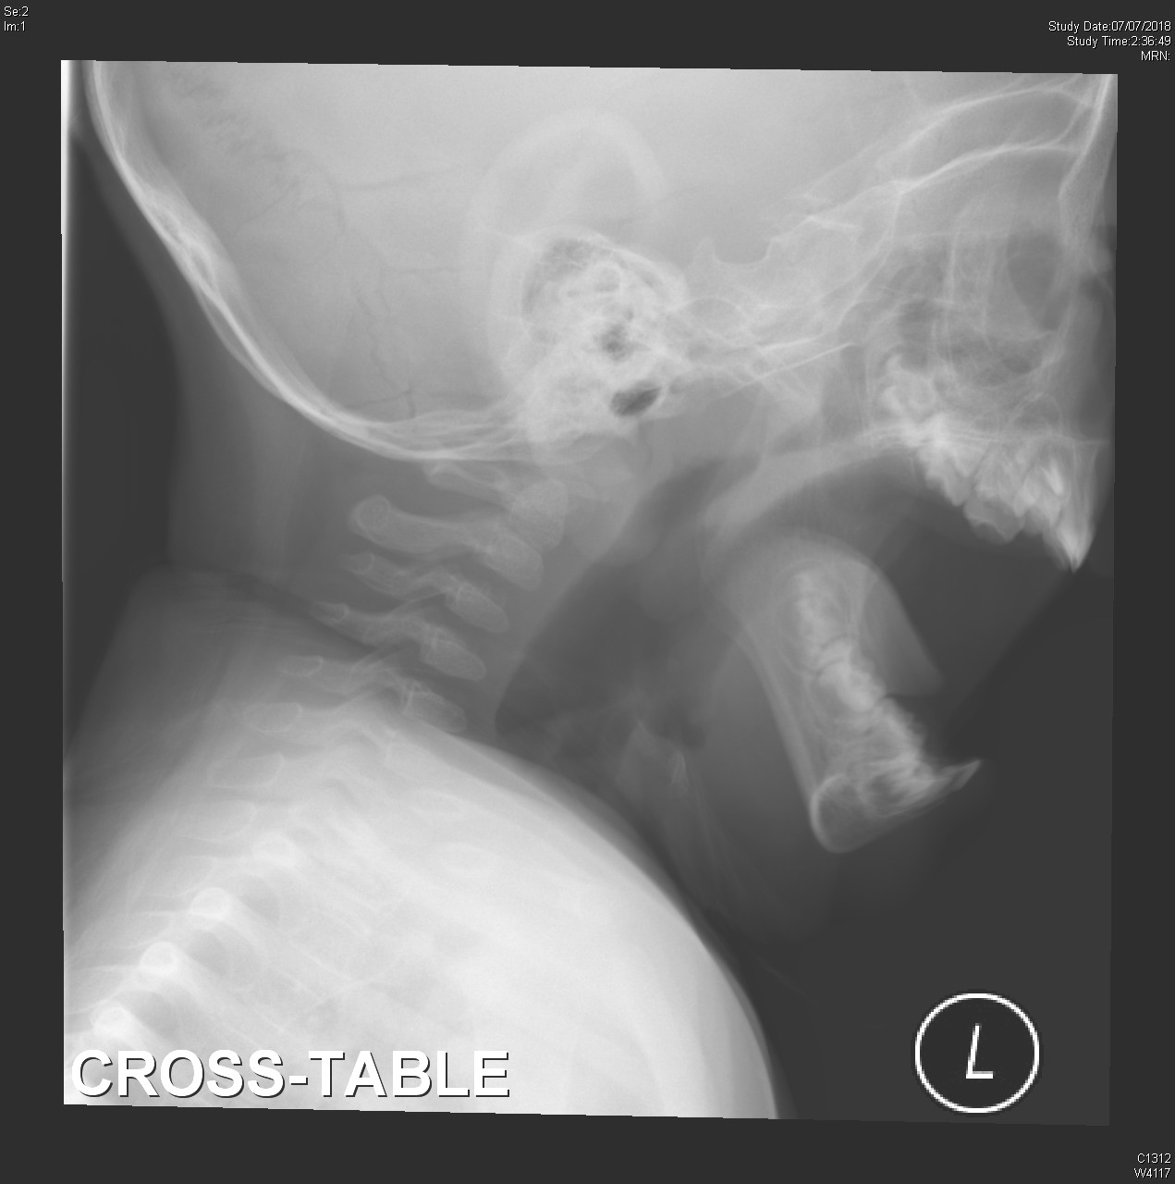
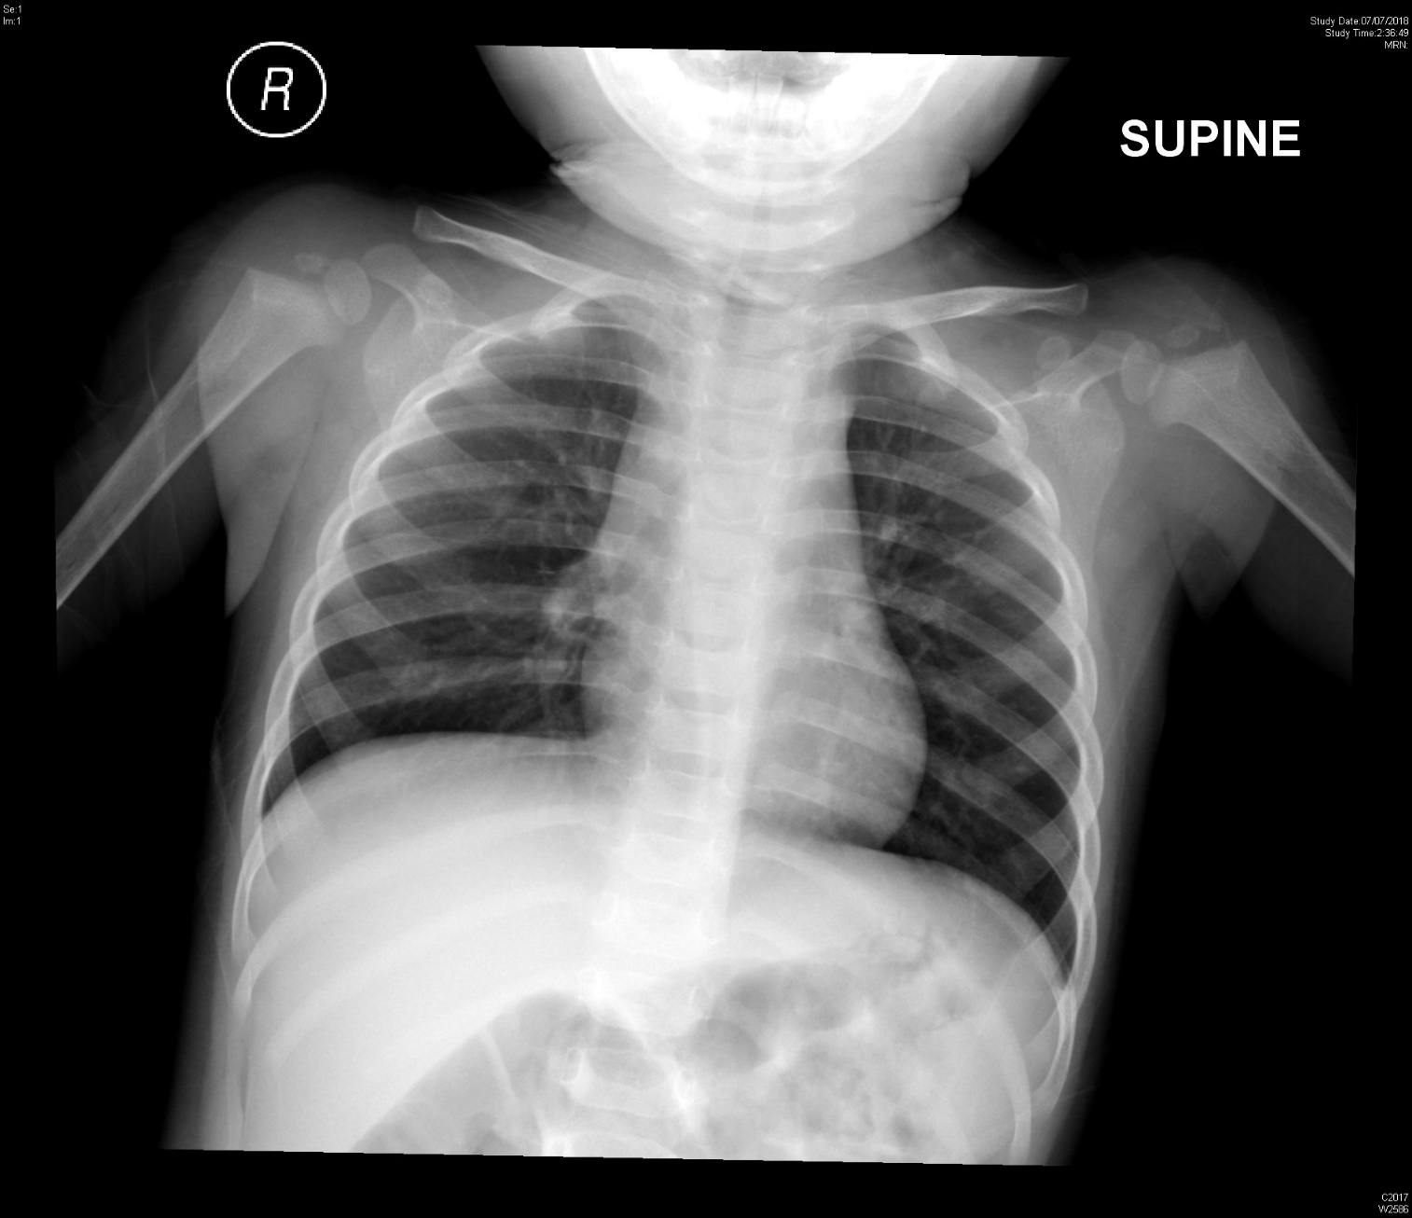

Slide 4
1. What are the x ray findings?
  steeple sign
  supraglottic distension

Slide 6
2. What is the diagnosis?
  Croup
3. How would you assess the severity?
  by the presence or absence of stridor at rest
  the degree of chest wall retractions
  air entry
  pallor or cyanosis
  mental status

Slide 8
4. What treatment would you give?
  Dexamethasone 0.6mg /kg po
  Nebulized adrenaline 1:1000 (0.5ml/kg, max 5ml )
  O2 , antipyretics

Slide 9
5. 30mins after the treatment, the patient improved.
  Her Mother asked whether the patient can be discharged.
  How would you advise?
  Croup symptoms may recur (after adrenaline effect wear off, usual ~2hrs )
  Need observation 3-4hrs , may discharge if
    No stridor at rest
    Normal pulse oximetry
    Good air exchange
    Normal color
    Normal level of consciousness
    Demonstrated ability to tolerate fluids by mouth
    Caregivers understand the indications for return to care and would be able to return if necessary
  FU in next 24 hrs

Slide 10
Case 2.
11/F good past health
no urine output and suprapubic distension for 12 hrs.
bowel opening
P/E: suprapubic mass +
Bedside USG was preformed

Slide 11
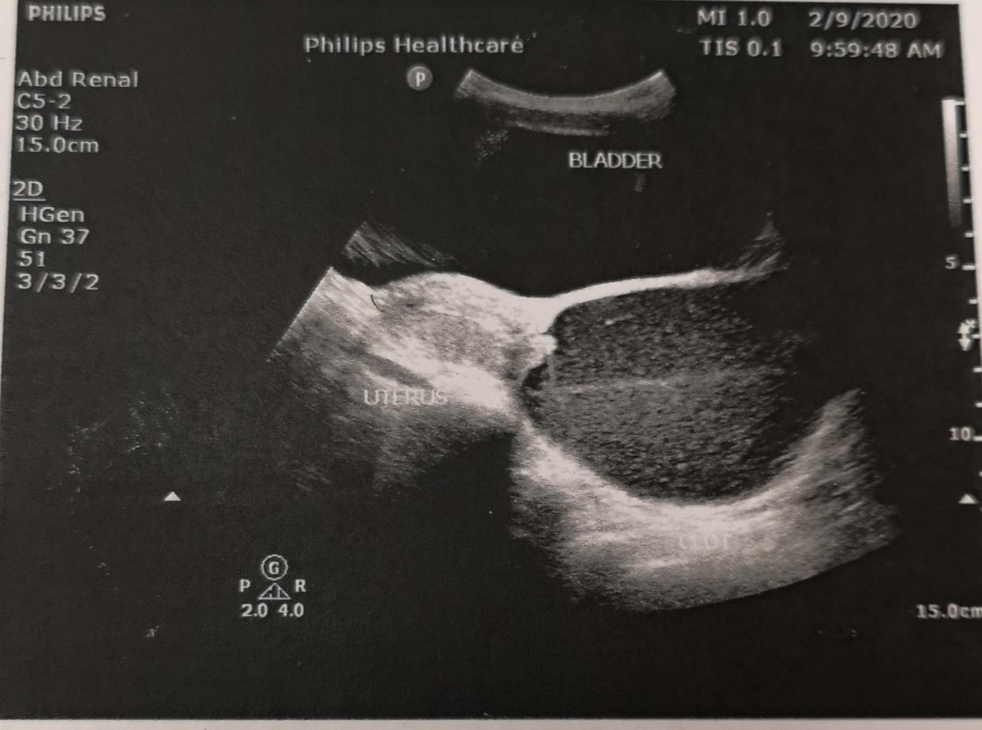

Slide 12
1. What is the USG finding?
  distended fluid-filled vagina (Hematocolpos) and uterus (hematometra)
2.What history would you like to ask?
  menstruation history

Slide 13
3.What is the diagnosis?
  Imperforate hymen
4. What is the treatment?
  Insert foley catheter
  Surgical repair

Slide 14
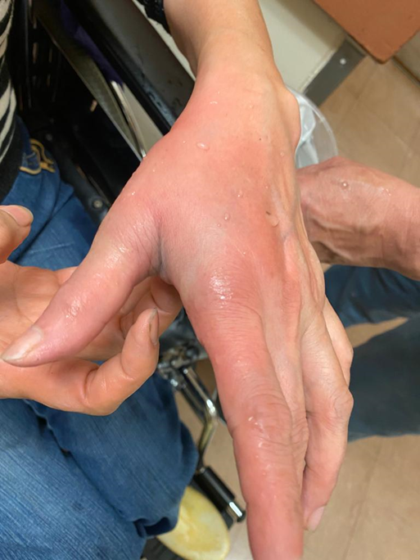
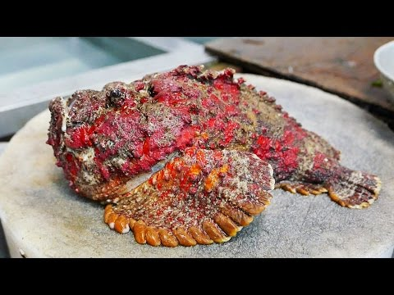
Case3
63/F
Left hand was stung by fish at market (with photo)
Sever pain and numbness
BP 190/107 P 92

Slide 15
1. What is the diagnosis and what initial treatment would you give?
  analgesic, hot water immersion (45 C)
  X ray, wound exploration for FB
  Tetanus prophylaxis

Slide 16
2. what specific treatment would you give?
  Stonefish antivenom im
  -1 vial for 1-2 punctures
  -2 vial for 3-4 punctures
  -3 vial for >=5 punctures

Slide 17
3. what are the complications of the injury?
  Necrosis and potential for delayed healing
  Infection (e.g. Vibrio)

Slide 18
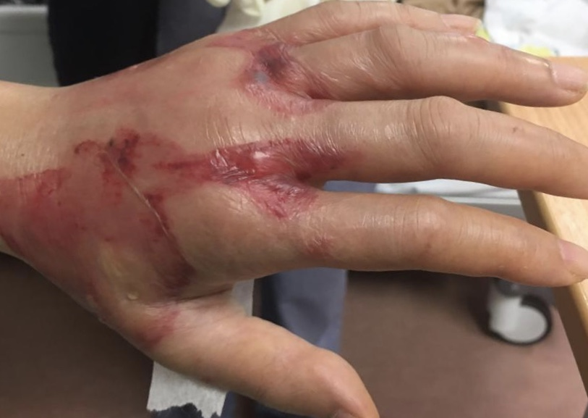
Progress of the patient
  Given 1 vial of stonefish antivenom im
  admitted to EMW
  D/C on D3

Slide 19
Case4
42/F
S/F while chasing bus
Left shoulder injury

Slide 20
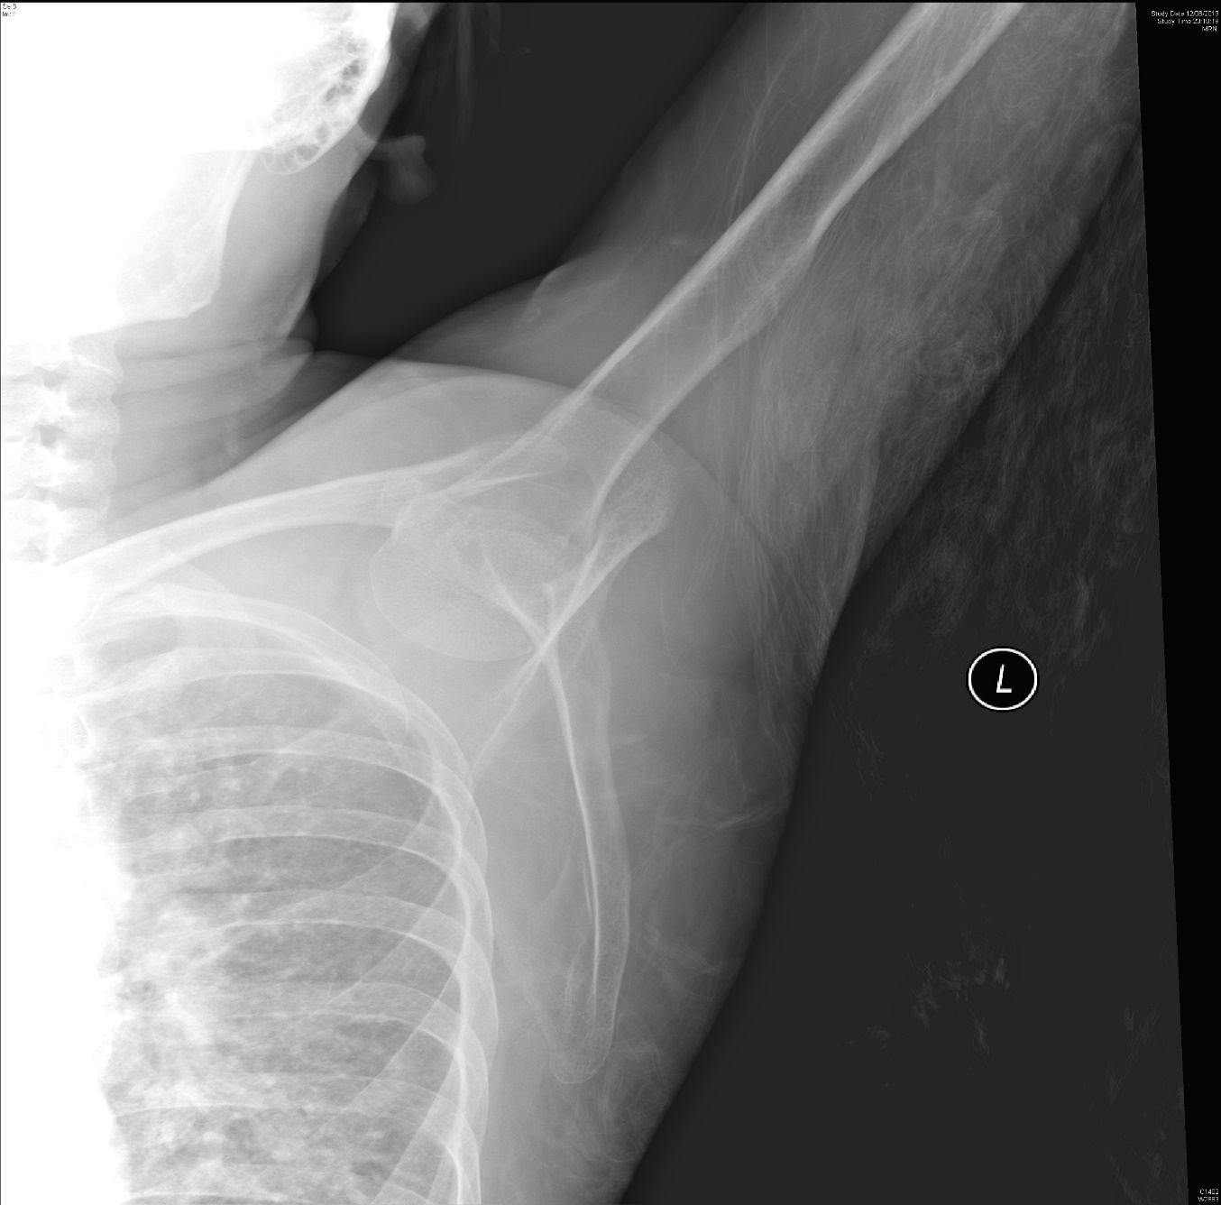
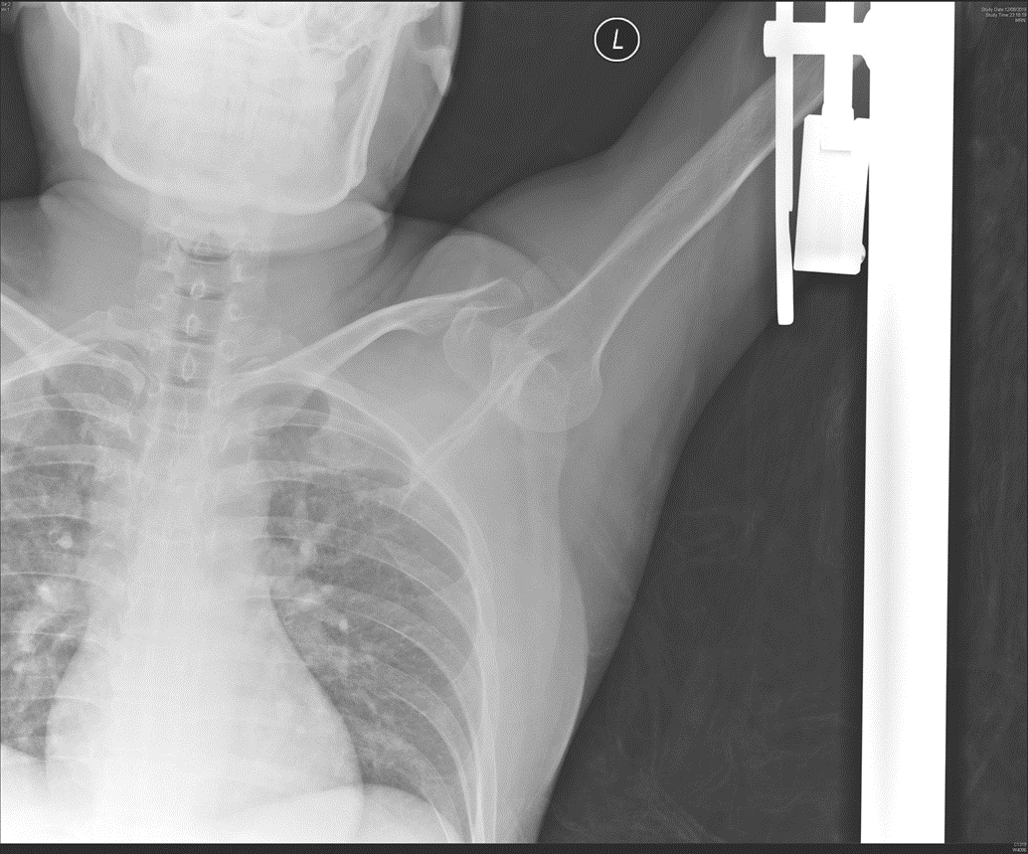

Slide 21
1. What are the x ray finding and diagnosis?
  X ray AP:
    humeral head displaced inferomedically to the glenoid fossa
    Humerus in marked abduction
  Inferior shoulder dislocation (luxatio erecta)

Slide 22
2.what are the 2 possible treatment methods in ED?
  Traction and counter traction
  2-step reduction
    Convert the inferior dislocation into an anterior dislocation by pushing the proximal humerus anteriorly while pulling the elbow in a superior position
    Adduct the arm
    Use any reduction technique for anterior dislocation

Slide 23


Slide 24
3. What are the complications of the injury?
  Brachial plexus nerve injury esp axillary nerve injury
  Axillary artery thrombosis
  Rotator cuff injury
  Fracture of greater tuberosity of humerus, glenoid rim, acromion or clavicle
  Glenolabral tear

Slide 25
Thank you

