Slide 1
JCM OSCE 07.2020
RH AED

Slide 2
Case 1
A 27 year old gentleman attended the emergency department after falling on his outstretched left hand while playing a game of football.
He complained of pain and decreased range of movement in the wrist joint.

Slide 3
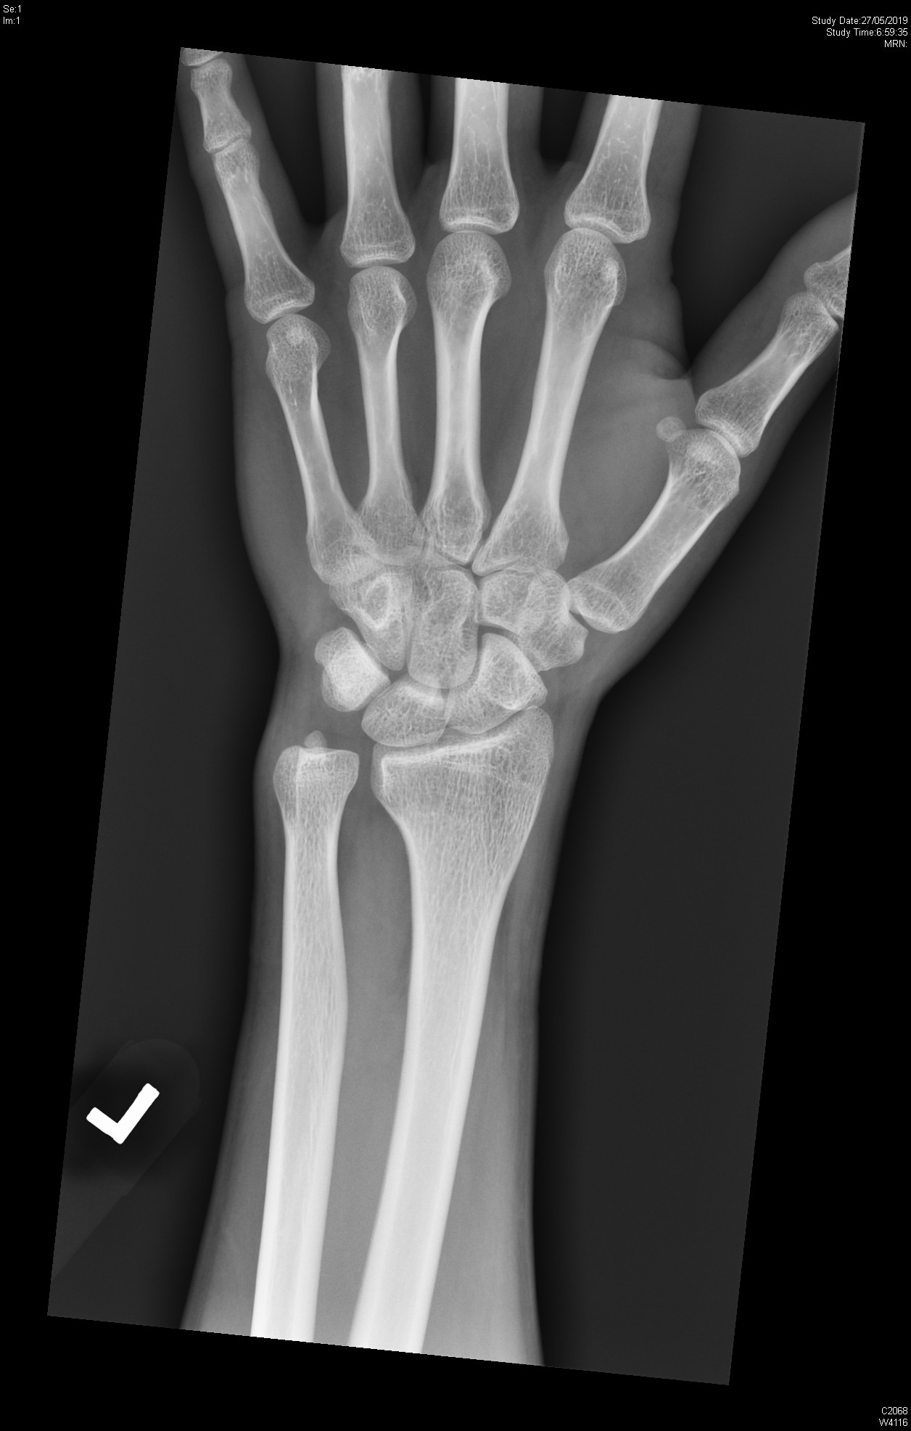
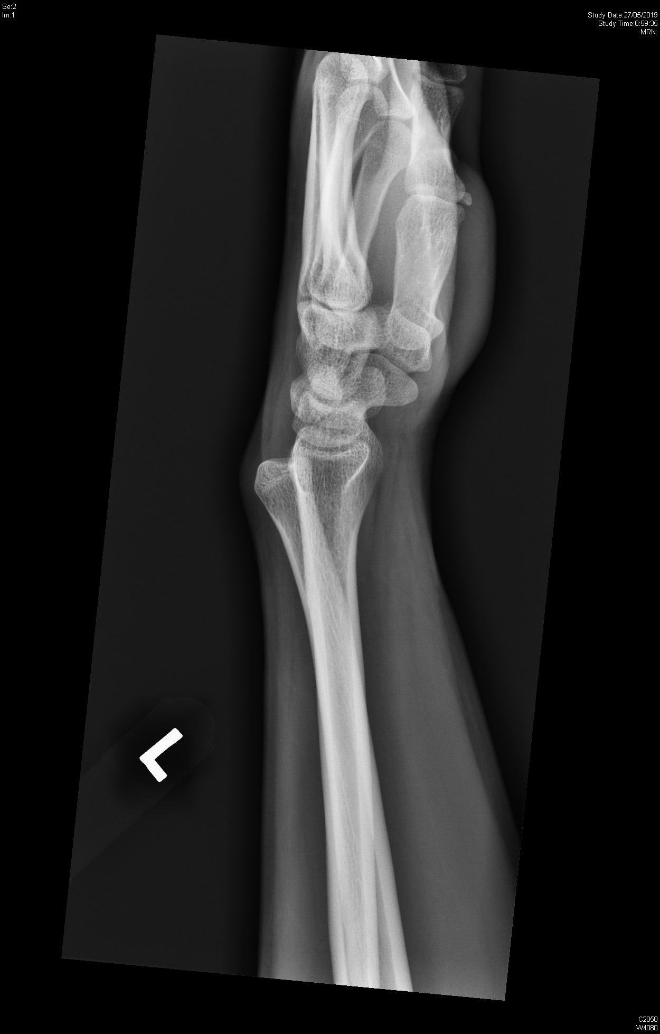

Slide 4
Case 1
What abnormalities can be seen on the X-rays films?

Slide 5
Case 1
Name 2 clinical tests that may be useful for this injury.

Slide 6
Case 1
What structures may be damaged in this injury?

Slide 7
Case 1
What is your initial treatment for this patient?

Slide 8
Case 2
A 18 year old lifeguard underestimated pool depth and jumped head first into a 1.6 meter deep pool from pool side.
He complained of severe neck pain thereafter

Slide 9
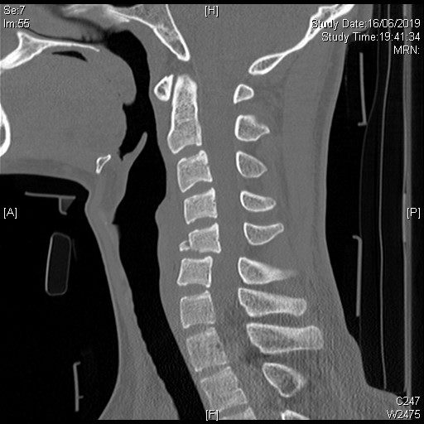

Slide 10
Case 2
What are the abnormalities on this CT film

Slide 11
Case 2
What important structures may be affected in this injury?

Slide 12
Case 2
Name the different types of incomplete spinal cord injury syndromes.

Slide 13
Case 2
Name 2 clinical decision rules to help you determine need for imaging in cervical injuries.

Slide 14
Case 3
A 53 year old diabetic patient complained of a wound of his left foot for 1 month.

Slide 15
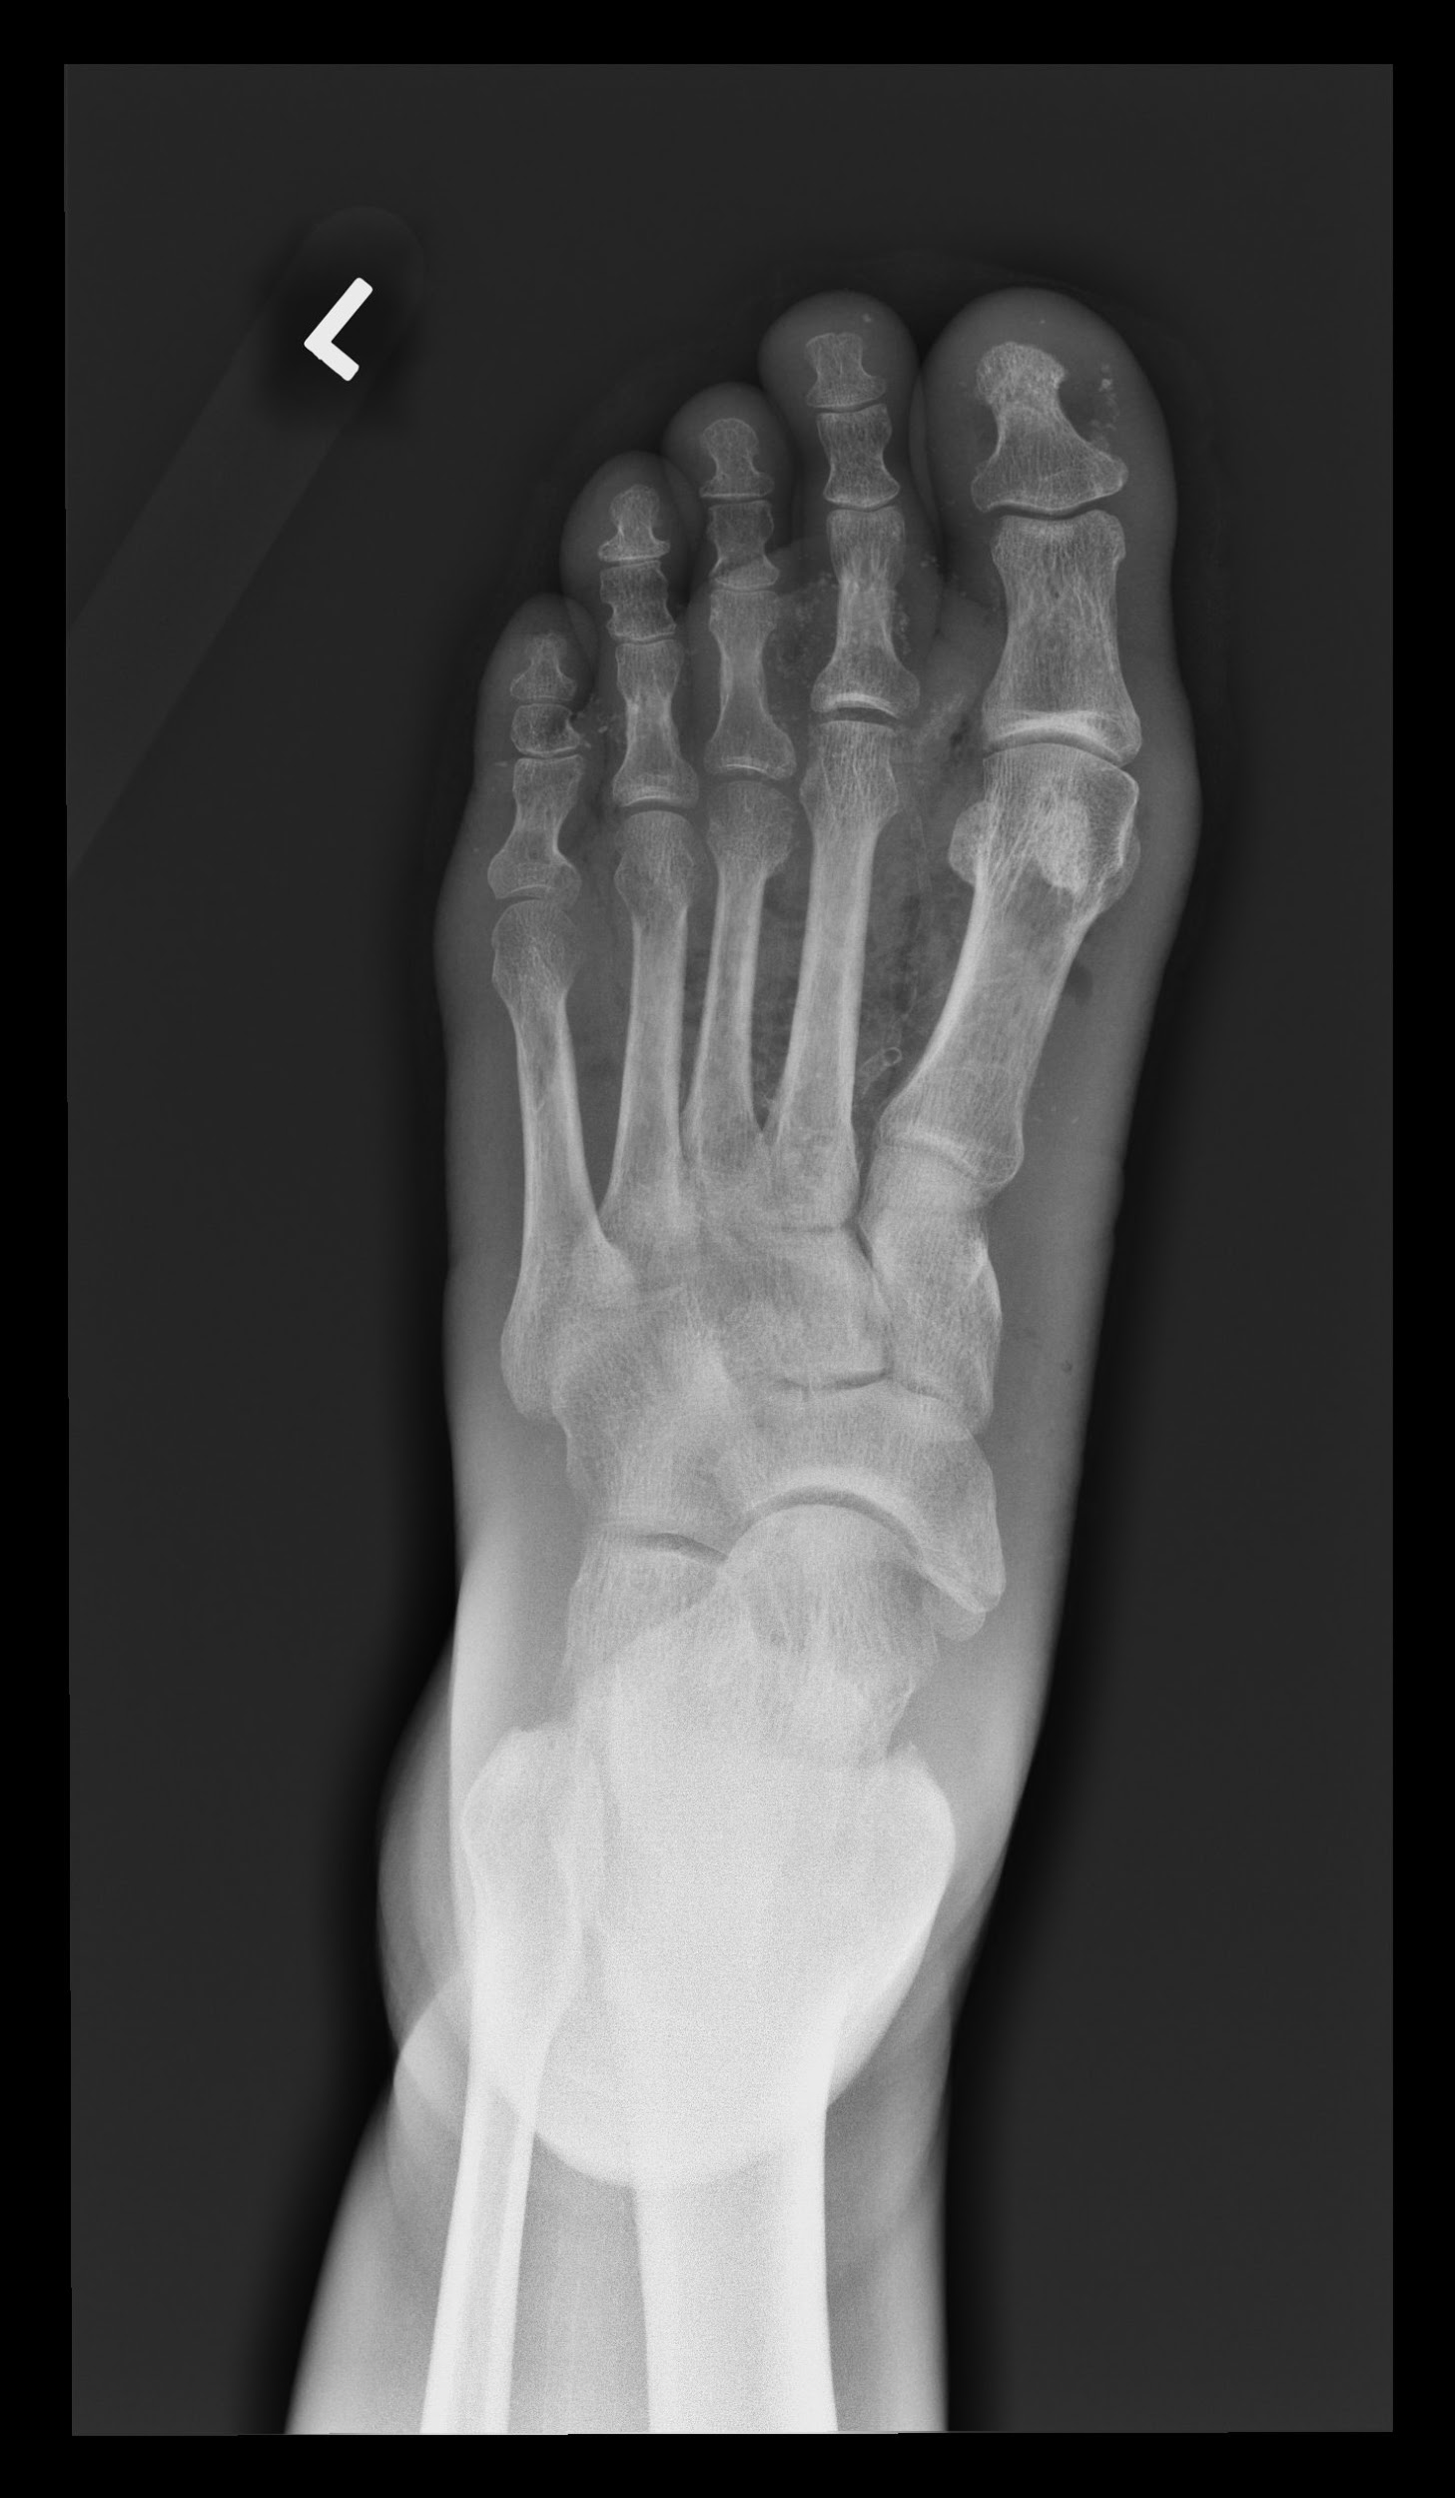
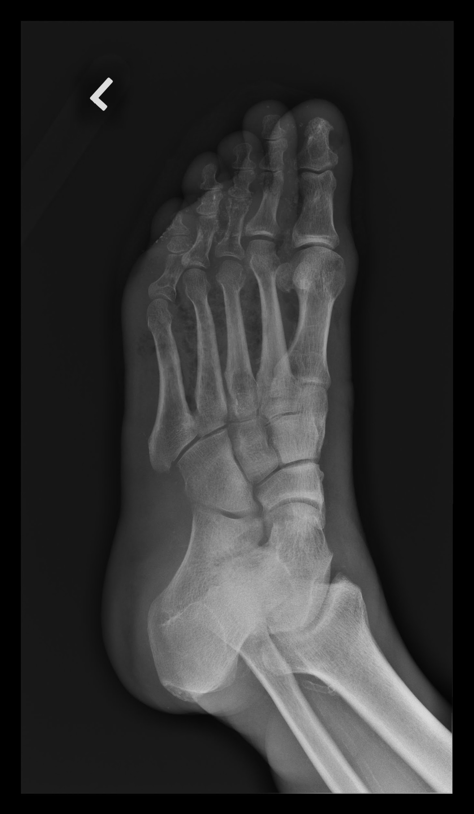

Slide 16
Case 3
What abnormalities are seen on the radiograph?

Slide 17
Case 3
Name several differential diagnoses.

Slide 18
Case 3
The causative organism was found to be Clostridial. What are the 2 main clinical presentation of this disease and the most common pathogen?

Slide 19
Case 3
Name 2 standard and 1 investigational modality of treatment

Slide 20
Case 4
A 69 year old lady sustained a fall in the street.
She injured her left forearm with an open wound.

Slide 21
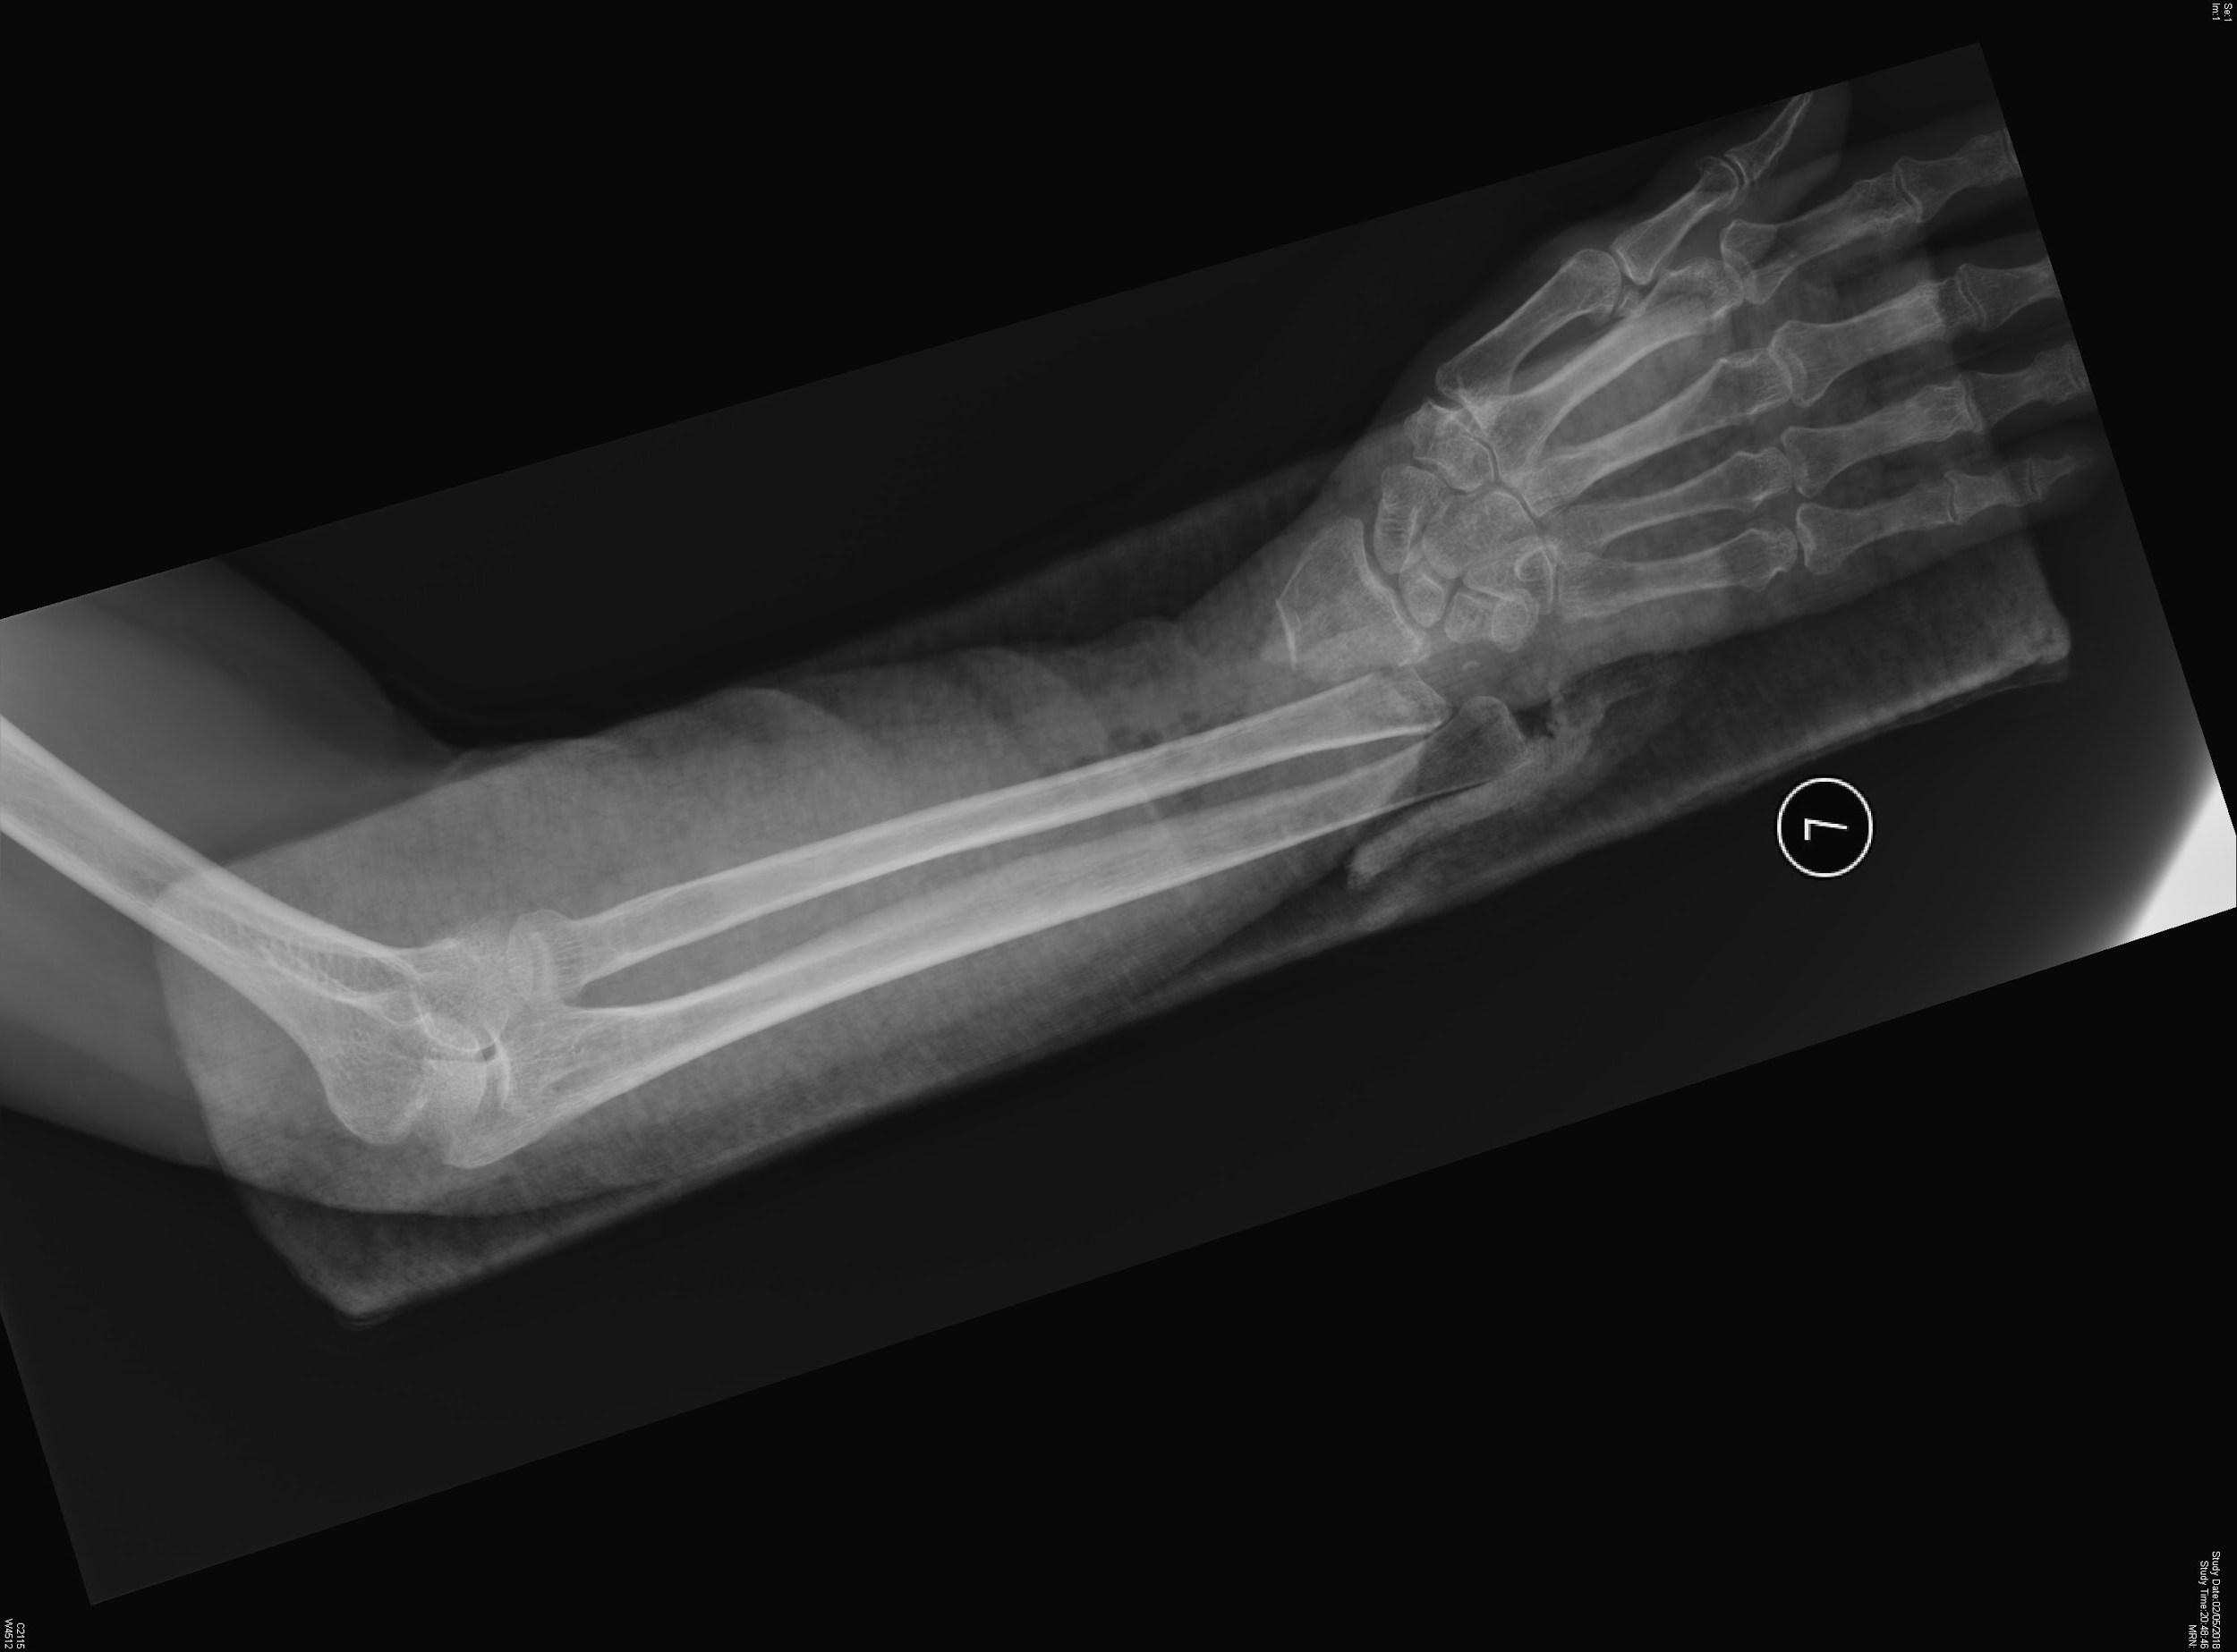
Case 4

Slide 22
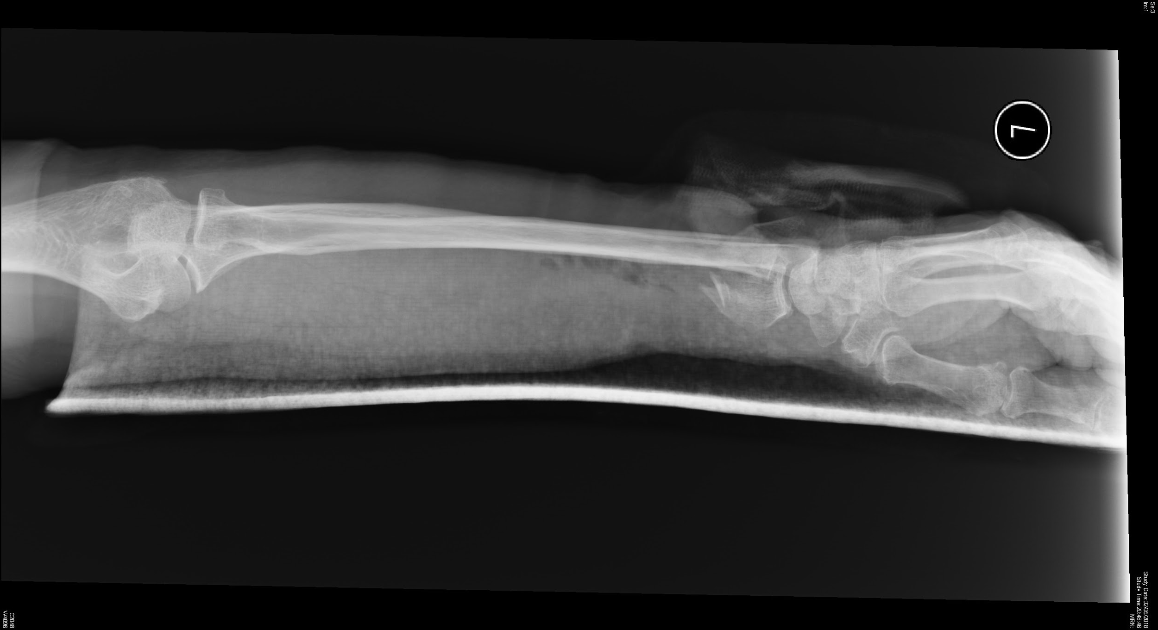
Case 4

Slide 23
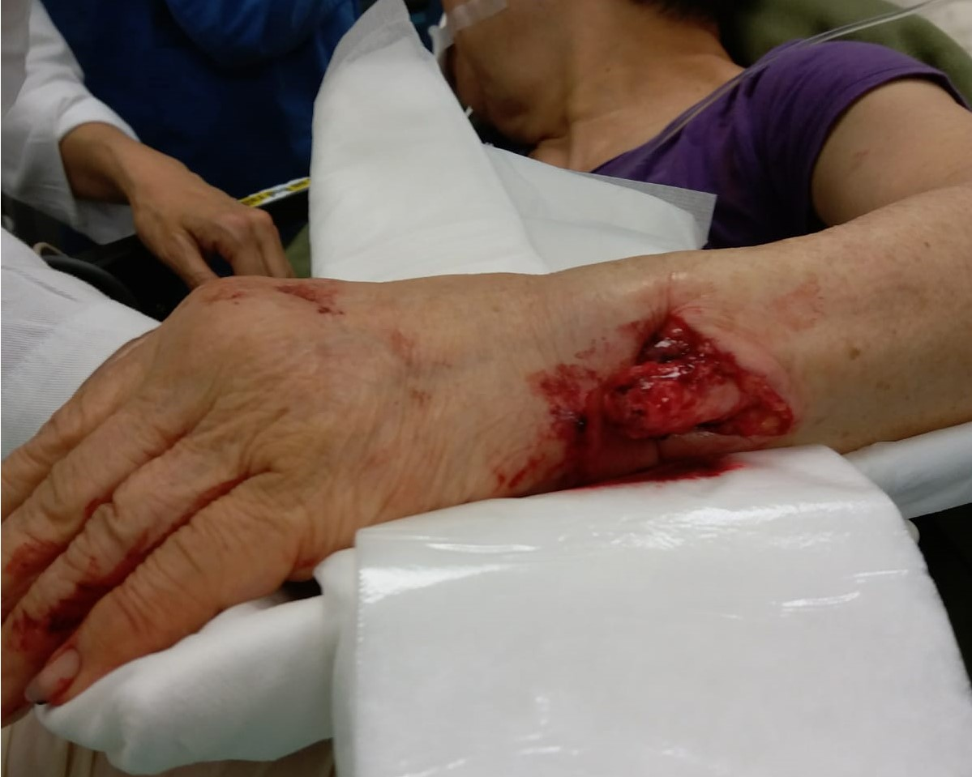
Case 4

Slide 24
Case 4
Describe the X-ray findings

Slide 25
Case 4
Name this type of forearm fracture

Slide 26
Case 4
Name the structures likely to be damaged by this injury

Slide 27
Case 4
Name one grading score for assessment of open extremity fractures

