Slide 1
JCM OSCE 07.2020
RH AED

Slide 2
Case 1
A 27 year old gentleman attended the emergency department after falling on his outstretched left hand while playing a game of football.
He complained of pain and decreased range of movement in the wrist joint.

Slide 3
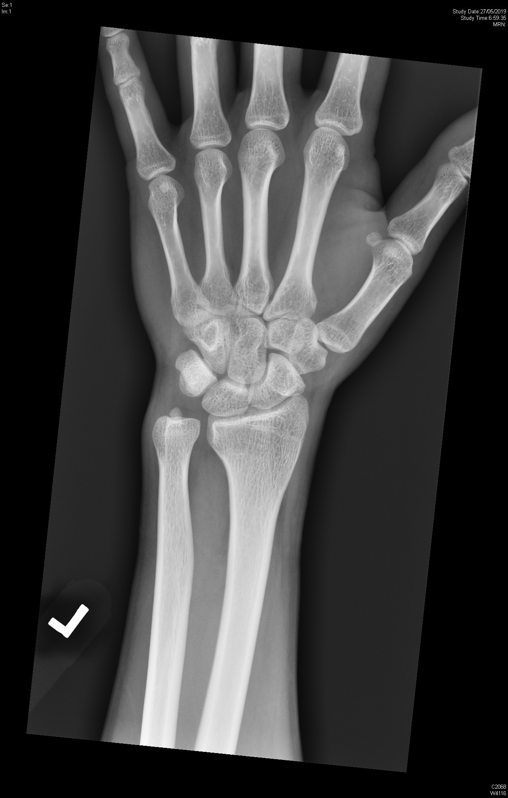
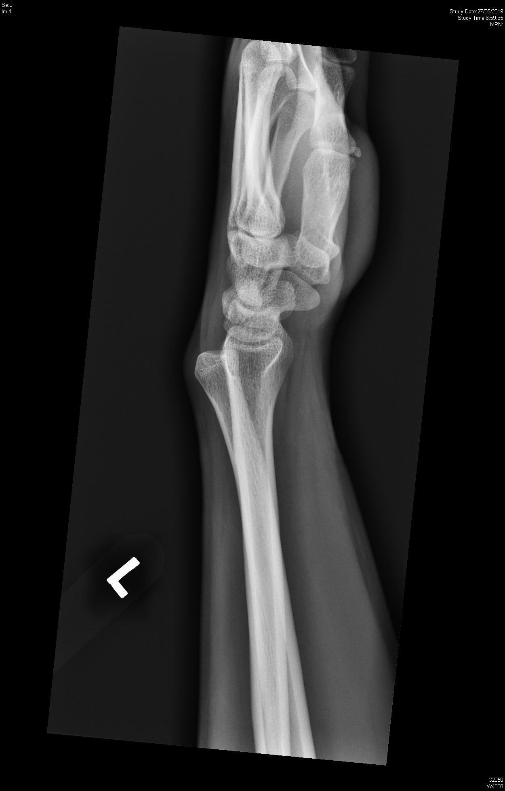

Slide 4
Case 1
What abnormalities can be seen on the X-rays films?

Slide 5
Case 1
What abnormalities can be seen on the X-rays films?
Widening of the DURJ
dorsal subluxation of the ulnar head

Slide 6
Case 1
Name 2 clinical tests that may be useful for this injury.

Slide 7
Case 1
Name 2 clinical tests that may be useful for this injury.
Ballottement test
Piano key test
Grind test
Radius pull
Clunk test
Impingement sign

Slide 8
Case 1
What structures may be damaged in this injury?

Slide 9
Case 1
What structures may be damaged in this injury?
Triangular Fibrocartilage Complex
Dorsal and volar radioulnar ligaments

Slide 10
Case 1
What is your initial treatment for this patient?

Slide 11
Case 1
What is your initial treatment for this patient?
Reduction of the ulnar head.
Immobilization with splint or cast

Slide 12
Case 2
A 18 year old lifeguard underestimated pool depth and jumped head first into a 1.6 meter deep pool from pool side.
He complained of severe neck pain thereafter.

Slide 13
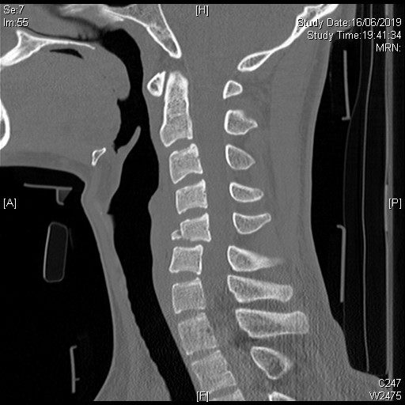

Slide 14
Case 2
What are the abnormalities on this CT film

Slide 15
Case 2
What are the abnormalities on this CT film
Tear drop fracture of C5
Anterior/posterior translocation of C5/C6

Slide 16
Case 2
What important structures may be affected in this injury?

Slide 17
Case 2
What important structures may be affected in this injury?
Posterior longitudinal ligament
Anterior longitudinal ligament
Spinal cord
Intervertebral disc
Anterior spinal artery

Slide 18
Case 2
Name the different types of incomplete spinal cord injury syndromes.

Slide 19
Case 2
Name the different types of incomplete spinal cord injury syndromes.
Anterior cord syndrome
Posterior cord syndrome
Central cord syndrome
Brown-Séquard syndrome
Conus medullaris

Slide 20
Case 2
Name 2 clinical decision rules to help you determine need for imaging in cervical injuries.

Slide 21
Case 2
Name 2 clinical decision rules to help you determine need for imaging in cervical injuries.
NEXUS low risk criteria
Canadian C-Spine rule

Slide 22
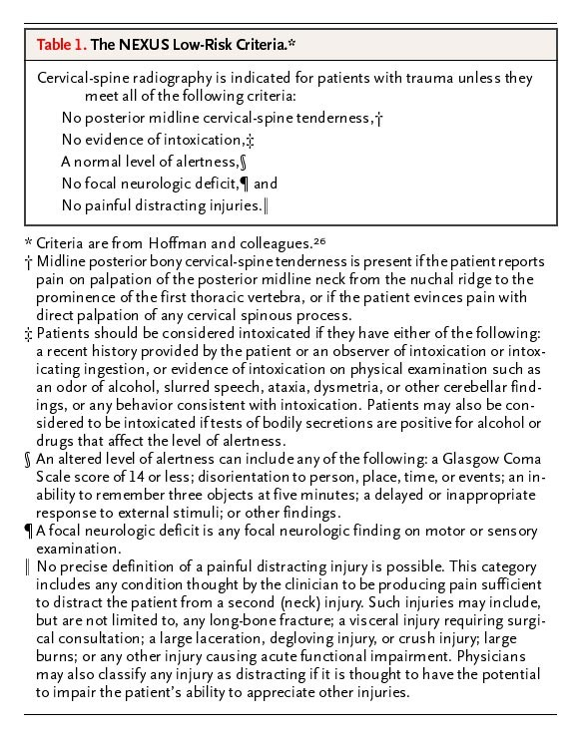
NEXUS Low Risk Criteria

Slide 23
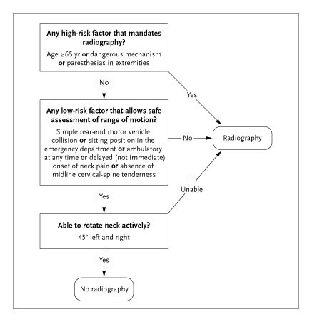
Canadian C-Spine Rule

Slide 24
Case 3
A 53 year old diabetic patient complained of a wound of his left foot for 1 month.

Slide 25
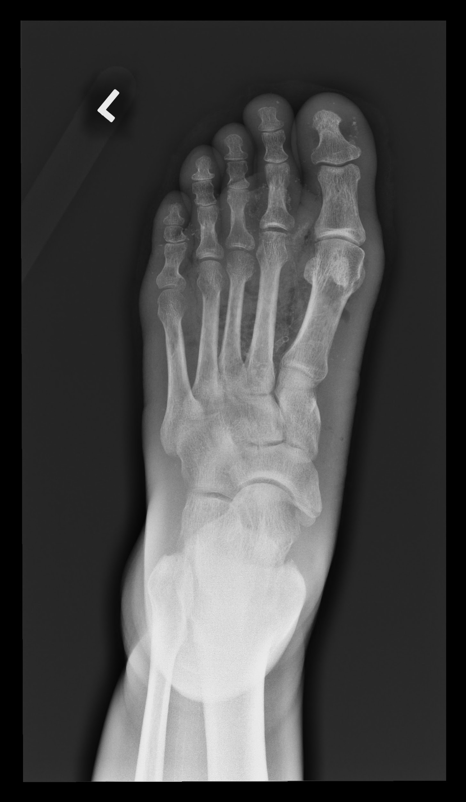
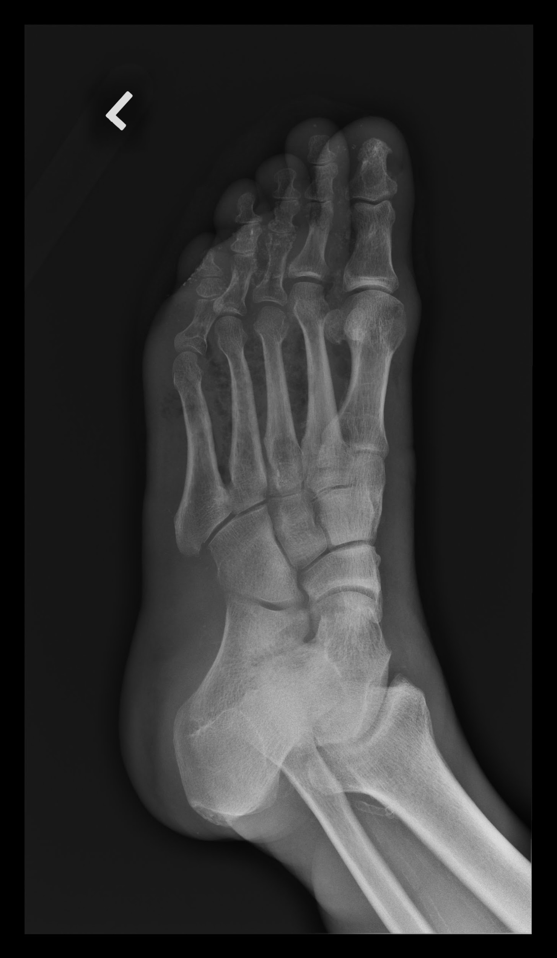

Slide 26
Case 3
What abnormalities are seen on the radiograph?

Slide 27
Case 3
What abnormalities are seen on the radiograph?
Gas within soft tissue surrounding metatarsals
Osteopenia of proximal phalanx of 3rd 4th and 5th toes

Slide 28
Case 3
Name several differential diagnoses.

Slide 29
Case 3
Name several differential diagnoses
Gas gangrene/myonecrosis
Anaerobic cellulitis
Necrotising fasciitis

Slide 30
Case 3
The causative organism was found to be Clostridial. What are the 2 main clinical presentation of this disease and the most common pathogen?

Slide 31
Case 3
What are the 2 main clinical presentation of this disease and the most common pathogen?
Traumatic gas gangrene
Clostridium Perfringens
Spontaneous gas gangrene
Clostridium Septicum

Slide 32
Case 3
Name 2 standard and 1 investigational modality of treatment

Slide 33
Case 3
Name 2 standard and 1 investigational modality of treatment
Surgical debridement
Antibiotic therapy
Hyperbaric oxygen therapy

Slide 34
Case 4
A 69 year old lady sustained a fall in the street.
She injured her left forearm with an open wound.

Slide 35
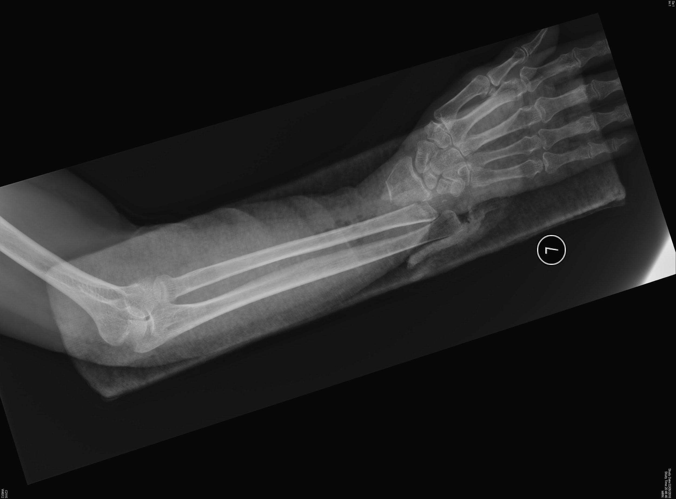
Case 4

Slide 36
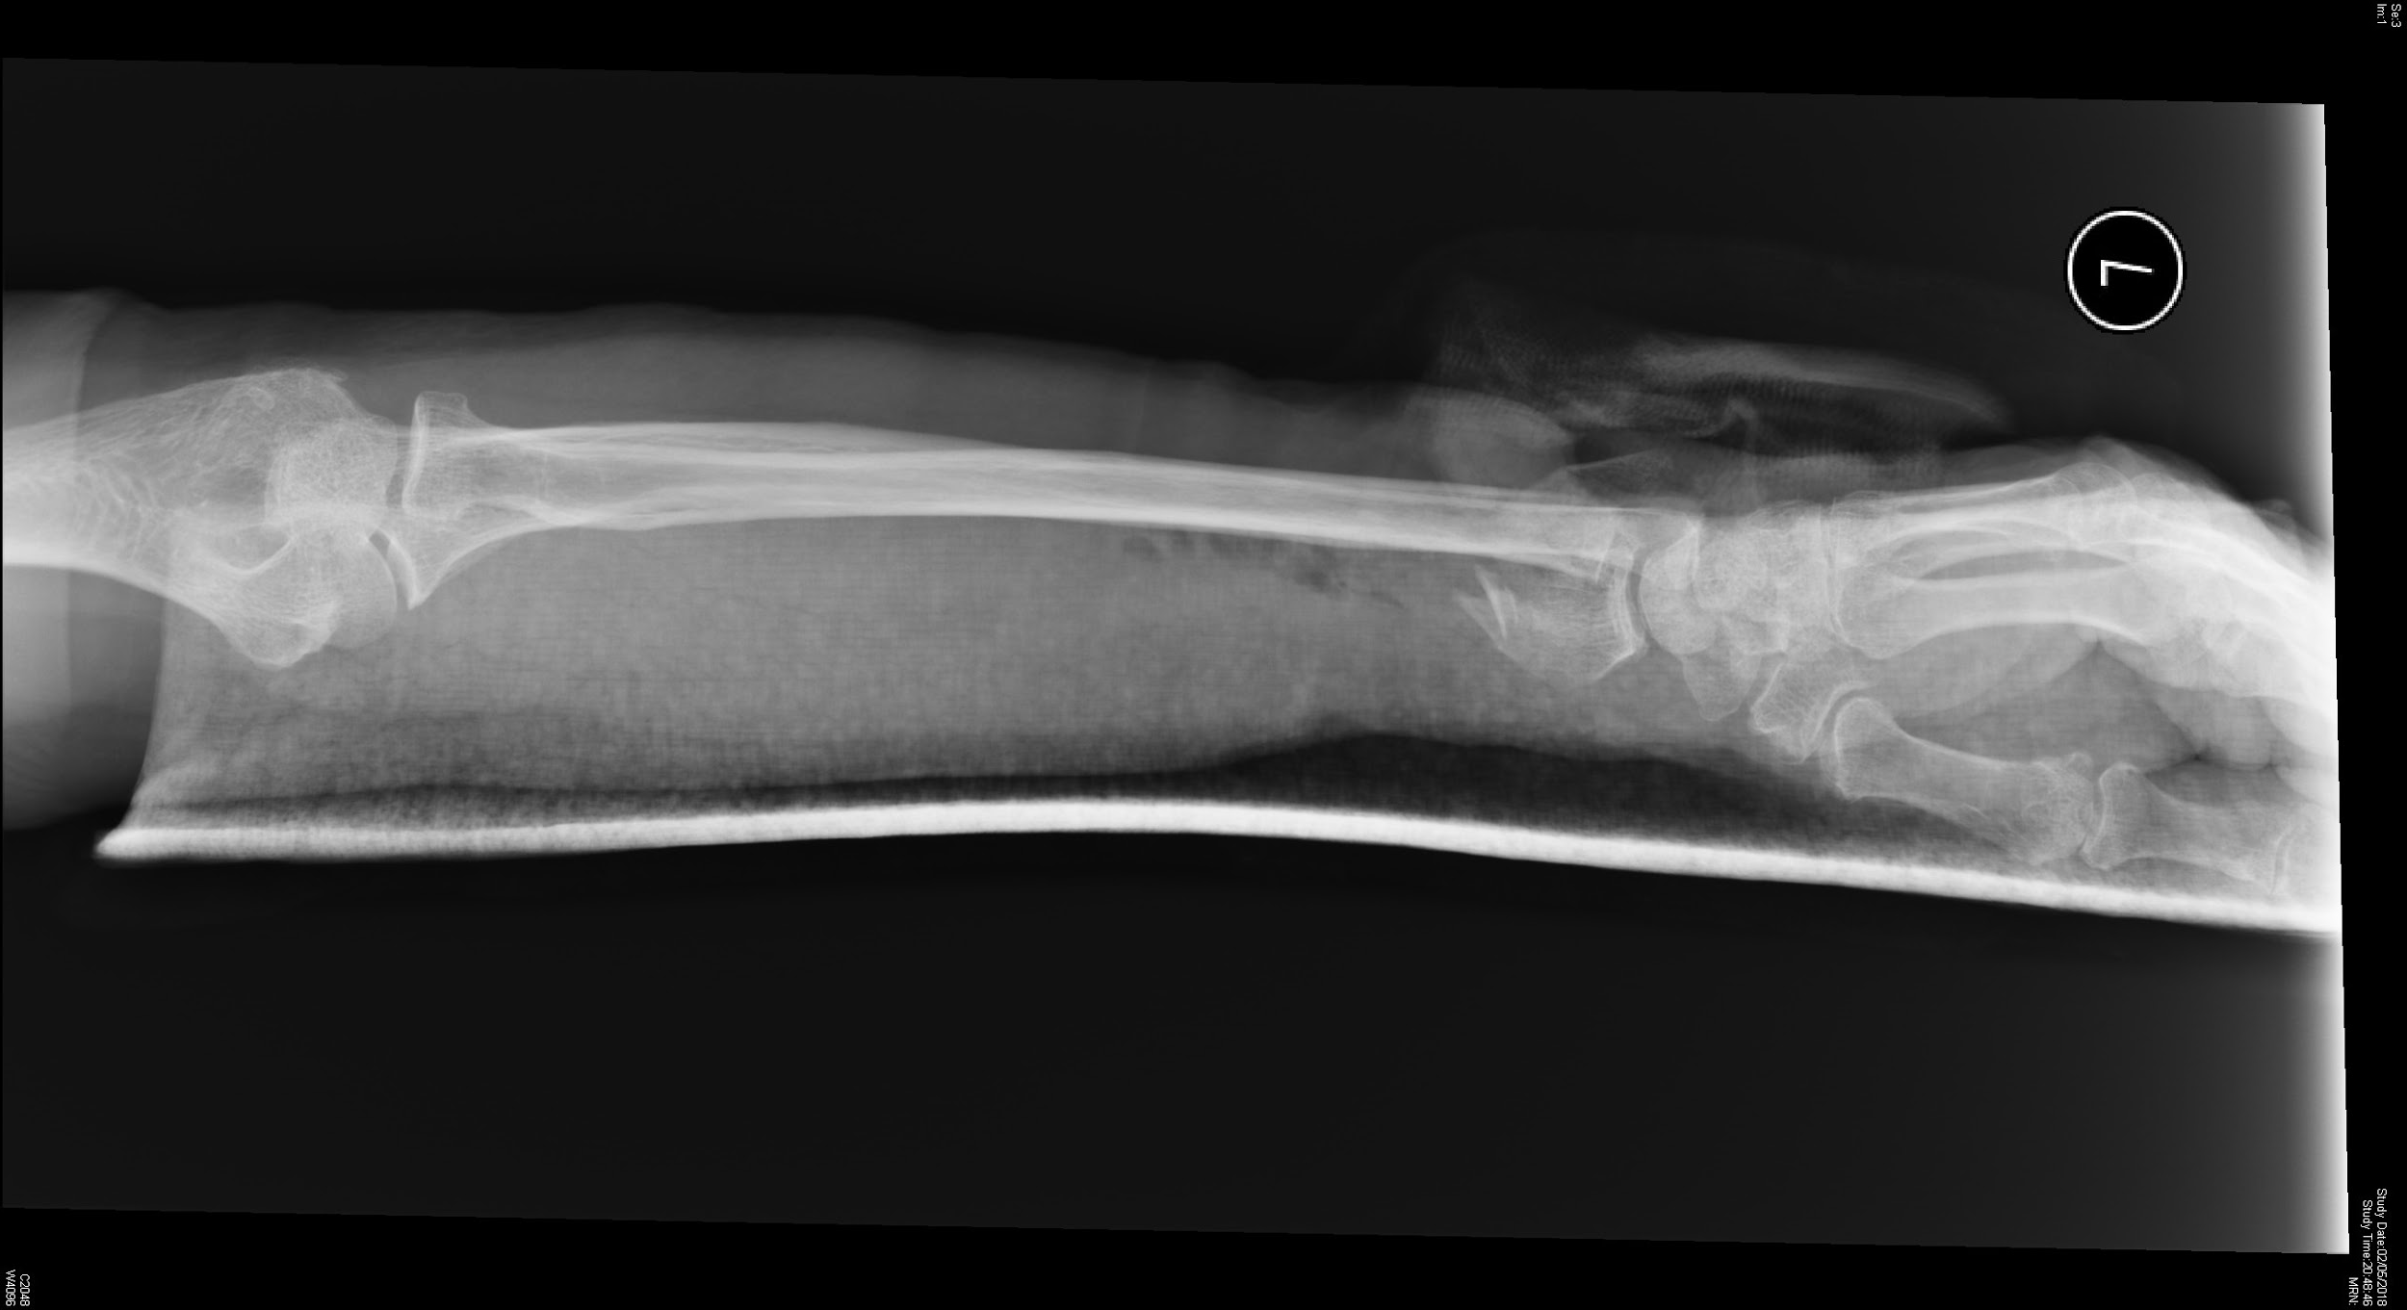
Case 4

Slide 37
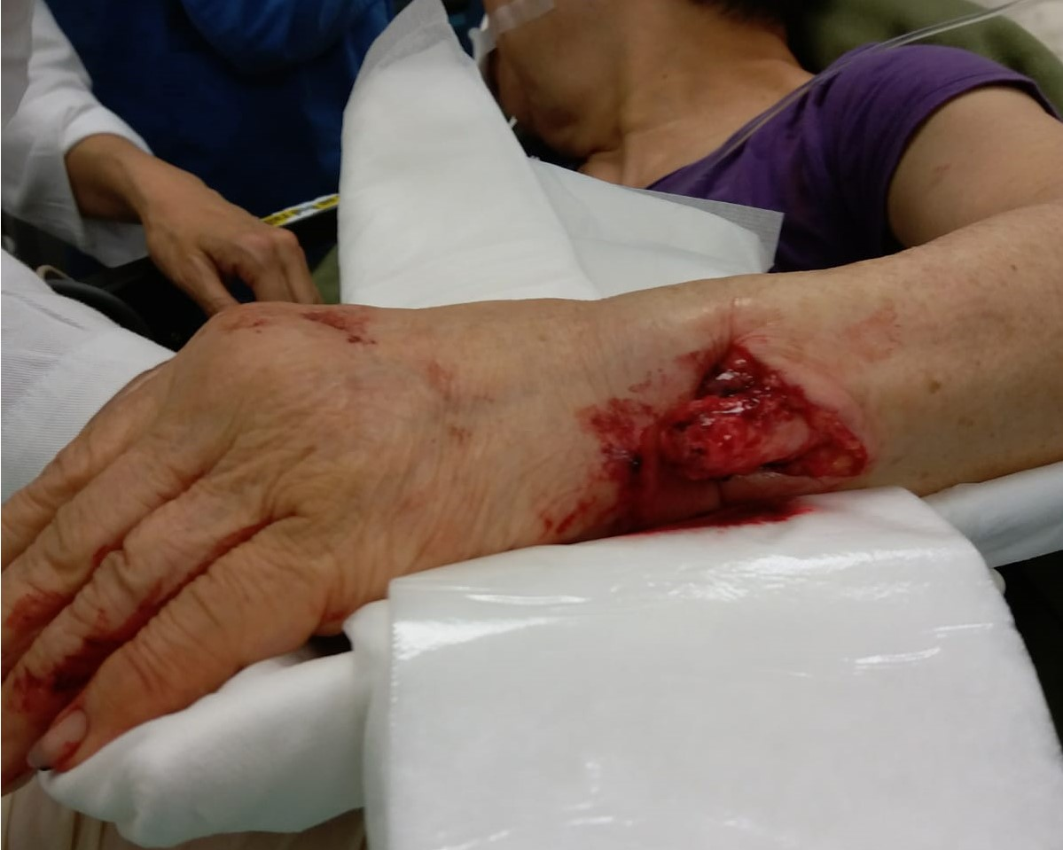
Case 4

Slide 38
Case 4
Describe the X-ray findings

Slide 39
Case 4
Describe the X-ray findings
Comminuted fracture distal radius shaft
Open dislocation of wrist

Slide 40
Case 4
Name this type of forearm fracture

Slide 41
Case 4
Name this type of forearm fracture
Galeazzi Fracture

Slide 42
Case 4
Name the structures likely to be damaged by this injury

Slide 43
Case 4
Name the structures likely to be damaged by this injury
Triangular Fibrocartilage Complex (TFCC)
Median Nerve
Ulnar Nerve
Radial Nerve
Ulnar artery

Slide 44
Case 4
Name one grading score for assessment of open extremity fractures

Slide 45
Case 4
Name one grading score for assessment of open extremity fractures
Gustilo-Anderson open fracture grading system

