Slide 1
JCM 5th August 2020
AHNH
AED

Slide 2
Case 1
M/35
Fell from motorbike at 60km/hr
Landed on right wrist with pain and swelling
No associated injury
X-ray of right wrist was taken

Slide 3
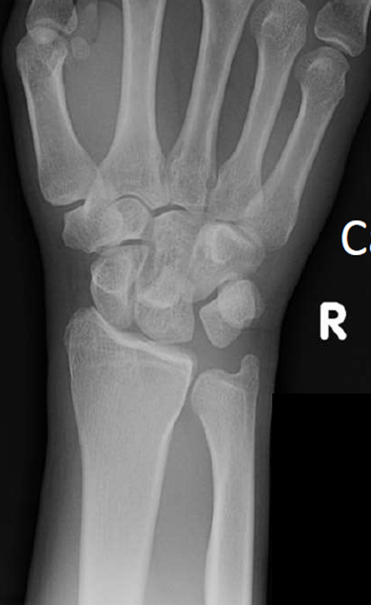
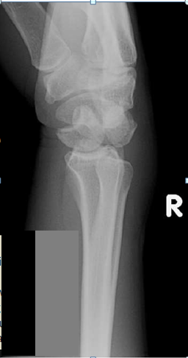

Slide 4
What is the x-ray finding?
What is the diagnosis?
What is the complication?
What is the management?

Slide 5
Case 2
Male, 20 years of age
Good past health
Contact lens user
Left eye red eye, eye pain, blurring of vision for 5 days

Slide 6
Clinical picture of left eye

Slide 7
What are the physical findings?
What is the diagnosis?
What is the management?

Slide 8
Case 3
30/M
Good past health.
Generalized weakness after exercise
Limb power 3/5
Afebrile

Slide 10
What are the ECG findings?
What is the clinical diagnosis?
What tests would you order?
What are the triggering factors for the above condition?
What is your management?

Slide 11
Case 4
28/F
Sore throat and fever only for few days
No travel history
Good past health

Slide 12
Physical examination:
Bilateral cervical LNs
Exudative tonsillitis
Abdomen: no organomegaly

Slide 13
Blood tests

Slide 15
What is the clinical diagnosis?
Suggest other 3 possible differential diagnoses.
What test to confirm the diagnosis?
Name 3 complications of the condition.
What is the treatment for the condition?

Slide 16
Case 5
30/M
Good past health
Fell with right cheek contusion.
Swelling over the right face.

Slide 17
CT face was done

Slide 19
What are the abnormal CT findings?
What is the diagnosis?
What is your management in AED?
Any precaution would you advise for patient?

