Slide 1
OSCE
NDH AED

Slide 2
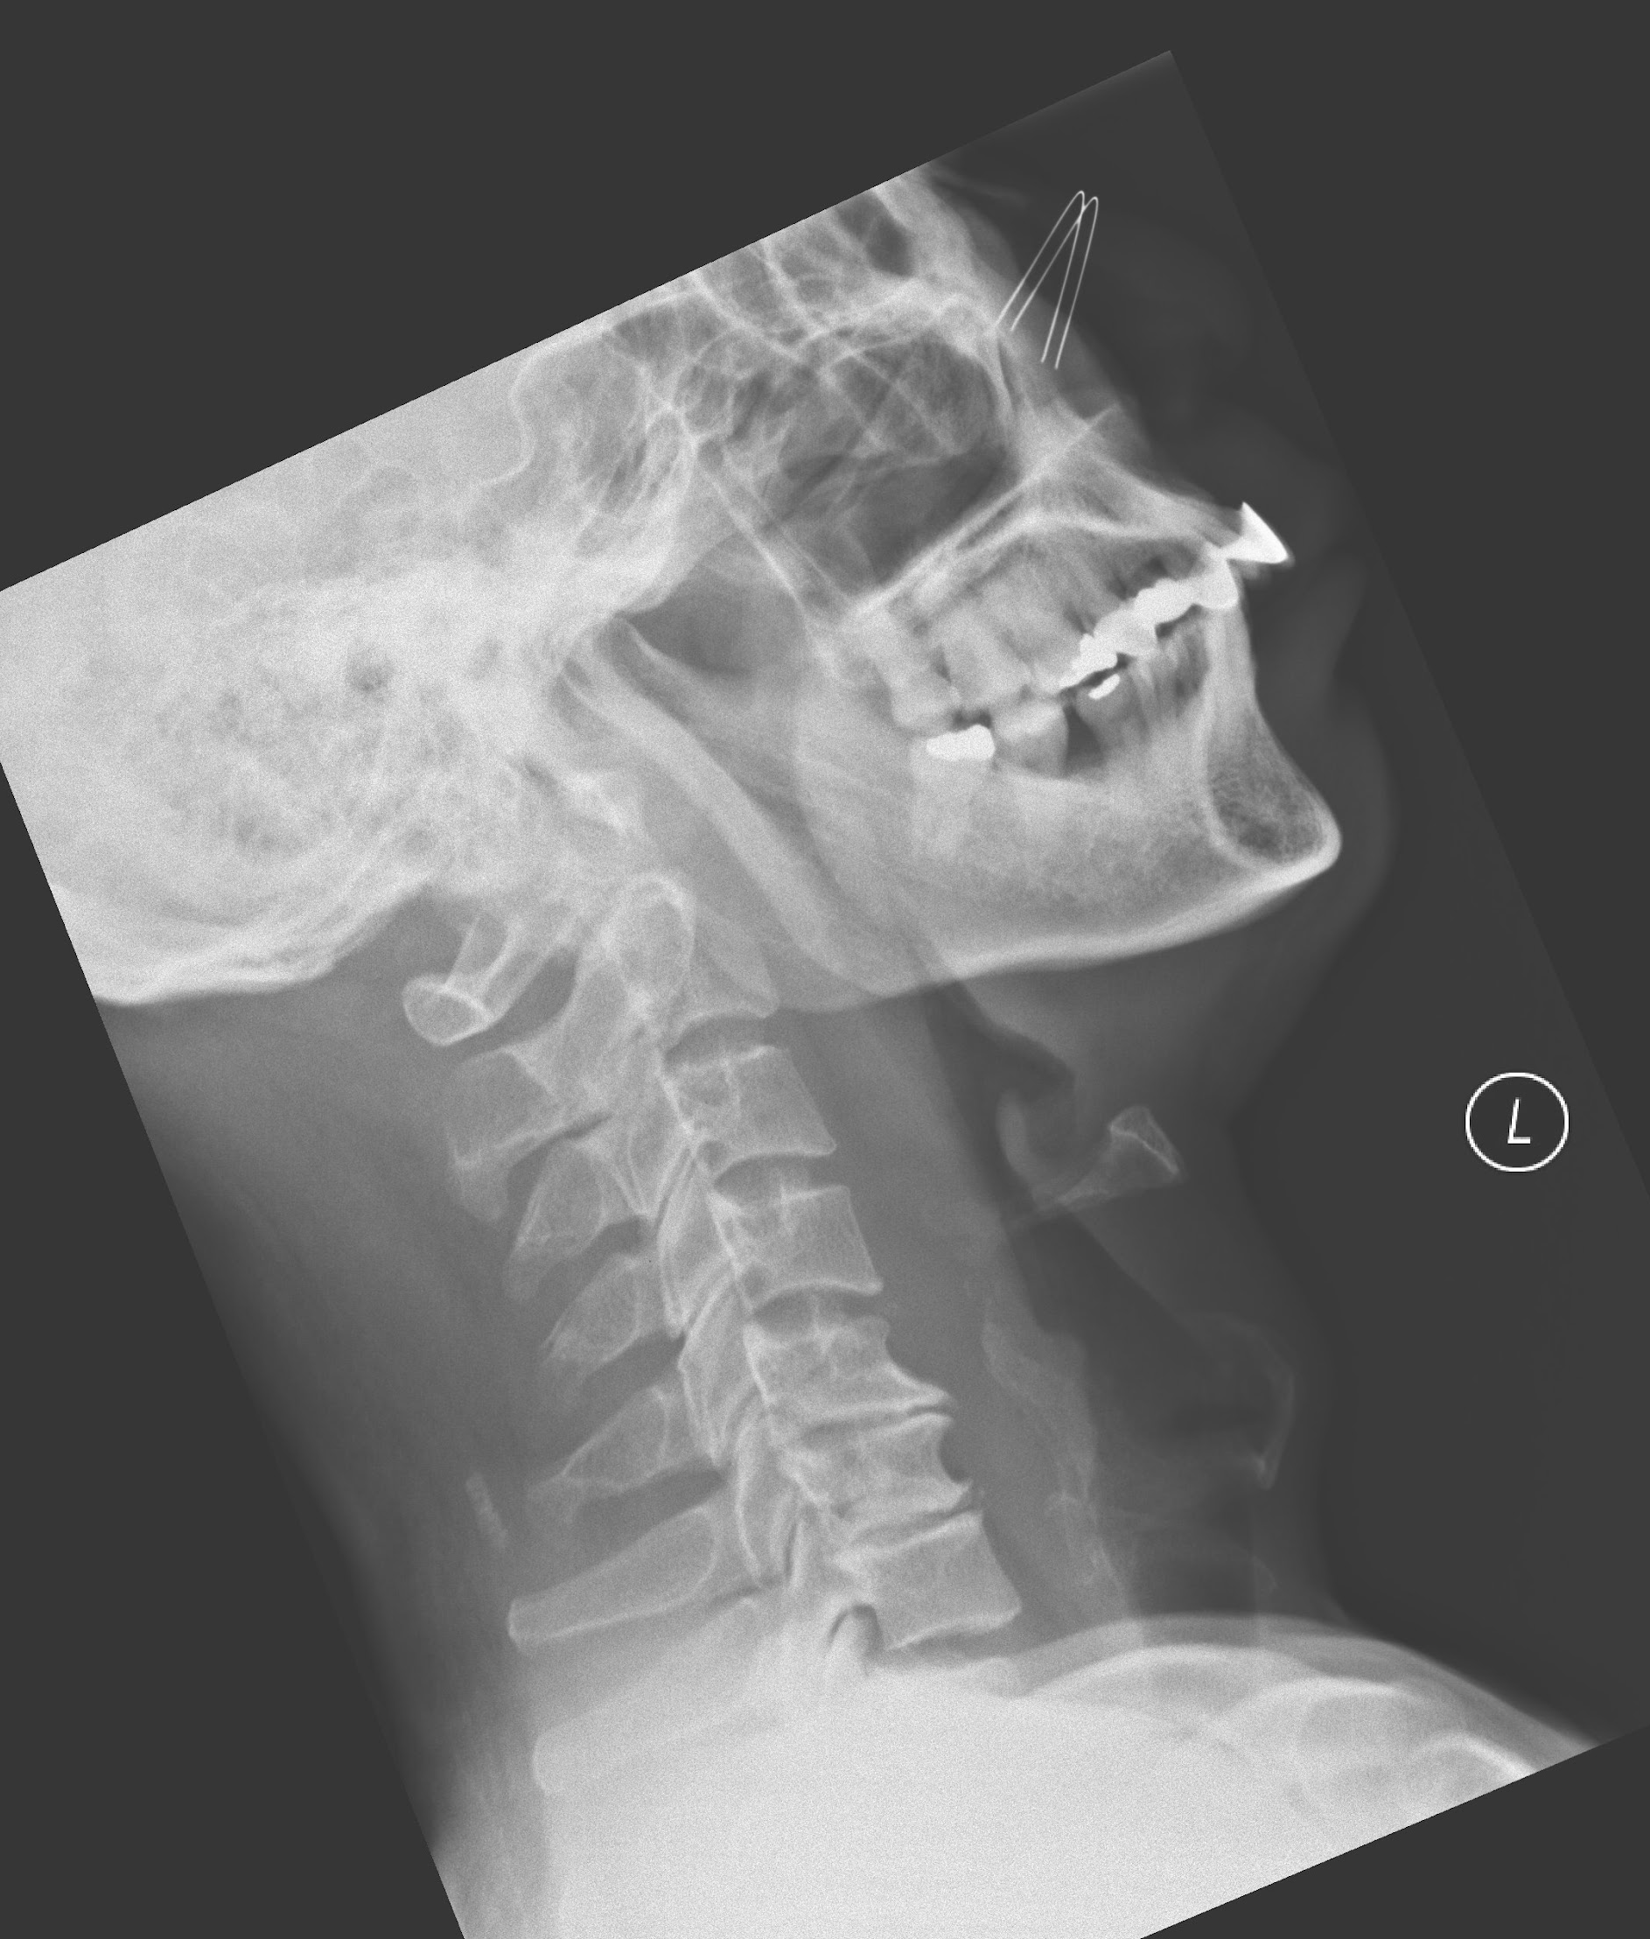
Case 1
43/M
Fever
Pain on swallowing for 2 days
XR Finding? (1)

Slide 3
Case 1
Prevertebral soft tissue swelling

Slide 4
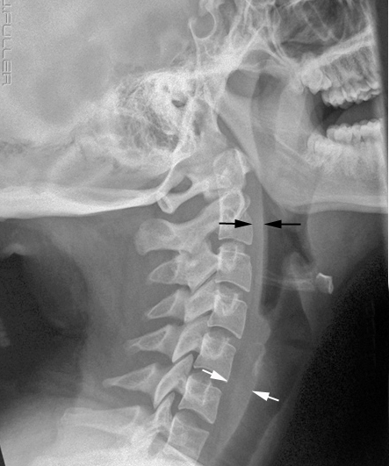
Case 1
Normal Thickness varies with age
C2 (black arrows)
<7mm
C1-4
<50% of width of adjacent vertebral body
C6 (white arrows)
≤14mm for patient with age <15
≤22mm for patient with age >15
C5-8
<1 adjacent vertebral width
Pitfall: falsely thickened in flexed neck

Slide 5
Case 1
Name 2 life threatening differential diagnoses?

Slide 6
Case 1
Name 2 life threatening differential diagnoses?
Deep neck infection
Retropharyngeal, parapharyngeal, or peritonsillar abscess
Supraglotitis
Ludwig’s angina

Slide 7
Case 1
Name 4 red flag signs we should look for during physical examination.

Slide 8
Case 1
Name 4 red flag signs we should look for during physical examination.
Airway obstruction
Stridor
Drooling
Muffled voice
Sniffing position
Respiratory distress

Slide 9
Case 1
Name 4 red flag signs we should look for during physical examination.
Sepsis with poor outcome
qSOFA criteria
SBP <=100
Altered mental status (GCS <15)
RR >=22

Slide 10
Case 1
What is the likely source of infection?

Slide 11
Case 1
What is the likely source of infection?
Dental / Odontogenic

Slide 12
Case 1
Name 2 deep neck spaces, for each space name 1 potential complication.

Slide 13
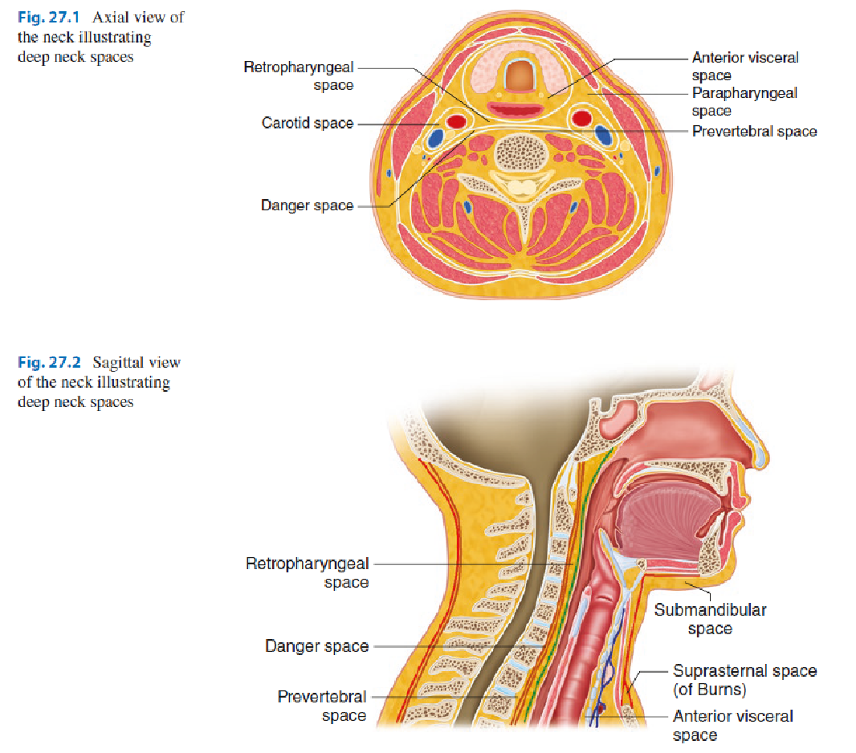
Deaep Neck Space Infections
H. A. Osborn and D. G. Deschler

Slide 14
Severe Soft Tissue Infections of the Head and Neck: A Primer
for Critical Care Physicians Lung (2009) 187:271–279

Slide 15
Case 1
Name 2 expected difficulties you would encounter during intubation.
Name 1 method to intubate this patient.

Slide 16
Case 1
Anticipating a difficult airway
Anatomy
Limited mouth opening / trismus
Tissue oedema
Immobility
Physiology
Hypoxia
Limited safe apneic time
Agitated patient
Drug-related
Loss of airway

Slide 17
Case 1
Options available:
Awake fiber-optic intubation
Nasotracheal
Orotracheal
Surgical airway as back up plan
Involve experts early!
Anaesthesiologist
Surgeon
ENT surgeon

Slide 18
Case 2
69/M
Declined memory for 1 month
Found lying on floor
Confusion
GCS 14/15
No scalp wound

Slide 19
Case 2
Name 2 aspects to differentiate between delirium and dementia during history taking.

Slide 20
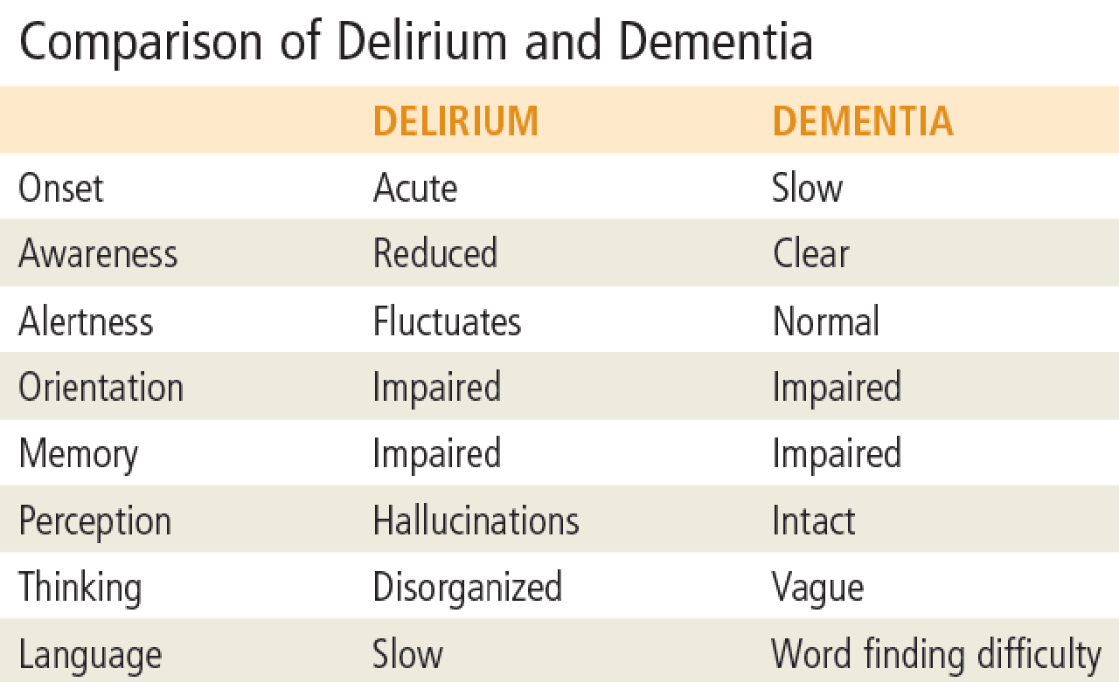
Rosen’s Emergency medicine 2018
P1281, Chapter94 Delirium and Dementia

Slide 21
Case 2
List 2 Point of care tests, and specify what to look for.

Slide 22
Case 2
List 2 Point of care tests, and specify what to look for.
H’stix
Hyper-/hypoglycemia
i-stat
Acidosis
Hypercapnia
Electrolyte disturbance (Na, Ca)
Urine toxicology and multistix for infection (WBC, nitrates) and rhabdomyolysis (RBC)
ECG
Arrhythmia
Altered QT/QRS interval
Notes:
Electrolyte disturbance
hypoNa
HyperCa

Slide 23
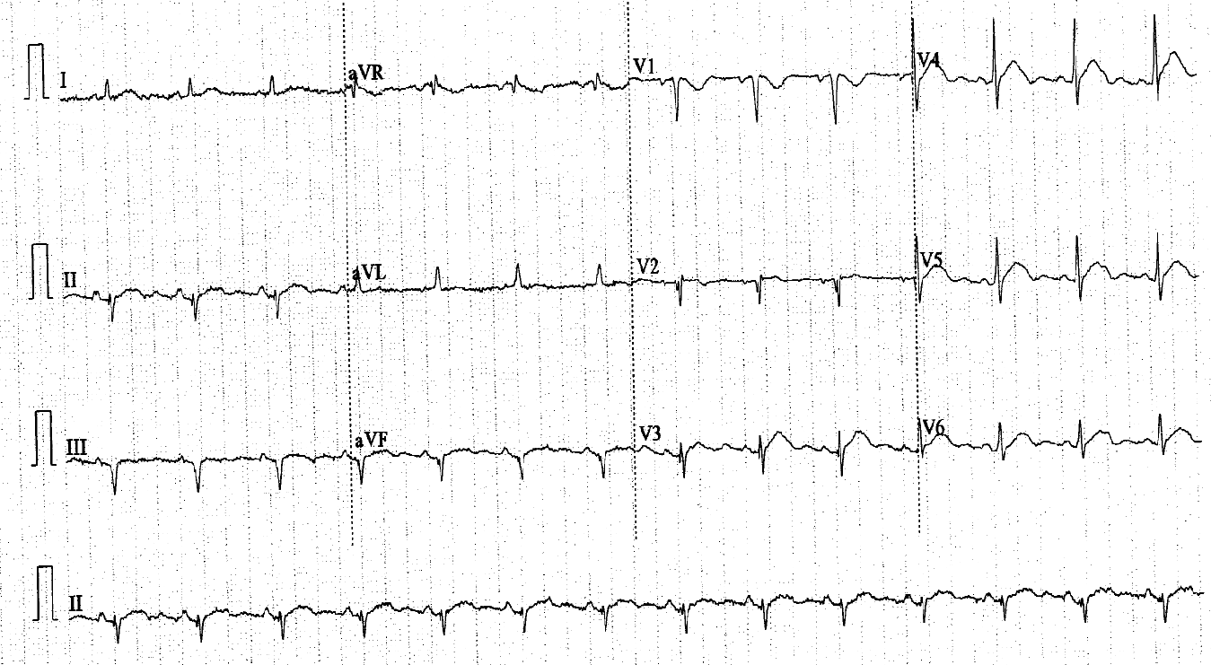
Findings?

Slide 24
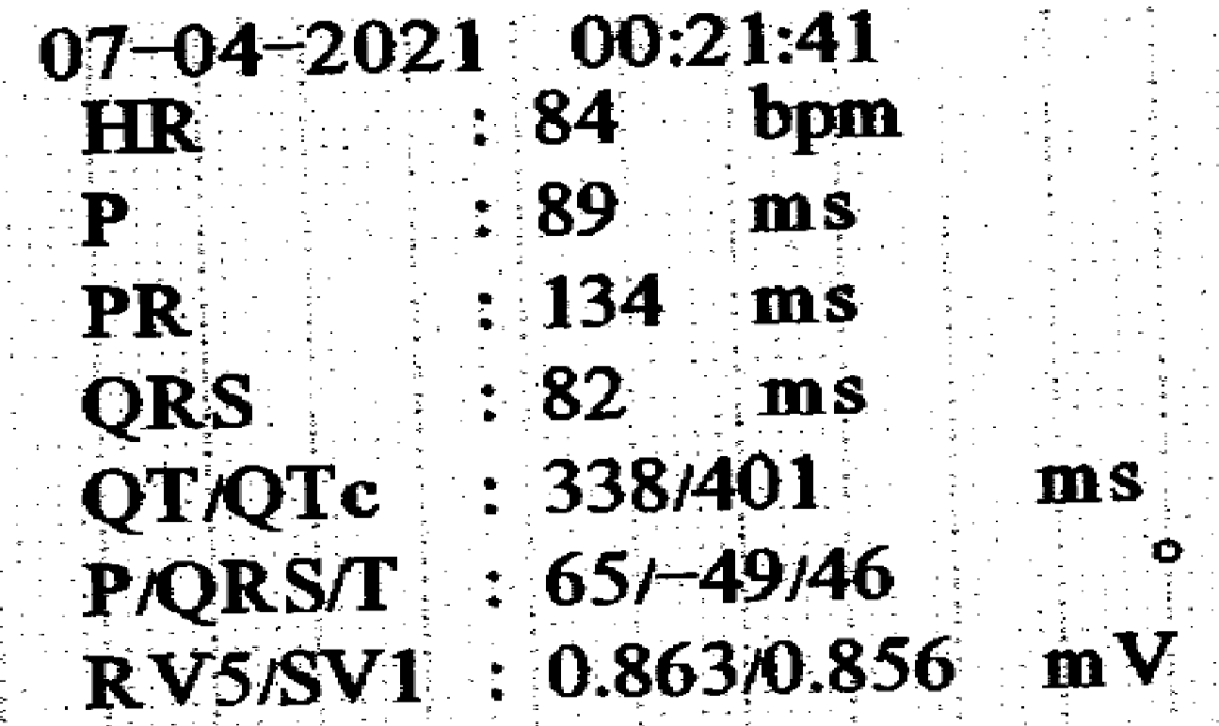
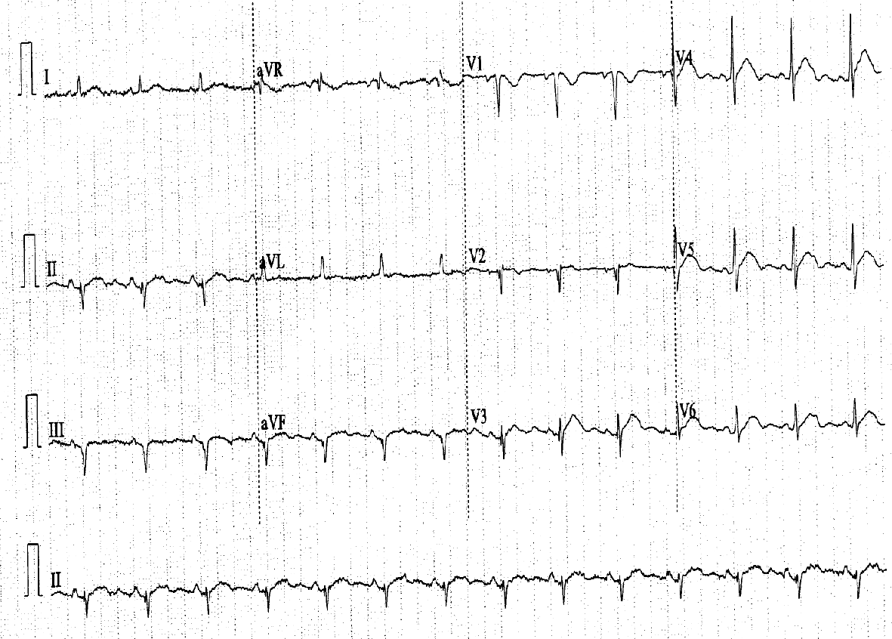
Short QT
Left axis deviation
U-wave
Name 2 ddx
http://pemsource.org/2018/03/09/qtc-as-half-the-rr/

Slide 25
Differential for short QT
Hypercalcemia
Short QT
Osborn wave (J wave)
For severe hypercalcemia:
ST elevation
Biphasic T wave
U wave
Digoxin
Hyperthermia
Short QT syndrome

Slide 26
Case 2
Name 2 XR findings.

Slide 27
Case 2
Name 2 XR findings.
Left lower lobe mass
Left pleural effusion
Ribs fracture
Osteolytic lesions over scapulae and R lower ribs

Slide 28
Case 2
What is the cause of confusion in this patient?
Notes:
Electrolyte disturbance
hypoNa
HyperCa

Slide 29
Case 2
What is the cause of confusion in this patient?
Hypercalcemia secondary to
Malignancy
Paraneoplastic syndrome
Bone metastasis
Brain metastasis
Sepsis
Notes:
Electrolyte disturbance
hypoNa
HyperCa

Slide 30
Case 3
You are working in a hospital without OBS/GYN
“a pregnant woman collapsed, CPR in progress, 5 min estimated time of arrival”

Slide 31
Case 3
What to prepare in terms of staff? (2)

Slide 32
Case 3
What to prepare in terms of staff? (2)
3 teams of staff
ACLS
PMCS
Neonatal resuscitation
Additional manpower
ICU
Paediatrician/Neonatologist
Surgeon
Delegated nurse for relatives
Notes:
Additional manpower
ICU - for prolonged resuscitation +/- eCPR
Paediatrician/Surgeon
Obstetrician - for maternal cardiac arrest call
Delegated nurse for relatives

Slide 33
Case 3
What to prepare in terms of equipment? (2)

Slide 34
Case 3
What to prepare in terms of equipment? (2)
Equipments and medications for ACLS
PMCS kit
Resuscitaire
Largest and appropriate resuscitation room
Room for family

Slide 35
Case 3
List 3 specific ACLS modifications.

Slide 36
Case 3
List 3 specific ACLS modifications.
Manually displace the uterus to the left
IV access above the diaphragm
Airway/ ventilation priority (ABC <— CBA)
(Standard hand position)
(No foetal monitor)
(Lateral tiling no longer recommended)
Notes:
Standard hand position (Previously recommended slightly higher, but there are no scientific data to support this)
lateral tilt no longer recommended
No fetal monitor

Slide 37
Case 3
Patient arrived
Asystole upon arrival
What life-saving procedure should be done?
When is it indicated in terms of gestational age?
Where is should it be done?
What is its physiological or anatomical benefits? List 3.

Slide 38
Case 3
Perimortem caesarean section (delivery) / Resuscitative hysterotomy
When: gestation 20+ weeks / uterus size at umbilicus
Timing: ASAP, within 5 min of collapse
The quoted 5-min rule is extrapolated from neonatal outcome
Location: Here, in the resuscitation room

Slide 39
Case 3
Benefits of PMCS
Relief aorto-caval compression
Improve ventilation mechanics
More efficient CPR
Reduce oxygen demand
Notes:
Relief aorto-caval compression (increase preload)
Improve ventilation mechanics (as no more diaphragmatic splinting)
More efficient CPR (as no more diaphragmatic splinting)
Reduce oxygen demand ( from placenta as it consumes a lot)

Slide 40
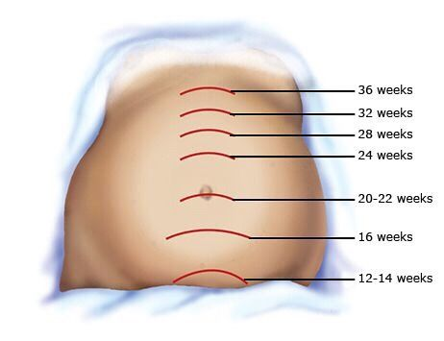
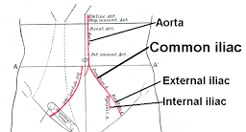
20 + 4 Scalpel scissor

Slide 41
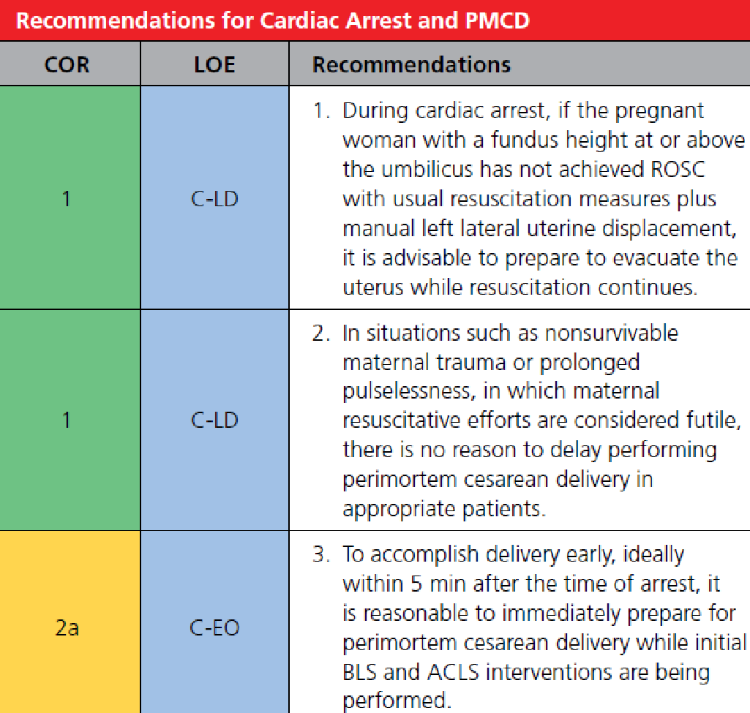
AHA 2020

Slide 42
AHA 2020 statement
Survival of the mother has been reported up to 39 minutes after the onset of maternal cardiac arrest
Neonatal survival has been documented with PMCD performed up to 30 minutes after the onset of maternal cardiac arrest
The expert recommendation for timing for PMCD in cardiac arrest at less than 5 minutes remains an important goal, though rarely achieved.

Slide 43
Case 3
The right leg was grossly swollen.
What is the cause of maternal arrest?

Slide 44
Case 3
The right leg was grossly swollen.
What is the cause of maternal arrest?
Massive pulmonary embolism secondary to right leg DVT.

Slide 45
Case 3
Give 1 medial and 1 non-medical treatment.
What is the dosage of medication to be used?

Slide 46
Case 3
Medical treatment:
Altepase (tPA)
50mg bolus IV in 2 minutes
Tenecteplase (TNK)
30-50mg bolus IV base on weight, BW/2 mg
Easier to reconstitute —> quicker access in code blue
https://emcrit.org/ibcc/pe/#thrombolysis:_regimens
Uptodate access on tPA/ TNK
Notes:
Altepase (tPA)
50mg bolus IV in 2 minutes (instead of traditional 100mg IV over 2 hours)

Slide 47
Case 3
Non-medical treatment:
ECMO CPR
Mechanical thrombectomy

Slide 48
Case 3
How long should CPR be continued after medication?

Slide 49
Case 3
How long should CPR be continued after medication?
60-90 min (European Resuscitation Council Guidelines 2021)

Slide 50
Case 4
Runner
Tripped and fell
Facial contusion

Slide 51
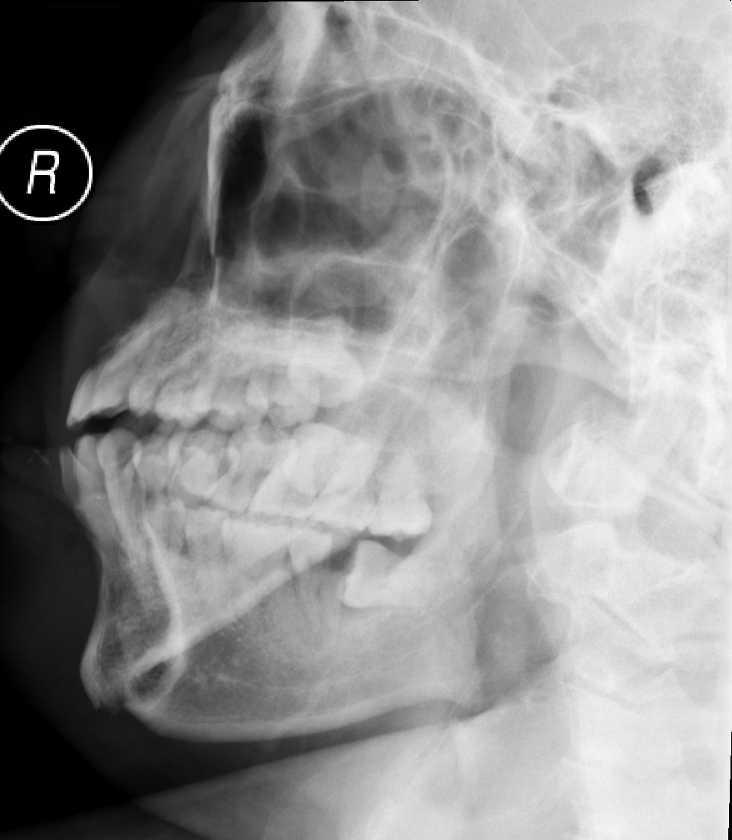
Case 4
XR findings?

Slide 52
# mandible: Right condyle /ramus, body of mandible.
# right medial maxilla
bilateral maxillary sinus fluid level
Notes:
Difficult to comment if condyle/ ramus #. CT finding: Condyle.

Slide 53
Case 4
Persistent posterior epistaxis despite pressure
Your junior suggested posterior packing
Give one reason against it.

Slide 54
Case 4
Contraindications in craniofacial trauma
Suspected basal skull injury

Slide 55
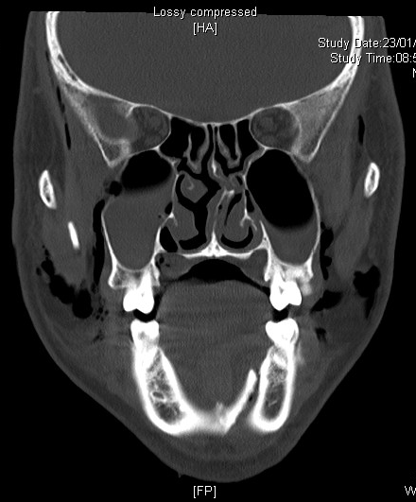
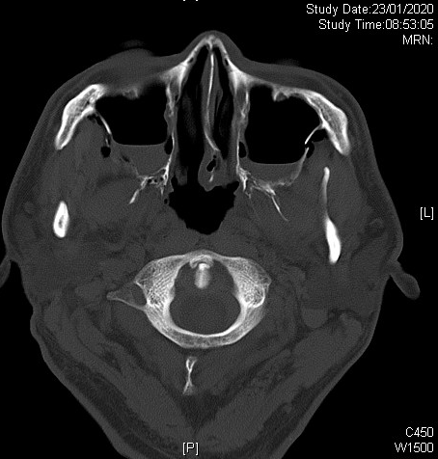
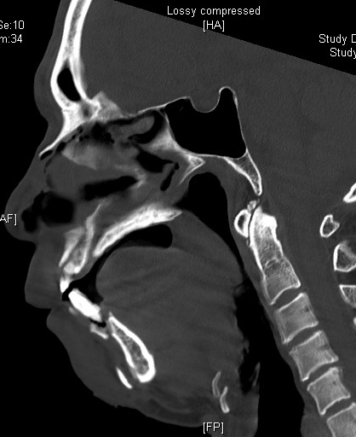
Case 4
What is the classification to be use?
Notes:
Q3: Suggest one injury classification (1) and what class/ type is this (1) ?

Slide 56
Case 4
LeFort classification
LeFort II fracture
Notes:
Le Fort I fractures are low transverse maxillary fractures above the teeth with no orbital involvement.
Le Fort II fractures generally have a pyramidal configuration and involve the nasal, lacrimal, and maxillary bones as well as the medial orbital floor.
Le Fort III fractures cause craniofacial disjunction, in which the entire facial skeleton is completely detached from the base of the skull and is suspended only by soft tissues. The orbital floor as well as the medial and lateral orbital walls are involved.

Slide 57
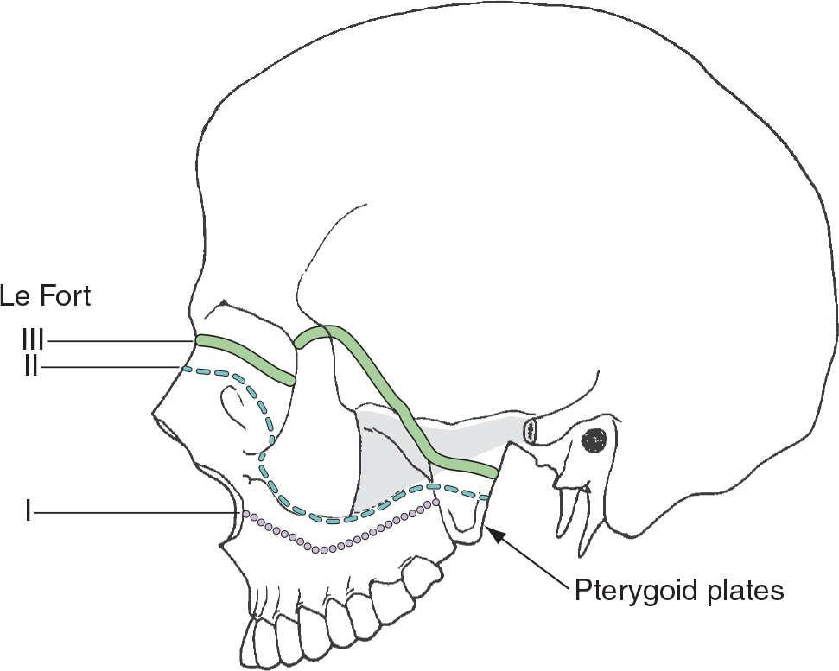
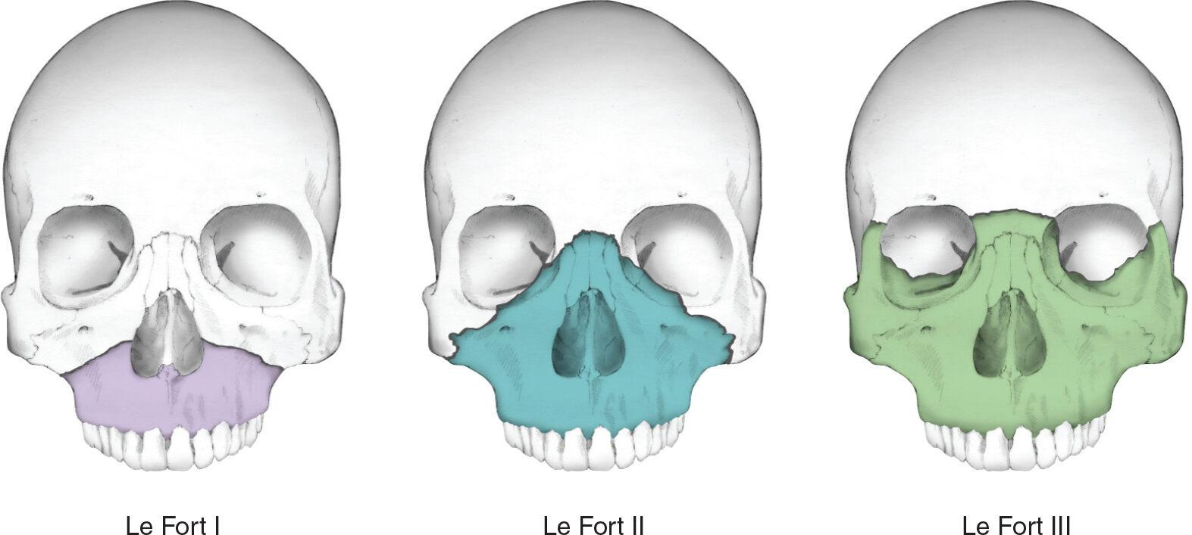
LeFort classification
Type 1
Pterygoid plate not involved - by CT
Type 2
Medial orbital wall
Type 3
Lateral orbital wall
Notes:
Le Fort I fractures are low transverse maxillary fractures above the teeth with no orbital involvement.
Le Fort II fractures generally have a pyramidal configuration and involve the nasal, lacrimal, and maxillary bones as well as the medial orbital floor.
Le Fort III fractures cause craniofacial disjunction, in which the entire facial skeleton is completely detached from the base of the skull and is suspended only by soft tissues. The orbital floor as well as the medial and lateral orbital walls are involved.

Slide 58
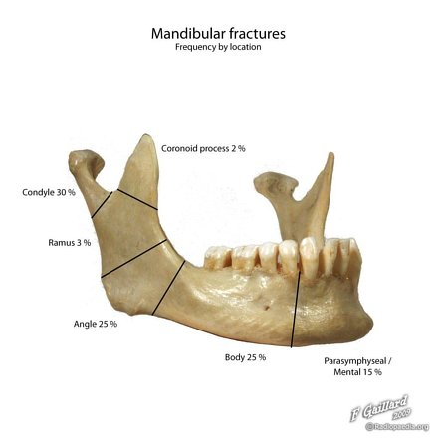
Mandibular fracture
Mandibular #
Open
Comminuted
Location
Stability
Bilateral mandibular fracture
Unstable
Posterior displacement of tongue
Upper airway obstruction

Slide 59
Case 4
Agitated
Insisted sitting
Desaturation with SpO2 89% RA
Junior suggested RSI
Give 2 reasons against RSI.

Slide 60
Case 4
Expecting difficult airway
Physiological
Very limited safe- apneic time
Anatomical
Bleeding
Loss of structure support after muscle relaxant

Slide 61
Case 4
List 1 drawback for
Delayed sequence intubation
Awake fibreoptic intubation

Slide 62
Case 4
Delayed sequence intubation
Ketamine adverse effect:
Hyper-salivation
Apnea in rapid injection
Collapsed airway due to muscle relaxant effect
Awake fibreoptic intubation
Time to set up equipment and LA
Advanced skill to avoid gag-reflex
Obscured view by blood

Slide 63
Case 4
What are the predictors for difficult surgical airway?
Notes:
L

Slide 64
Case 4
What are the predictors for difficult surgical airway?
SHORT
S urgery or other airway obstruction
H ematoma (includes infection/abscess)
O besity
R adiation distortion (and other deformity)
T umor
Notes:
L

