Slide 1
OSCE JCM Dec 2021

Slide 2
Case 1
M/54
Facial swelling for 1/52
BP 129/96 P98 RR 16 SpO2 97 T 36.8
Chest discomfort+
Periorbital swelling+
Prominent neck veins and florid superficial chest wall veins+

Slide 4
Q1a. Describe the abnormal finding in the CXR.

Slide 5
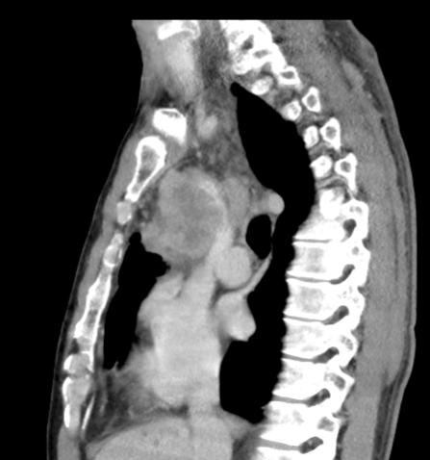

Slide 6
Q1b. Describe the abnormal finding in the CT images and your clinical diagnosis?

Slide 7
Q1c. What are the life threatening complications you may encounter in this patient?

Slide 8
Q1d. What is the treatment of choice for the life threatening complications?

Slide 9
Case 2
F/75
DM, ESRF
Left sided chorea for 2 days
BP 162/108 P 86 RR 14 SPO2 99 RA T 36
GCS 4+5+6 pupils 4mm both and R+
H'stix 24.3
GEM 4000 pH 7.35 BE -1.4 Na 137 K 4

Slide 10
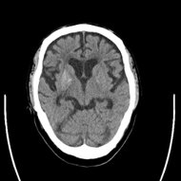

Slide 11
Q2a. Describe the abnormal CT finding.

Slide 12
Q2b. With the CT finding, what is the possible diagnosis if the chorea subsided after correction of hyperglycemia?

Slide 13
Q2c. Name two drugs that can cause this condition?

Slide 14
Q2d. Name two common toxins that can cause this condition?

Slide 15
Case 3
M/43
Driver of a private car driving at ~40-50km/hr with another private car hit it from behind at unknown speed
Flexion/extension injury of neck
Immediate neck pain and bilateral hand numbness, but numbness gradually decreased
Neck tender over cervical spine+
Neurological exam. showed only slight numbness over LT thumb and L/F

Slide 16
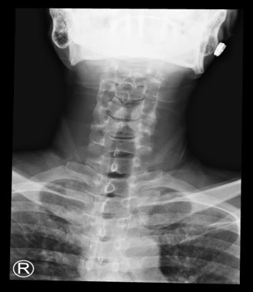

Slide 17
Q3a. Describe the abnormal XR findings.

Slide 18
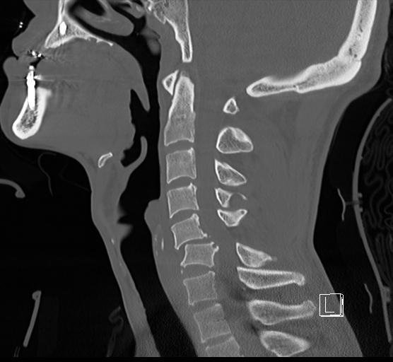
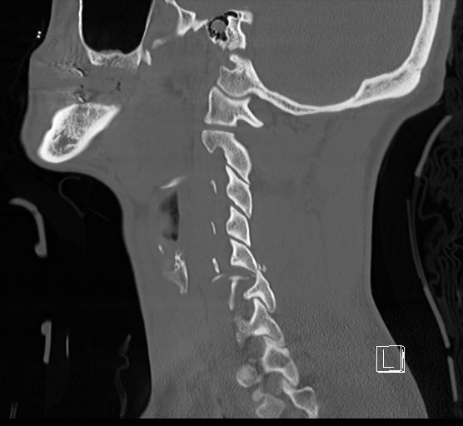
Sagittal reconstruction images of the cervical spine from left to right

Slide 19
Q3b. Describe the abnormal CT findings.

Slide 20
Q3c. What is your diagnosis and the typical XR finding?

Slide 21
Q3d. What is the common complication of this type of injury?

Slide 22
Case 4
A 17 year old teenage student with good past health complained of chest pain for 1 day
Vitals at triage
–Temp 37.6
–BP 155/75, HR 122bpm
–SpO2 99% on RA; RR 14/min

Slide 24
Q4a. Describe 3 abnormal ECG findings.

Slide 25
Q4b. What are the possible diagnoses? (list 3 DDx )

Slide 26
Q4c. If the patient got 2nd dose of BioNTech Covid-19 vaccination 2 days before chest pain and his high-sensitivity troponin I was 18300, what is the likely diagnosis ?

Slide 27
Q4d. What are subsequent, important and relevant investigations (list 2 items)?

Slide 28
Q4e. What are risk factors for myocarditis/pericarditis after mRNA Covid-19 vaccination?

Slide 29
Case 5
M/41
Sudden left eye vision loss for 3-4 hours
No pain/ redness
VA RE 20/25 LE HM
Left relative afferent pupillary defect+

Slide 31
Q5a. Describe the abnormal finding of the fundus.

Slide 32
Q5b. What is the likely diagnosis?

Slide 33
Q5c. What are the treatments you can give?

Slide 34
Q5d. What are the specialties you are going to contact?

