Slide 1
OSCE
Jan 2022

Slide 2
Q1
A 40-year-old gentlemen with hx of hyperlipidaemia on statin complained of retrosternal pain after playing football with his friends for 30 minutes. The pain radiated to his left shoulder and jaw. He had nausea, sweating and mild shortness of breath. He had no fever nor URTI symptoms.
On arrival to AED, he was alert and conscious. His blood pressure was 163/95. RR 18 Temp 37 °C . An ECG was done in the triage station and as follows.

Slide 3
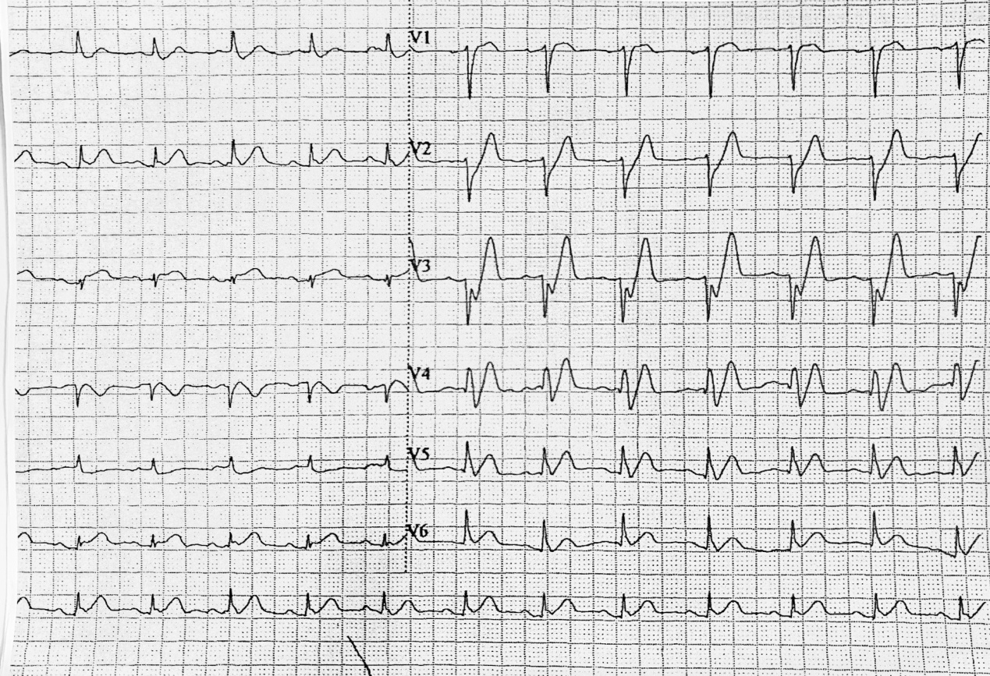
1. Please describe the ECG findings

Slide 4
1. Please describe the ECG findings
  SR, around 86bpm
  Tall, prominent, symmetrical T waves in V2-4
  Upsloping ST segment depression in V2-5
  Absence of ST elevation in the precordial leads

Slide 5
2. What was the diagnosis?

Slide 6
2. What was the diagnosis?
  De Winter syndrome

Slide 7
3. Which coronary artery/arteries was involved in this disease?

Slide 8
3. Which coronary artery/arteries was involved in this disease?
  ~2% of acute LAD occlusions

Slide 9
4. What was your management?

Slide 10
4. What was your management?
  Considered as “STEMI-equivalent”
    Manage in R room
    Activate PPCI call
    Blood test fpr CBP, L/RFT, hsTnT, CE, clotting profile, lipid profile
    Consider to give aspirin, ticagrelor if not C/I

Slide 11
Q2
A child was brought to the AED by his father who witnessed him falling from the monkey bar and landing on the left elbow. The child complained of left elbow pain and reduced range of motion.

Slide 12
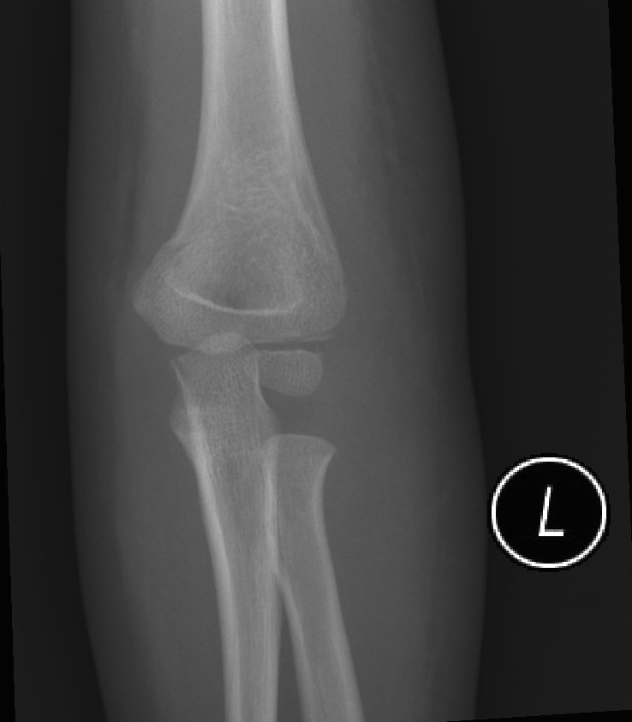
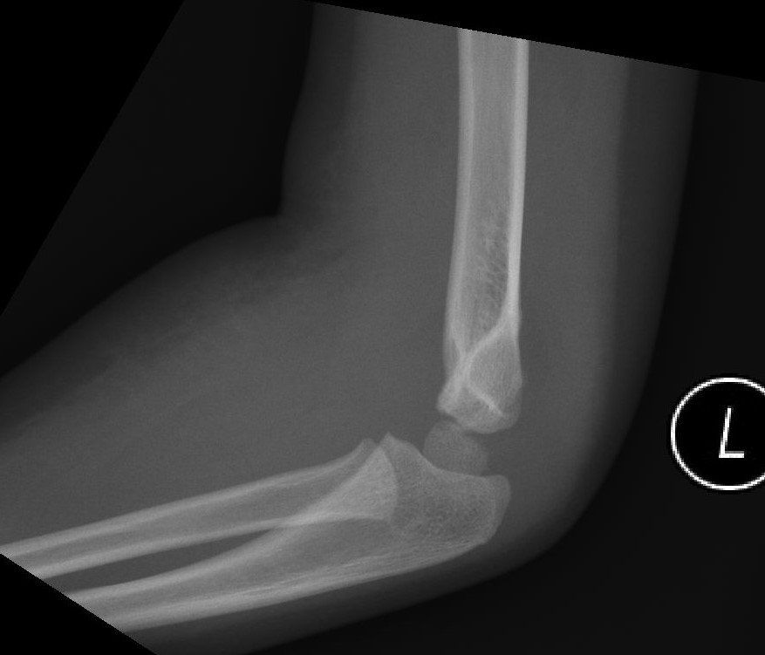
1. What were the x-ray findings?

Slide 13
1. What were the x-ray findings?
  A subtle fracture line which involves a thin portion of the distal humeral metaphysis

Slide 14
  Posterior fat pad sign +ve
  Soft tissue swelling +ve

Slide 15
2. What was the estimated age of this child ? Please give explanation on your estimation

Slide 16
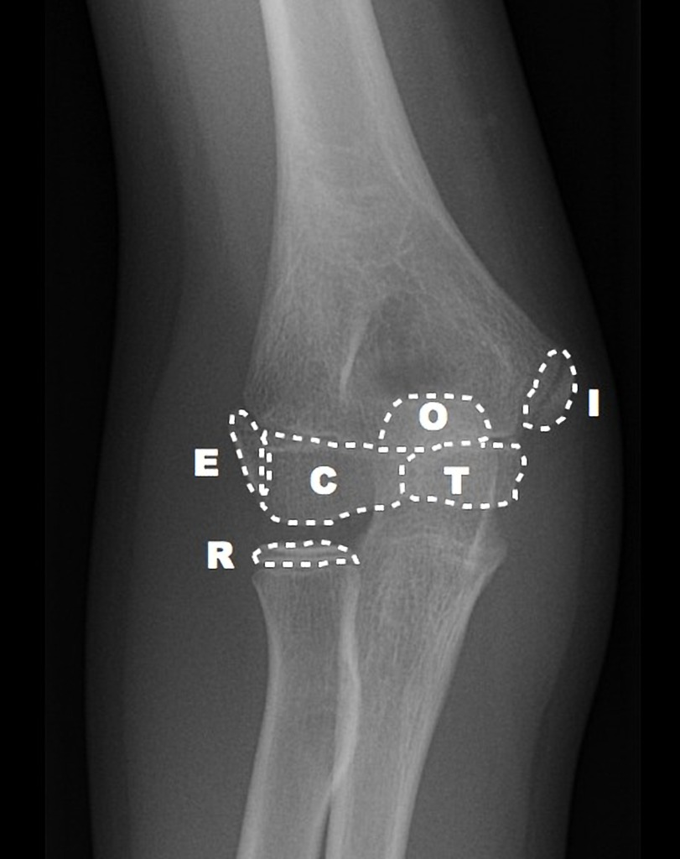
CRITOL
Ossification center of the Elbow | Sequence of appearance of ossification centres
Capitellum | 1
Radial head | 3
Internal (medial) epicondyle | 5
Trochlea | 7
Olecranon | 9
External (lateral) epicondyle | 11

Slide 17
The estimated age is 3 years old.

Slide 18
3. What are the 3 most common elbow injuries in children

Slide 19
3. What are the 3 most common elbow injuries in children
  Supracondylar fractures (41%)
  Radial head subluxation (28%)
  Lateral condylar fracture (11%)

Slide 20
4. What was the diagnosis in this child?

Slide 21
4. What was the diagnosis in this child?
  L lateral condylar fracture

Slide 22
5. What was your management?

Slide 23
5. What was your management?
  Long arm cast for 4-6 weeks

Slide 24
Q3
A 4-year-old child was brought to the AED by her mother for suspected foreign body ingestion. Her mother bought him a remote control car as his birthday gift. She noted that the battery of the remote controller was missing after his son played the car for around 1 hour.

Slide 25
A CXR was taken and shown below.

Slide 26
1. What important history would you ask from the mother?

Slide 27
1. What important history would you ask from the mother?
  Battery type
  Battery charge state
  Time of ingestion
  Number of batteries ingested
  Magnet co-ingestion
  History of esophageal anomaly, stricture, or surgery

Slide 28
2. What were the x-ray findings?

Slide 29
2. What were the x-ray findings?
  A circular radio-opaque FB in upper thoracic region
  No sign of pneumomediastinum

Slide 30
3. What kind of battery was ingested? What was the characteristic shown on the x-ray?

Slide 31
3. What kind of battery was ingested? What was the characteristic shown on the x-ray?
Button battery
  Bilaminar, double-ring appearance on AP view
  Step-off appearance on lateral view

Slide 32
4. Was the radio-opaque foreign body impacted on the trachea or oesophagus? Please explain

Slide 33
4. Was the radio-opaque foreign body impacted on the trachea or oesophagus? Please explain
  In the oesophagus

Slide 34
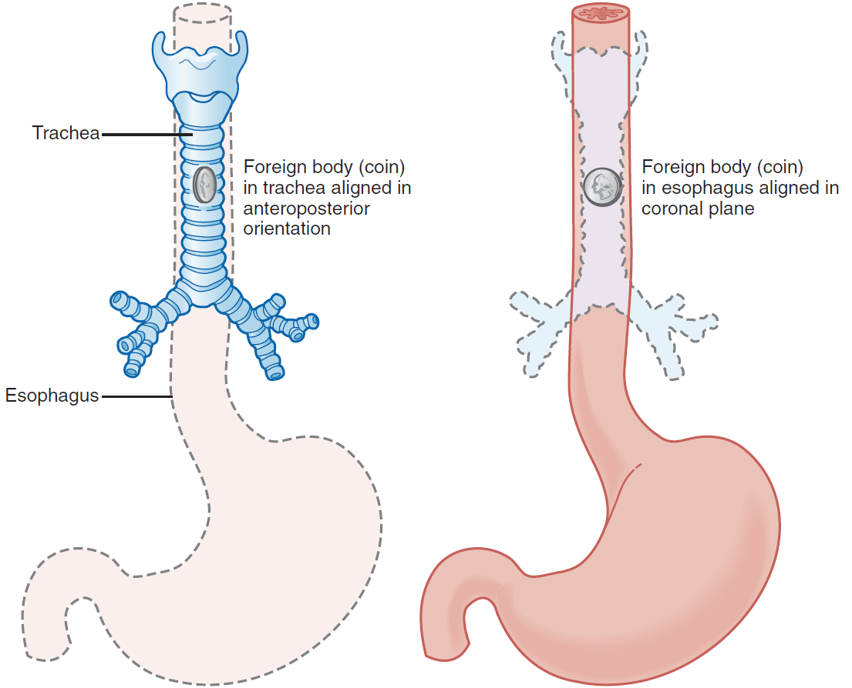
Esophagus
  Align themselves in the coronal plane
  Posterior to the tracheal air column on lateral view
Trachea
  Align themselves in the sagittal plane
  Overlap with the tracheal air column on lateral view

Slide 35
5. What were the mechanisms of injuries caused by this kind of battery?

Slide 36
5. What were the mechanisms of injuries caused by this kind of battery?
  Electrical discharge
  Leakage of contents
  Alkaline solution
  Heavy metals
  Pressure necrosis

Slide 37
6. Which medication would you consider to give to the child if endoscopic removal was not readily available?

Slide 38
6. Which medication would you consider to give to the child if endoscopic removal was not readily available?
  Sucralfate (1g/10nl)
    Give 10 mL PO every 10 minutes, up to 3 doses

Slide 39
7. The mother asked if there was anything she could give to her child at home in order to decrease the injuries caused by this kind of battery. What was your advice?

Slide 40
7. The mother asked if there was anything she could give to her child at home in order to decrease the injuries caused by this kind of battery. What was your advice?
Honey
  10ml without dilution, given orally at home, every 10 minutes up to 6 doses
  Mechanism: coat the battery and prevent local generation of OH- thereby delaying alkaline burns to adjacent tissue
  Indications
    Asymptomatic
    Acute ingestion within 12 hours
    No honey allergy
    Older than 1 year old

Slide 41
Q4
A 69-year-old lady with hx of HT, gout and chronic renal impairment, complained of right knee pain for 6 months. She had increased pain in recent 2 days and thus visited the AED. She had no recent hx of injury.
Physical examination showed tenderness and mild swelling on the medial joint line of the right knee. ROM was normal. The drawer test and valgus/varus stress test were negative.

Slide 42
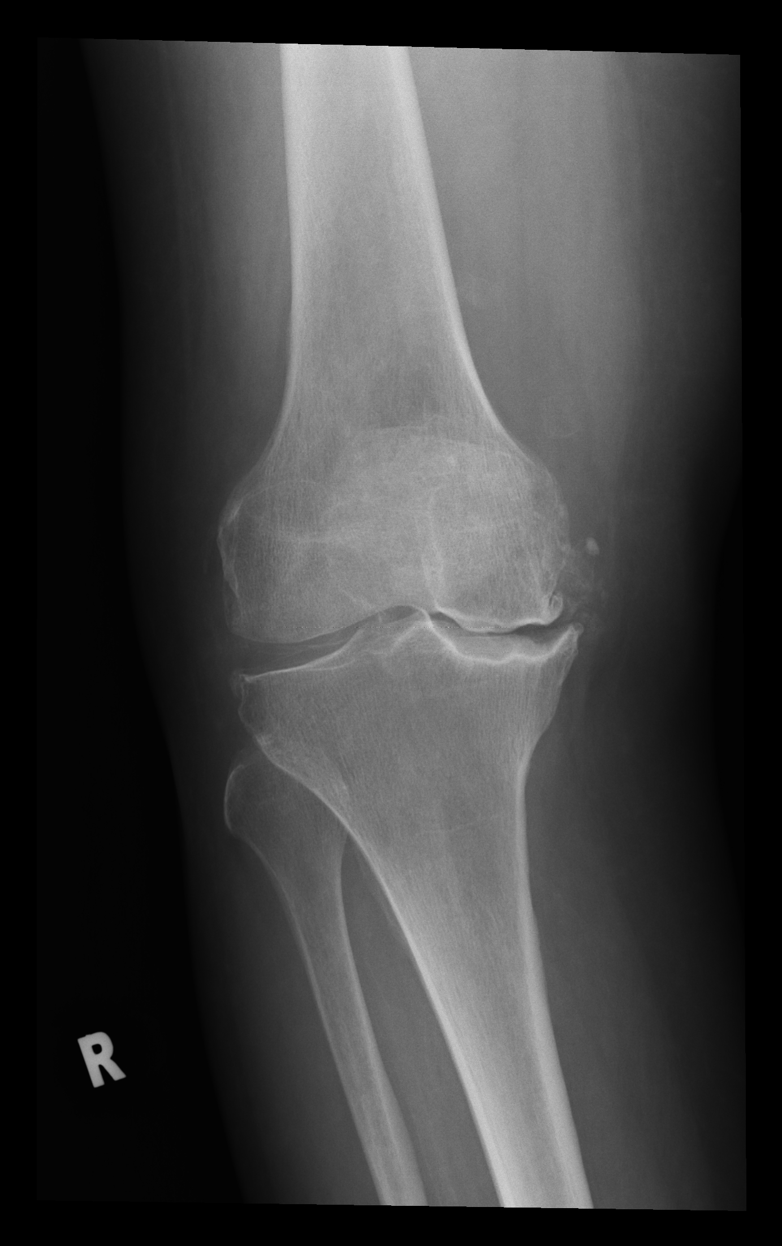
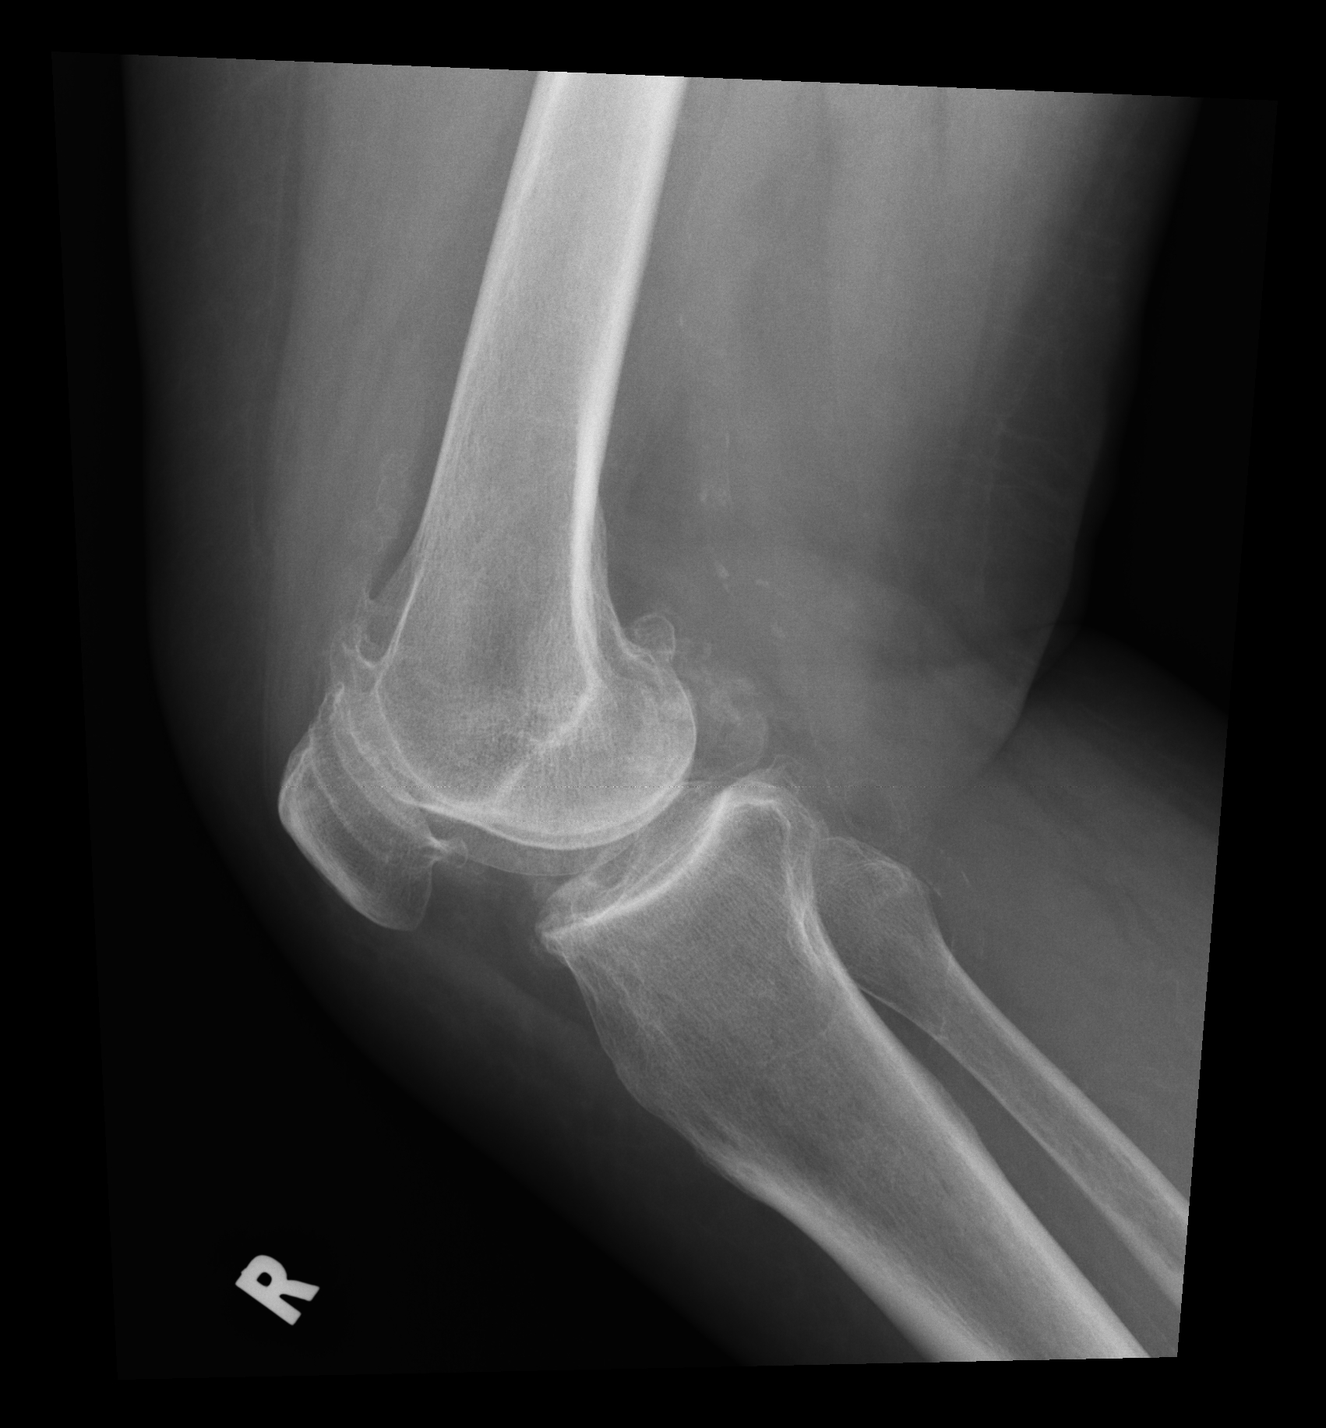
X-ray of the right knee was taken and shown below.

Slide 43
1. Please describe the X-ray findings.

Slide 44
1. Please describe the X-ray findings.
  Depression and marked irregularity of the articular sufaces of R medical femoral condyle and medial tibia plateau with sclerotic change
  Chondrocalcinosis at tibiofemoral joints and degenerative of R knee

Slide 45
2. What was the diagnosis?

Slide 46
2. What was the diagnosis?
  Subchondral insufficiency fracture of the knee (SIF/SIFK)
  (previously known as spontaneous osteonecrosis of the knee (SONK))

Slide 47
3. What was the cause of this condition?

Slide 48
3. What was the cause of this condition?
  Osteoporosis and subchondral insufficiency fracture that progresses to subchondral collapse with secondary osteonecrosis
  in the absence of acute trauma, typically affecting older adults. (F>M)

Slide 49
4. What were the differential diagnoses?

Slide 50
4. What were the differential diagnoses?
  osteochondritis dissecans of the knee
  subchondral stress/fatigue fracture

Slide 51
5. What kind of further investigation would be useful in diagnosis and delineation of the extent of the condition?

Slide 52
5. What kind of further investigation would be useful in diagnosis and delineation of the extent of the condition?
  MRI is helpful to confirm the diagnosis and assist in determining the extent of disease
  subchondral bone plate fracture
  focal subchondral area of low signal intensity subjacent to the subchondral bone plate representing local ischemia
  ill-defined bone marrow oedema and a lack of peripheral low signal intensity rim as seen in osteonecrosis and bone infarct

Slide 53
6. What was the treatment options?

Slide 54
6. What was the treatment options?
Conservative – analgesia, protected weight bearing and physiotherapy directed at quadriceps strengthening
Operative -- for progressive cases that fail conservative management or in more advanced cases, arthroplasty or high tibial osteotomy may be considered

Slide 55
THE END
Thank you

