Slide 1
JCM OSCE September 2023
Dr. chan yin man
Resident trainee
Department of accident and emergency, ruttonjee hospital

Slide 2
Case presentation
F/55
Past medical history: Diabetes mellitus
Left foot swelling for 1 week
Associated with mild pain

Slide 3
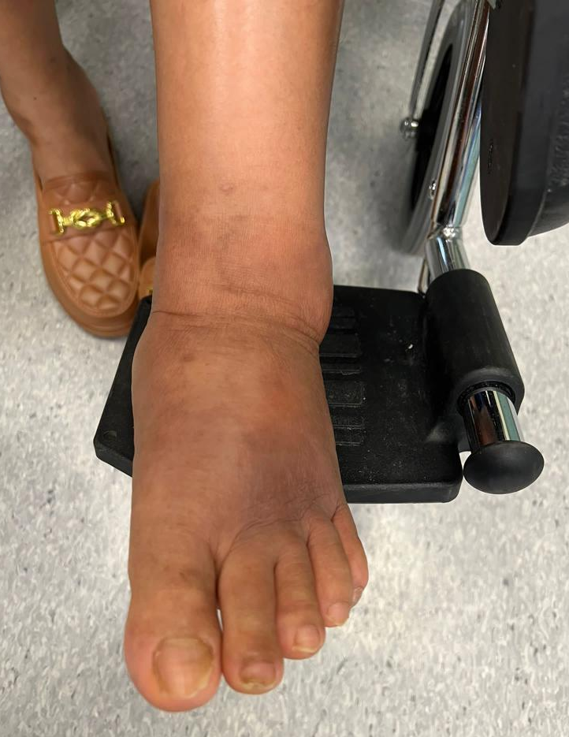
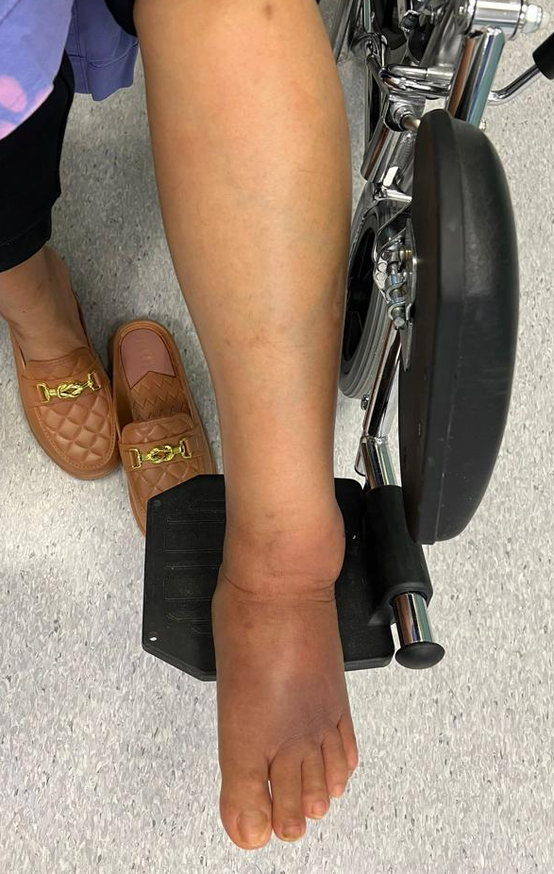
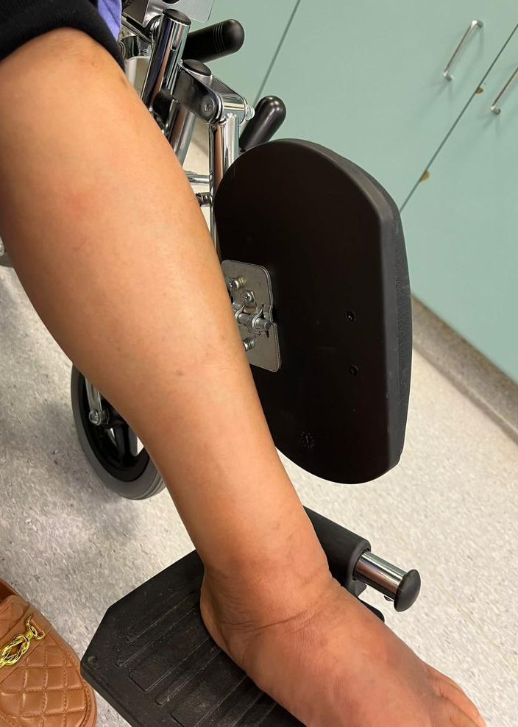
PHYSICAL EXAMINATION

Slide 4
questions
Describe the findings of physical examination. (1 mark)

Slide 5
X-ray of left foot

Slide 6
X-ray of left foot

Slide 7
questions
2. Describe the X-ray findings. (1 mark)

Slide 8
questions
3. Give 1 trauma related differential diagnosis and 1 non-trauma related differential diagnosis. (1 mark)

Slide 9
Case presentation
On further enquiry of history:
No preceding injury
Still able to go to market every day

Slide 10
questions
4. What is the more likely diagnosis from question 3? (0.5 mark)

Slide 11
questions
5. What is the management at A&E? (1 mark)

Slide 12
cAse presentation
F/53
Right eye redness for 2 weeks
No improvement with Froptic and chloramphenicol eye drops
Associated with mild pain
No blurring of vision

Slide 13
Case presentation
Past medical history:
Thyroid cancer with operation done
Benign ovarian tumour with ovarian cystectomy done in the mainland in 2007
Hypertension

Slide 14
Physical examination

Slide 15
questions
1. Describe 2 findings from the above photos. (1 mark)

Slide 16
questions
2. Give 2 non-infectious diagnoses. (1 mark)

Slide 17
progress
Mydrin P eye drops were given

Slide 18
questions
3. What is the purpose of the mydrin P eye drops? (1 mark)

Slide 19
progress
Eye consultation:
Use mydrin P
Suggested for prednisolone forte 1 drop QID as well

Slide 20
progress
Less redness after use of mydrin P

Slide 21
Physical examination

Slide 22
questions
4. What is the diagnosis? (0.5 mark)

Slide 23
questions
5. Give 2 associated medical conditions for the eye presentation in this lady? (1 mark)

Slide 24
questions
6. What is the management at A&E? (1 mark)

Slide 25
Case presentation
F/72
Slipped and fell
Landed on left out-stretched hand
Complained of left thumb pain
No wound or bleeding
No other site of injury

Slide 26
Case presentation
Physical examination:
Normal alignment of left thumb
Bruising over left 1st CMCJ
Tenderness over UCL of left 1st CMCJ
Laxity upon valgus stress
Impaired ROM of left thumb
Unremarkable neurological examination

Slide 27
questions
1. Suggest 2 anatomical parts that could be injured from the physical examination. (1 mark)

Slide 28
questions
2. What is your next step of management? (0.5 mark)

Slide 29
X-ray of left hand

Slide 30
X-ray of left thumb

Slide 31
questions
3. Describe 1 positive finding and 1 negative finding from the X-ray. (1 mark)

Slide 32
Ultrasonography of mcpj of left thumb
Distal
Proximal
Distal
Proximal
Normal side
Affected side

Slide 33
questions
4. Describe the USG findings. (1 mark)

Slide 34
QUESTIONS
5. What is the diagnosis? (0.5 mark)

Slide 35
questions
6. How would you manage this patient? (1 mark)

Slide 36
progress
Referred to O&T
Scheduled A&E follow-up
Analgesics were prescribed
Referred occupational therapist for thumb spica splint

Slide 37
Case presentation
M/68
Past medical history: Hypertension, diabetes mellitus, hyperlipidaemia, fatty liver
Tripped and fell forward
Complained of severe left shoulder pain limiting movement
No weakness or numbness
No other site of injury

Slide 38
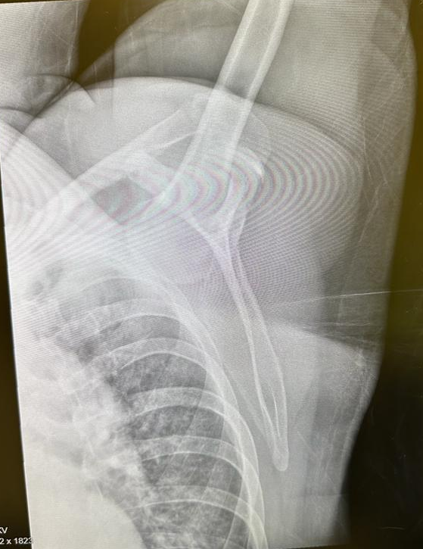
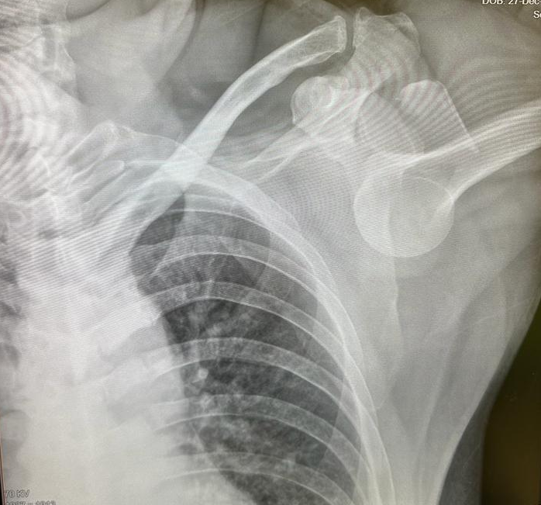
X-ray of left shoulder

Slide 39
questions
Give 2 radiological findings on the X-rays? (1 mark)
What is the expected deformity or position of the shoulder? (0.5 mark)

Slide 40
questions
3. Give 3 complications related to this shoulder condition? (1.5 mark)

Slide 41
questions
4. How would you manage this patient at A&E? (1 mark)

Slide 42
questions
5. What technique would you manage the patient as mentioned in Question 4? (0.5 mark)

Slide 43
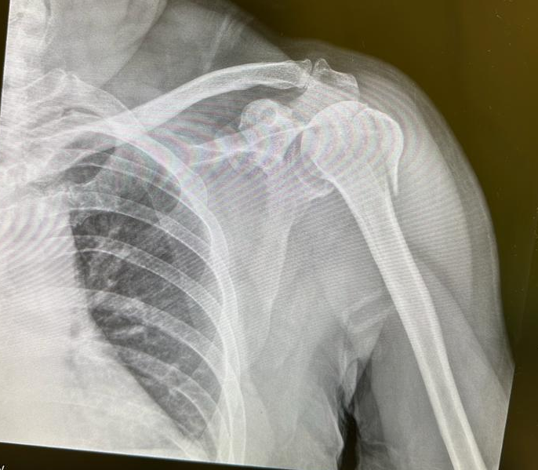
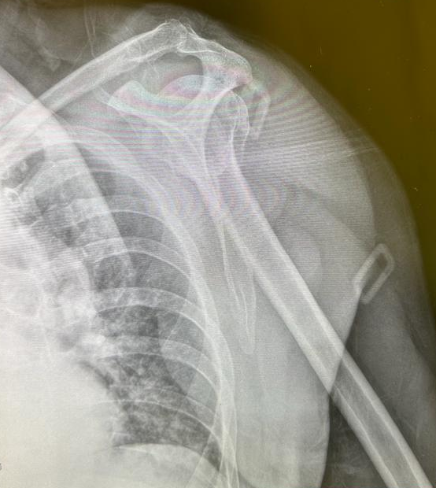
Post-reduction X-ray

Slide 44
progress
Axillary nerve was intact
Distal neurovascular status was intact
The patient was put on shoulder immobilizer
Scheduled follow-up within about 1 week

Slide 45
questions
6. What is the management if reduction is not successful? (0.5 mark)

Slide 46
Case presentation
M/68
Left facial asymmetry for 2 days
No viral prodrome or fever
No tinnitus
No choking
No other focal neurological deficit

Slide 47
Case presentation
Past medical history:
Hypertension, diabetes mellitus, hypercholesterolaemia
Schizophrenia

Slide 48
questions
1. What neurological examination will you perform next? (1 mark)

Slide 49
case presentation
On further inquiry of history:
History of fracture left temporal bone 2 weeks ago

Slide 50
questions
2. What investigation will you perform? (1 mark)

Slide 51
Computed tomography of brain

Slide 52
Computed tomography of temporal bone

Slide 53
questions
3. Describe the CT findings. (1 mark)

Slide 54
questions
4. What are the 2 types of temporal bone fracture? (1 mark)

Slide 55
questions
5. What is your next step of management? (1 mark)

Slide 56
progress
ENT consultation:
Not to start oral steroid at the moment in view of H’stix 14.7

Slide 57
progress
Follow-up at ENT clinic:
Facial nerve function was intact on physical examination after 3 months

